Slide 1
Feature Extraction

Slide 2
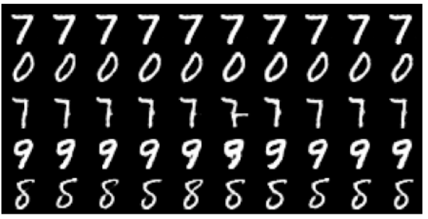
InfoGAN
Regular
GAN
(The colors represents the characteristics.)
Modifying a specific dimension,
no clear meaning
What we expect
Actually …
Notes:
InfoGAN solve the problem of Mode collapse

Slide 3
What is InfoGAN?
z
c
Generator
x
Discriminator
=
scalar
z’
encoder
“Auto-encoder”
Classifier
Parameter
sharing
decoder
(only the last layer is different)
Predict the code c that generates x
c

Slide 4
What is InfoGAN?
z
c
Generator
x
c must have clear influence on x
=
z’
encoder
“Auto-encoder”
Classifier
decoder
The classifier can recover c from x.
Predict the code c that generates x
c

Slide 5
https://arxiv.org/abs/1606.03657

Slide 6
VAE-GAN
Anders Boesen, Lindbo Larsen, Søren Kaae Sønderby, Hugo Larochelle, Ole Winther, “Autoencoding beyond pixels using a learned similarity metric”, ICML. 2016
Minimize reconstruction error
Minimize reconstruction error
Discriminate real, generated and reconstructed images
z close to normal
Cheat discriminator
Encoder
Generator
(Decoder)
Discriminator
x
z
x
scalar
as close as possible
VAE
Discriminator provides the reconstruction loss
GAN
Notes:
Autoencoding beyond pixels using a learned similarity metric (2015) [pdf]
Adversarial Autoencoders (2015) [pdf]

Slide 7
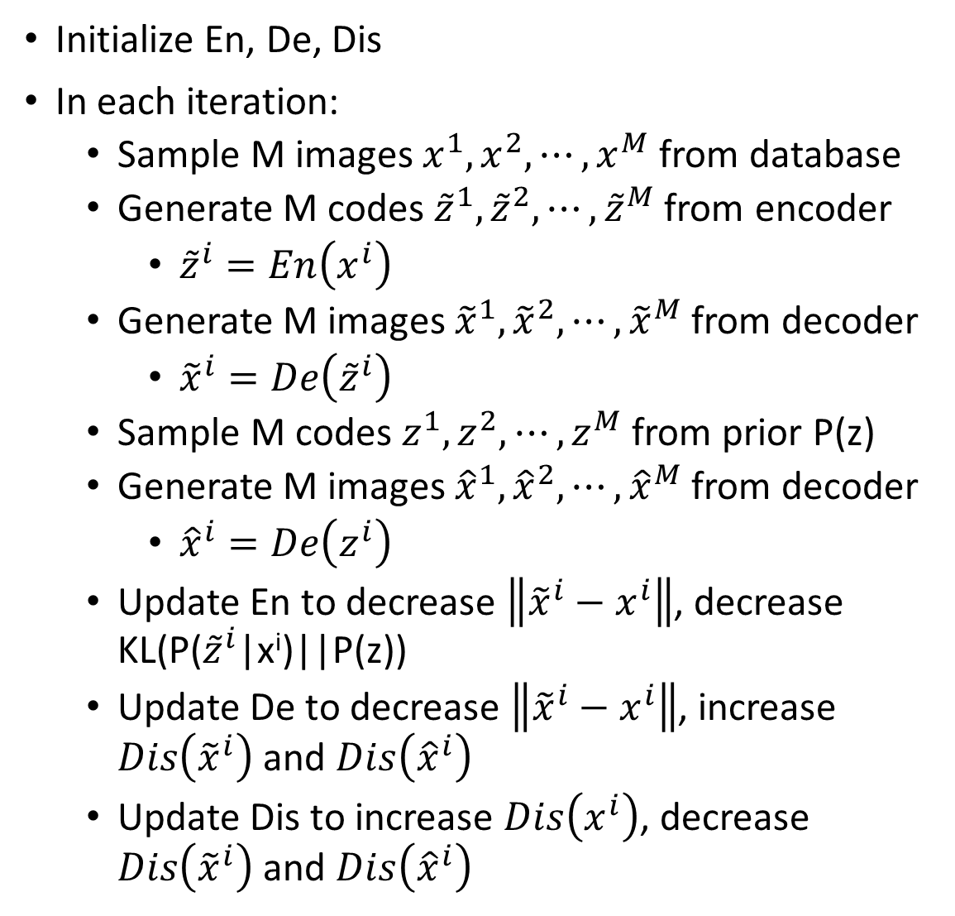
Algorithm
Initialize En, De, Dis
In each iteration:
Sample M images $x^{1},x^{2},⋯,x^{M}$ from database
Generate M codes ${\tilde{z}}^{1},{\tilde{z}}^{2},⋯,{\tilde{z}}^{M}$ from encoder
${\tilde{z}}^{i}=En\left(x^{i}\right)$
Generate M images ${\tilde{x}}^{1},{\tilde{x}}^{2},⋯,{\tilde{x}}^{M}$from decoder
${\tilde{x}}^{i}=De\left({\tilde{z}}^{i}\right)$
Sample M codes $z^{1},z^{2},⋯,z^{M}$ from prior P(z)
Generate M images ${\hat{x}}^{1},{\hat{x}}^{2},⋯,{\hat{x}}^{M}$from decoder
${\hat{x}}^{i}=De\left(z^{i}\right)$
Update En to decrease $\left\|{\tilde{x}}^{i}−x^{i}\right\|$, decrease KL(P(${\tilde{z}}^{i}$|x^{i})||P(z))
Update De to decrease $\left\|{\tilde{x}}^{i}−x^{i}\right\|$, increase $Dis\left({\tilde{x}}^{i}\right)$ and $Dis\left({\hat{x}}^{i}\right)$
Update Dis to increase $Dis\left(x^{i}\right)$, decrease $Dis\left({\tilde{x}}^{i}\right)$ and $Dis\left({\hat{x}}^{i}\right)$
Another kind of discriminator:
real
gen
recon
Discriminator
x

Slide 8
BiGAN
(from prior distribution)
from encoder or decoder?
code z
code z
Encoder
Decoder
Discriminator
Image x
Image x
Image x
code z
(real)
(generated)
Notes:
Can I provide the full proof here?
In the end, Bi-GAN = Autoencoder
Different kind of regularization

Slide 9
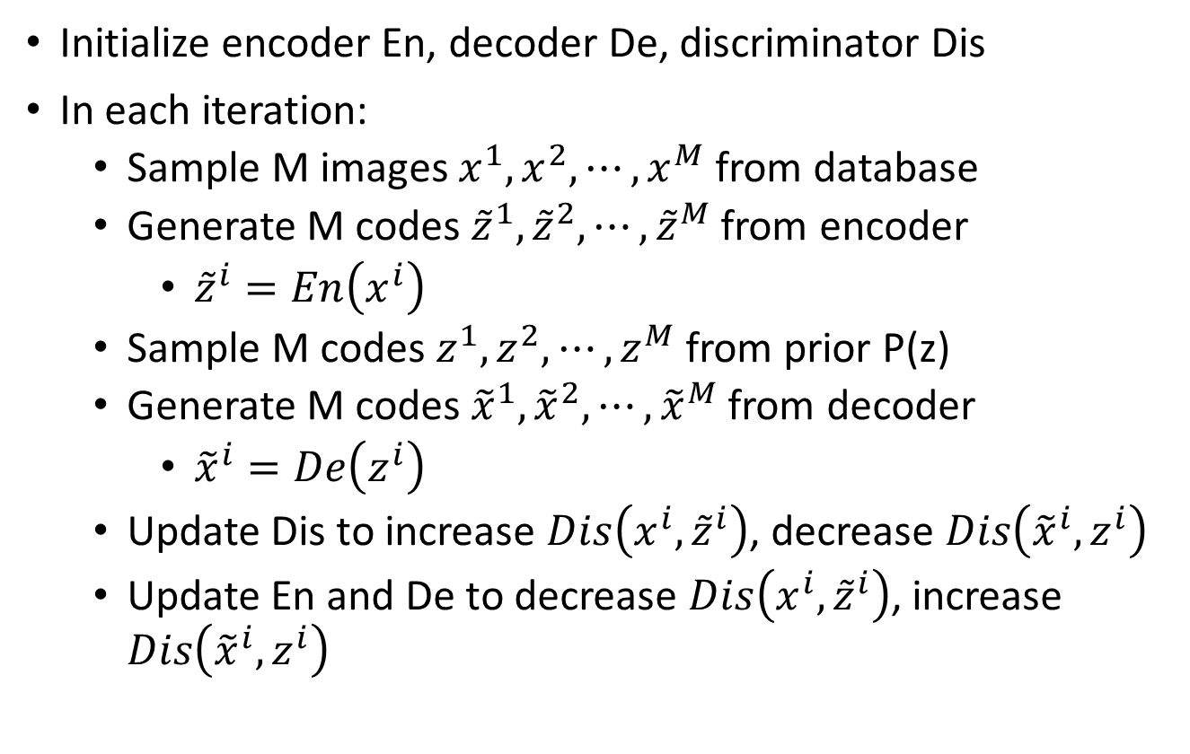
Algorithm
Initialize encoder En, decoder De, discriminator Dis
In each iteration:
Sample M images $x^{1},x^{2},⋯,x^{M}$ from database
Generate M codes ${\tilde{z}}^{1},{\tilde{z}}^{2},⋯,{\tilde{z}}^{M}$ from encoder
${\tilde{z}}^{i}=En\left(x^{i}\right)$
Sample M codes $z^{1},z^{2},⋯,z^{M}$ from prior P(z)
Generate M codes ${\tilde{x}}^{1},{\tilde{x}}^{2},⋯,{\tilde{x}}^{M}$ from decoder
${\tilde{x}}^{i}=De\left(z^{i}\right)$
Update Dis to increase $Dis\left(x^{i},{\tilde{z}}^{i}\right)$, decrease $Dis\left({\tilde{x}}^{i},z^{i}\right)$
Update En and De to decrease $Dis\left(x^{i},{\tilde{z}}^{i}\right)$, increase $Dis\left({\tilde{x}}^{i},z^{i}\right)$
Notes:
Draw en, de jointly

Slide 10


(from prior distribution)
from encoder or decoder?
code z
code z
Encoder
Decoder
Discriminator
Image x
Image x
Image x
code z
(real)
(generated)
Evaluate the difference between P and Q
$$P\left(x,z\right)$$
$$Q\left(x,z\right)$$
P and Q would be the same
Optimal encoder and decoder:
En(x’) = z’
De(z’) = x’
For all x’
De(z’’) = x’’
En(x’’) = z’’
For all z’’
Notes:
有一部分是動不了的
Can I provide the full proof here?
In the end, Bi-GAN = Autoencoder
Different kind of regularization

Slide 11


BiGAN
Optimal encoder and decoder:
En(x’) = z’
De(z’) = x’
For all x’
De(z’’) = x’’
En(x’’) = z’’
For all z’’
How about?
$$\tilde{x}$$
$$\tilde{z}$$
Decoder
Encoder
En, De
z
x
Encoder
Decoder
x
En, De
z

Slide 12
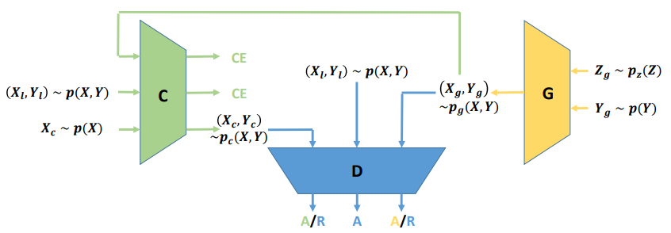
Triple GAN
Chongxuan Li, Kun Xu, Jun Zhu, Bo Zhang, “Triple Generative Adversarial Nets”, arXiv 2017

Slide 13
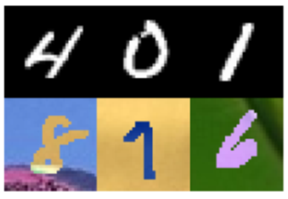
Domain-adversarial training
Training and testing data are in different domains
Generator
feature
Training data:
The same distribution
Testing data:
Generator
feature
Hana Ajakan, Pascal Germain, Hugo Larochelle, François Laviolette, Mario Marchand, Domain-Adversarial Training of Neural Networks, JMLR, 2016

Slide 14
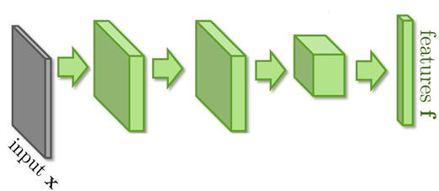
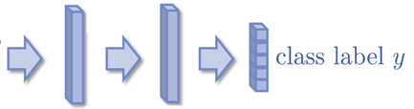
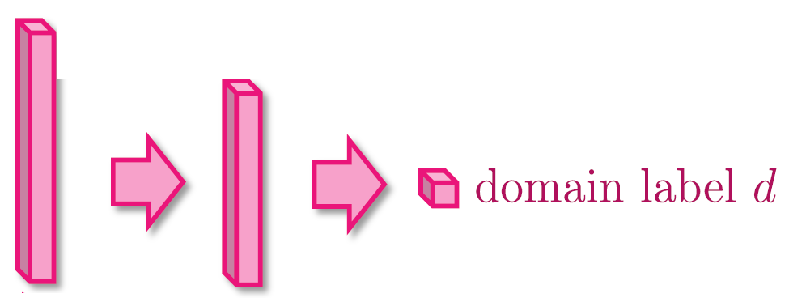
Domain-adversarial training
Maximize label classification accuracy + minimize domain classification accuracy
Maximize label classification accuracy
feature extractor
Label predictor
Domain classifier
Not only cheat the domain classifier, but satisfying label classifier at the same time
Maximize domain classification accuracy
This is a big network, but different parts have different goals.

Slide 15
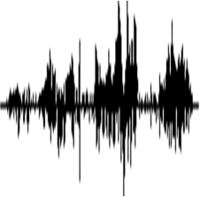
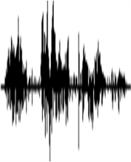



Original Seq2seq Auto-encoder
RNN
Encoder
RNN
Decoder
input segment
reconstructed
Include phonetic information, speaker information, etc.
Feature Disentangle
Phonetic Encoder
$$z$$
RNN Decoder
input segment
Speaker Encoder
reconstructed
$$e$$

Slide 16






Feature Disentangle
Phonetic Encoder
$$z$$
RNN Decoder
input segment
Speaker Encoder
reconstructed
$$e$$
Assume that we know speaker ID of segments.
$$x^{i}$$
Speaker Encoder
$$e^{i}$$
distance larger than a threshold
as close as possible
different speakers
same speaker
$$x^{j}$$
Speaker Encoder
$$e^{j}$$

Slide 17




Feature Disentangle
Phonetic Encoder
$$z$$
RNN Decoder
input segment
Speaker Encoder
reconstructed
$$e$$
Inspired from domain adversarial training
$$x^{i}$$
$$z^{i}$$
Phonetic Encoder
Speaker
Classifier
score
$$x^{j}$$
Phonetic Encoder
$$z^{j}$$
same speaker
Learn to confuse Speaker Classifier
different speakers

Slide 18
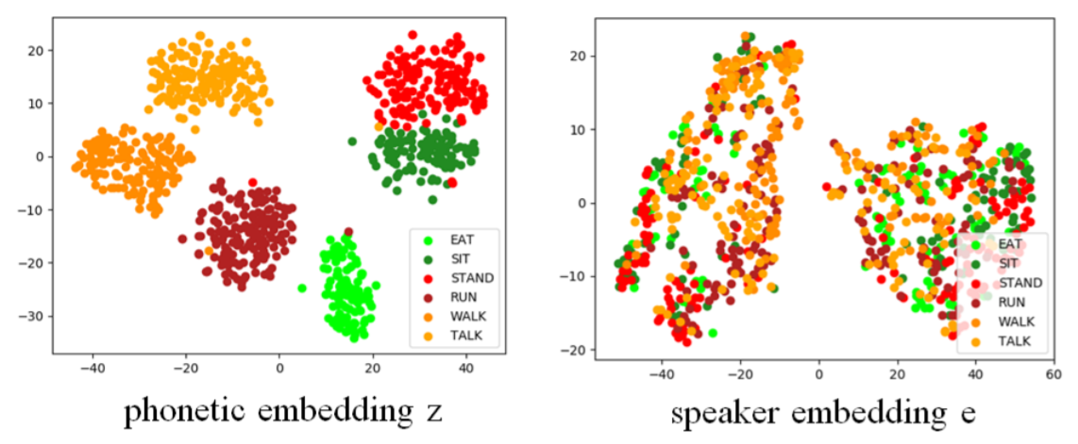
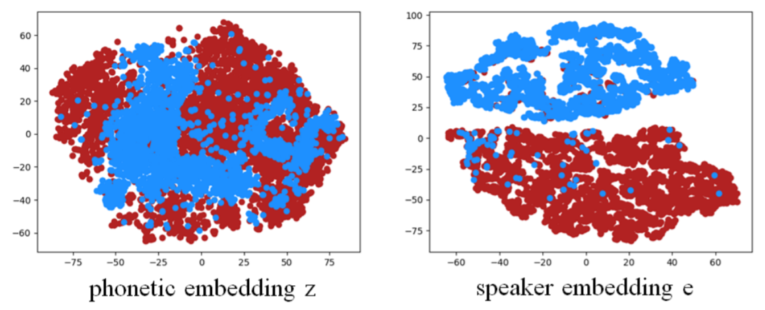
Audio segments of two different speakers

Slide 19
Acknowledgement
感謝 許傑盛 同學發現投影片上的打字錯誤

