Slide 1
fGAN: General Framework of GAN

Slide 2
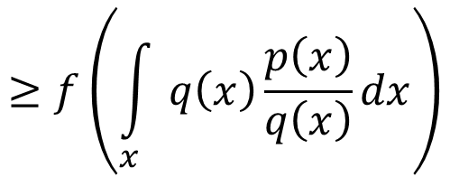
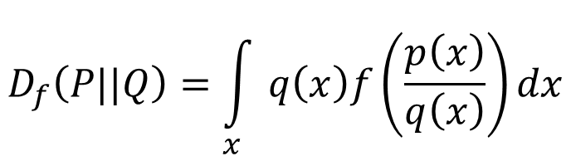
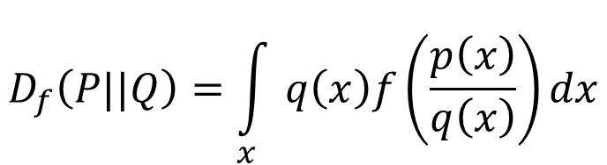
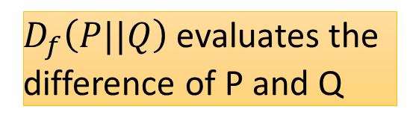

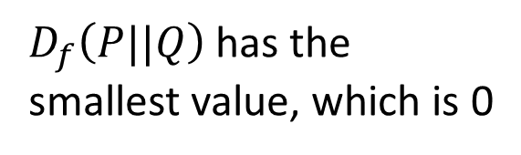
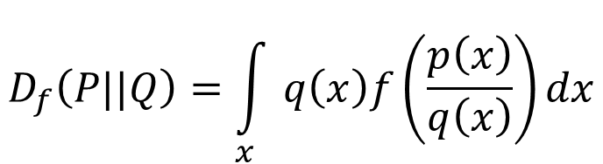
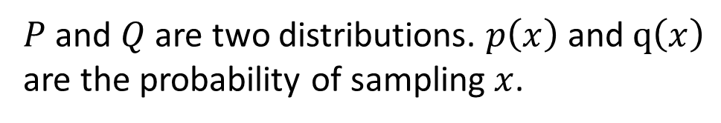
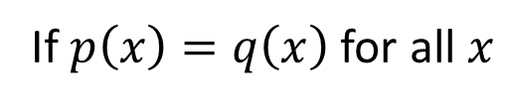

f-divergence
$P$ and $Q$ are two distributions. $p\left(x\right)$ and $q\left(x\right)$ are the probability of sampling $x$.
$$D_{f}\left(P||Q\right)=\int_{x}{q\left(x\right)f\left(\frac{p\left(x\right)}{q\left(x\right)}\right)dx}$$
f is convex
$D_{f}\left(P||Q\right)$ evaluates the difference of P and Q
f(1) = 0
If $p\left(x\right)=q\left(x\right)$ for all $x$
= 1
$$D_{f}\left(P||Q\right)=\int_{x}{q\left(x\right)f\left(\frac{p\left(x\right)}{q\left(x\right)}\right)dx}$$
smallest
$$=0$$
$$D_{f}\left(P||Q\right)=\int_{x}{q\left(x\right)f\left(\frac{p\left(x\right)}{q\left(x\right)}\right)dx}$$
= 0
If P and Q are the same distributions,
$$≥f\left(\int_{x}{q\left(x\right)\frac{p\left(x\right)}{q\left(x\right)}dx}\right)$$
Because f is convex
$D_{f}\left(P||Q\right)$ has the smallest value, which is 0
$$=f\left(1\right)=0$$
Notes:
The constraint of f is for non-negative
http://www.stat.berkeley.edu/~aditya/resources/STAT212aOverview.pdf

Slide 3

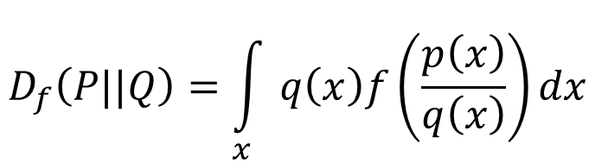
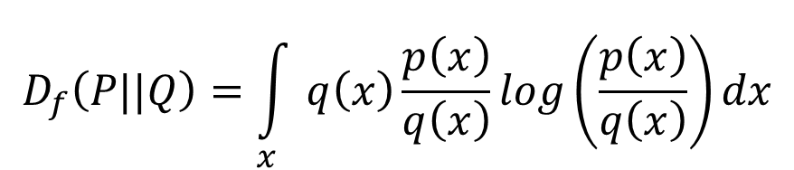
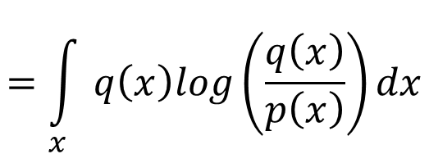
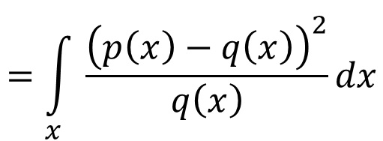
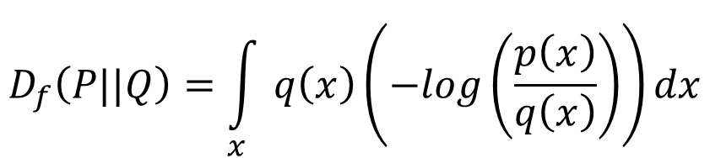
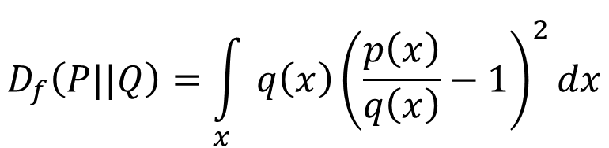


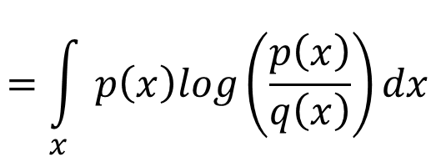
f-divergence
$$D_{f}\left(P||Q\right)=\int_{x}{q\left(x\right)f\left(\frac{p\left(x\right)}{q\left(x\right)}\right)dx}$$
f is convex
f(1) = 0
$$f\left(x\right)=xlogx$$
KL
$$D_{f}\left(P||Q\right)=\int_{x}{q\left(x\right)\frac{p\left(x\right)}{q\left(x\right)}log\left(\frac{p\left(x\right)}{q\left(x\right)}\right)dx}$$
$$=\int_{x}{p\left(x\right)log\left(\frac{p\left(x\right)}{q\left(x\right)}\right)dx}$$
$$f\left(x\right)=−logx$$
Reverse KL
$$D_{f}\left(P||Q\right)=\int_{x}{q\left(x\right)\left(−log\left(\frac{p\left(x\right)}{q\left(x\right)}\right)\right)dx}$$
$$=\int_{x}{q\left(x\right)log\left(\frac{q\left(x\right)}{p\left(x\right)}\right)dx}$$
$$f\left(x\right)={\left(x−1\right)}^{2}$$
Chi Square
$$D_{f}\left(P||Q\right)=\int_{x}{q\left(x\right){\left(\frac{p\left(x\right)}{q\left(x\right)}−1\right)}^{2}dx}$$
$$=\int_{x}{\frac{{\left(p\left(x\right)−q\left(x\right)\right)}^{2}}{q\left(x\right)}dx}$$
Notes:
The constraint of f is for non-negative
http://www.stat.berkeley.edu/~aditya/resources/STAT212aOverview.pdf

Slide 4



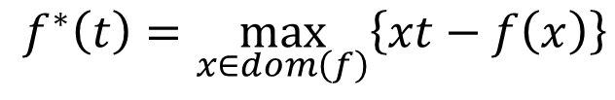

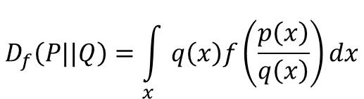


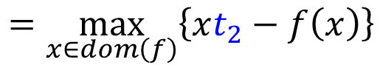







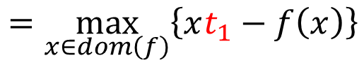
Fenchel Conjugate
$$D_{f}\left(P||Q\right)=\int_{x}{q\left(x\right)f\left(\frac{p\left(x\right)}{q\left(x\right)}\right)dx}$$
f is convex, f(1) = 0
Every convex function f has a conjugate function f*
$$f^{∗}\left(t\right)=\max_{x∈dom\left(f\right)}\left\{xt−f\left(x\right)\right\}$$
$$f^{∗}\left(t_{1}\right)$$
$$=\max_{x∈dom\left(f\right)}\left\{xt_{1}−f\left(x\right)\right\}$$
$$x_{1}t_{1}−f\left(x_{1}\right)$$
$$f^{∗}\left(t_{1}\right)$$
$$f^{∗}\left(t_{2}\right)$$
$$=\max_{x∈dom\left(f\right)}\left\{xt_{2}−f\left(x\right)\right\}$$
$$x_{3}t_{2}−f\left(x_{3}\right)$$
$$f^{∗}\left(t_{2}\right)$$
$$x_{2}t_{1}−f\left(x_{2}\right)$$
$$x_{2}t_{2}−f\left(x_{2}\right)$$
$$x_{3}t_{1}−f\left(x_{3}\right)$$
$$x_{1}t_{2}−f\left(x_{1}\right)$$
$$t_{1}$$
$$t_{2}$$
$$t$$
Notes:
supernum 最小上界
http://www.seas.ucla.edu/~vandenbe/236C/lectures/conj.pdf
Proof at here: http://www.control.lth.se/media/Education/DoctorateProgram/2015/LargeScaleConvexOptimization/Lectures/conj_fcn.pdf

Slide 5






Fenchel Conjugate
$$D_{f}\left(P||Q\right)=\int_{x}{q\left(x\right)f\left(\frac{p\left(x\right)}{q\left(x\right)}\right)dx}$$
f is convex, f(1) = 0
Every convex function f has a conjugate function f*
$$f^{∗}\left(t\right)=\max_{x∈dom\left(f\right)}\left\{xt−f\left(x\right)\right\}$$
$$x_{1}t−f\left(x_{1}\right)$$
$$f^{∗}\left(t_{1}\right)$$
$$f^{∗}\left(t_{2}\right)$$
$$x_{2}t−f\left(x_{2}\right)$$
$$x_{3}t−f\left(x_{3}\right)$$
$$t_{1}$$
$$t_{2}$$
$$t$$
Notes:
Fix x, t is variable
supernum 最小上界
http://www.seas.ucla.edu/~vandenbe/236C/lectures/conj.pdf
Proof at here: http://www.control.lth.se/media/Education/DoctorateProgram/2015/LargeScaleConvexOptimization/Lectures/conj_fcn.pdf

Slide 6





Fenchel Conjugate
Every convex function f has a conjugate function f*
$$f^{∗}\left(t\right)=\max_{x∈dom\left(f\right)}\left\{xt−f\left(x\right)\right\}$$
$$\text{10}\text{t}\text{ – 10 }\text{log}\text{ 10}$$
$$f\left(x\right)=xlogx$$
Something like exponential?
$$\text{1}\text{t}\text{ –1}\text{log}\text{1}$$
= 1t – 0
$$f^{∗}\left(t\right)=exp\left(t−1\right)$$
$$\text{0.1}\text{t}\text{ – 0.1}\text{log}\text{0.1}$$
Notes:
http://www.seas.ucla.edu/~vandenbe/236C/lectures/conj.pdf
0.1t - 0.1log0.1
1t – 0
10t – 10 log 10

Slide 7

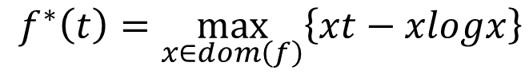



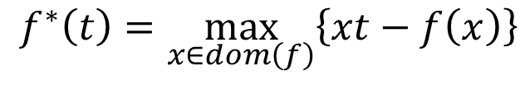


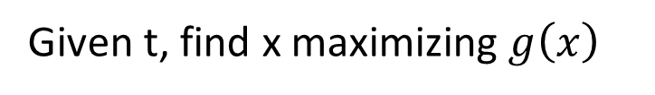
Fenchel Conjugate
Every convex function f has a conjugate function f*
(f*)* = f
$$f^{∗}\left(t\right)=\max_{x∈dom\left(f\right)}\left\{xt−f\left(x\right)\right\}$$
$$f\left(x\right)=xlogx$$
$$f^{∗}\left(t\right)=exp\left(t−1\right)$$
$$f^{∗}\left(t\right)=\max_{x∈dom\left(f\right)}\left\{xt−xlogx\right\}$$
$$g\left(x\right)=xt−xlogx$$
Given t, find x maximizing $g\left(x\right)$
$$t−logx−1=0$$
$$x=exp\left(t−1\right)$$
$$f^{∗}\left(t\right)=exp\left(t−1\right)×t−exp\left(t−1\right)×\left(t−1\right)$$
$$=exp\left(t−1\right)$$
Notes:
http://www.seas.ucla.edu/~vandenbe/236C/lectures/conj.pdf

Slide 8
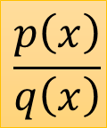
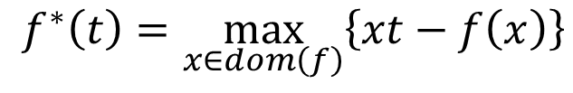
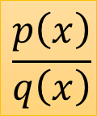
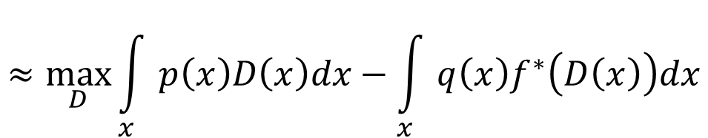
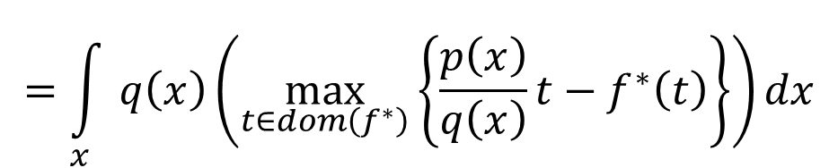
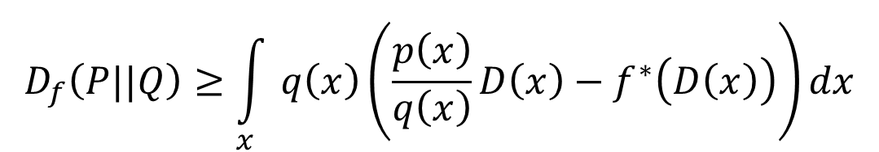
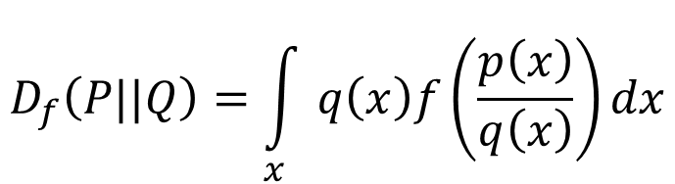
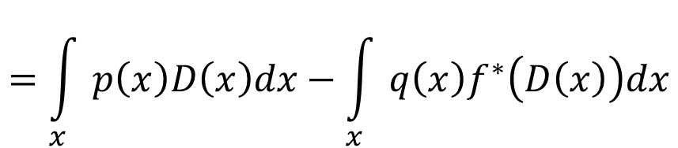
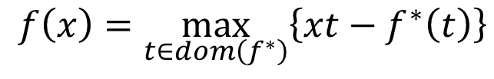
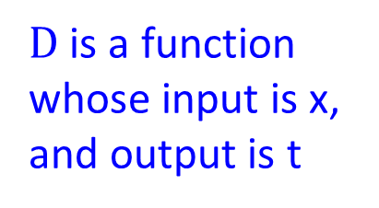
Connection with GAN
$$f^{∗}\left(t\right)=\max_{x∈dom\left(f\right)}\left\{xt−f\left(x\right)\right\}$$
$$f\left(x\right)=\max_{t∈dom\left(f^{∗}\right)}\left\{xt−f^{∗}\left(t\right)\right\}$$
$$D_{f}\left(P||Q\right)=\int_{x}{q\left(x\right)f\left(\frac{p\left(x\right)}{q\left(x\right)}\right)dx}$$
$$\frac{p\left(x\right)}{q\left(x\right)}$$
$$\frac{p\left(x\right)}{q\left(x\right)}$$
$$=\int_{x}{q\left(x\right)\left(\max_{t∈dom\left(f^{∗}\right)}\left\{\frac{p\left(x\right)}{q\left(x\right)}t−f^{∗}\left(t\right)\right\}\right)dx}$$
$$≈\max_{D}{\int_{x}{p\left(x\right)D\left(x\right)dx−\int_{x}{q\left(x\right)f^{∗}\left(D\left(x\right)\right)dx}}}$$
$$D_{f}\left(P||Q\right)≥\int_{x}{q\left(x\right)\left(\frac{p\left(x\right)}{q\left(x\right)}D\left(x\right)−f^{∗}\left(D\left(x\right)\right)\right)dx}$$
$D$ is a function whose input is x, and output is t
$$=\int_{x}{p\left(x\right)D\left(x\right)dx−\int_{x}{q\left(x\right)f^{∗}\left(D\left(x\right)\right)dx}}$$
Notes:
最小上界
Imagine that there is a function $T\left(x\right)$ whose output is t

Slide 9
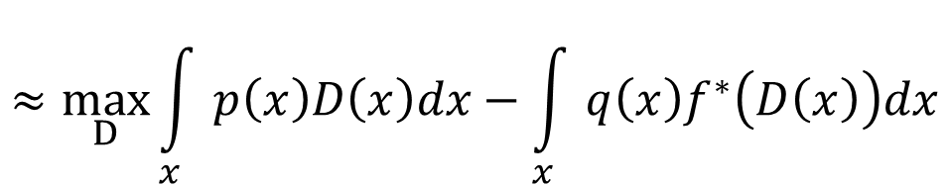
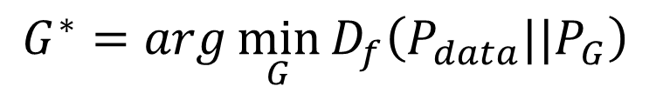


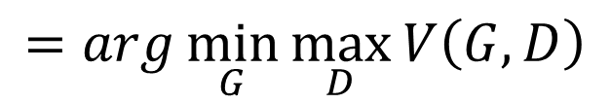
Connection with GAN
$$≈\max_{D}\int_{x}{p\left(x\right)D\left(x\right)dx−\int_{x}{q\left(x\right)f^{∗}\left(D\left(x\right)\right)dx}}$$
$$D_{f}\left(P||Q\right)$$
$$=\max_{D}\left\{E_{x\sim P}\left[D\left(x\right)\right]−E_{x\sim Q}\left[f^{∗}\left(D\left(x\right)\right)\right]\right\}$$
Samples from P
Samples from Q
$$D_{f}\left(P_{data}||P_{G}\right)$$
$$=\max_{D}\left\{E_{x\sim P_{data}}\left[D\left(x\right)\right]−E_{x\sim P_{G}}\left[f^{∗}\left(D\left(x\right)\right)\right]\right\}$$
Original GAN has different V(G,D)
$$G^{∗}=arg\min_{G}{D_{f}\left(P_{data}||P_{G}\right) }$$
$$=arg\min_{G}{\max_{D}\left\{E_{x\sim P_{data}}\left[D\left(x\right)\right]−E_{x\sim P_{G}}\left[f^{∗}\left(D\left(x\right)\right)\right]\right\}}$$
$$=arg\min_{G}{\max_{D}{V\left(G,D\right)}}$$
familiar? ☺

Slide 10
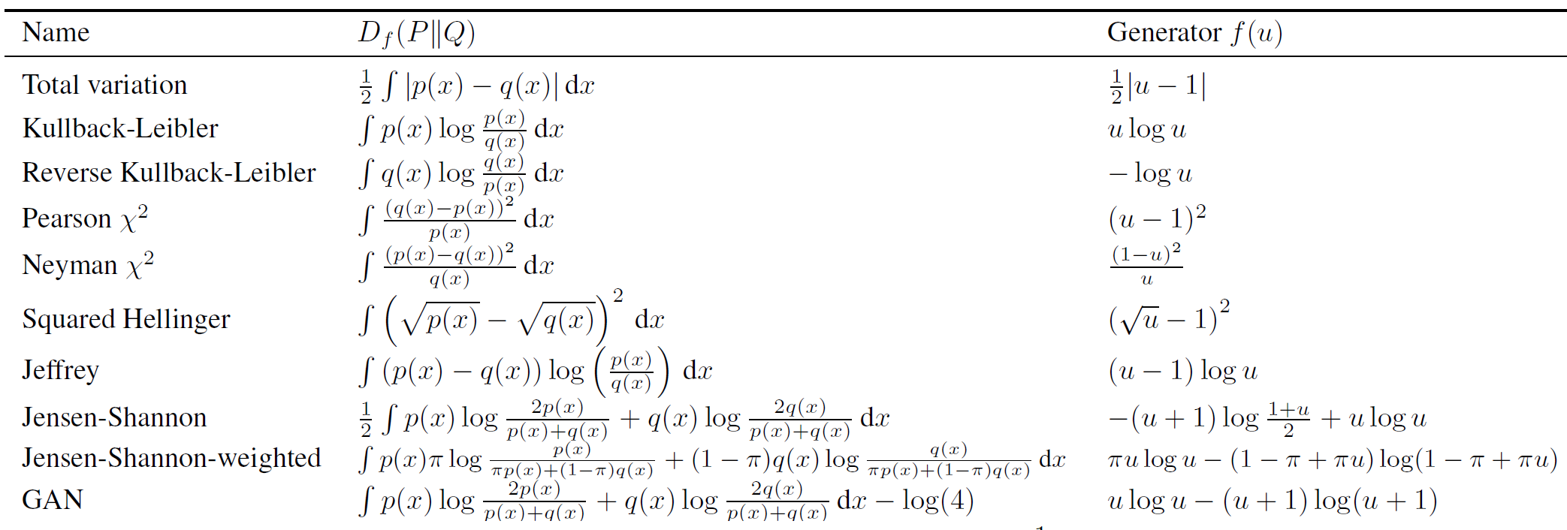
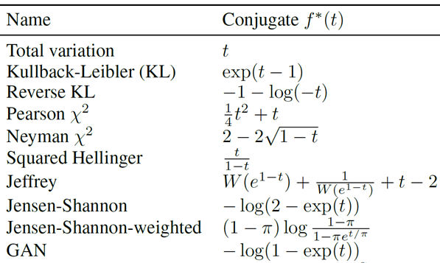

$$D_{f}\left(P_{data}||P_{G}\right)$$
$$=\max_{D}\left\{E_{x\sim P_{data}}\left[D\left(x\right)\right]−E_{x\sim P_{G}}\left[f^{∗}\left(D\left(x\right)\right)\right]\right\}$$
Using the f-divergence you like ☺
https://arxiv.org/pdf/1606.00709.pdf

Slide 11

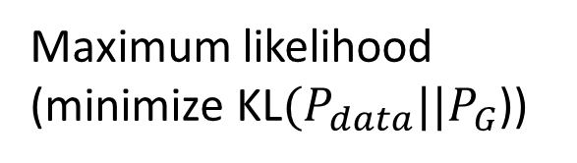



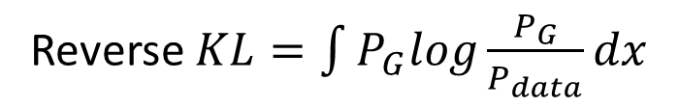
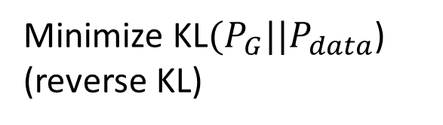
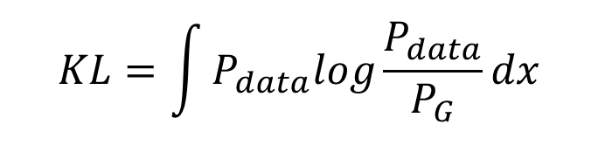
Flaw in Optimization?
Modified from Ian Goodfellow’s tutorial
$$KL=\int{P_{data}log\frac{P_{data}}{P_{G}}dx}$$
Reverse $KL=\int{P_{G}log\frac{P_{G}}{P_{data}}dx}$
$$P_{data}$$
$$P_{data}$$
$$P_{G}$$
$$P_{G}$$
Maximum likelihood (minimize KL$(P_{data}||P_{G}$))
Minimize KL$(P_{G}||P_{data}$) (reverse KL)

Slide 12
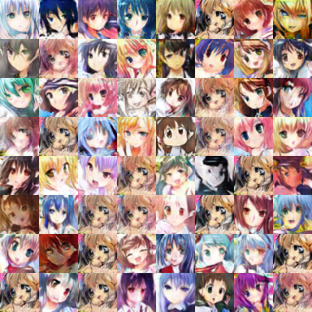
Mode Collapse
Training with too many iterations ……
: real data
: generated data

Slide 13
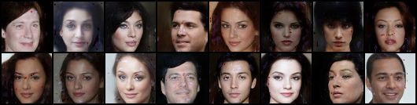
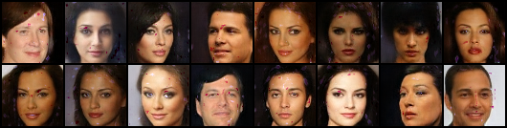
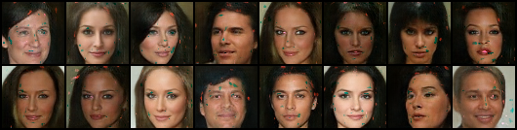
Mode Dropping
Generator switches mode during training
Generator
at iteration t
Generator
at iteration t+1
Generator
at iteration t+2
BEGAN on CelebA
Notes:
Beige skin KK[beʒ]
Dark skin

Slide 14
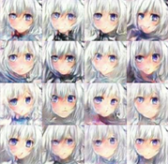
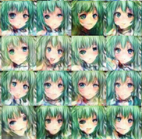

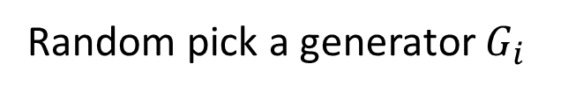
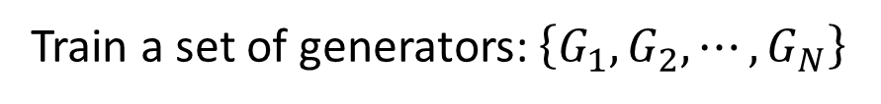
Outlook: Ensemble
Train a set of generators: $\left\{G_{1},G_{2},⋯,G_{N}\right\}$
To generate an image
Random pick a generator $G_{i}$
Use $G_{i}$ to generate the image
……
Generator
1
Generator
2
……
Notes:
Considering AdaGAN

