Slide 1
Pointer Network
Notes:
Image
Aaron van den Oord, Nal Kalchbrenner, Koray Kavukcuoglu, Pixel Recurrent Neural Networks, arXiv preprint, 2016
Aaron van den Oord, Nal Kalchbrenner, Oriol Vinyals, Lasse Espeholt, Alex Graves, Koray Kavukcuoglu, Conditional Image Generation with PixelCNN Decoders, arXiv preprint, 2016
Video
Aaron van den Oord, Nal Kalchbrenner, Koray Kavukcuoglu, Pixel Recurrent Neural Networks, arXiv preprint, 2016
Handwriting
Alex Graves, Generating Sequences With Recurrent Neural Networks, arXiv preprint, 2013
Speech
Aaron van den Oord, Sander Dieleman, Heiga Zen, Karen Simonyan, Oriol Vinyals, Alex Graves, Nal Kalchbrenner, Andrew Senior,Koray Kavukcuoglu, WaveNet: A Generative Model for Raw Audio, 2016
Generating a structured object component-by-component based on a given condition

Slide 2








Pointer Network
4
2
7
6
5
3
NN
$$x_{1}$$
$$x_{2}$$
$$x_{3}$$
$$x_{4}$$
……
coordinate of P₁
$$y_{1}$$
$$y_{2}$$
$$y_{3}$$
$$y_{4}$$
Notes:
中譯「凸包」或「凸殼」。在多維空間中有一群散佈各處的點，「凸包」是包覆這群點的所有外殼當中，表面積暨容積最小的一個外殼，而最小的外殼一定是凸的。
http://www.csie.ntnu.edu.tw/~u91029/ConvexHull.html
二維平面上的凸包是一個凸多邊形，在所有點的外圍繞一圈即得凸包。另外，最頂端、最底端、最左端、最右端的點，一定是凸包上的點。

Slide 3
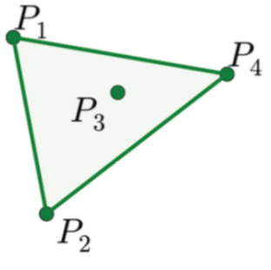
Sequence-to-sequence?
machine
learning
~
~
…
…
機
器
學
習
…
Encoder
Decoder

Slide 4








Sequence-to-sequence?
Problem?
{1, 2, 3, 4, END}
1
4
2
~
~
~
…
Of course, one can add attention.
…
$$x_{1}$$
$$x_{2}$$
$$x_{3}$$
$$x_{4}$$
…
$$y_{1}$$
$$y_{2}$$
$$y_{3}$$
$$y_{4}$$
Encoder
Decoder

Slide 5


















Pointer Network
$$x_{0}$$
: END
$$y_{0}$$
Attention Weight
key
0.5
$$z^{0}$$
$$h^{0}$$
$$h^{1}$$
$$h^{2}$$
$$h^{3}$$
$$h^{4}$$
$$x_{0}$$
$$x_{1}$$
$$x_{2}$$
$$x_{3}$$
$$x_{4}$$
$$y_{0}$$
$$y_{1}$$
$$y_{2}$$
$$y_{3}$$
$$y_{4}$$
Notes:
Word vector

Slide 6



Pointer Network
$$x_{0}$$
: END
$$y_{0}$$
Output:
1
What decoder can output depends on the input.
~
argmax from this distribution
key
0.0
0.5
0.3
0.2
0.0
$$z^{0}$$
$$z^{1}$$
$$x_{1}$$
$$y_{1}$$
$$h^{0}$$
$$h^{1}$$
$$h^{2}$$
$$h^{3}$$
$$h^{4}$$
$$x_{0}$$
$$x_{1}$$
$$x_{2}$$
$$x_{3}$$
$$x_{4}$$
$$y_{0}$$
$$y_{1}$$
$$y_{2}$$
$$y_{3}$$
$$y_{4}$$
Notes:
Word vector

Slide 7



Pointer Network
$$x_{0}$$
: END
$$y_{0}$$
Output:
4
What decoder can output depends on the input.
~
argmax from this distribution
key
0.0
0.0
0.1
0.2
0.7
……
$$z^{0}$$
$$z^{1}$$
$$z^{2}$$
$$x_{1}$$
$$x_{4}$$
$$y_{1}$$
$$y_{4}$$
$$h^{0}$$
$$h^{1}$$
$$h^{2}$$
$$h^{3}$$
$$h^{4}$$
The process stops when “END” has the largest attention weights.
$$x_{0}$$
$$x_{1}$$
$$x_{2}$$
$$x_{3}$$
$$x_{4}$$
$$y_{0}$$
$$y_{1}$$
$$y_{2}$$
$$y_{3}$$
$$y_{4}$$
Notes:
Word vector

Slide 8
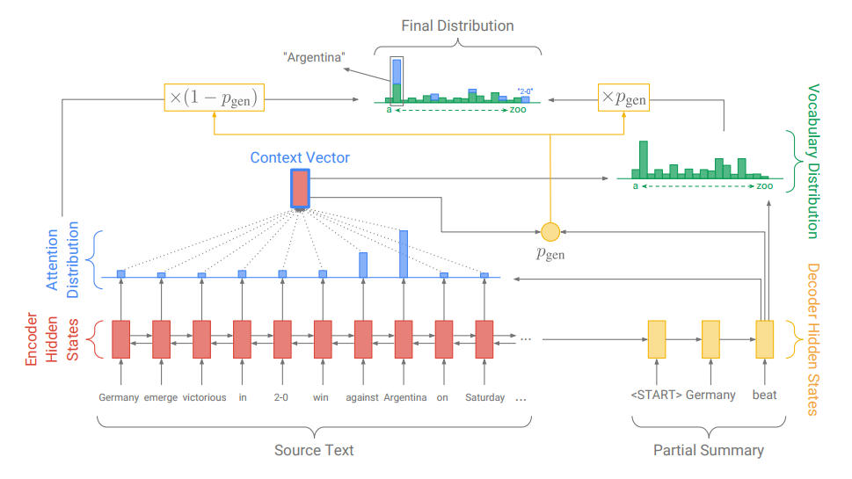
Applications - Summarization
https://arxiv.org/abs/1704.04368

Slide 9
More Applications
Machine Translation
Chat-bot
User: X寶你好，我是庫洛洛
Machine:庫洛洛你好，很高興認識你
Notes:
Jiatao Gu, Zhengdong Lu, Hang Li, Victor O.K. Li, “Incorporating Copying Mechanism in Sequence-to-Sequence Learning”, ACL, 2016
Caglar Gulcehre, Sungjin Ahn, Ramesh Nallapati, Bowen Zhou, Yoshua Bengio, “Pointing the Unknown Words”, ACL, 2016
https://arxiv.org/abs/1704.04368
Get to the point

