Slide 1
Recursive Structure

Slide 2
Application: Sentiment Analysis
h⁰
f
h¹
f
h²
f
h³
f
g
sentiment
x¹
x²
x³
x⁴
word vector
Word Sequence
h³
g
Recurrent Structure
Special case of recursive structure
f
h¹
same dimension
h²
Recursive Structure
How to stack function f is already determined
f
f
x¹
x²
x³
x⁴

Slide 3
Recursive Model
syntactic structure
How to do it is out of the scope
not
very
good
word sequence:
not
very
good
Notes:
https://openreview.net/pdf?id=Skvgqgqxe
Cons$tuency
(phrase
structure)

Slide 4
Recursive Model
syntactic structure
By composing the two meaning, what should the meaning be.
not
very
good
Dimension of word vector = |Z|
Meaning of “very good”
V(“very good”)
Input: 2 X |Z|, output: |Z|
f
V(“not”)
V(“very”)
V(“good”)
not
very
good
Notes:
Cons$tuency
(phrase
structure)

Slide 5
Recursive Model
syntactic structure
V(w_{A} w_{B}) ≠ V(w_{A}) + V(w_{B})
“not”: neutral
not
very
good
“good”: positive
“not good”: negative
Meaning of “very good”
V(“very good”)
f
V(“not”)
V(“very”)
V(“good”)
not
very
good
Notes:
Cons$tuency
(phrase
structure)

Slide 6
Recursive Model
syntactic structure
V(w_{A} w_{B}) ≠ V(w_{A}) + V(w_{B})
“棒”: positive
not
very
good
“好棒”: positive
“好棒棒”: negative
Meaning of “very good”
V(“very good”)
network
f
V(“not”)
V(“very”)
V(“good”)
not
very
good
Notes:
Cons$tuency
(phrase
structure)

Slide 7
Recursive Model
syntactic structure
“not good”
“not bad”
not
very
good
f
f
Meaning of “very good”
“not”
“good”
“not”
“bad”
V(“very good”)
: “reverse” another input
f
“not”
V(“not”)
V(“very”)
V(“good”)
not
very
good
Notes:
Cons$tuency
(phrase
structure)

Slide 8
Recursive Model
syntactic structure
“very good”
“very bad”
not
very
good
f
f
Meaning of “very good”
“very”
“good”
“very”
“bad”
V(“very good”)
: “emphasize” another input
f
“very”
V(“not”)
V(“very”)
V(“good”)
not
very
good
Notes:
Cons$tuency
(phrase
structure)

Slide 9
-
ref
5 classes
( -- , - , 0 , + , ++ )
output
g
Train both …
V(“not very good”)
f
f
g
f
V(“not”)
V(“very”)
V(“good”)
not
very
good
Notes:
http://nlp.stanford.edu:8080/sentiment/rntnDemo.html
Cons$tuency
(phrase
structure)

Slide 10
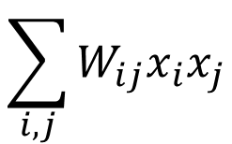




Recursive Neural Tensor Network
$$p$$
W
$$=σ\left( \right)$$
f
Little interaction between a and b
$$a$$
$$b$$
$$\sum_{i,j}{W_{ij}x_{i}x_{j}}$$
W
x
x^{T}
+
$$=σ\left( \right)$$
Notes:
Advantages
Single layer can model complex interactions
Disadvantages
Tensor V is potentially gigantic
Room for research on tensor networks?
Does not appear to be well-explored
Cubic parameter growth
Highly expressive

Slide 11
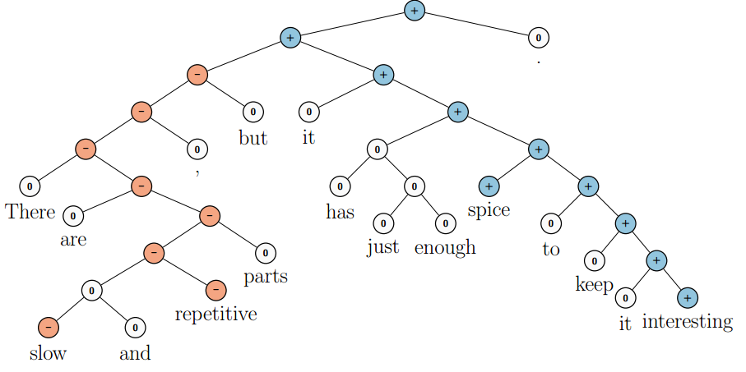
Experiments
5-class sentiment classification ( -- , - , 0 , + , ++ )
Demo: http://nlp.stanford.edu:8080/sentiment/rntnDemo.html

Slide 12
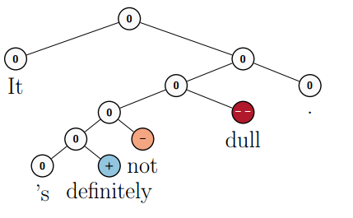
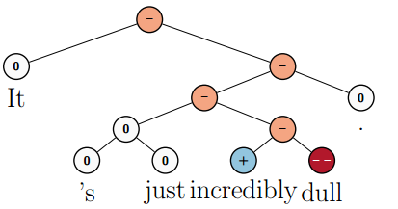
Experiments
Socher, Richard, et al. "Recursive deep models for semantic compositionality over a sentiment treebank." Proceedings of the conference on empirical methods in natural language processing (EMNLP). Vol. 1631. 2013.
Notes:
Dull 平淡

Slide 13






Matrix-Vector Recursive Network
f
inherent meaning
how it changes the others
=
W
=
W_{M}
=
$$σ\left( \right)$$
=
$$a$$
Informative?
$$A$$
$$b$$
$$B$$
Zero?
$\left[\begin{matrix}−1 & 0 \\ 0 & −1\end{matrix}\right]$?
Identity?
not
good
Notes:
Richard Socher Brody Huval Christopher D. Manning Andrew Y. Ng EMNLP 2012

Slide 14
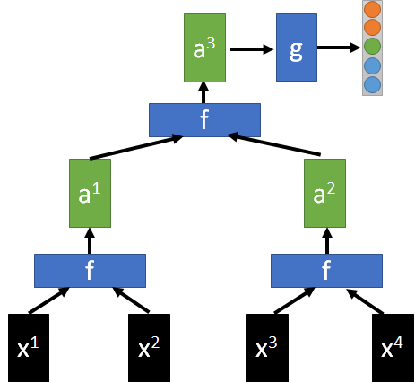
Tree LSTM
h^{t-1}
h^{t}
LSTM
Typical LSTM
m^{t-1}
m^{t}
Tree LSTM
x^{t}
h³
m³
LSTM
h¹
m¹
m²
h²

Slide 15
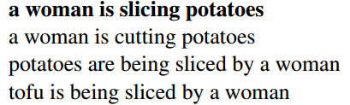

More Applications
Sentence relatedness
NN
Recursive Neural Network
Recursive Neural Network
Tai, Kai Sheng, Richard Socher, and Christopher D. Manning. "Improved semantic representations from tree-structured long short-term memory networks." arXiv preprint arXiv:1503.00075 (2015).
Sentence 1
Sentence 2

