Slide 1
Semi-supervised Learning
Notes:
https://www.youtube.com/watch?v=Jp7f4uYU29A
米

Slide 2
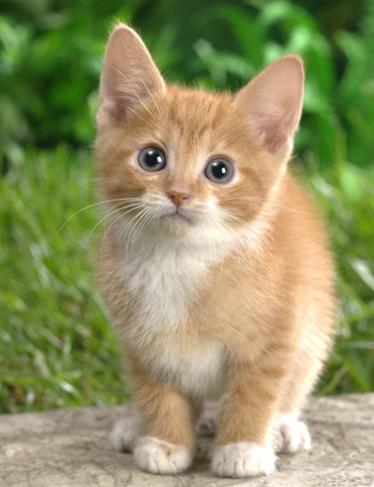
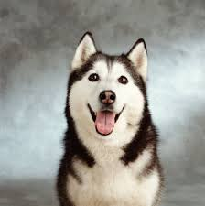
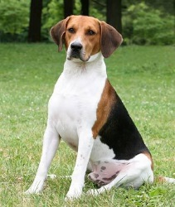
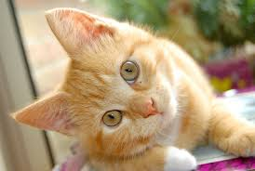
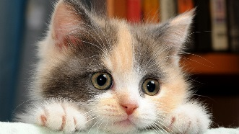
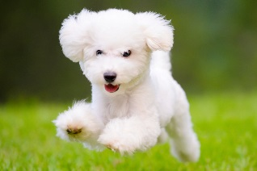
Introduction
Labelled data
cat
dog
Unlabeled data
(Image of cats and dogs without labeling)

Slide 3
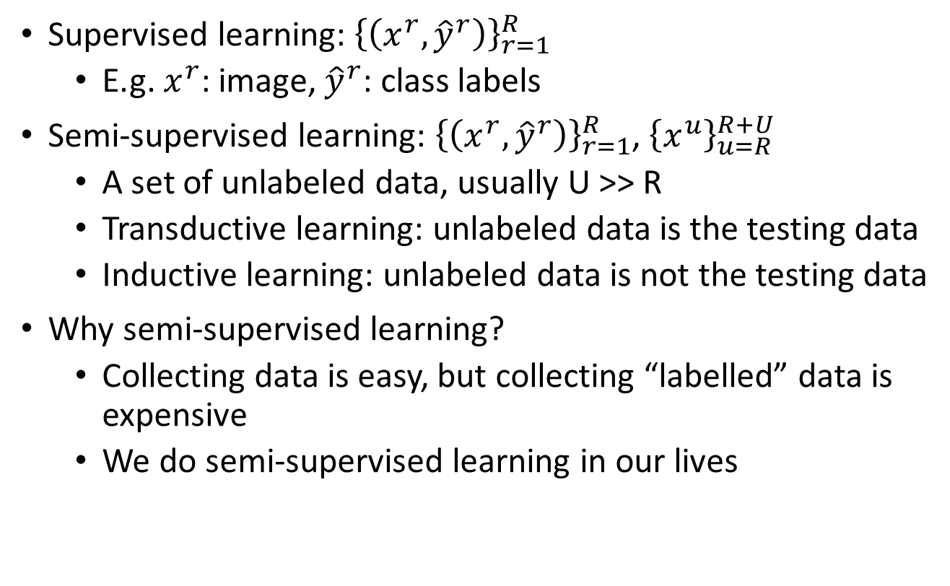
Introduction
Supervised learning: ${\left\{\left(x^{r},{\hat{y}}^{r}\right)\right\}}_{r=1}^{R}$
E.g. $x^{r}$: image, ${\hat{y}}^{r}$: class labels
Semi-supervised learning: ${\left\{\left(x^{r},{\hat{y}}^{r}\right)\right\}}_{r=1}^{R}$, ${\left\{x^{u}\right\}}_{u=R}^{R+U}$
A set of unlabeled data, usually U >> R
Transductive learning: unlabeled data is the testing data
Inductive learning: unlabeled data is not the testing data
Why semi-supervised learning?
Collecting data is easy, but collecting “labelled” data is expensive
We do semi-supervised learning in our lives

Slide 4
Why semi-supervised learning helps?
Who knows?
The distribution of the unlabeled data tell us something.
Usually with some assumptions
Notes:
Peesuod-labels

Slide 5
Outline
Low-density Separation Assumption
Smoothness Assumption
Semi-supervised Learning for Generative Model
Better Representation
Notes:
Generating pseudo-labels for unlabeled data
Where to put cluster and label

Slide 6
Semi-supervised Learning for Generative Model
Notes:
https://www.youtube.com/watch?v=Jp7f4uYU29A
米

Slide 7

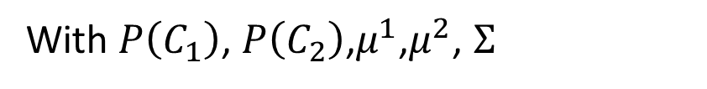
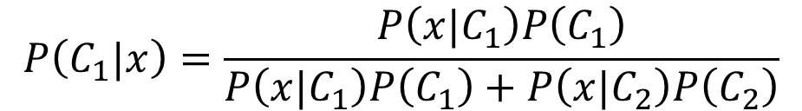


Supervised Generative Model
Given labelled training examples $x^{r}$ $∈$ $C_{1},C_{2}$
looking for most likely prior probability P(C_{i}) and class-dependent probability P(x|C_{i})
P(x|C_{i}) is a Gaussian parameterized by $μ^{i}$ and $Σ$
$$μ^{1},Σ$$
$$μ^{2},Σ$$
Decision Boundary
With $P\left(C_{1}\right)$, $P\left(C_{2}\right)$,$μ^{1}$,$μ^{2}$, $Σ$
$$P\left(C_{1}|x\right)=\frac{P\left(x|C_{1}\right)P\left(C_{1}\right)}{P\left(x|C_{1}\right)P\left(C_{1}\right)+P\left(x|C_{2}\right)P\left(C_{2}\right)}$$
Notes:
original

Slide 8

Semi-supervised Generative Model
Given labelled training examples $x^{r}$ $∈$ $C_{1},C_{2}$
looking for most likely prior probability P(C_{i}) and class-dependent probability P(x|C_{i})
P(x|C_{i}) is a Gaussian parameterized by $μ^{i}$ and $Σ$
$$μ^{1},Σ$$
$$μ^{2},Σ$$
Decision Boundary
The unlabeled data $x^{u}$ help re-estimate $P\left(C_{1}\right)$, $P\left(C_{2}\right)$, $μ^{1}$,$μ^{2}$, $Σ$
Notes:
original

Slide 9

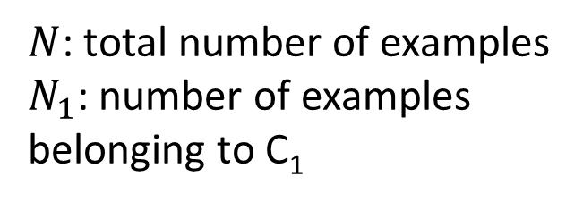

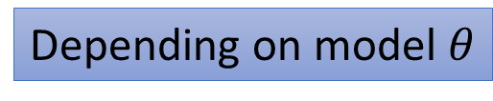
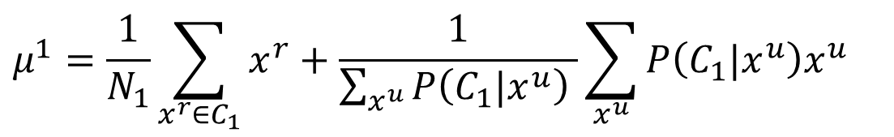
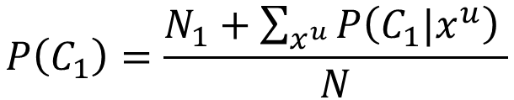
Semi-supervised Generative Model
The algorithm converges eventually, but the initialization influences the results.
Initialization:$θ=\left\{P\left(C_{1}\right)\text{,}P\left(C_{2}\right)\text{,}μ^{1}\text{,}μ^{2}\text{, }Σ\right\}$
Step 1: compute the posterior probability of unlabeled data
Step 2: update model
E
$$P_{θ}\left(C_{1}|x^{u}\right)$$
Depending on model $θ$
Back to step 1
M
$N$: total number of examples
$N_{1}$: number of examples belonging to C₁
$$P\left(C_{1}\right)=\frac{N_{1}+\sum_{x^{u}}{P\left(C_{1}|x^{u}\right) }}{N}$$
$$μ^{1}=\frac{1}{N_{1}}\sum_{x^{r}∈C_{1}}{x^{r}}+\frac{1}{\sum_{x^{u}}{P\left(C_{1}|x^{u}\right) }}\sum_{x^{u}}{P\left(C_{1}|x^{u}\right)x^{u}}$$
……

Slide 10
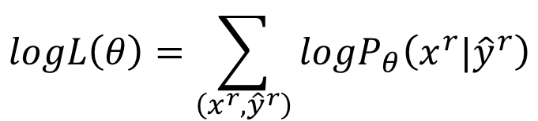

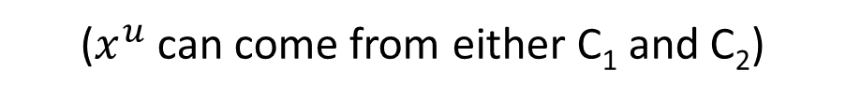
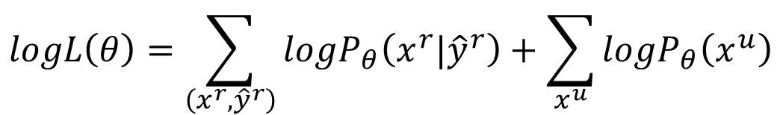
Why?
$$θ=\left\{P\left(C_{1}\right)\text{,}P\left(C_{2}\right)\text{,}μ^{1}\text{,}μ^{2}\text{, }Σ\right\}$$
Maximum likelihood with labelled data
Maximum likelihood with labelled + unlabeled data
$$logL\left(θ\right)=\sum_{\left(x^{r},{\hat{y}}^{r}\right)}{logP_{θ}\left(x^{r}|{\hat{y}}^{r}\right)}$$
$$logL\left(θ\right)=\sum_{\left(x^{r},{\hat{y}}^{r}\right)}{logP_{θ}\left(x^{r}|{\hat{y}}^{r}\right)}+\sum_{x^{u}}{logP_{θ}\left(x^{u}\right)}$$
Solved iteratively
$$P_{θ}\left(x^{u}\right)=P_{θ}\left(x^{u}|C_{1}\right)P\left(C_{1}\right)+P_{θ}\left(x^{u}|C_{2}\right)P\left(C_{2}\right)$$
($x^{u}$ can come from either C₁ and C₂)
Notes:
The truth is

Slide 11


Semi-supervised Learning Low-density Separation
非黑即白
“Black-or-white”
Notes:
https://www.cis.upenn.edu/~mkearns/papers/em-kmeans.pdf

Slide 12
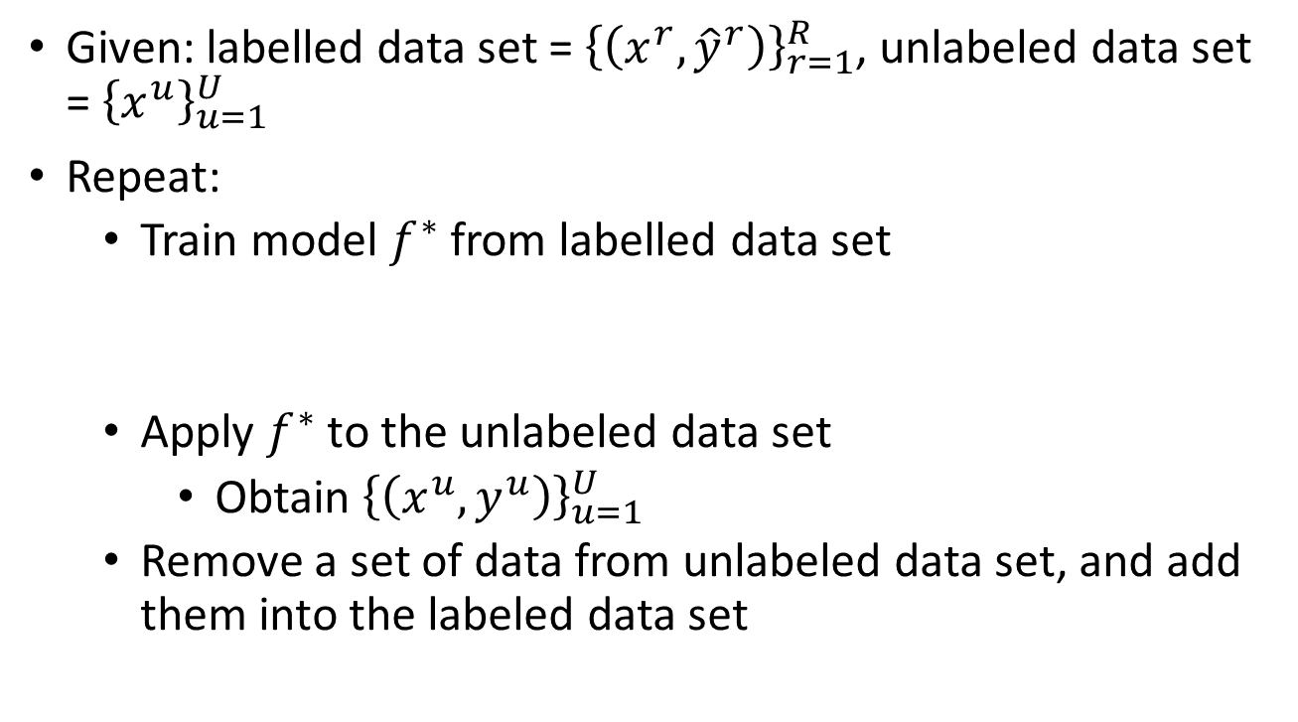
Self-training
Given: labelled data set = ${\left\{\left(x^{r},{\hat{y}}^{r}\right)\right\}}_{r=1}^{R}$, unlabeled data set = ${\left\{x^{u}\right\}}_{u=1}^{U}$
Repeat:
Train model $f^{∗}$ from labelled data set
Apply $f^{∗}$ to the unlabeled data set
Obtain ${\left\{\left(x^{u},y^{u}\right)\right\}}_{u=1}^{U}$
Remove a set of data from unlabeled data set, and add them into the labeled data set
You can use any model here.
Regression?
Pseudo-label
How to choose the data set remains open
You can also provide a weight to each data.
Notes:
Some mistake may be corrected

Slide 13

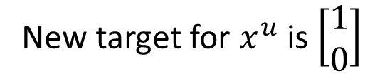

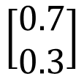

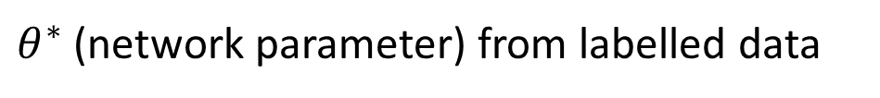
Self-training
Similar to semi-supervised learning for generative model
Hard label v.s. Soft label
Considering using neural network
$θ^{∗}$ (network parameter) from labelled data
Hard
Class 1
New target for $x^{u}$ is $\left[\begin{aligned}1 \\ 0\end{aligned}\right]$
$$x^{u}$$
$$θ^{∗}$$
$$\left[\begin{aligned}0.7 \\ 0.3\end{aligned}\right]$$
It looks like class 1, then it is class 1.
Soft
70% Class 1
30% Class 2
New target for $x^{u}$ is $\left[\begin{aligned}0.7 \\ 0.3\end{aligned}\right]$
Doesn’t work …

Slide 14
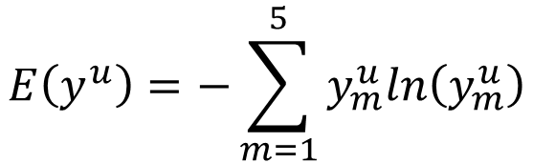





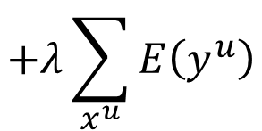



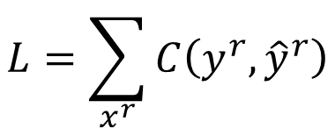


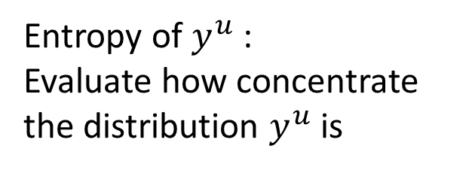
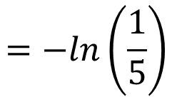
Entropy-based Regularization
Entropy of $y^{u}$:
Evaluate how concentrate the distribution $y^{u}$ is
$$x^{u}$$
$$θ^{∗}$$
$$y^{u}$$
Distribution
$$E\left(y^{u}\right)=−\sum_{m=1}^{5}{y_{m}^{u}ln\left(y_{m}^{u}\right)}$$
$$y^{u}$$
Good!
$$E\left(y^{u}\right)=0$$
1
2
3
4
5
As small as possible
$$y^{u}$$
Good!
$$E\left(y^{u}\right)=0$$
1
2
3
4
5
$$L=\sum_{x^{r}}{C\left(y^{r},{\hat{y}}^{r}\right)}$$
labelled data
Bad!
$$E\left(y^{u}\right)$$
$$y^{u}$$
$$=−ln\left(\frac{1}{5}\right)$$
$$+λ\sum_{x^{u}}{E\left(y^{u}\right)}$$
unlabeled data
1
2
3
4
5
$$=ln5$$

Slide 15
Outlook: Semi-supervised SVM
Enumerate all possible labels for the unlabeled data
Find a boundary that can provide the largest margin and least error
Thorsten Joachims, ”Transductive Inference for Text Classification using Support Vector Machines”, ICML, 1999
Notes:
https://www.cs.cornell.edu/people/tj/publications/joachims_99c.pdf
http://www.cs.cmu.edu/~guestrin/Class/10701-S06/Slides/tsvms-pca.pdf

Slide 16
Semi-supervised Learning Smoothness Assumption
近朱者赤，近墨者黑
“You are known by the company you keep”

Slide 17
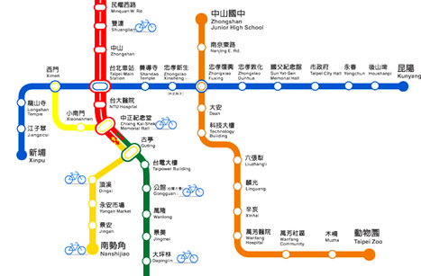
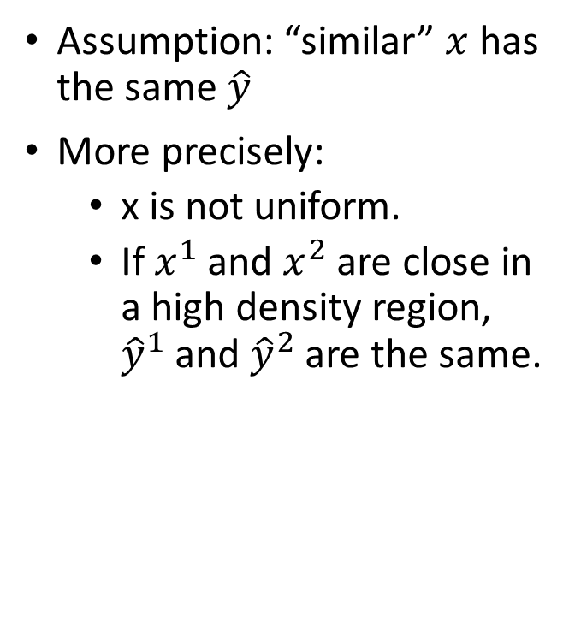
Smoothness Assumption
Assumption: “similar” $x$ has the same $\hat{y}$
More precisely:
x is not uniform.
If $x^{1}$ and $x^{2}$ are close in a high density region, ${\hat{y}}^{1}$ and ${\hat{y}}^{2}$ are the same.
connected by a high density path
公館 v.s. 台北車站
Source of image: http://hips.seas.harvard.edu/files/pinwheel.png
公館 v.s. 科技大樓
Notes:
血輪演

Slide 18
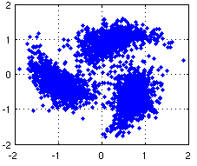
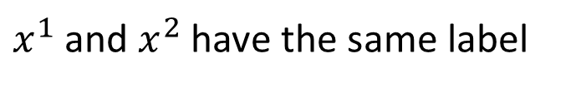



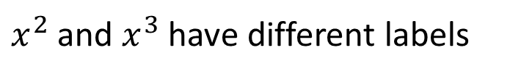
Smoothness Assumption
Assumption: “similar” $x$ has the same $\hat{y}$
More precisely:
x is not uniform.
If $x^{1}$ and $x^{2}$ are close in a high density region, ${\hat{y}}^{1}$ and ${\hat{y}}^{2}$ are the same.
$$x^{3}$$
$$x^{1}$$
$$x^{2}$$
connected by a high density path
$x^{1}$ and $x^{2}$ have the same label
Source of image: http://hips.seas.harvard.edu/files/pinwheel.png
$x^{2}$ and $x^{3}$ have different labels
Notes:
血輪演

Slide 19


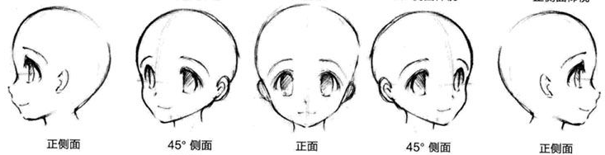
Smoothness Assumption
Not similar?
similar?
“indirectly” similar
with stepping stones
(The example is from the tutorial slides of Xiaojin Zhu.)
Source of image: http://www.moehui.com/5833.html/5/
Notes:
face recognition

Slide 20
Smoothness Assumption
Classify astronomy vs. travel articles
(The example is from the tutorial slides of Xiaojin Zhu.)
Notes:
Asteroid小行星
Comet彗星
zodiac黃道帶
Zion耶路撒冷zaɪən

Slide 21
Smoothness Assumption
Classify astronomy vs. travel articles
(The example is from the tutorial slides of Xiaojin Zhu.)
Notes:
Asteroid小行星
Comet彗星
zodiac黃道帶
Zion耶路撒冷zaɪən

Slide 22
Cluster and then Label
Cluster 2
Class 2
Class 1
Class 1
Class 2
Class 2
Cluster 1
Cluster 3
Using all the data to learn a classifier as usual

Slide 23

Graph-based Approach
How to know $x^{1}$ and $x^{2}$ are connected by a high density path
Represented the data points as a graph
Graph representation is nature sometimes.
E.g. Hyperlink of webpages, citation of papers
Sometimes you have to construct the graph yourself.

Slide 24

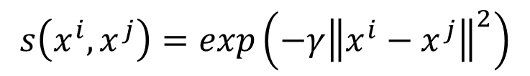
Graph-based Approach - Graph Construction
The images are from the tutorial slides of Amarnag Subramanya and Partha Pratim Talukdar
Define the similarity $s\left(x^{i},x^{j}\right)$ between $x^{i}$ and $x^{j}$
Add edge:
K Nearest Neighbor
e-Neighborhood
Edge weight is proportional to s$\left(x^{i},x^{j}\right)$
Gaussian Radial Basis Function:
$$s\left(x^{i},x^{j}\right)=exp\left(−γ{\left\|x^{i}−x^{j}\right\|}^{2}\right)$$

Slide 25
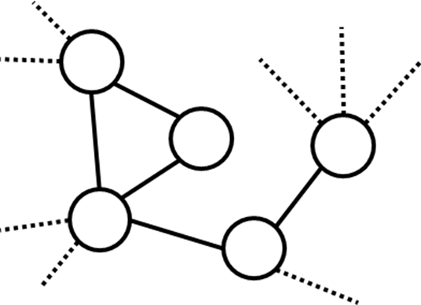
Graph-based Approach
Class 1
Class 1
Class 1
Class 1
Class 1
x
The labelled data influence their neighbors.
Propagate through the graph

Slide 26


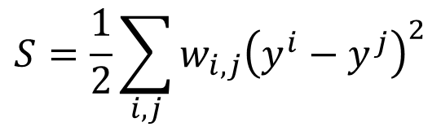








Graph-based Approach
Define the smoothness of the labels on the graph
$$S=\frac{1}{2}\sum_{i,j}{w_{i,j}{\left(y^{i}−y^{j}\right)}^{2}}$$
Smaller means smoother
For all data (no matter labelled or not)
$$y^{1}=1$$
x¹
$$y^{1}=0$$
x¹
3
3
2
2
$$y^{3}=1$$
$$y^{3}=1$$
x³
1
x³
1
x²
x²
$$y^{2}=1$$
$$y^{2}=1$$
1
1
x⁴
x⁴
$$S=0.5$$
$$S=3$$
$$y^{4}=0$$
$$y^{4}=0$$
Notes:
2 + 3 + 1
Assume lable a scalar

Slide 27
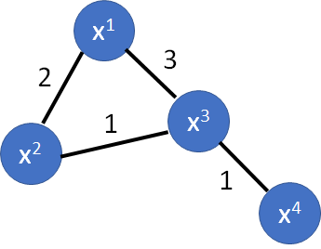





Graph-based Approach
Define the smoothness of the labels on the graph
$$S=\frac{1}{2}\sum_{i,j}{w_{i,j}{\left(y^{i}−y^{j}\right)}^{2}}$$
$$=y^{T}Ly$$
y: (R+U)-dim vector
$$y={\left[⋯y^{i}⋯y^{j}⋯\right]}^{T}$$
L: (R+U) x (R+U) matrix
Graph Laplacian
$$W=\left[\begin{matrix}\begin{matrix}0 & 2 \\ 2 & 0\end{matrix} & \begin{matrix}3 & 0 \\ 1 & 0\end{matrix} \\ \begin{matrix}3 & 1 \\ 0 & 0\end{matrix} & \begin{matrix}0 & 1 \\ 1 & 0\end{matrix}\end{matrix}\right]$$
$$D=\left[\begin{matrix}\begin{matrix}5 & 0 \\ 0 & 3\end{matrix} & \begin{matrix}0 & 0 \\ 0 & 0\end{matrix} \\ \begin{matrix}0 & 0 \\ 0 & 0\end{matrix} & \begin{matrix}5 & 0 \\ 0 & 1\end{matrix}\end{matrix}\right]$$
$$L=D−W$$
Notes:
8 + 75 + 9 + 16

Slide 28


Graph-based Approach
Define the smoothness of the labels on the graph
$$S=\frac{1}{2}\sum_{i,j}{w_{i,j}{\left(y^{i}−y^{j}\right)}^{2}}$$
Depending on model parameters
$$=y^{T}Ly$$
$$L=\sum_{x^{r}}{C\left(y^{r},{\hat{y}}^{r}\right)}$$
$$+λS$$
smooth
As a regularization term
J. Weston, F. Ratle, and R. Collobert, “Deep learning via semi-supervised embedding,” ICML, 2008
smooth
smooth
Notes:
https://github.com/CuriousAI/ladder
https://arxiv.org/pdf/1507.02672.pdf …..

Slide 29
Semi-supervised Learning Better Representation
去蕪存菁，化繁為簡

Slide 30
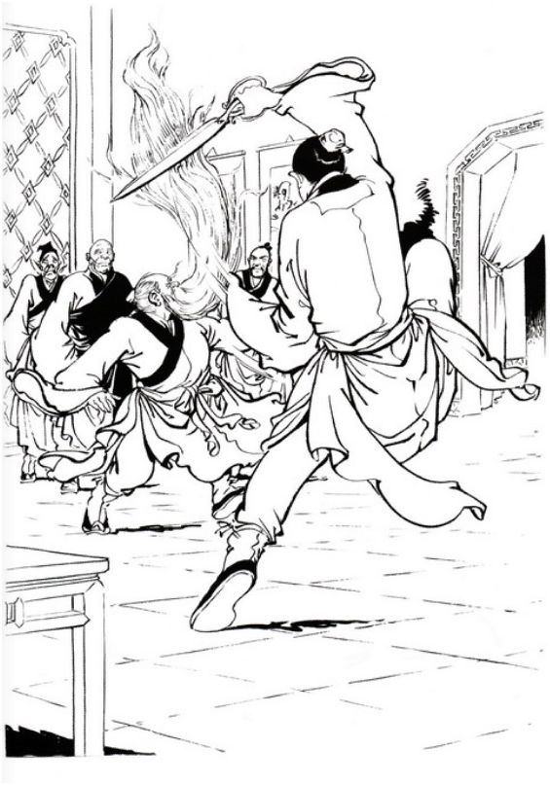
Looking for Better Representation
Find a better (simpler) representations from the unlabeled data
Original representation
Better representation
(In unsupervised learning part)

Slide 31
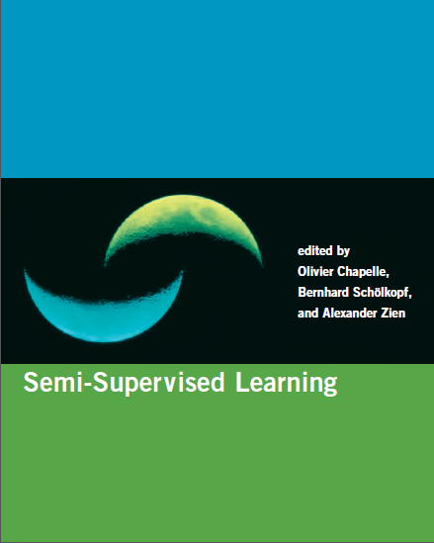
Reference
http://olivier.chapelle.cc/ssl-book/
Notes:
http://olivier.chapelle.cc/ssl-book/ssl_toc.pdf

Slide 32
Acknowledgement
感謝 劉議隆 同學指出投影片上的錯字
感謝 丁勃雄 同學指出投影片上的錯字

