Slide 1
Regression
Hung-yi Lee
李宏毅

Slide 2

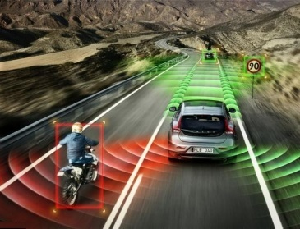


Regression: Output a scalar
Stock Market Forecast
Self-driving Car
Recommendation
Dow Jones Industrial Average at tomorrow
$$f\left( \right)=$$
$$f\left( \right)=$$
方向盤角度
$$f\left( \right)=$$
購買可能性
使用者 A
商品 B

Slide 3








Example Application
Estimating the Combat Power (CP) of a pokemon after evolution
$$x_{cp}$$
CP after evolution
$$f\left( \right)=$$
$$y$$
$$x_{s}$$
$$x$$
$$x_{hp}$$
$$x_{w}$$
$$x_{h}$$

Slide 4

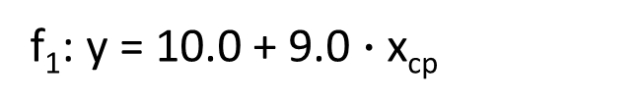
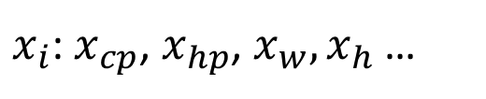
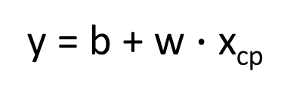
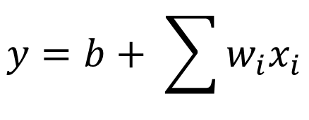


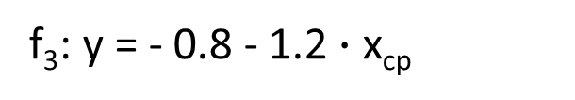
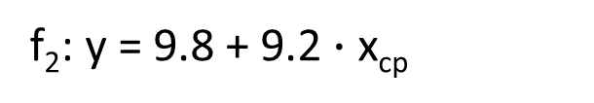

Step 1: Model
w and b are parameters (can be any value)
y = b + w $∙$ x_{cp}
f₁: y = 10.0 + 9.0 $∙$ x_{cp}
A set of function
Model
f₂: y = 9.8 + 9.2 $∙$ x_{cp}
f₃: y = - 0.8 - 1.2 $∙$ x_{cp}
…… infinite
CP after evolution
$$x$$
$$y$$
$$f\left( \right)=$$
$x_{i}$: $x_{cp}$, $x_{hp}$, $x_{w},x_{h}$ …
$$y=b+ \sum{w_{i}x_{i}}$$
Linear model:
feature
$w_{i}$: weight, b: bias

Slide 5






Step 2: Goodness of Function
y = b + w $∙$ x_{cp}
A set of function
Model
function
input:
function
Output (scalar):
$${\hat{y}}^{1}$$
$$x^{1}$$
$${\hat{y}}^{2}$$
$$x^{2}$$
Training
Data
Notes:
卡咪龜

Slide 6
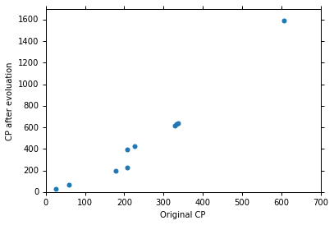







Step 2: Goodness of Function
Training Data: 10 pokemons
$$\left(x^{1},{\hat{y}}^{1}\right)$$
$$\left(x^{2},{\hat{y}}^{2}\right)$$
$$\left(x_{cp}^{n},{\hat{y}}^{n}\right)$$
$$……$$
$$\hat{y}$$
$$\left(x^{10},{\hat{y}}^{10}\right)$$
This is real data.
$$x_{cp}$$
Source: https://www.openintro.org/stat/data/?data=pokemon

Slide 7

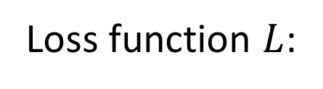

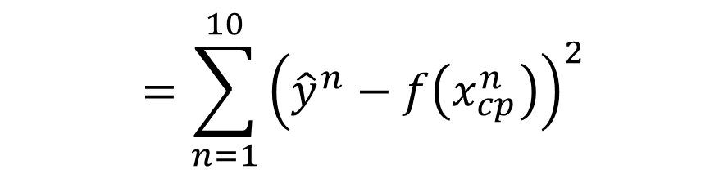
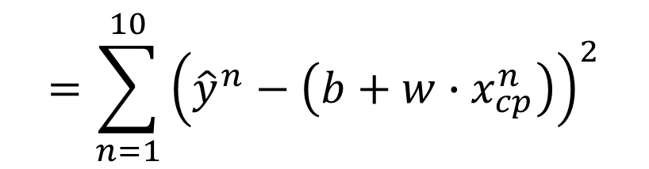
Step 2: Goodness of Function
y = b + w $∙$ x_{cp}
A set of function
Loss function $L$:
Model
Input: a function, output: how bad it is
Estimation error
$$=\sum_{n=1}^{10}{{\left({\hat{y}}^{n}−f\left(x_{cp}^{n}\right)\right)}^{2}}$$
Goodness of function f
$$L\left(f\right)$$
Estimated y based on input function
Sum over examples
Training
Data
$$L\left(w,b\right)$$
$$=\sum_{n=1}^{10}{{\left({\hat{y}}^{n}−\left(b+w∙x_{cp}^{n}\right)\right)}^{2}}$$

Slide 8
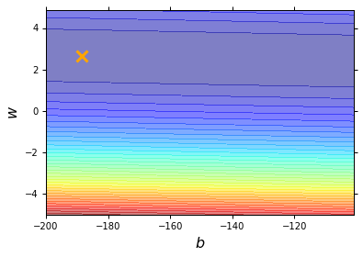
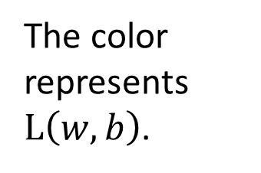
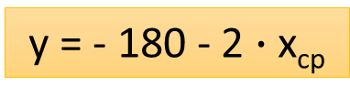
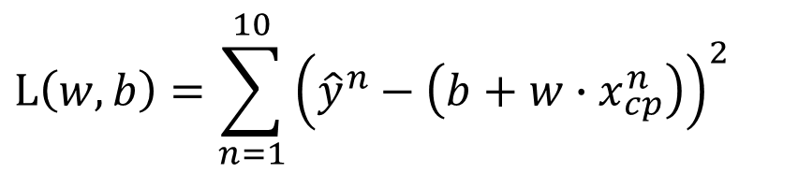
Step 2: Goodness of Function
$$L\left(w,b\right)=\sum_{n=1}^{10}{{\left({\hat{y}}^{n}−\left(b+w∙x_{cp}^{n}\right)\right)}^{2}}$$
Loss Function
Each point in the figure is a function
smallest
y = - 180 - 2 $∙$ x_{cp}
The color represents $L\left(w,b\right)$.
Very large
(true example)

Slide 9
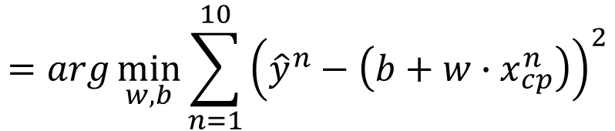

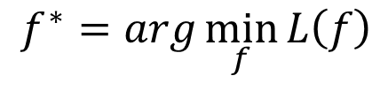

Step 3: Best Function
$$L\left(w,b\right)$$
$$=\sum_{n=1}^{10}{{\left({\hat{y}}^{n}−\left(b+w∙x_{cp}^{n}\right)\right)}^{2}}$$
A set of function
Model
Goodness of function f
Pick the “Best” Function
$$f^{∗}=\arg{\min_{f}{L\left(f\right)}}$$
Gradient Descent
Training
Data
$$w^{∗},b^{∗}=arg\min_{w,b}{L\left(w,b\right)}$$
$$=arg\min_{w,b}{\sum_{n=1}^{10}{{\left({\hat{y}}^{n}−\left(b+w∙x_{cp}^{n}\right)\right)}^{2}}}$$
Notes:
http://speech.ee.ntu.edu.tw/~tlkagk/courses/LA_2016/Lecture/orthogonal%20projection%20(v2).ecm.mp4/index.html

Slide 10

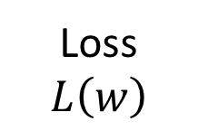
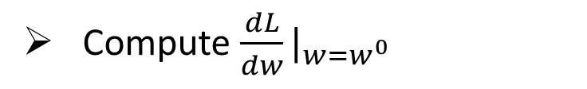

Step 3: Gradient Descent
http://chico386.pixnet.net/album/photo/171572850
$$w^{∗}=arg\min_{w}{L\left(w\right)}$$
Consider loss function 𝐿(𝑤) with one parameter w:
(Randomly) Pick an initial value w⁰
Compute $\frac{dL}{dw}|_{w=w^{0}}$
Loss
$$L\left(w\right)$$
Negative
Increase w
Positive
Decrease w
w⁰

Slide 11
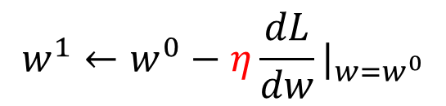

Step 3: Gradient Descent
http://chico386.pixnet.net/album/photo/171572850
$$w^{∗}=arg\min_{w}{L\left(w\right)}$$
Consider loss function 𝐿(𝑤) with one parameter w:
(Randomly) Pick an initial value w⁰
Compute $\frac{dL}{dw}|_{w=w^{0}}$
$$w^{1}←w^{0}−η\frac{dL}{dw}|_{w=w^{0}}$$
Loss
$$L\left(w\right)$$
η is called “learning rate”
w⁰
$$−η\frac{dL}{dw}|_{w=w^{0}}$$

Slide 12


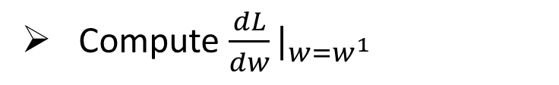
Step 3: Gradient Descent
$$w^{∗}=arg\min_{w}{L\left(w\right)}$$
Consider loss function 𝐿(𝑤) with one parameter w:
(Randomly) Pick an initial value w⁰
Compute $\frac{dL}{dw}|_{w=w^{0}}$
$$w^{1}←w^{0}−η\frac{dL}{dw}|_{w=w^{0}}$$
Loss
$$L\left(w\right)$$
Compute $\frac{dL}{dw}|_{w=w^{1}}$
$$w^{2}←w^{1}−η\frac{dL}{dw}|_{w=w^{1}}$$
…… Many iteration
Local minima
global minima
w⁰
w¹
w²
w^{T}

Slide 13

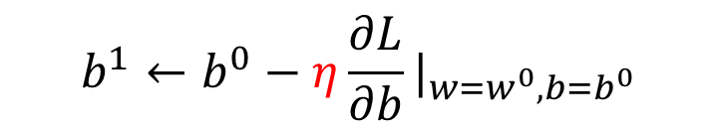

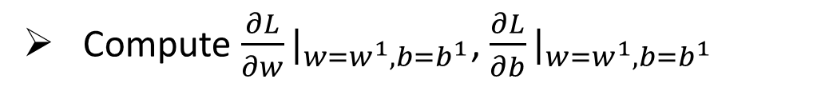
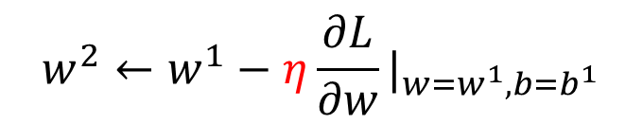



Step 3: Gradient Descent
$$\left[\begin{aligned}\frac{∂L}{∂w} \\ \frac{∂L}{∂b}\end{aligned}\right]$$
$$∇L=$$
gradient
How about two parameters?
$$w^{∗},b^{∗}=arg\min_{w,b}{L\left(w,b\right)}$$
(Randomly) Pick an initial value w⁰, b⁰
Compute $\frac{∂L}{∂w}|_{w=w^{0},b=b^{0}}$, $\frac{∂L}{∂b}|_{w=w^{0},b=b^{0}}$
$$w^{1}←w^{0}−η\frac{∂L}{∂w}|_{w=w^{0},b=b^{0}}$$
$$b^{1}←b^{0}−η\frac{∂L}{∂b}|_{w=w^{0},b=b^{0}}$$
Compute $\frac{∂L}{∂w}|_{w=w^{1},b=b^{1}}$, $\frac{∂L}{∂b}|_{w=w^{1},b=b^{1}}$
$$w^{2}←w^{1}−η\frac{∂L}{∂w}|_{w=w^{1},b=b^{1}}$$
$$b^{2}←b^{1}−η\frac{∂L}{∂b}|_{w=w^{1},b=b^{1}}$$
Notes:
鄭凱文

Slide 14
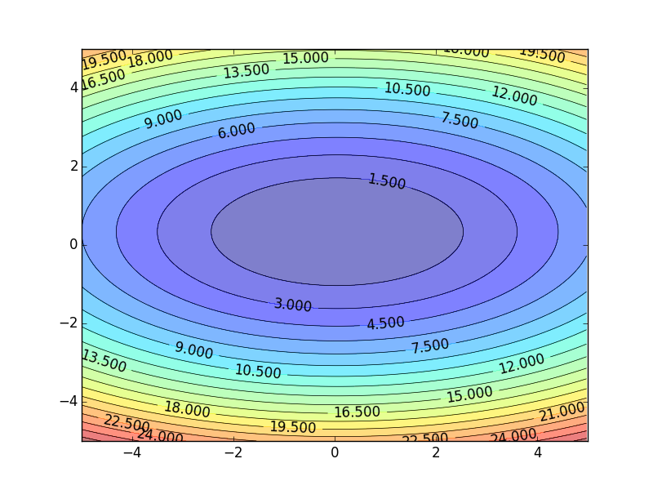
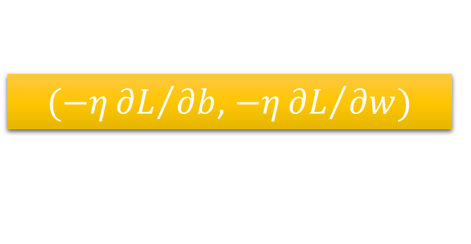
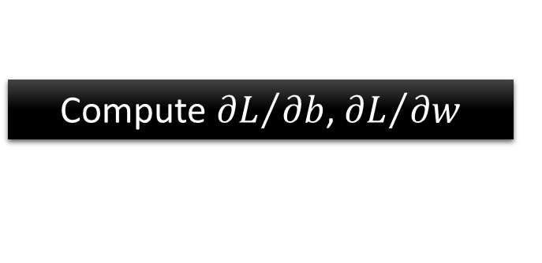


Step 3: Gradient Descent
Color: Value of Loss L(w,b)
$$w$$
$(−η{∂L}/{∂b}$, $−η{∂L}/{∂w})$
Compute ${∂L}/{∂b}$, ${∂L}/{∂w}$
$$b$$
Notes:
Don’t worry. In linear regression, the loss function L is convex.
No local minima
Questions: image you are playing AOC
A network can have millions of parameters.
Backpropagation is the way to compute the gradients efficiently (not today)
Ref: http://speech.ee.ntu.edu.tw/~tlkagk/courses/MLDS_2015_2/Lecture/DNN%20backprop.ecm.mp4/index.html

Slide 15


Step 3: Gradient Descent
When solving:
Each time we update the parameters, we obtain $θ$ that makes $L\left(θ\right)$ smaller.
$$θ^{∗}=arg\max_{θ}{L\left(θ\right)}$$
by gradient descent
$$L\left(θ^{0}\right)>L\left(θ^{1}\right)>L\left(θ^{2}\right)>…$$
Is this statement correct?
Notes:
Demo minecraft

Slide 16
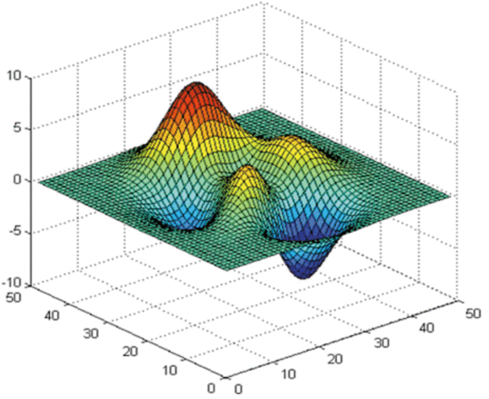






Step 3: Gradient Descent
Loss
Very slow at the plateau
$$L$$
Stuck at saddle point
$$w_{1}$$
$$w_{2}$$
Stuck at local minima
$$∂L∕∂w$$
$$≈0$$
$$∂L∕∂w$$
$$=0$$
$$∂L∕∂w$$
$$=0$$
The value of the parameter w
Notes:
Demo: Why all the problmes/

Slide 17
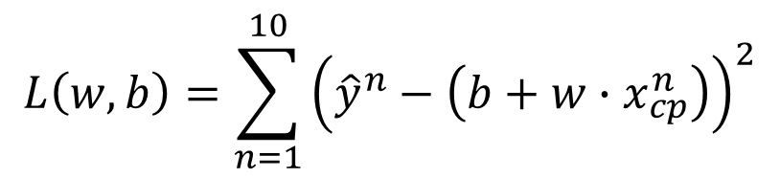

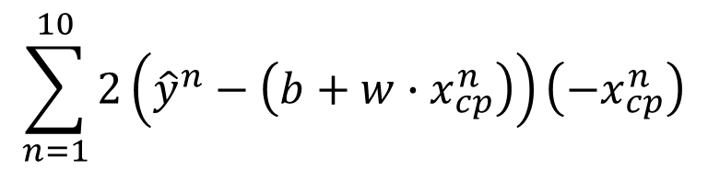


Step 3: Gradient Descent
Formulation of ${∂L}/{∂w}$ and ${∂L}/{∂b}$
$$L\left(w,b\right)=\sum_{n=1}^{10}{{\left({\hat{y}}^{n}−\left(b+w∙x_{cp}^{n}\right)\right)}^{2}}$$
$$\sum_{n=1}^{10}{2\left({\hat{y}}^{n}−\left(b+w∙x_{cp}^{n}\right)\right)\left(−x_{cp}^{n}\right)}$$
$$\frac{∂L}{∂w}=?$$
$$\frac{∂L}{∂b}=?$$

Slide 18
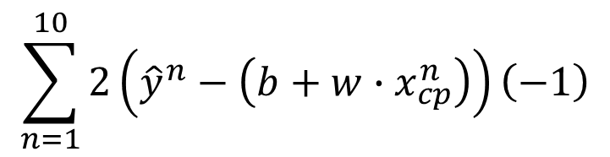
Step 3: Gradient Descent
Formulation of ${∂L}/{∂w}$ and ${∂L}/{∂b}$
$$L\left(w,b\right)=\sum_{n=1}^{10}{{\left({\hat{y}}^{n}−\left(b+w∙x_{cp}^{n}\right)\right)}^{2}}$$
$$\sum_{n=1}^{10}{2\left({\hat{y}}^{n}−\left(b+w∙x_{cp}^{n}\right)\right)\left(−x_{cp}^{n}\right)}$$
$$\frac{∂L}{∂w}=?$$
$$\frac{∂L}{∂b}=?$$
$$\sum_{n=1}^{10}{2\left({\hat{y}}^{n}−\left(b+w∙x_{cp}^{n}\right)\right)\left(−1\right)}$$

Slide 19
Step 3: Gradient Descent
Notes:
http://python.ntu.edu.tw/user/tlkagk/notebooks/Gradient%20Descent%20Demo.ipynb
Demo?????????????????????????????????????

Slide 20
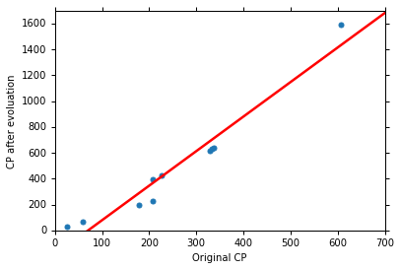
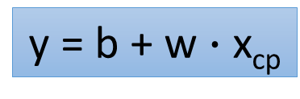
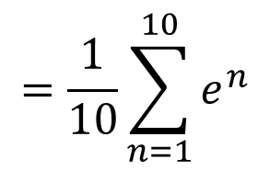


How’s the results?
Training Data
y = b + w $∙$ x_{cp}
b = -188.4
$$e^{1}$$
w = 2.7
Average Error on Training Data
$$e^{2}$$
$$=\frac{1}{10}\sum_{n=1}^{10}{e^{n}}$$
= 31.9

Slide 21
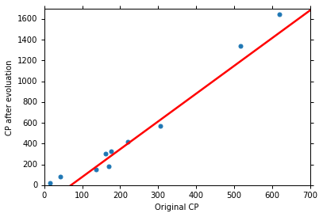
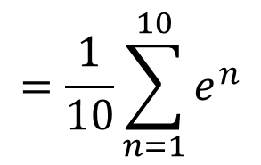
How’s the results? - Generalization
What we really care about is the error on new data (testing data)
Another 10 pokemons as testing data
y = b + w $∙$ x_{cp}
b = -188.4
How can we do better?
w = 2.7
Average Error on Testing Data
$$=\frac{1}{10}\sum_{n=1}^{10}{e^{n}}$$
= 35.0
> Average Error on Training Data (31.9)

Slide 22
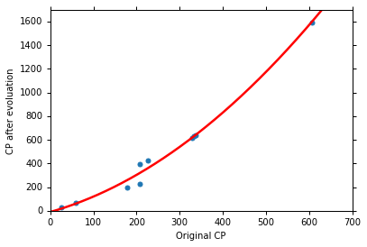

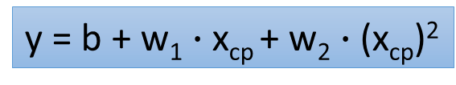
Selecting another Model
y = b + w₁ $∙$ x_{cp} + w₂ $∙$ (x_{cp})²
Best Function
b = -10.3
w₁ = 1.0, w₂ = 2.7 x 10⁻³
Average Error = 15.4
Testing:
Average Error = 18.4
Better! Could it be even better?

Slide 23
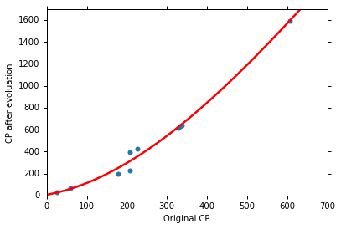
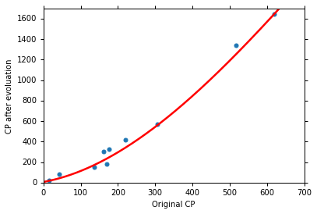
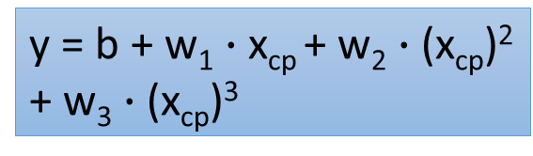
Selecting another Model
y = b + w₁ $∙$ x_{cp} + w₂ $∙$ (x_{cp})²
+ w₃ $∙$ (x_{cp})³
Best Function
b = 6.4, w₁ = 0.66
w₂ = 4.3 x 10⁻³
w₃ = -1.8 x 10⁻⁶
Average Error = 15.3
Testing:
Average Error = 18.1
Slightly better.
How about more complex model?

Slide 24



Selecting another Model
y = b + w₁ $∙$ x_{cp} + w₂ $∙$ (x_{cp})²
+ w₃ $∙$ (x_{cp})³ + w₄ $∙$ (x_{cp})⁴
Best Function
Average Error = 14.9
Testing:
Average Error = 28.8
The results become worse ...

Slide 25



Selecting another Model
y = b + w₁ $∙$ x_{cp} + w₂ $∙$ (x_{cp})²
+ w₃ $∙$ (x_{cp})³ + w₄ $∙$ (x_{cp})⁴
+ w₅ $∙$ (x_{cp})⁵
Best Function
Average Error = 12.8
Testing:
Average Error = 232.1
The results are so bad.

Slide 26






Model Selection
Training Data
1.
y = b + w $∙$ x_{cp}
2.
y = b + w₁ $∙$ x_{cp} + w₂ $∙$ (x_{cp})²
y = b + w₁ $∙$ x_{cp} + w₂ $∙$ (x_{cp})²
+ w₃ $∙$ (x_{cp})³
3.
y = b + w₁ $∙$ x_{cp} + w₂ $∙$ (x_{cp})²
+ w₃ $∙$ (x_{cp})³ + w₄ $∙$ (x_{cp})⁴
4.
y = b + w₁ $∙$ x_{cp} + w₂ $∙$ (x_{cp})²
+ w₃ $∙$ (x_{cp})³ + w₄ $∙$ (x_{cp})⁴
+ w₅ $∙$ (x_{cp})⁵
A more complex model yields lower error on training data.
5.
If we can truly find the best function

Slide 27

Model Selection
 | Training | Testing
1 | 31.9 | 35.0
2 | 15.4 | 18.4
3 | 15.3 | 18.1
4 | 14.9 | 28.2
5 | 12.8 | 232.1
Overfitting
A more complex model does not always lead to better performance on testing data.
This is Overfitting.
Select suitable model
Notes:
metaphohr

Slide 28

Let’s collect more data
There is some hidden factors not considered in the previous model ……

Slide 29





What are the hidden factors?
Eevee
Pidgey
Weedle
Caterpie
Notes:
Species
獨角蟲-
綠毛蟲

Slide 30










Back to step 1: Redesign the Model
$$y=b+ \sum{w_{i}x_{i}}$$
Linear model?
x
$x_{s}=\text{species}$ of x
If $x_{s}=\text{Pidgey}$:
$$y=b_{1}+w_{1}∙x_{cp}$$
If $x_{s}=\text{Weedle}$:
$$y=b_{2}+w_{2}∙x_{cp}$$
If $x_{s}=\text{Caterpie}$:
$$y=b_{3}+w_{3}∙x_{cp}$$
If $x_{s}=\text{Eevee}$:
$$y=b_{4}+w_{4}∙x_{cp}$$
y
Notes:
Pidgey
Weedle
Caterpie
Eevee

Slide 31













Back to step 1: Redesign the Model
$$y=b+ \sum{w_{i}x_{i}}$$
Linear model?
$$y=b_{1}∙δ\left(x_{s}=\text{Pidgey}\right)$$
1
1
$$x_{cp}$$
$$+w_{1}∙δ\left(x_{s}=\text{Pidgey}\right)x_{cp}$$
$$δ\left(x_{s}=\text{Pidgey}\right)$$
0
$$+b_{2}∙δ\left(x_{s}=\text{Weedle}\right)$$
=1
If $x_{s}=\text{Pidgey}$
$$+w_{2}∙δ\left(x_{s}=\text{Weedle}\right)x_{cp}$$
0
=0
otherwise
$$+b_{3}∙δ\left(x_{s}=\text{Caterpie}\right)$$
0
$$+w_{3}∙δ\left(x_{s}=\text{Caterpie}\right)x_{cp}$$
0
If $x_{s}=\text{Pidgey}$
$$+b_{4}∙δ\left(x_{s}=\text{Eevee}\right)$$
0
$$y=b_{1}+w_{1}∙x_{cp}$$
$$+w_{4}∙δ\left(x_{s}=\text{Eevee}\right)x_{cp}$$
0
Notes:
Pidgey
Weedle
Caterpie
Eevee

Slide 32


Training Data
Average error = 3.8
Testing
Data
Average error = 14.3

Slide 33



Are there any other hidden factors?
CP after evolution
weight
CP after evolution
CP after evolution
Height
HP

Slide 34









Back to step 1: Redesign the Model Again
x
If $x_{s}=\text{Pidgey}$:
$$y′=b_{1}+w_{1}∙x_{cp}+w_{5}∙{\left(x_{cp}\right)}^{2}$$
If $x_{s}=\text{Weedle}$:
$$y′=b_{2}+w_{2}∙x_{cp}+w_{6}∙{\left(x_{cp}\right)}^{2}$$
Training Error
= 1.9
If $x_{s}=\text{Caterpie}$:
$$y′=b_{3}+w_{3}∙x_{cp}+w_{7}∙{\left(x_{cp}\right)}^{2}$$
$$y′=b_{4}+w_{4}∙x_{cp}+w_{8}∙{\left(x_{cp}\right)}^{2}$$
Testing Error
= 102.3
If $x_{s}=\text{Eevee}$:
$$y=y′+w_{9}∙x_{hp}+w_{10}∙{\left(x_{hp}\right)}^{2}$$
Overfitting!
$$+w_{11}∙x_{h}+w_{12}∙{\left(x_{h}\right)}^{2}+w_{13}∙x_{w}+w_{14}∙{\left(x_{w}\right)}^{2}$$
y
Notes:
Put all the information

Slide 35








Back to step 2: Regularization
$$y=b+ \sum{w_{i}x_{i}}$$
The functions with smaller $w_{i}$ are better
$$L=\sum_{n}{{\left({\hat{y}}^{n}−\left(b+ \sum{w_{i}x_{i}}\right)\right)}^{2}}$$
$$+λ\sum{{\left(w_{i}\right)}^{2}}$$
Smaller $w_{i}$ means …
smoother
$$y=b+ \sum{w_{i}x_{i}}$$
$$y+\sum{w_{i}Δx_{i}}$$
$$=b+ \sum{w_{i}{(x}_{i}\text{+}\text{Δ}\text{x}\text{i} )}$$
We believe smoother function is more likely to be correct
Do you have to apply regularization on bias?

Slide 36



Regularization
$$λ$$ | Training | Testing
0 | 1.9 | 102.3
1 | 2.3 | 68.7
10 | 3.5 | 25.7
100 | 4.1 | 11.1
1000 | 5.6 | 12.8
10000 | 6.3 | 18.7
100000 | 8.5 | 26.8
smoother
How smooth?
Select $λ$ obtaining the best model
Training error: larger$λ$, considering the training error less
We prefer smooth function, but don’t be too smooth.

Slide 37
Conclusion
Pokémon: Original CP and species almost decide the CP after evolution
There are probably other hidden factors
Gradient descent
More theory and tips in the following lectures
We finally get average error = 11.1 on the testing data
How about new data? Larger error? Lower error?
Next lecture: Where does the error come from?
More theory about overfitting and regularization
The concept of validation

Slide 38
Reference
Bishop: Chapter 1.1

Slide 39
Acknowledgment
感謝 鄭凱文 同學發現投影片上的符號錯誤
感謝 童寬 同學發現投影片上的符號錯誤
感謝 黃振綸 同學發現課程網頁上影片連結錯誤的符號錯誤

