Slide 1
Unsupervised Learning: Deep Auto-encoder
Notes:
http://www.deeplearningbook.org/contents/autoencoders.html
Output
- idea of compressions
-audoencoder
- application
retrieval
image
-also as initilization

Slide 2
Unsupervised Learning
“We expect unsupervised learning to become far more important in the longer term. Human and animal learning is largely unsupervised: we discover the structure of the world by observing it, not by being told the name of every object.” – LeCun, Bengio, Hinton, Nature 2015
As I've said in previous statements: most of human and animal learning is unsupervised learning. If intelligence was a cake, unsupervised learning would be the cake, supervised learning would be the icing on the cake, and reinforcement learning would be the cherry on the cake. We know how to make the icing and the cherry, but we don't know how to make the cake.
- Yann LeCun, March 14, 2016 (Facebook)
Notes:
櫻桃梗

Slide 3

Auto-encoder
Usually <784
Compact representation of the input object
NN
Encoder
code
28 X 28 = 784
Learn together
NN
Decoder
Can reconstruct the original object
code

Slide 4







Recap: PCA
Minimize
$${\left(x−\hat{x} \right)}^{2}$$
As close as possible
encode
decode
$$x$$
$$c$$
$$\hat{x}$$
$$W$$
$$W^{T}$$
hidden layer
(linear)
Input layer
output layer
Bottleneck later
Output of the hidden layer is the code
Notes:
A neutral net whose output tries to reconstruct the input
Target of output ($\hat{y}$) = input ($x$)

Slide 5






Deep Auto-encoder
Symmetric is not necessary.
Of course, the auto-encoder can be deep
As close as possible
…
…
Layer
Layer
Output Layer
Input Layer
Layer
bottle
Layer
Layer
Layer
$$W_{2}^{T}$$
$$W_{1}$$
$$W_{2}$$
$$W_{1}^{T}$$
Initialize by RBM layer-by-layer
$$x$$
Code
$$\hat{x}$$
Reference: Hinton, Geoffrey E., and Ruslan R. Salakhutdinov. "Reducing the dimensionality of data with neural networks." Science 313.5786 (2006): 504-507
Notes:
codes

Slide 6




Deep Auto-encoder
Original Image
784
30
784
PCA
Deep
Auto-encoder
784
1000
500
250
30
250
500
784
1000
Notes:
Hand-written digits
Deep auto-encoder has better reconstruction capability

Slide 7
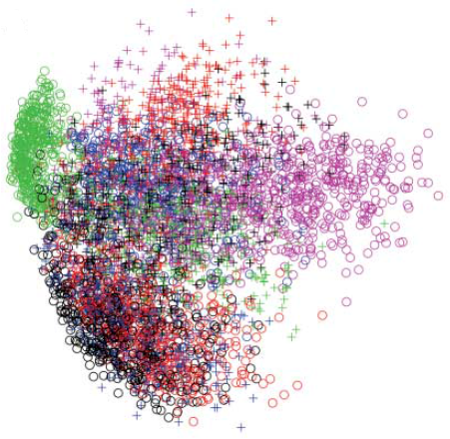
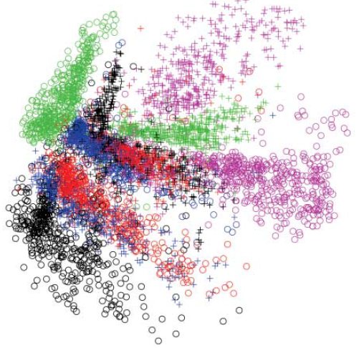
784
2
784
784
1000
500
250
2
250
500
784
1000
Notes:
From 30 to 2

Slide 8
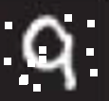




Auto-encoder
More: Contractive auto-encoder
Ref: Rifai, Salah, et al. "Contractive auto-encoders: Explicit invariance during feature extraction.“ Proceedings of the 28th International Conference on Machine Learning (ICML-11). 2011.
De-noising auto-encoder
As close as possible
encode
decode
$$c$$
$$x$$
$$x′$$
$$\hat{x}$$
Add noise
Vincent, Pascal, et al. "Extracting and composing robust features with denoising autoencoders." ICML, 2008.
Notes:
有收縮性的

Slide 9
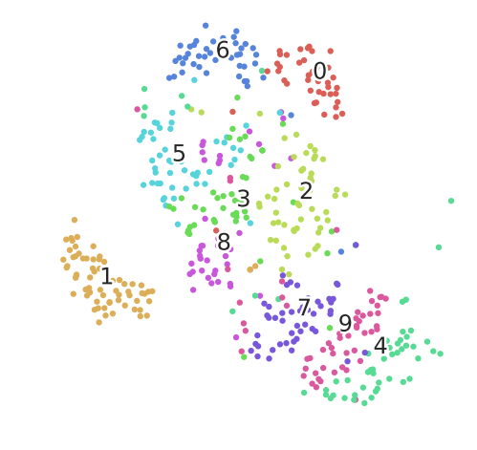
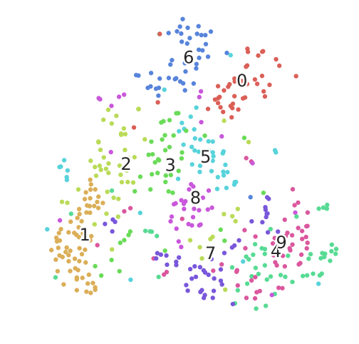
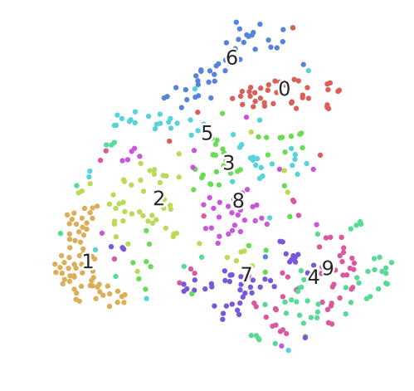

Deep Auto-encoder - Example
NN
Encoder
$$c$$
PCA 降到32-dim
Pixel -> tSNE

Slide 10
Auto-encoder – Text Retrieval
Vector Space Model
Bag-of-word
this
1
is
1
word string:
“This is an apple”
query
a
0
an
1
…
apple
1
pen
0
document
Semantics are not considered.
Notes:
idf

Slide 11
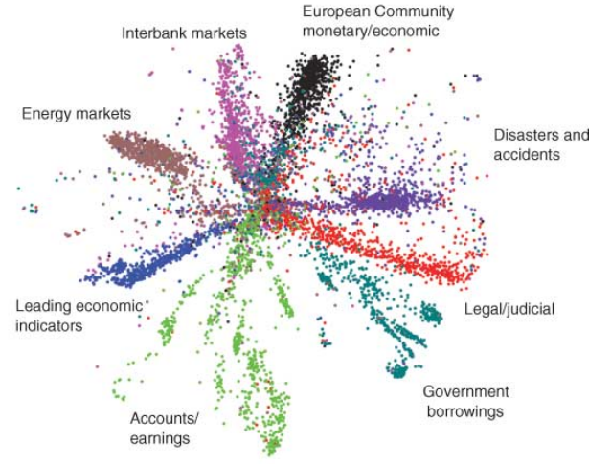
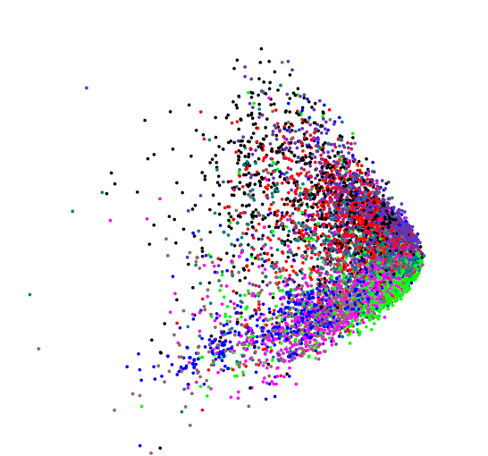
Auto-encoder – Text Retrieval
The documents talking about the same thing will have close code.
2
query
125
250
500
2000
LSA: project documents to 2 latent topics
Bag-of-word
(document or query)
Notes:
The qeruy not always have the common word

Slide 12
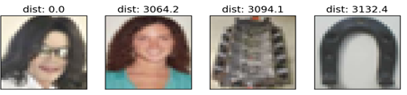
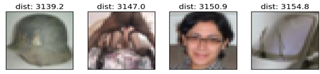
Auto-encoder – Similar Image Search
Retrieved using Euclidean distance in pixel intensity space
(Images from Hinton’s slides on Coursera)
Reference: Krizhevsky, Alex, and Geoffrey E. Hinton. "Using very deep autoencoders for content-based image retrieval." ESANN. 2011.
Notes:
Direct compute on pixel label is slow!

Slide 13

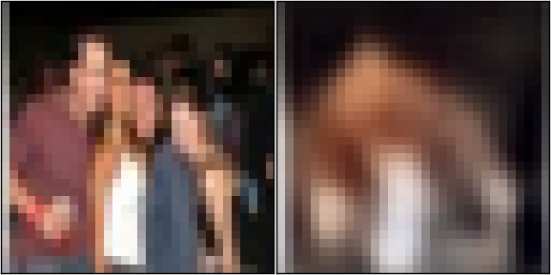


Auto-encoder – Similar Image Search
code
8192
2048
1024
512
256
4096
32x32
(crawl millions of images from the Internet)
Notes:
Reconstructions of 32x32 color images from 256-bit codes

Slide 14
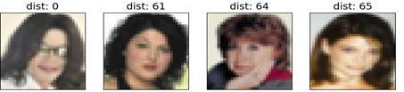
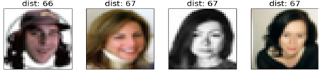
Retrieved using Euclidean distance in pixel intensity space
retrieved using 256 codes
Notes:
faster

Slide 15
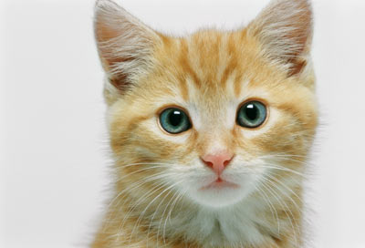
Auto-encoder for CNN
As close as possible
Deconvolution
Convolution
Deconvolution
Unpooling
Pooling
Unpooling
Deconvolution
Convolution
Deconvolution
code
Unpooling
Pooling
Unpooling
Notes:
這個圖可能有問題!

Slide 16
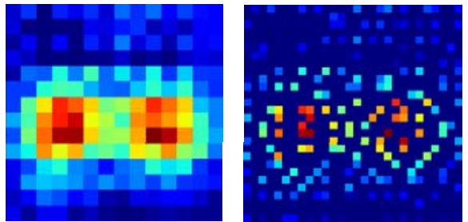
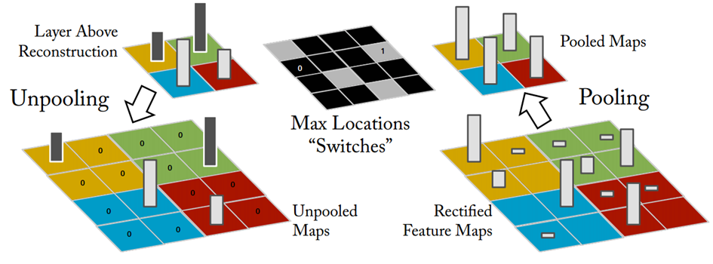
CNN -Unpooling
14 x 14
28 x 28
Alternative: simply repeat the values
Source of image : https://leonardoaraujosantos.gitbooks.io/artificial-inteligence/content/image_segmentation.html

Slide 17
CNN - Deconvolution
Actually, deconvolution is convolution.
+
+
+
=
+

Slide 18


Auto-encoder – Pre-training DNN
Greedy Layer-wise Pre-training again
output
10
500
Target
1000
784
$$\hat{x}$$
W¹’
1000
1000
W¹
Input
784
Input
784
$$x$$

Slide 19



Auto-encoder – Pre-training DNN
Greedy Layer-wise Pre-training again
output
10
500
1000
$${\hat{a}}^{1}$$
W²’
Target
1000
1000
W²
1000
1000
$$a^{1}$$
fix
W¹
Input
784
Input
784
$$x$$

Slide 20


Auto-encoder – Pre-training DNN
Greedy Layer-wise Pre-training again
output
$${\hat{a}}^{2}$$
10
1000
W³’
500
500
W³
Target
$$a^{2}$$
1000
1000
fix
W²
1000
1000
$$a^{1}$$
fix
W¹
Input
784
Input
784
$$x$$

Slide 21
Auto-encoder – Pre-training DNN
Find-tune by backpropagation
Greedy Layer-wise Pre-training again
output
output
10
10
Random init
W⁴
500
500
W³
Target
1000
1000
W²
1000
1000
W¹
Input
784
Input
784
$$x$$

Slide 22
Learning More - Restricted Boltzmann Machine
Neural networks [5.1] : Restricted Boltzmann machine – definition
https://www.youtube.com/watch?v=p4Vh_zMw-HQ&index=36&list=PL6Xpj9I5qXYEcOhn7TqghAJ6NAPrNmUBH
Neural networks [5.2] : Restricted Boltzmann machine – inference
https://www.youtube.com/watch?v=lekCh_i32iE&list=PL6Xpj9I5qXYEcOhn7TqghAJ6NAPrNmUBH&index=37
Neural networks [5.3] : Restricted Boltzmann machine - free energy
https://www.youtube.com/watch?v=e0Ts_7Y6hZU&list=PL6Xpj9I5qXYEcOhn7TqghAJ6NAPrNmUBH&index=38

Slide 23
Learning More - Deep Belief Network
Neural networks [7.7] : Deep learning - deep belief network
https://www.youtube.com/watch?v=vkb6AWYXZ5I&list=PL6Xpj9I5qXYEcOhn7TqghAJ6NAPrNmUBH&index=57
Neural networks [7.8] : Deep learning - variational bound
https://www.youtube.com/watch?v=pStDscJh2Wo&list=PL6Xpj9I5qXYEcOhn7TqghAJ6NAPrNmUBH&index=58
Neural networks [7.9] : Deep learning - DBN pre-training
https://www.youtube.com/watch?v=35MUlYCColk&list=PL6Xpj9I5qXYEcOhn7TqghAJ6NAPrNmUBH&index=59
Notes:
$≠$DNN

Slide 24
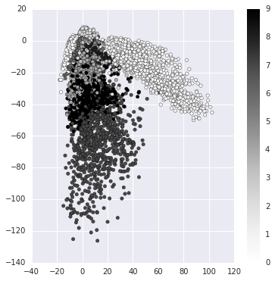
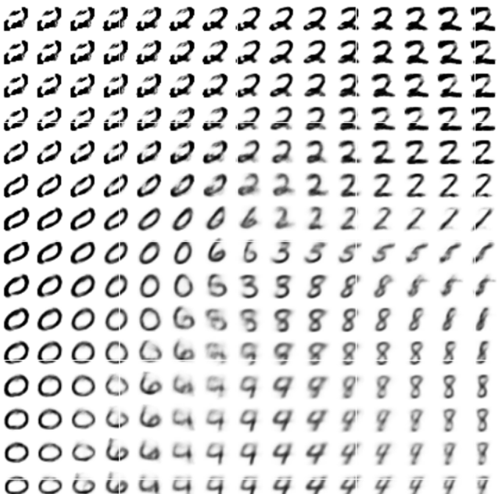
Next …..
NN
Decoder
code
Can we use decoder to generate something?
Notes:
SOM: http://alaric-research.blogspot.tw/2011/02/self-organizing-map.html

Slide 25
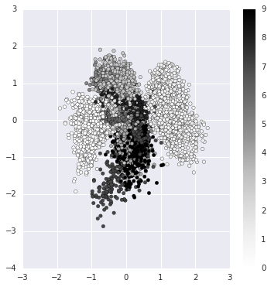
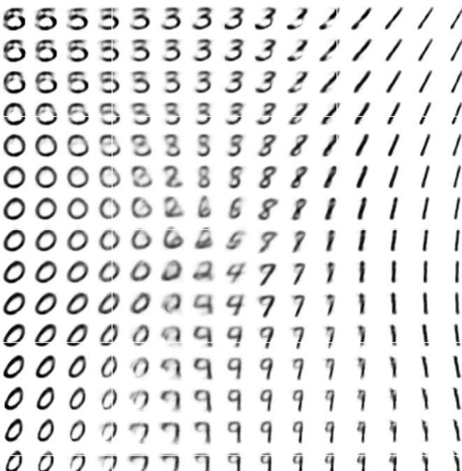
Next …..
NN
Decoder
code
Can we use decoder to generate something?
Notes:
SOM: http://alaric-research.blogspot.tw/2011/02/self-organizing-map.html

Slide 26
Appendix
Notes:
http://www.deeplearningbook.org/contents/autoencoders.html
Output
- idea of compressions
-audoencoder
- application
retrieval
image
-also as initilization

Slide 27
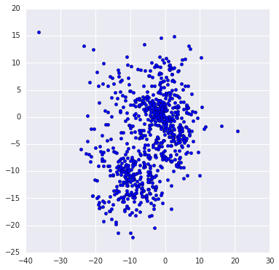
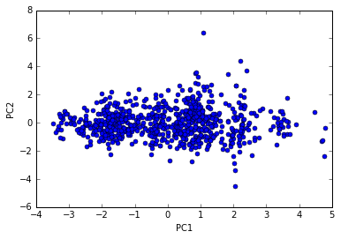
Pokémon
http://140.112.21.35:2880/~tlkagk/pokemon/pca.html
http://140.112.21.35:2880/~tlkagk/pokemon/auto.html
The code is modified from
http://jkunst.com/r/pokemon-visualize-em-all/

Slide 28
Add: Ladder Network
http://rinuboney.github.io/2016/01/19/ladder-network.html
https://mycourses.aalto.fi/pluginfile.php/146701/mod_resource/content/1/08%20semisup%20ladder.pdf
https://arxiv.org/abs/1507.02672

Slide 29
