Slide 1
Ensemble

Slide 2
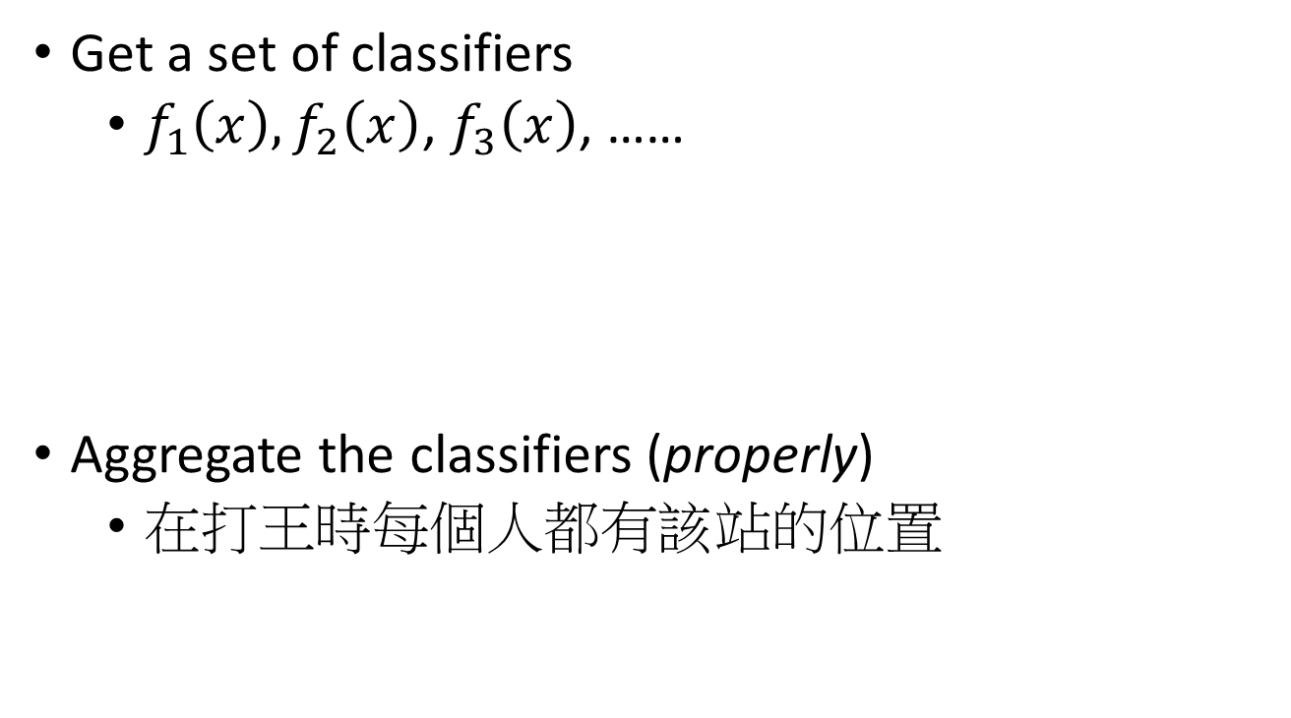
Framework of Ensemble
Get a set of classifiers
$f_{1}\left(x\right),f_{2}\left(x\right)$, $f_{3}\left(x\right)$, ……
Aggregate the classifiers (properly)
在打王時每個人都有該站的位置
坦
補
DD
They should be diverse.

Slide 3
Ensemble: Bagging

Slide 4
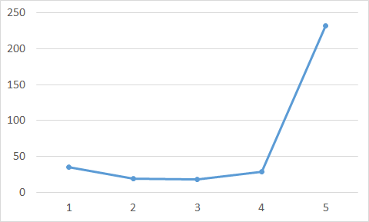

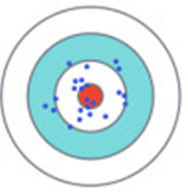
Review: Bias v.s. Variance
Error from bias
Error from variance
Error observed
Underfitting
Overfitting
Large Bias
Small Bias
Small Variance
Large Variance
Notes:
We have to know where is the error come from?

Slide 5
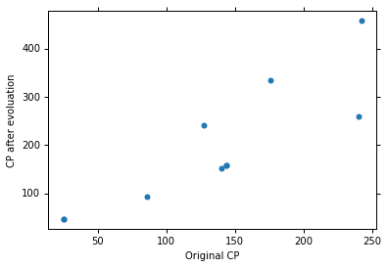
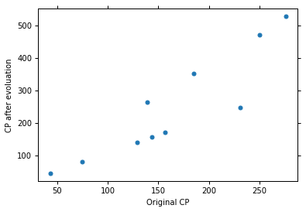
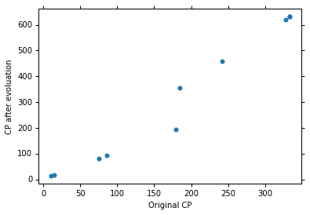




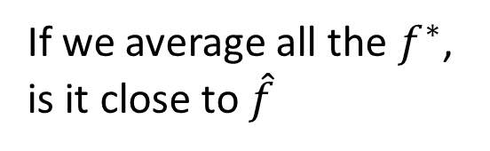
Universe 1
Universe 2
Universe 3
A complex model will have large variance.
If we average all the $f^{∗}$, is it close to $\hat{f}$
We can average complex models to reduce variance.
$$E\left[f^{∗}\right]=\hat{f}$$

Slide 6
Bagging
Sampling N’ examples with replacement
N training examples
(usually N=N’)
Set 1
Set 2
Set 3
Set 4
Function
1
Function
2
Function
3
Function
4

Slide 7
Bagging
This approach would be helpful when your model is complex, easy to overfit.
e.g. decision tree
Testing data x
Function
1
Function
2
Function
3
Function
4
y₁
y₂
y₃
y₄
Average/voting

Slide 8


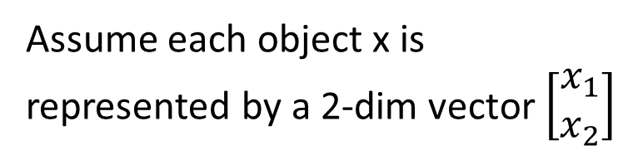



Decision Tree
Assume each object x is represented by a 2-dim vector $\left[\begin{aligned}x_{1} \\ x_{2}\end{aligned}\right]$
$$x_{2}$$
x₁ < 0.5
$$x_{2}=0.7$$
yes
no
$$x_{2}=0.3$$
x₂ < 0.3
x₂ < 0.7
$$x_{1}$$
$$x_{1}=0.5$$
yes
no
yes
no
The questions in training …..
Class 1
Class 2
Class 2
Class 1
number of branches,
Branching criteria,
termination criteria,
base hypothesis
Can have more complex questions

Slide 9
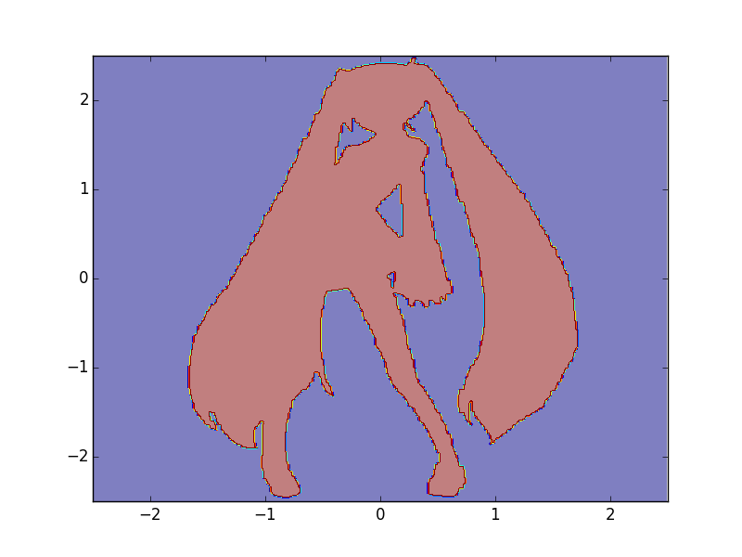

Experiment: Function of Miku
0
1
http://speech.ee.ntu.edu.tw/~tlkagk/courses/MLDS_2015_2/theano/miku
(1st column: x, 2nd column: y, 3rd column: output (1 or 0) )

Slide 10
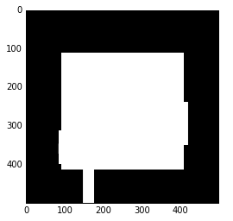
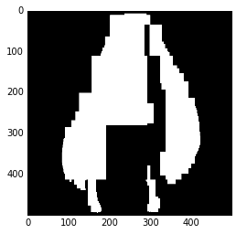
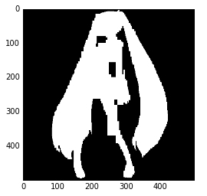

Experiment:
Function of Miku
Single
Decision
Tree
Depth = 5
Depth = 10
Depth = 15
Depth = 20

Slide 11
Random Forest
train | f₁ | f₂ | f₃ | f₄
x¹ | O | X | O | X
x² | O | X | X | O
x³ | X | O | O | X
x⁴ | X | O | X | O
Decision tree:
Easy to achieve 0% error rate on training data
If each training example has its own leaf ……
Random forest: Bagging of decision tree
Resampling training data is not sufficient
Randomly restrict the features/questions used in each split
Out-of-bag validation for bagging
Using RF = f₂+f₄ to test x¹
Using RF = f₂+f₃ to test x²
Using RF = f₁+f₄ to test x³
Using RF = f₁+f₃ to test x⁴
Out-of-bag (OOB) error
Good error estimation of testing set

Slide 12
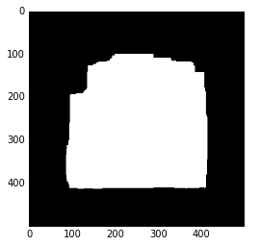
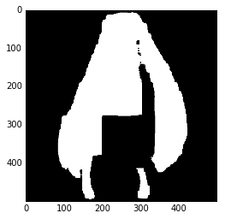


Experiment:
Function of Miku
Random
Forest
Depth = 5
Depth = 10
(100 trees)
Depth = 15
Depth = 20

Slide 13
Ensemble: Boosting
Improving Weak Classifiers

Slide 14
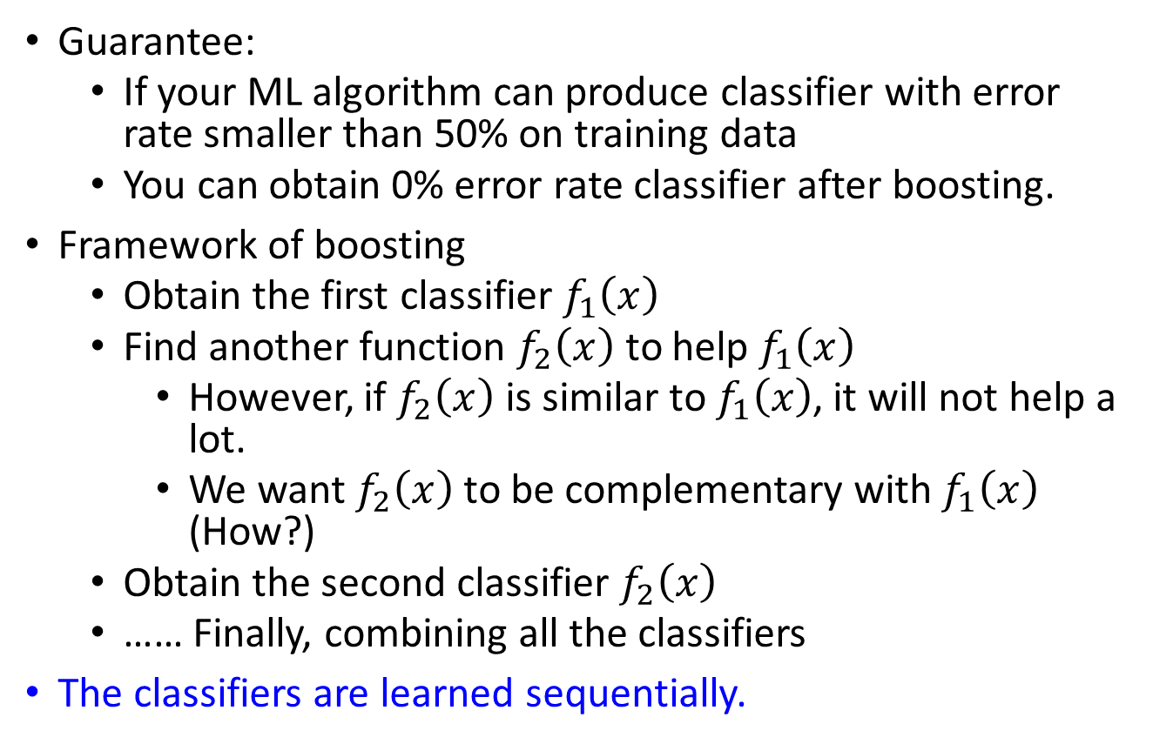
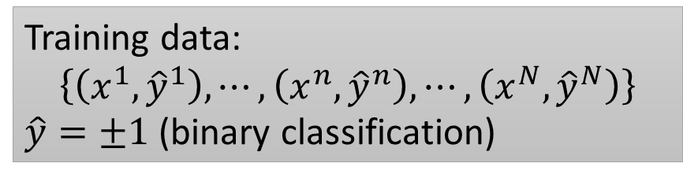
Boosting
Training data:
$$\left\{\left(x^{1},{\hat{y}}^{1}\right),⋯,\left(x^{n},{\hat{y}}^{n}\right),⋯,\left(x^{N},{\hat{y}}^{N}\right)\right\}$$
$\hat{y}=±1$ (binary classification)
Guarantee:
If your ML algorithm can produce classifier with error rate smaller than 50% on training data
You can obtain 0% error rate classifier after boosting.
Framework of boosting
Obtain the first classifier $f_{1}\left(x\right)$
Find another function $f_{2}\left(x\right)$ to help $f_{1}\left(x\right)$
However, if $f_{2}\left(x\right)$ is similar to $f_{1}\left(x\right)$, it will not help a lot.
We want $f_{2}\left(x\right)$ to be complementary with $f_{1}\left(x\right)$ (How?)
Obtain the second classifier $f_{2}\left(x\right)$
…… Finally, combining all the classifiers
The classifiers are learned sequentially.
Notes:
We use an ML algorithm to obtain a function $f_{1}\left(x\right)$
If $f_{1}\left(x\right)$ is weak, i.e. bad performance on training data, what can we do?

Slide 15





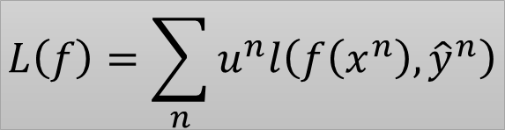

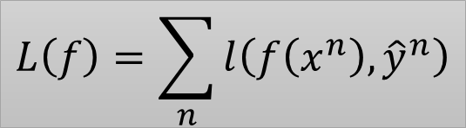
How to obtain different classifiers?
Training on different training data sets
How to have different training data sets
Re-sampling your training data to form a new set
Re-weighting your training data to form a new set
In real implementation, you only have to change the cost/objective function
$$L\left(f\right)=\sum_{n}{l\left(f\left(x^{n}\right),{\hat{y}}^{n}\right)}$$
$$\left(x^{1},{\hat{y}}^{1},u^{1}\right)$$
$$u^{1}=1$$
0.4
$$\left(x^{2},{\hat{y}}^{2},u^{2}\right)$$
$$u^{2}=1$$
2.1
$$L\left(f\right)=\sum_{n}{u^{n}l\left(f\left(x^{n}\right),{\hat{y}}^{n}\right)}$$
$$\left(x^{3},{\hat{y}}^{3},u^{3}\right)$$
$$u^{3}=1$$
0.7

Slide 16
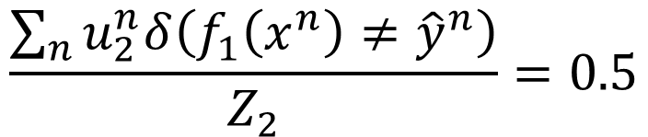

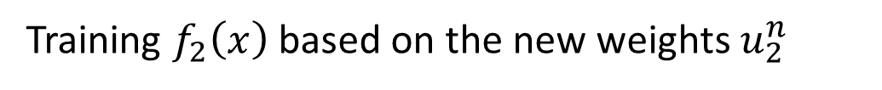

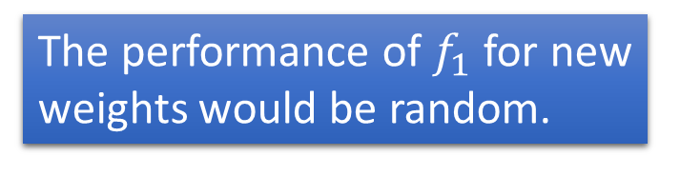
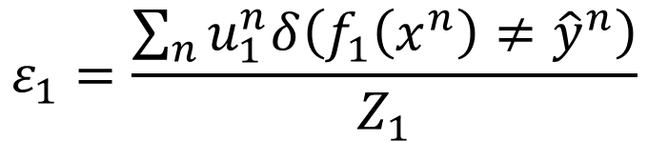

Idea of Adaboost
Idea: training $f_{2}\left(x\right)$ on the new training set that fails $f_{1}\left(x\right)$
How to find a new training set that fails $f_{1}\left(x\right)$?
$ε_{1}$: the error rate of $f_{1}\left(x\right)$ on its training data
$$ε_{1}=\frac{\sum_{n}{u_{1}^{n}δ\left(f_{1}\left(x^{n}\right)≠{\hat{y}}^{n}\right)}}{Z_{1}}$$
$$Z_{1}=\sum_{n}{u_{1}^{n}}$$
$$ε_{1}<0.5$$
Changing the example weights from $u_{1}^{n}$ to $u_{2}^{n}$ such that
$$\frac{\sum_{n}{u_{2}^{n}δ\left(f_{1}\left(x^{n}\right)≠{\hat{y}}^{n}\right)}}{Z_{2}}=0.5$$
The performance of $f_{1}$ for new weights would be random.
Training $f_{2}\left(x\right)$ based on the new weights $u_{2}^{n}$
Notes:
$$ε^{1}>0.5$$

Slide 17


















Re-weighting Training Data
Idea: training $f_{2}\left(x\right)$ on the new training set that fails $f_{1}\left(x\right)$
How to find a new training set that fails $f_{1}\left(x\right)$?
$$\left(x^{1},{\hat{y}}^{1},u^{1}\right)$$
$$u^{1}=1$$
$$u^{1}=1/\sqrt{3}$$
$$\left(x^{2},{\hat{y}}^{2},u^{2}\right)$$
$$u^{2}=1$$
$$u^{2}=\sqrt{3}$$
$$u^{3}=1$$
$$u^{3}=1/\sqrt{3}$$
$$\left(x^{3},{\hat{y}}^{3},u^{3}\right)$$
$$\left(x^{4},{\hat{y}}^{4},u^{4}\right)$$
$$u^{4}=1$$
$$u^{4}=1/\sqrt{3}$$
$ε_{2}<$0.5
$ε_{1}=$0.25
0.5
$$f_{1}\left(x\right)$$
$$f_{2}\left(x\right)$$

Slide 18
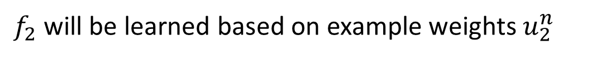
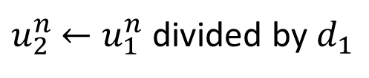
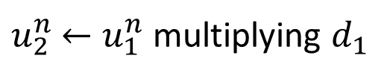
Re-weighting Training Data
Idea: training $f_{2}\left(x\right)$ on the new training set that fails $f_{1}\left(x\right)$
How to find a new training set that fails $f_{1}\left(x\right)$?
If $x^{n}$ misclassified by $f_{1}$ ($f_{1}\left(x^{n}\right)≠{\hat{y}}^{n}$)
$u_{2}^{n}$ $←u_{1}^{n}$ multiplying $d_{1}$
increase
If $x^{n}$ correctly classified by $f_{1}$ ($f_{1}\left(x^{n}\right)={\hat{y}}^{n}$)
$u_{2}^{n}$ $←u_{1}^{n}$ divided by $d_{1}$
decrease
$f_{2}$ will be learned based on example weights $u_{2}^{n}$
What is the value of $d_{1}$?
Notes:
Intuitive reason:

Slide 19

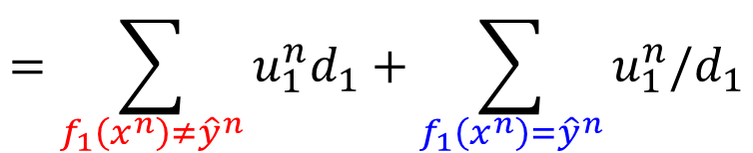
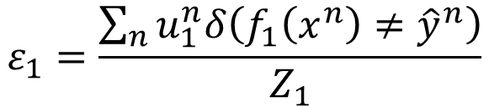
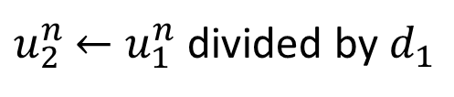
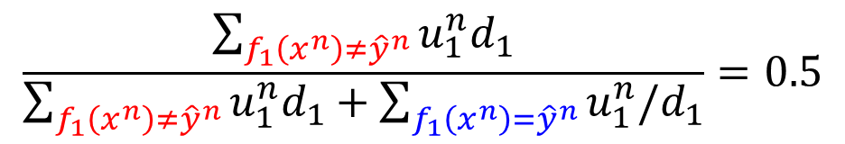

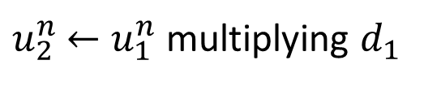

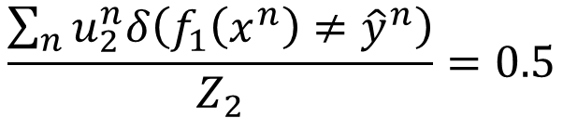

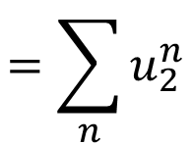
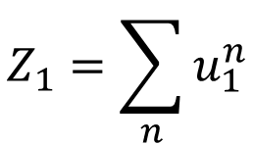
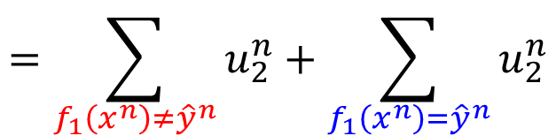
Re-weighting Training Data
$$ε_{1}=\frac{\sum_{n}{u_{1}^{n}δ\left(f_{1}\left(x^{n}\right)≠{\hat{y}}^{n}\right)}}{Z_{1}}$$
$$Z_{1}=\sum_{n}{u_{1}^{n}}$$
$$\frac{\sum_{n}{u_{2}^{n}δ\left(f_{1}\left(x^{n}\right)≠{\hat{y}}^{n}\right)}}{Z_{2}}=0.5$$
$$f_{1}\left(x^{n}\right)≠{\hat{y}}^{n}$$
$u_{2}^{n}$ $←u_{1}^{n}$ multiplying $d_{1}$
$$f_{1}\left(x^{n}\right)={\hat{y}}^{n}$$
$u_{2}^{n}$ $←u_{1}^{n}$ divided by $d_{1}$
$$=\sum_{f_{1}\left(x^{n}\right)≠{\hat{y}}^{n}}{u_{1}^{n}d_{1}}$$
$$=\sum_{f_{1}\left(x^{n}\right)≠{\hat{y}}^{n}}{u_{2}^{n}}+\sum_{f_{1}\left(x^{n}\right)={\hat{y}}^{n}}{u_{2}^{n}}$$
$$=\sum_{n}{u_{2}^{n}}$$
$$=\sum_{f_{1}\left(x^{n}\right)≠{\hat{y}}^{n}}{u_{1}^{n}d_{1}}+\sum_{f_{1}\left(x^{n}\right)={\hat{y}}^{n}}{u_{1}^{n}/d_{1}}$$
$$\frac{\sum_{f_{1}\left(x^{n}\right)≠{\hat{y}}^{n}}{u_{1}^{n}d_{1}}}{\sum_{f_{1}\left(x^{n}\right)≠{\hat{y}}^{n}}{u_{1}^{n}d_{1}}+\sum_{f_{1}\left(x^{n}\right)={\hat{y}}^{n}}{u_{1}^{n}/d_{1}}}=0.5$$
2

Slide 20
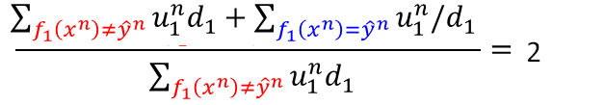





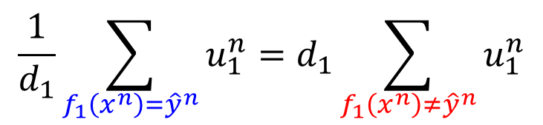
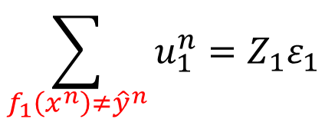
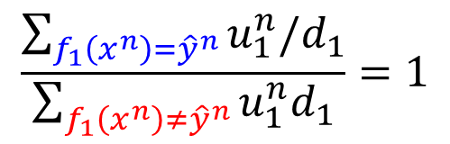
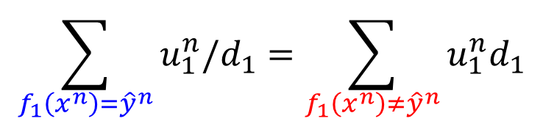
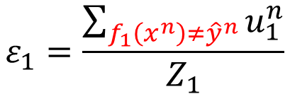
Re-weighting Training Data
$$ε_{1}=\frac{\sum_{n}{u_{1}^{n}δ\left(f_{1}\left(x^{n}\right)≠{\hat{y}}^{n}\right)}}{Z_{1}}$$
$$Z_{1}=\sum_{n}{u_{1}^{n}}$$
$$\frac{\sum_{n}{u_{2}^{n}δ\left(f_{1}\left(x^{n}\right)≠{\hat{y}}^{n}\right)}}{Z_{2}}=0.5$$
$$f_{1}\left(x^{n}\right)≠{\hat{y}}^{n}$$
$u_{2}^{n}$ $←u_{1}^{n}$ multiplying $d_{1}$
$$f_{1}\left(x^{n}\right)={\hat{y}}^{n}$$
$u_{2}^{n}$ $←u_{1}^{n}$ divided by $d_{1}$
$$\frac{\sum_{f_{1}\left(x^{n}\right)={\hat{y}}^{n}}{u_{1}^{n}/d_{1}}}{\sum_{f_{1}\left(x^{n}\right)≠{\hat{y}}^{n}}{u_{1}^{n}d_{1}}}=1$$
$$\sum_{f_{1}\left(x^{n}\right)={\hat{y}}^{n}}{u_{1}^{n}/d_{1}}=\sum_{f_{1}\left(x^{n}\right)≠{\hat{y}}^{n}}{u_{1}^{n}d_{1}}$$
$$\frac{1}{d_{1}}\sum_{f_{1}\left(x^{n}\right)={\hat{y}}^{n}}{u_{1}^{n}}=d_{1}\sum_{f_{1}\left(x^{n}\right)≠{\hat{y}}^{n}}{u_{1}^{n}}$$
$$ε_{1}=\frac{\sum_{f_{1}\left(x^{n}\right)≠{\hat{y}}^{n}}{u_{1}^{n}}}{Z_{1}}$$
$$Z_{1}\left(1−ε_{1}\right)$$
$$Z_{1}ε_{1}$$
$$Z_{1}\left(1−ε_{1}\right)/d_{1}=Z_{1}ε_{1}d_{1}$$
$$\sum_{f_{1}\left(x^{n}\right)≠{\hat{y}}^{n}}{u_{1}^{n}}=Z_{1}ε_{1}$$
$$d_{1}=\sqrt{{\left(1−ε_{1}\right)}/{ε_{1}}}$$
$$>1$$

Slide 21






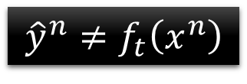
Algorithm for AdaBoost
Giving training data $\left\{\left(x^{1},{\hat{y}}^{1},u_{1}^{1} \right),⋯,\left(x^{n},{\hat{y}}^{n},u_{1}^{n}\right),⋯,\left(x^{N},{\hat{y}}^{N},u_{1}^{N}\right)\right\}$
$\hat{y}=±1$ (Binary classification), $u_{1}^{n}=1$ (equal weights)
For t = 1, …, T:
Training weak classifier $f_{t}\left(x\right)$ with weights $\left\{u_{t}^{1},⋯,u_{t}^{N}\right\}$
$ε_{t}$ is the error rate of $f_{t}\left(x\right)$ with weights $\left\{u_{t}^{1},⋯,u_{t}^{N}\right\}$
For n = 1, …, N:
If $x^{n}$ is misclassified by $f_{t}\left(x\right)$:
$u_{t+1}^{n}=u_{t}^{n}×d_{t}$
Else:
$u_{t+1}^{n}=u_{t}^{n}/d_{t}$
$${\hat{y}}^{n}≠f_{t}\left(x^{n}\right)$$
$$=u_{t}^{n}×exp\left(α_{t}\right)$$
$$d_{t}=\sqrt{{\left(1−ε_{t}\right)}/{ε_{t}}}$$
$$α_{t}=ln\sqrt{{\left(1−ε_{t}\right)}/{ε_{t}}}$$
$$=u_{t}^{n}×exp\left(−α_{t}\right)$$
$$u_{t+1}^{n}←u_{t}^{n}×exp\left(−{\hat{y}}^{n}f_{t}\left(x^{n}\right)α_{t}\right)$$
Notes:
(output is $±1$)

Slide 22

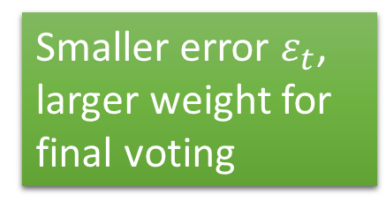
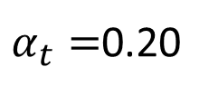
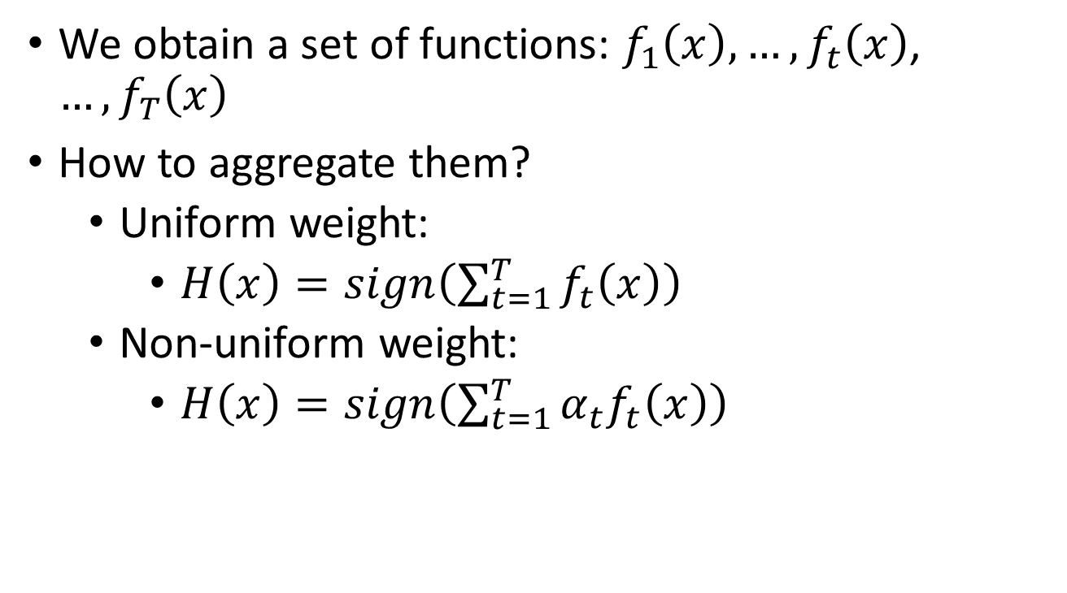
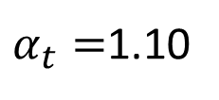



Algorithm for AdaBoost
We obtain a set of functions: $f_{1}\left(x\right),…,f_{t}\left(x\right)$, $…,f_{T}\left(x\right)$
How to aggregate them?
Uniform weight:
$H\left(x\right)=sign\left(\sum_{t=1}^{T}{f_{t}\left(x\right)}\right)$
Non-uniform weight:
$H\left(x\right)=sign\left(\sum_{t=1}^{T}{α_{t}f_{t}\left(x\right)}\right)$
Smaller error $ε_{t}$, larger weight for final voting
$$α_{t}=ln\sqrt{{\left(1−ε_{t}\right)}/{ε_{t}}}$$
$$ε_{t}=0.1$$
$$ε_{t}=0.4$$
$$u_{t+1}^{n}=u_{t}^{n}×exp\left(−{\hat{y}}^{n}f_{t}\left(x^{n}\right)α_{t}\right)$$
$α_{t}=$1.10
$α_{t}=$0.20

Slide 23




Toy Example
T=3, weak classifier = decision stump
t=1
+
+
1.0
1.53
1.0
+
0.65
+
-
-
1.0
1.53
+
+
1.0
1.53
+
-
-
-
1.0
0.65
+
-
1.0
1.0
0.65
0.65
$$ε_{1}=0.30$$
+
-
1.0
1.0
0.65
0.65
+
-
-
1.0
0.65
$$d_{1}=1.53$$
-
$$α_{1}=0.42$$
$$f_{1}\left(x\right)$$

Slide 24







Toy Example
T=3, weak classifier = decision stump
$f_{1}\left(x\right)$:
t=2
$$α_{1}=0.42$$
+
+
1.53
0.78
+
0.65
0.33
-
+
-
1.53
+
0.78
+
1.53
0.78
0.33
-
-
0.65
+
-
-
+
0.65
0.65
1.26
1.26
$$ε_{2}=0.21$$
0.65
0.33
0.33
0.65
-
+
-
+
-
0.65
$$d_{2}=1.94$$
1.26
-
$$α_{2}=0.66$$
$$f_{2}\left(x\right)$$

Slide 25












Toy Example
T=3, weak classifier = decision stump
$f_{1}\left(x\right)$:
$f_{2}\left(x\right)$:
t=3
$$α_{1}=0.42$$
$$α_{2}=0.66$$
+
0.78
$f_{3}\left(x\right)$:
0.33
+
-
0.78
+
0.78
$$α_{3}=0.95$$
$$f_{3}\left(x\right)$$
0.33
-
-
+
1.26
1.26
$$ε_{3}=0.13$$
0.33
0.33
$$d_{3}=2.59$$
+
-
1.26
-
$$α_{3}=0.95$$

Slide 26






Toy Example
Final Classifier: $H\left(x\right)=sign\left(\sum_{t=1}^{T}{α_{t}f_{t}\left(x\right)}\right)$
$$sign($$
$$0.42$$
+
$$0.66$$
+
$$0.95$$
$$)$$
+
+
-
+
+
-
-
+
-
-

Slide 27



Warning of Math
$$H\left(x\right)=sign\left(\sum_{t=1}^{T}{α_{t}f_{t}\left(x\right)}\right)$$
$$α_{t}=ln\sqrt{{\left(1−ε_{t}\right)}/{ε_{t}}}$$
As we have more and more $f_{t}$ (T increases), $H\left(x\right)$ achieves smaller and smaller error rate on training data.

Slide 28







Error Rate of Final Classifier
Final classifier: $H\left(x\right)=sign\left(\sum_{t=1}^{T}{α_{t}f_{t}\left(x\right)}\right)$
$α_{t}=ln\sqrt{{\left(1−ε_{t}\right)}/{ε_{t}}}$
$$g\left(x\right)$$
Training Data Error Rate
$$=\frac{1}{N}\sum_{n}{δ\left(H\left(x^{n}\right)≠{\hat{y}}^{n}\right)}$$
$$=\frac{1}{N}\sum_{n}{δ\left({\hat{y}}^{n}g\left(x^{n}\right) \text{<0}\right)}$$
$$≤\frac{1}{N}\sum_{n}{exp\left(−{\hat{y}}^{n}g\left(x^{n}\right) \right)}$$
$${\hat{y}}^{n}g\left(x^{n}\right)$$

Slide 29












$$g\left(x\right)=\sum_{t=1}^{T}{α_{t}f_{t}\left(x\right)}$$
Training Data Error Rate
$$≤\frac{1}{N}\sum_{n}{exp\left(−{\hat{y}}^{n}g\left(x^{n}\right) \right)}$$
$$=\frac{1}{N}Z_{T+1}$$
$$α_{t}=ln\sqrt{{\left(1−ε_{t}\right)}/{ε_{t}}}$$
$Z_{t}$: the summation of the weights of training data for training $f_{t}$
What is $Z_{T+1}=?$
$$Z_{T+1} =\sum_{n}{u_{T+1}^{n}}$$
$$u_{1}^{n}=1$$
$$u_{T+1}^{n}=\prod_{t=1}^{T}{exp\left(−{\hat{y}}^{n}f_{t}\left(x^{n}\right)α_{t}\right)}$$
$$u_{t+1}^{n}=u_{t}^{n}×exp\left(−{\hat{y}}^{n}f_{t}\left(x^{n}\right)α_{t}\right)$$
$$Z_{T+1} =\sum_{n}{\prod_{t=1}^{T}{exp\left(−{\hat{y}}^{n}f_{t}\left(x^{n}\right)α_{t}\right)}}$$
$$g\left(x\right)$$
$$=\sum_{n}{exp\left(−{\hat{y}}^{n}\sum_{t=1}^{T}{f_{t}\left(x^{n}\right)α_{t}}\right)}$$

Slide 30








$$g\left(x\right)=\sum_{t=1}^{T}{α_{t}f_{t}\left(x\right)}$$
Training Data Error Rate
$$≤\frac{1}{N}\sum_{n}{exp\left(−{\hat{y}}^{n}g\left(x^{n}\right) \right)}$$
$$=\frac{1}{N}Z_{T+1}$$
$$α_{t}=ln\sqrt{{\left(1−ε_{t}\right)}/{ε_{t}}}$$
$$Z_{1}=N$$
(equal weights)
$$Z_{t}=Z_{t−1}ε_{t}exp\left(α_{t}\right)+Z_{t−1}\left(1−ε_{t}\right)exp\left(−α_{t}\right)$$
Misclassified portion in $Z_{t−1}$
Correctly classified portion in $Z_{t−1}$
$$=Z_{t−1}ε_{t}\sqrt{{\left(1−ε_{t}\right)}/{ε_{t}}}+Z_{t−1}\left(1−ε_{t}\right)\sqrt{{ε_{t}}/{\left(1−ε_{t}\right)}}$$
$$=Z_{t−1}×2\sqrt{ε_{t}\left(1−ε_{t}\right)}$$
$$Z_{T+1}=N\prod_{t=1}^{T}{2\sqrt{ε_{t}\left(1−ε_{t}\right)}}$$
$$≤\prod_{t=1}^{T}{2\sqrt{ε_{t}\left(1−ε_{t}\right)}}$$
Training Data Error Rate
Smaller and smaller
<1

Slide 31
End of Warning
Notes:
So many good explaination !!!!!!!!!!!!!!!!!
http://stats.stackexchange.com/questions/2691/making-sense-of-principal-component-analysis-eigenvectors-eigenvalues

Slide 32




Even though the training error is 0, the testing error still decreases?
$$=sign\left(\sum_{t=1}^{T}{α_{t}f_{t}\left(x\right)}\right)$$
$$H\left(x\right)$$
$$g\left(x\right)$$
Margin = $\hat{y}g\left(x\right)$

Slide 33








Large Margin?
$$=sign\left(\sum_{t=1}^{T}{α_{t}f_{t}\left(x\right)}\right)$$
$$H\left(x\right)$$
$$g\left(x\right)$$
Training Data Error Rate =
$$=\frac{1}{N}\sum_{n}{δ\left(H\left(x^{n}\right)≠{\hat{y}}^{n}\right)}$$
Adaboost
$$≤\frac{1}{N}\sum_{n}{exp\left(−{\hat{y}}^{n}g\left(x^{n}\right) \right)}$$
Logistic regression
$$=\prod_{t=1}^{T}{2\sqrt{ε_{t}\left(1−ε_{t}\right)}}$$
SVM
Getting smaller and smaller as T increase
$${\hat{y}}^{n}g\left(x^{n}\right)$$

Slide 34




Experiment:
Function of Miku
Adaboost
+Decision Tree
T = 10
T = 20
(depth = 5)
T = 50
T = 100

Slide 35
To learn more …
Introduction of Adaboost:
Freund; Schapire (1999). "A Short Introduction to Boosting“
Multiclass/Regression
Y. Freund, R. Schapire, “A Decision-Theoretic Generalization of on-Line Learning and an Application to Boosting”, 1995.
Robert E. Schapire and Yoram Singer. Improved boosting algorithms using confidence-rated predictions. In Proceedings of the Eleventh Annual Conference on Computational Learning Theory, pages 80–91, 1998.
Gentle Boost
Schapire, Robert; Singer, Yoram (1999). "Improved Boosting Algorithms Using Confidence-rated Predictions".

Slide 36




General Formulation of Boosting
Initial function $g_{0}\left(x\right)=0$
For t = 1 to T:
Find a function $f_{t}\left(x\right)$ and $α_{t}$ to improve $g_{t−1}\left(x\right)$
$g_{t−1}\left(x\right)=\sum_{i=1}^{t−1}{α_{i}f_{i}\left(x\right)}$
$g_{t}\left(x\right)=g_{t−1}\left(x\right)+α_{t}f_{t}\left(x\right)$
Output: $H\left(x\right)=sign\left(g_{T}\left(x\right)\right)=sign\left(\sum_{t=1}^{T}{α_{t}f_{t}\left(x\right)}\right)$
What is the learning target of $g\left(x\right)$?
$$L\left(g\right)=\sum_{n}{l\left({\hat{y}}^{n},g\left(x^{n}\right)\right)}$$
$$=\sum_{n}{exp\left(−{\hat{y}}^{n}g\left(x^{n}\right) \right)}$$
Minimize

Slide 37





Gradient Boosting
Find $g\left(x\right)$, minimize $L\left(g\right)=\sum_{n}{exp\left(−{\hat{y}}^{n}g\left(x^{n}\right) \right)}$
If we already have $g\left(x\right)=g_{t−1}\left(x\right)$, how to update $g\left(x\right)$?
Gradient Descent:
$$g_{t}\left(x\right)=g_{t−1}\left(x\right)−η\frac{∂L\left(g\right)}{∂g\left(x\right)}$$
$$g\left(x\right)=g_{t−1}\left(x\right)$$
$$−\sum_{n}{exp\left(−{\hat{y}}^{n}g_{t−1}\left(x^{n}\right) \right)\left(−{\hat{y}}^{n}\right)}$$
Same direction
$$g_{t}\left(x\right)=g_{t−1}\left(x\right)+α_{t}f_{t}\left(x\right)$$

Slide 38








Gradient Boosting
$$\sum_{n}{exp\left(−{\hat{y}}^{n}g_{t}\left(x^{n}\right) \right)\left({\hat{y}}^{n}\right)}$$
$$f_{t}\left(x\right)$$
Same direction
We want to find $f_{t}\left(x\right)$ maximizing
Minimize Error
$$\sum_{n}{exp\left(−{\hat{y}}^{n}g_{t−1}\left(x^{n}\right) \right)\left({\hat{y}}^{n}\right)f_{t}\left(x^{n}\right)}$$
example weight $u_{t}^{n}$
Same sign
$$=exp\left(−{\hat{y}}^{n}\sum_{i=1}^{t−1}{α_{i}}f_{i}\left(x^{n}\right)\right)$$
$$u_{t}^{n}=exp\left(−{\hat{y}}^{n}g_{t−1}\left(x^{n}\right)\right)$$
$$=\prod_{i=1}^{t−1}{exp\left(−{\hat{y}}^{n}α_{i}f_{i}\left(x^{n}\right)\right)}$$
Exactly the weights we obtain in Adaboost

Slide 39












Gradient Boosting
Find $g\left(x\right)$, minimize $L\left(g\right)=\sum_{n}{exp\left(−{\hat{y}}^{n}g\left(x^{n}\right) \right)}$
$α_{t}$ is something like learning rate
$$g_{t}\left(x\right)=g_{t−1}\left(x\right)+α_{t}f_{t}\left(x\right)$$
Find $α_{t}$minimzing $L\left(g_{t+1}\right)$
$$L\left(g\right)=\sum_{n}{exp\left(−{\hat{y}}^{n}\left(g_{t−1}\left(x\right)+α_{t}f_{t}\left(x\right)\right) \right)}$$
Find $α_{t}$ such that
$$=\sum_{n}{exp\left(−{\hat{y}}^{n}g_{t−1}\left(x\right)\right)exp\left(−{\hat{y}}^{n}α_{t}f_{t}\left(x\right)\right)}$$
$$\frac{∂L\left(g\right)}{∂α_{t}}=0$$
$$=\sum_{{\hat{y}}^{n}≠f_{t}\left(x\right)}{exp\left(−{\hat{y}}^{n}g_{t−1}\left(x^{n}\right)\right)exp\left(α_{t}\right)}$$
$$α_{t}=$$
$$ln\sqrt{{\left(1−ε_{t}\right)}/{ε_{t}}}$$
$$+\sum_{{\hat{y}}^{n}=f_{t}\left(x\right)}{exp\left(−{\hat{y}}^{n}g_{t−1}\left(x^{n}\right)\right)exp\left(−α_{t}\right)}$$
Adaboost!

Slide 40
Cool Demo
http://arogozhnikov.github.io/2016/07/05/gradient_boosting_playground.html
Notes:
http://scikit-learn.org/stable/auto_examples/ensemble/plot_gradient_boosting_regularization.html#sphx-glr-auto-examples-ensemble-plot-gradient-boosting-regularization-py

Slide 41
Ensemble: Stacking

Slide 42
Voting
小明’s system
y
老王’s system
y
Majority
Vote
x
老李’s system
y
小毛’s system
y
Notes:
You can ask machine to output confidence

Slide 43
Stacking
Training
Data
Training
Data
Val
Data
Testing
Data
小明’s system
y
老王’s system
y
x
Final
Classifier
老李’s system
y
小毛’s system
y
as new feature

