Slide 1
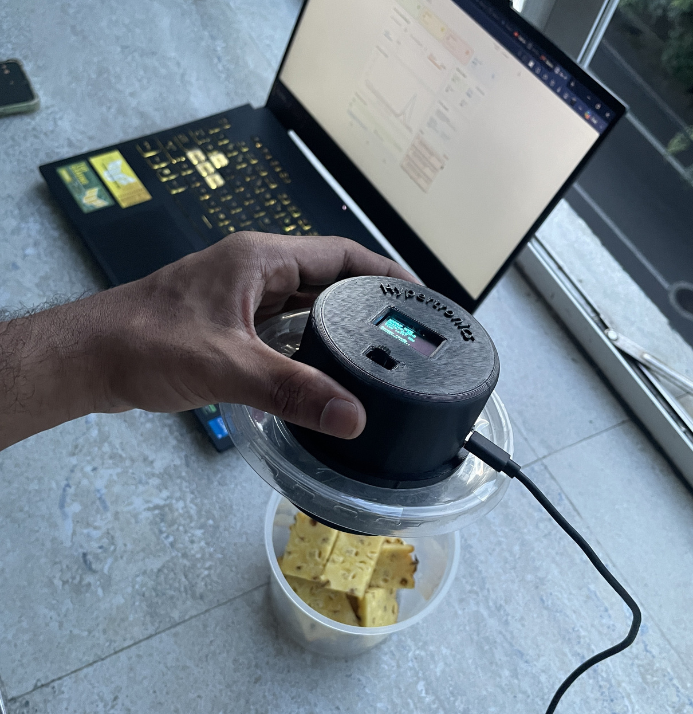
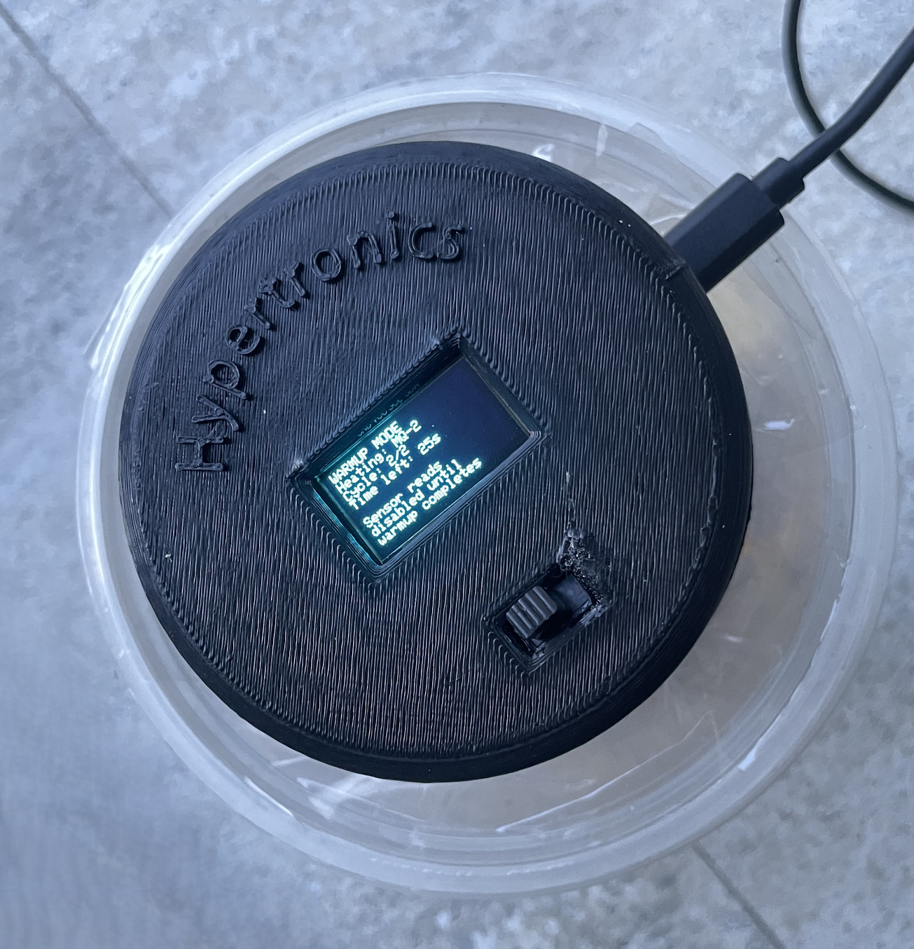
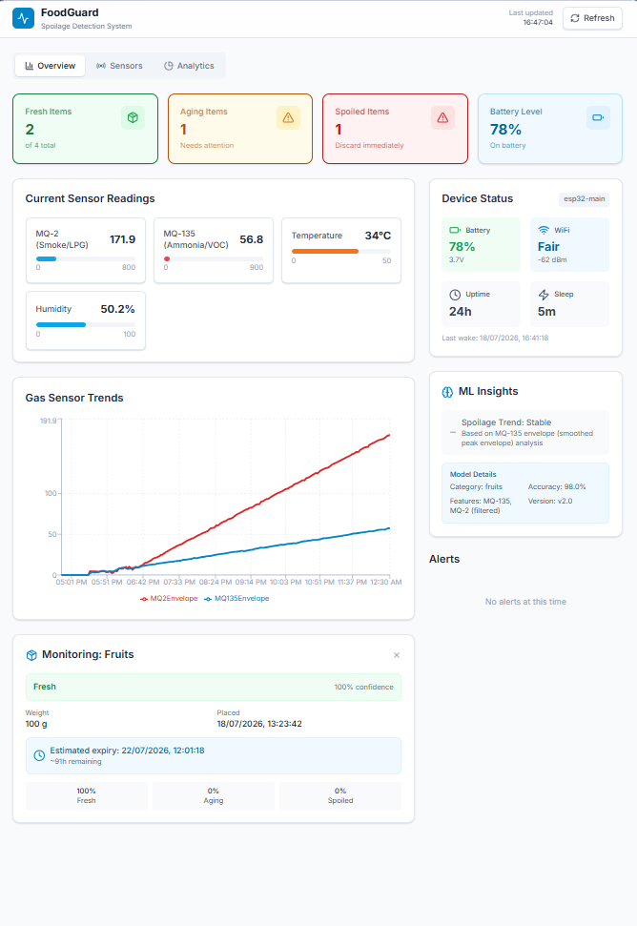




Introducing
FOODGUARD
In food retail and catering, spoilage often goes undetected until it's too late, especially when relying on temperature alone, leading to health risks, waste, and lost trust.
We introduce FoodGuard — a non-invasive device that senses spoilage gases in real time, uses machine learning to forecast expiry, and triggers instant alerts both on-device and on a live dashboard.
Capabilities of our device:
ML based
Live Dashboard
Real-time visual indication
Temperature Monitoring
Gas Detection
A project by Team Hypertronics
LKR 8500 Only
For more information contact us!
hypertronics619@gmail.com

