Slide 1
World Cup 2022 Prediction
Khalil Daoud

Slide 2
Motivation
World Cup 2022 is happening currently in Qatar
The World Cup brings fans from all over the world together.
With the group stage over. How close can we predict the teams that would make it to the bracket stage.

Slide 3
The Approach:
Prepare the dataset of the upcoming games.
Try different Machine Learning Algorithm to find the model that fits our data best
Apply the most Accurate model to the group stage of the World Cup.
Find the best performing teams and rank them

Slide 4
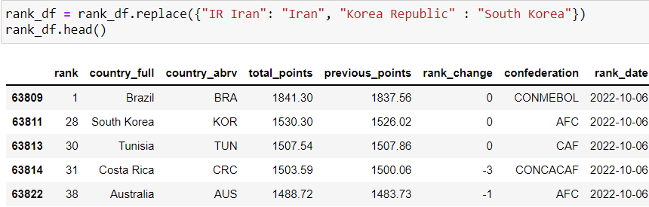
The Datasets
FIFA World Rankings

Slide 5
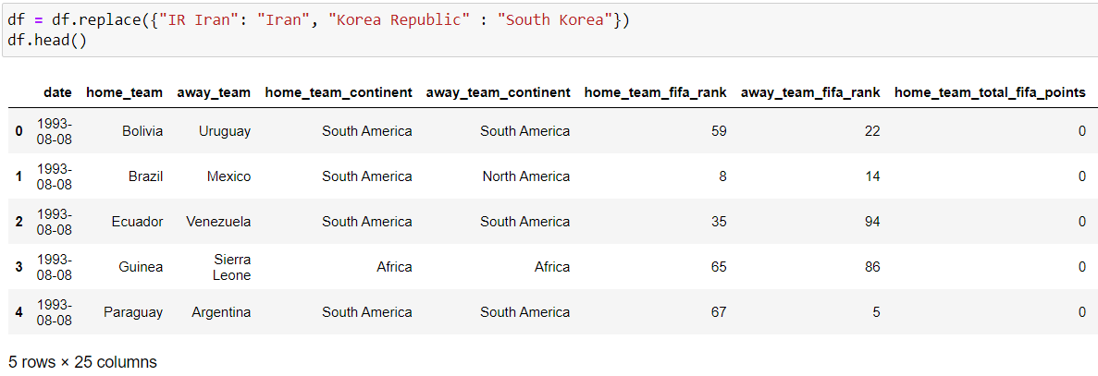
The Datasets
International Matches from 1993 to 2022

Slide 6
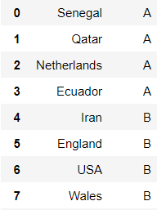
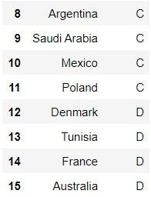
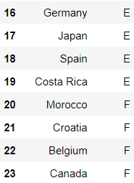
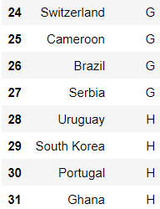
The Datasets
Qatar 2022 Groups

Slide 7
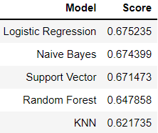
Models Comparison
Logistic Regression Perform Best
Followed Closely by Naïve Bayes and SVM
Random Forest and KNN perform worst
Logistic Regression is the Chosen Model to make the Prediction
Logistic Regression Perform Best
Followed Closely by Naïve Bayes and SVM
Random Forest and KNN perform worst
Logistic Regression is the Chosen Model to make the Prediction

Slide 8
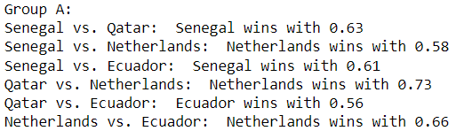
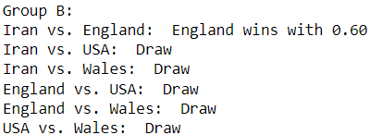
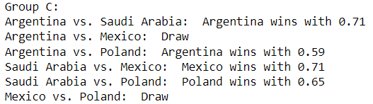
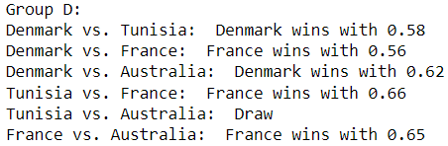
Group Stage Results

Slide 9
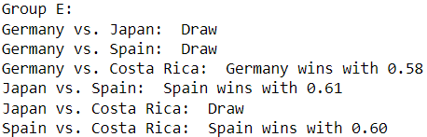
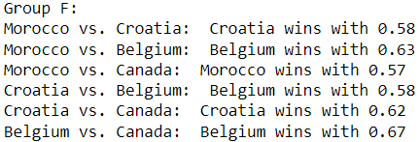
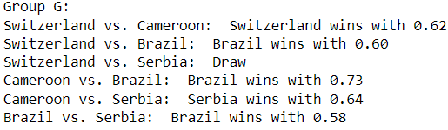
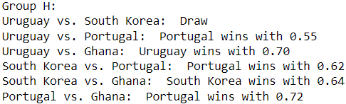
Group Stage Results

Slide 10
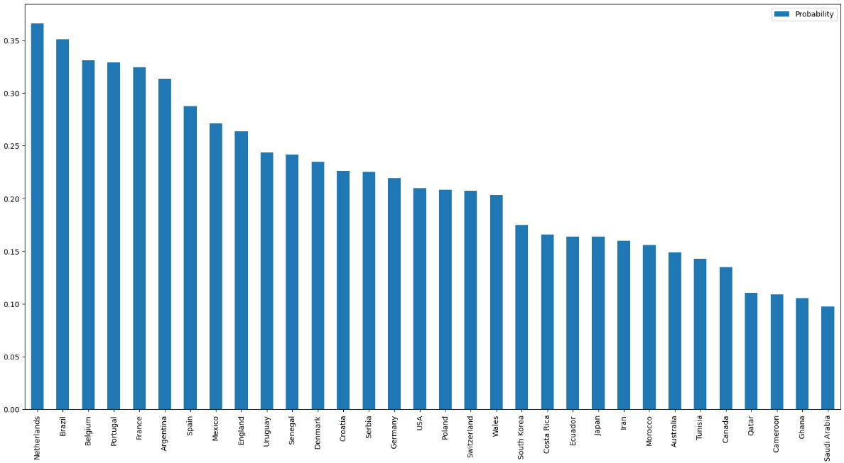
Overall Odds of Winning by Team

Slide 11

TOP 1
Netherlands 0.3658870200773294

Slide 12
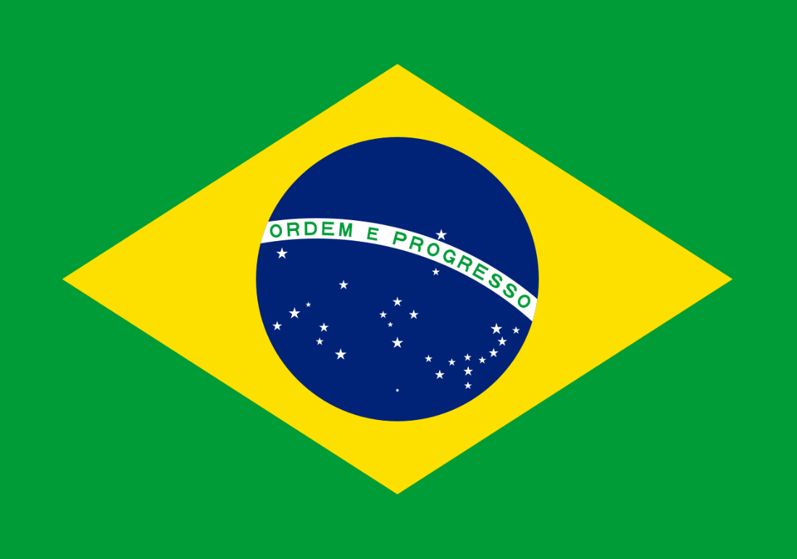

TOP 3
Brazil 0.35106224026524196
Belgium 0.33083368024216436

Slide 13
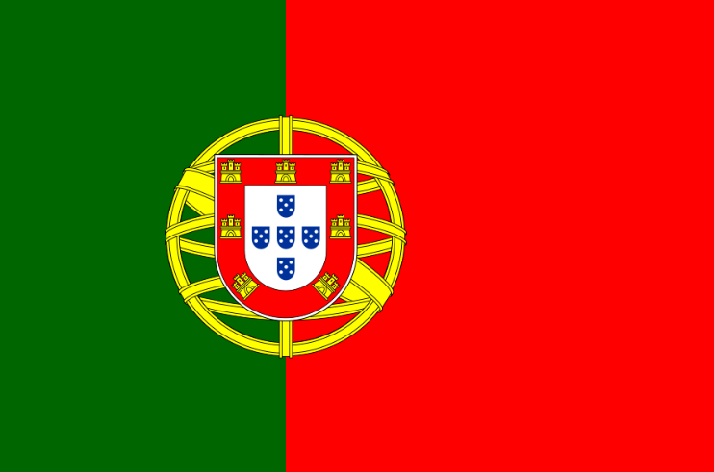


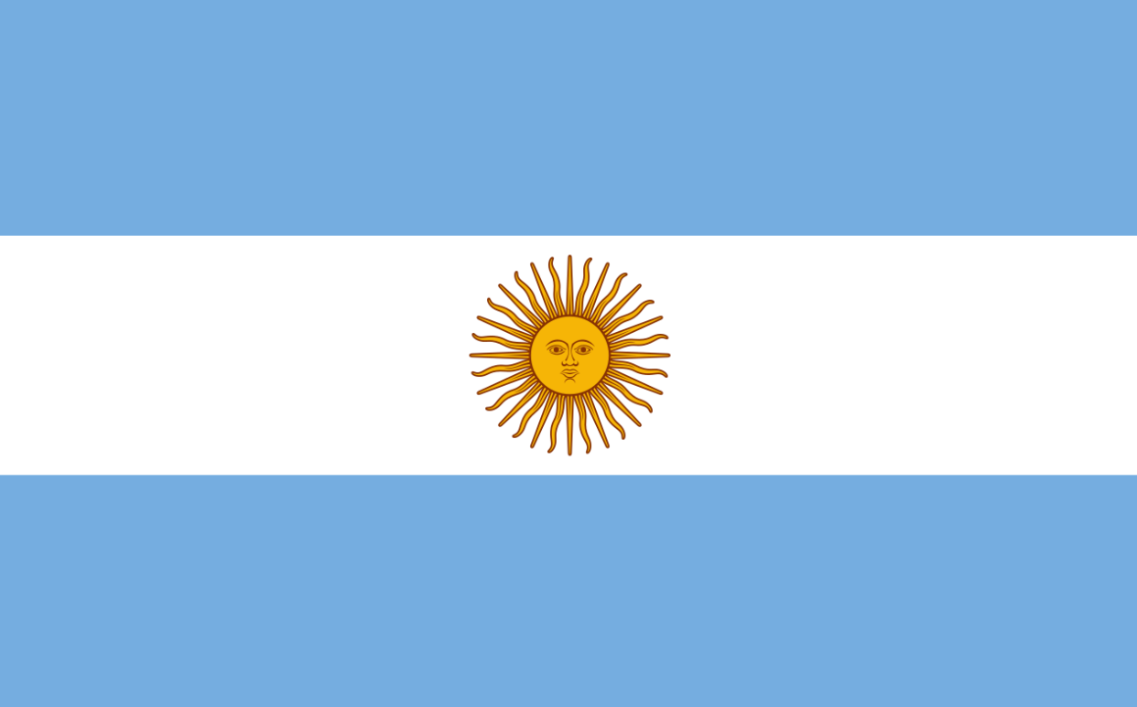
Runners up
Portugal 0.3287946913120302
France 0.3243524729218949
Spain 0.28733509137308366
Argentina 0.31322363437226963

Slide 14
Comparing Predictions to Reality
Predicted top 16
Actual top 16
Netherlands
Brazil
Belgium
Portugal
France
Argentina
Spain
Mexico
England
Uruguay
Senegal
Denmark
Croatia
Serbia
Germany
USA
Netherlands
Brazil
Morocco
Portugal
France
Argentina
Spain
Poland
England
South Korea
Senegal
Australia
Croatia
Switzerland
Spain
USA

Slide 15
Limitations and improvements
Current model predicts the group stage games and make a World Cup winner prediction based on that. Its possible to create a tournament bracket and predict the winner of 1 vs 1 games.
Current Dataset doesn’t consider player performances and their physical status (injured, recovered, …)
We can update the model as games finish which will improve the prediction of future games.
Test different Hyperparameters

Slide 16
Thank You!

Slide 17
References
https://www.kaggle.com/code/isaaclangit/fifa-world-cup
https://www.kaggle.com/code/scottsuk0306/fifa-world-cup-2022-group-stage-prediction/
https://www.fifa.com/fifa-world-ranking

