Slide 1

Introducing Walmart ++
Kinjal Das

Slide 2
Agenda
Introduction
Case Structure
Customer Pain points
Problem Statement
Business Case
Customer Personas
Customer Journey
Operational workflow
Consolidated Feature List - MVP
Product Success Metrics and Monitoring
Subsequent Iterations
Revenue Projections

Slide 3
Case Structure
Customer Facing workflows
Customer Facing Feature List
Customer Pain Points
Problem Statement
Business case
Feature Priority and MVP
Operational Workflows
Operational Feature List
Backlog features

Slide 4

Customer Pain Points
Currently on Walmart+ plan, a customer must wait for the next day delivery or 2-day delivery.
For any emergency purchases, the customer must visit Walmart store. There might be scenarios such as below when the going to Walmart store becomes difficult:
Travel and packing
Friends and Family coming over
No available modes of transportation
Snowfall and heavy rain
Emergency purchases can be below:
Pharmacy and medicines
Groceries
Electronics and auxiliary electronics items

Slide 5
Problem Statement
Walmart Customers must wait for at least 2 days to get the delivery for their items, forcing the Walmart customers to utilize the competitors shopping platform
If the Walmart Customers use the competitors shopping platform, there is higher rate of the customer churn and decrease in the Customer lifetime value (CLV) by 25%¹
The stickiness of the shopping platform is on an average of 23% ², meaning there is 23% chances of the users navigating to another platform because of lack of same day delivery
Positive Impact of cross services adoption because of Same Day Delivery services (Walmart++) on Walmart+ and/or Pick-Up services
Positive impact on scale of operations and further boost of “Every Day Low Price” strategy

Slide 6
Business Case
Executive Summary :
Walmart Mobile App and Walmart.com will offer a same day delivery service (Walmart++) for Walmart Mobile app users for no order minimum. Walmart.com users will have to pay a delivery charge based on the timeslot selection. The product category that is eligible for the Walmart++ services will be determined by product category configuration and inventory analytics
Financials:
Walmart++ projected revenues is $1,656MM¹ in the first year and total of $5,781 MM of revenue in the first 3 years.
Operations
Leveraging the existing customer ordering experience and leveraging existing Walmart operations capabilities, the new Walmart++ service can be rolled out in selected cities in phase 1 and in subsequent phases to other cities

Slide 7
Customer Personas
Customer 1 (Personal) : Customer 1 has invited family and friends for Thanksgiving and suddenly realized that Customer 1 doesn’t have cranberry for his or her Mom’s favorite Cranberry sauce. Customer 1 is now panicking and as Customer 1 must prepare thanksgiving dinner for his or her friends and family, Customer 1 doesn’t have time to drive to Walmart store
Constraints : Time, Delivery, Fresh
Decision points : Quick or fast delivery, Not price sensitive
Motivation: Not willing to make minimum purchase, Doesn’t mind high delivery fees
Customer 2 (Professional) : Customer 2 is visiting San Francisco for a conference and realized that Customer 2 forgot laptop charging cable. Customer 2 has all day conference, and Customer 2 would look unprofessional if Customer 2 had to borrow charging cable from other conference participants. Customer 2 also must attend conference networking event now as he is speaking in that event, so Customer 2 doesn’t have any time to drive or transportation to Walmart Store in a new city
Constraints : Time, Delivery
Decision points : Fast delivery, Not price sensitive
Motivation: Not willing to make minimum purchase, Doesn’t mind high delivery fees

Slide 8
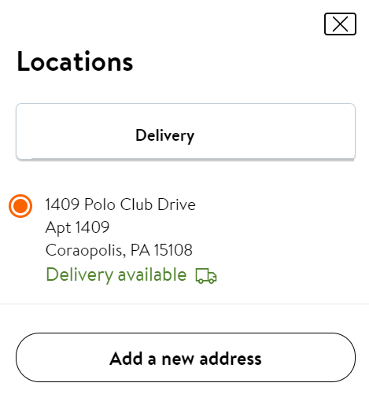
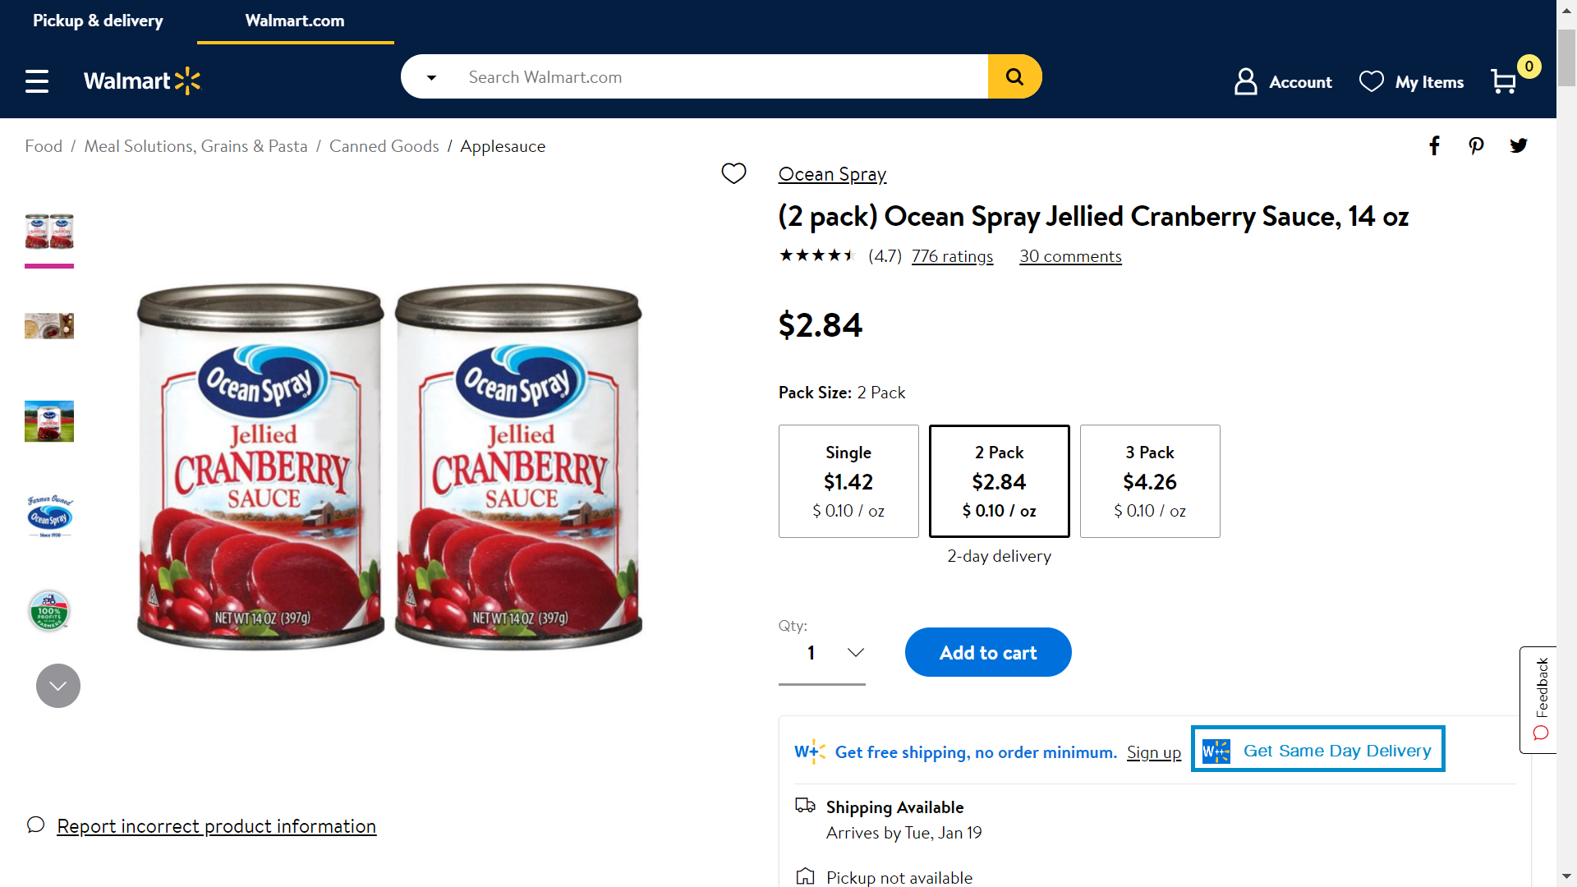
Customer Journey (Contd.)
Select Location/Address (One time User activity)
User searches Items and add to cart. The Items can be shown as W++ eligible

Slide 9
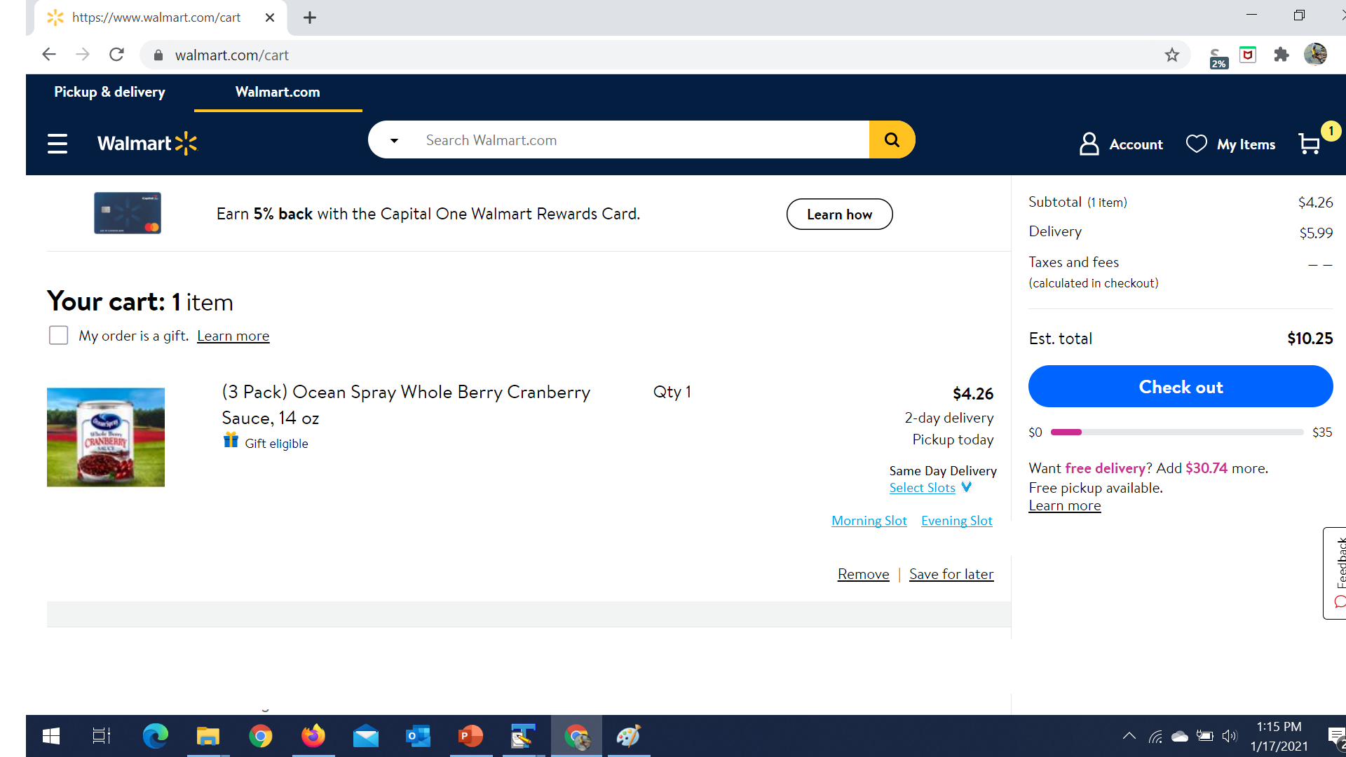
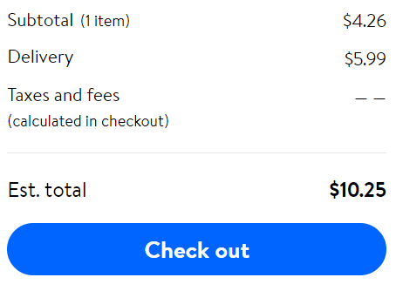
Customer Journey
User searches selects available slots based on the current time
Based on slots selection, total amount is adjusted, and User checks out

Slide 10
Operational Workflow
Assumptions:
Doordash is our last mile delivery partner
Doordash associates are going to collect packages from Walmart Store or warehouse and deliver to the Walmart customer
Only one Walmart store will be used to fulfill the items
Not special category items
System accepts the Orders placed by Customer and prioritizes the fulfilment by different factors
Time slots selection
Pharmacy and medicines
Perishable items
Prepare a consolidated package for Last mile Delivery partner
Listing down Categories and Products that W++ eligible
Medicines collections and packaging
Perishable items and Cold packaging

Slide 11
Consolidated Feature List - MVP (Contd.)
Categories and Products availability for Walmart++ service
Ability to select categories as Walmart++ category eligible and by Region
Based on Analytics (Inventory and Daily store consumption), the products within the categories can be available for Walmart++ at a particular location
Customer Centric Features
Ability for Customer to select address of Delivery and saved at User profile (Existing functionality)
Based on the location, shortlisting of Walmart store within 10-15 miles and list of products eligible for Walmart++ fulfillment (Maximum of 10-15 miles ¹ ²)
Ability to choose the Delivery slots – (Delivery Fee is added based on the selection of slots)

Slide 12
Consolidated Feature List - MVP
Fulfilment Features
Ability to Prioritize customer order based on the selected slots
Ability to categorize and route the fulfilment to different sections based on
Pharmacy (instructions for dosage and special package – UV protection etc)
Perishable Items (Cold packages and packages of fragile items)
Other Categories
Ability to track and update by Walmart associate of the fulfilment of the order (Walmart Associate App – Existing App)
Ability to consolidate the order(s) – Single Customer Order
Ability to place the request to the Last Mile Delivery partner about 15 mins before Pick up
Ability to provide the SMS or email update to the customer
Non - Functional Features
Storage of Customer Data – Security and Encryption
Scaling of Backend services – with more customers opting for Walmart++ services

Slide 13
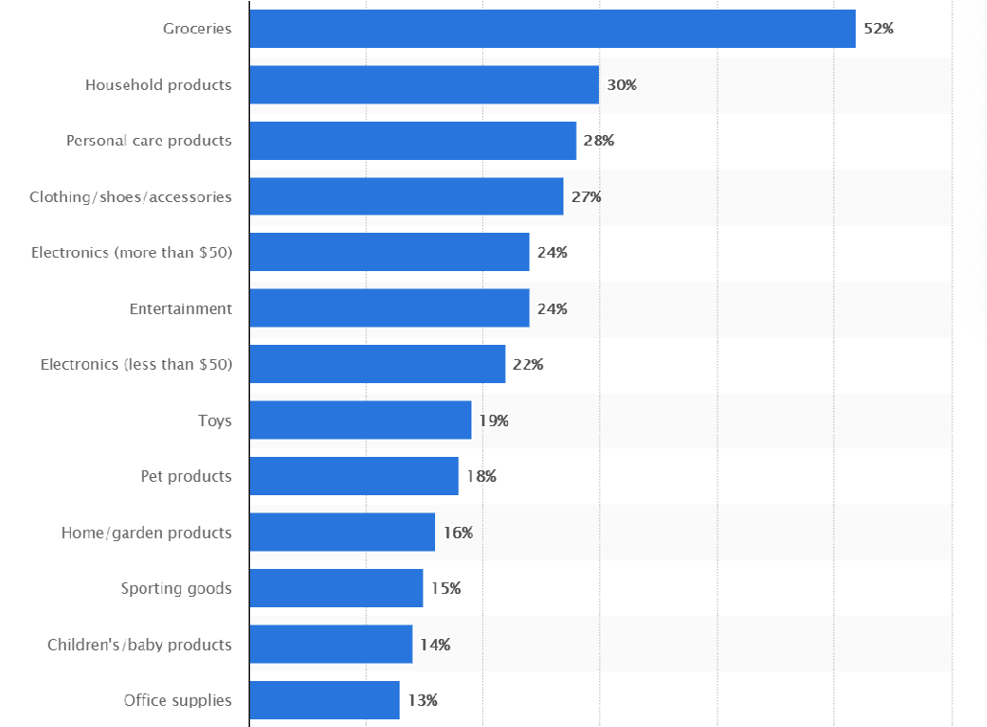
Walmart++ Categories
Below can be categories for same day delivery ¹ - Also include Pharmacy services

Slide 14
Walmart++ Success Metrics and Monitoring
1 Cart Abandonment rate
2 Number of existing Walmart customer utilizing the Walmart++ service
3 Number of new users using the Walmart++ services
4 Number of new users using other services – Walmart+ and Pick-Up services once they used Walmart++ services
5 Average purchases by user on Walmart++ compared with Walmart+ and Walmart.com
6 Daily Active users (DAU) and Monthly Active users (MAU)

Slide 15
Feature Sets for Next iterations (Contd.)
Products availability for Walmart++ service
ML to predict Product Categories to squeeze as much products can be made available to the customers
Customer Centric Features
Substitution configurations
If a customer is frequently ordering Walmart++ services, ability to recognize and provide a recommendation for the customer to order that product ahead of time
Saves money for the customer
Also, the supply chain can be more optimized
If a product is not Walmart++ category, and many customers are requesting for those products, that can be a feedback to Products availability for Walmart++ service
Real time chat with the Walmart associate during item fulfilment for Product substitution
Walmart ++

Slide 16
Feature Sets for Next iterations
Customer Centric Features (Contd.)
Ability to set Delivery prices by region (Promotional Prices) and by delivery slots
Fulfilment Features
Ability to group multiple customer orders so that Walmart Associate may be able to fulfil those orders together – the operations cost saving can be passed on the customer for later time slot
Non-Functional Features
Reporting and dashboard for executives
Data storage and integration with other services
A/B testing capability (Existing functionality)
Walmart ++

Slide 17
Revenue Projections
Year | 2020 | 2021 | 2022 | 2023 | 2024 | 2025
Number of Walmart Users (MM) | 138 | 146.28 | 155.06 | 164.36 | 174.22 | 184.68
Projected Number of Walmart++ users (MM) | 1.38 | 1.54 | 1.63 | 1.73 | 1.83 | 1.94
Average Yearly spends by each user | $1,200 | $ 1,267.20 | $ 1,338.16 | $ 1,413.10 | $ 1,492.23 | $ 1,575.80
Revenue from Walmart++ (in MM) | $1,656 | $ 1,946.34 | $ 2,178.66 | $ 2,438.70 | $ 2,729.79 | $ 3,055.61
Assumptions:
Considering the initial conversion of 1% of the Walmart.com users (Industry average is 4.78%)
Considering growth of Walmart.com users 6% (Average is 5.6% on shopping platform)
Considering growth of Walmart++ users by 5% (Conservative compared with Walmart.com users)
Considering Average Customer purchase is $1,200 (Compared with $1,400 on a competitive platform)
Not considering impact on focused marketing for Walmart++ services
Walmart ++

Slide 18
Thank You !!
Walmart ++

Slide 19
Data Sources
https://progressivegrocer.com/why-amazon-primed-record-breaking-2020
https://pathtopurchaseiq.com/amazon-still-primed-growth
https://www.today.com/news/walmart-announces-new-2-hour-delivery-service-t180490
https://pattern.com/blog/amazon-prime-a-timeline-from-2005-to-2020/
https://www.businessinsider.com/amazon-prime-now-reaches-25-of-customers-2016-3
https://www.bigcommerce.com/blog/amazon-statistics/#getting-the-prime-treatment
https://www.bigcommerce.com/articles/ecommerce/#the-impact-of-ecommerce
https://www.barrons.com/articles/amazon-sales-estimates-online-shopping-covid-19-lockdowns-landemic-51594153854
https://www.digitalcommerce360.com/2020/08/18/walmarts-online-sales-nearly-double-in-q2-as-pandemic-continues/#:~:text=For%20the%20second%20quarter%20of,7.5%25%20to%20reach%20%24140.20%20billion
https://www.similarweb.com/corp/blog/ecommerce-benchmarks-metrics/
https://blog.popcornmetrics.com/5-user-engagement-metrics-for-growth/
Walmart ++

