Slide 1
Multi-methods
Dávid Kelemen

Slide 2
Contents
Example tasks
Dispatching
Cecil
“Show me the code”
Multi-methods in other languages

Slide 3
Example tasks
Define space objects, i.e. Asteroids and SpaceShips, which are inherited from SpaceObject class. Given collide function should behave in different ways depending on the colliding objects’ types.
Create Point class that has 2 arguments: x and y (coordinates). Inherit a ColorPoint class that contains an extra (color) argument. Define equals function that checks if all arguments of two objects equal. What happenes if the object types differ?
Create shape objects: Circle, Triangle and Square (inherited from Shape class). Define draw function to print these objects. Behavior should differ by the Device type (subtype of OutputDevice)

Slide 4

Example Task – Space object collision

Slide 5
Introduction – single dispatching
OOP: run-time ‘type’ of the receiver determines the invoked method
Other arguments does not participate on method lookup
First argument is privileged
Problem: asymmetry
Binary methods (see later)
point1.equals(point2)
pairdo(c1, c2, block)
displayOn(shape, device)

Slide 6

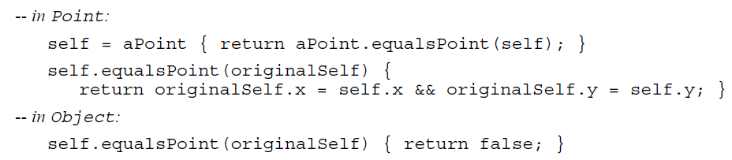
Introduction – Double dispatching
For each original method, the programmer must add at least two methods for each additional dispatched argument:
one that starts the double dispatching by resending the message to the argument with the type of the receiver encoded in the new name
another one that does the default action for arguments of other types.
Maintaining can be difficult and error-prone.

Slide 7
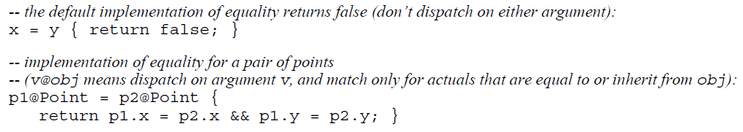
Introduction – Multiple dispatching
“A multi-method is a collection of method bodies associated with one message name.”
Multiple dispatching languages:
Arguments can participate in method lookup
Methods: multi-methods
Several privileged arguments
Just useful codes
More expressive
More natural
More readable
Less error-prone

Slide 8
multi-methods in OOP
Why not in modern languages?
Complexity
Efficiency
“Just don’t feel object-oriented”
Different programming style required
OOP: methods are associated to data types, which are inherited
Multi-methods are defined externally
CLOS: multimethods are grouped into generic functions (decentralized)
Functional-style
Outside of all objects → Encapsulation is precluded

Slide 9

Object-oriented multi-methods
Data-abstraction-oriented programming methodology
Idea: multi-method is part of each dispatched data type → Encapsulation
Closely connected multi-methods access an object’s private internals
Cecil
A message is sent to all its arguments, they together select the method
Method can be ‘part of’ several data types
Programming environment → browse all objects that related to a multi-method
A multi-method is granted privileged access to all objects of which the multi-method is a part
Multi-methods closely connected to its objects but weakly to each other

Slide 10
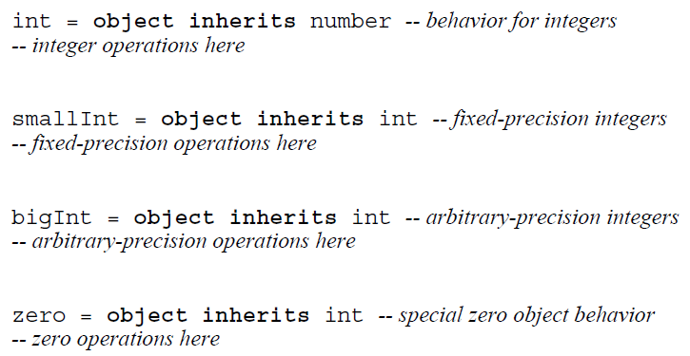
Cecil

Slide 11

Cecil

Slide 12
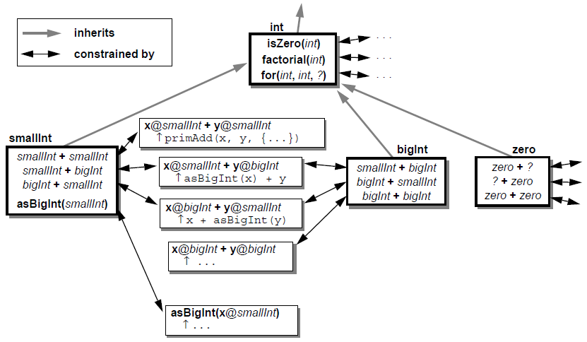
Cecil

Slide 13
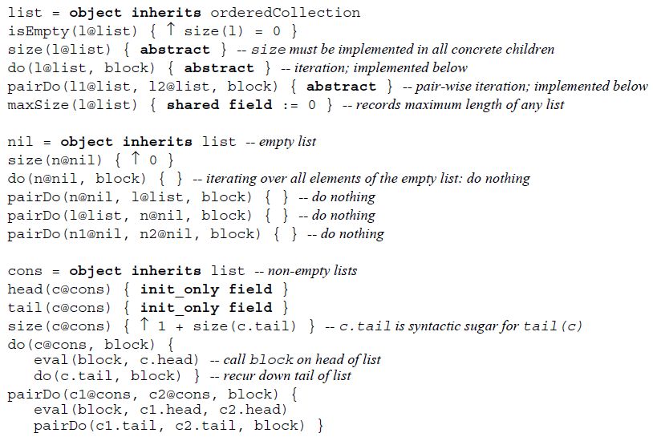

Slide 14
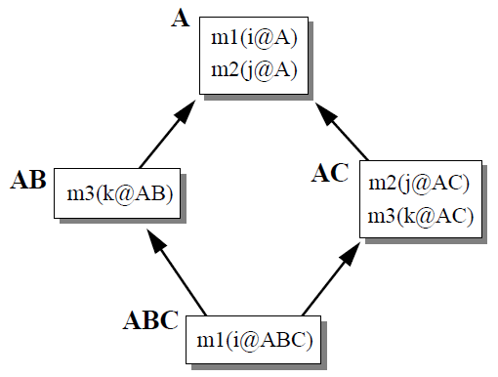
Cecil – method lookup
Problem: ambiguation
CLOS: linearization approach
Argument in earlier position dominates → No ambiguities
Cecil: partial order based on program’s inheritance graph
Class: (C > P) ⬄ C is a descendant of P
Method: (M > N) ⬄ each argument position i, the i^{th} argument constraint object of M is greater than or equal to the i^{th} argument constraint object of N
Constrained arguments are greater than unconstrained arguments
Possible ambiguities

Slide 15
Cecil – method lookup
Message sent
Find methods
System finds all method with the same name and number of arguments
Filter methods
System weeds out methods whose argument constraints are too restrictive
Choose method
Locate most specific method
“Message not understood”
“Message ambiguous”

Slide 16
Cecil - Examples
ABC abc = new ABC()
m1(abc)
m2(abc)
m3(abc)

Slide 17
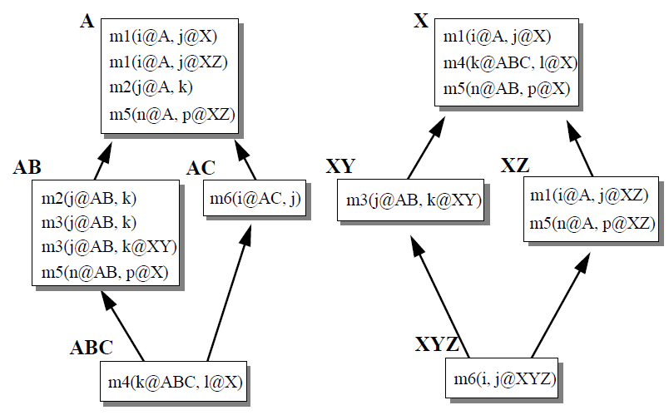
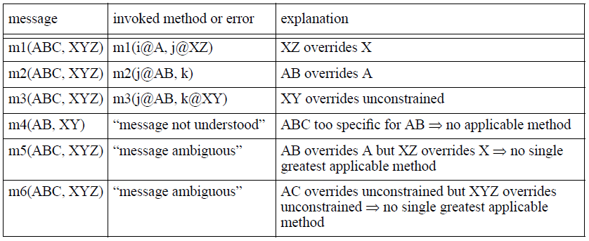
Cecil - Tasks

Slide 18
Cecil - Encapsulation
Data abstraction requires encapsulation
Clients are aware externally-visible interface (public)
Clients are unaffected to implementation (private)
Only the object’s methods can invoke them (“Inside”)
Multi-methods are internal?
How can get access to private methods?
Can it be private?

Slide 19
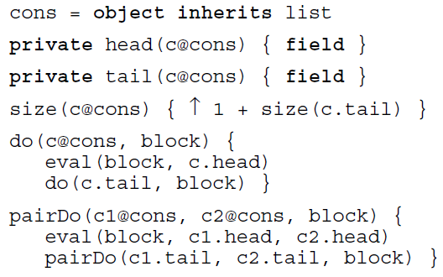
Encapsulation - Privileged multi-methods
Multi-method is “inside” of all the objects that are its argument constraints
Granted access to all the private operations
Not granted privilege to unconstraint arguments
Not a serious breach of encapsulation
Implementation change → easy to identify methods that might need to be updated

Slide 20
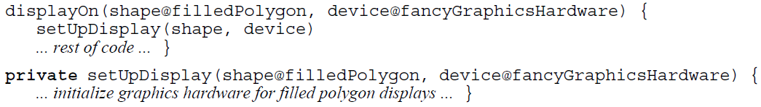
Encapsulation – Private multi-methods
How will multi-method be private?
Private to each of the argument constraints individually?
Private to them all as a group?
The setUpDisplay method for filled polygons and fancy hardware is declared private, but the displayOn method for filled polygons and fancy graphics hardware should be granted access since it is a part of both the filled polygon implementation and the fancy graphics hardware implementation.

Slide 21
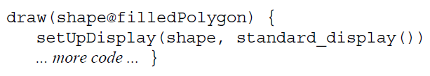
Encapsulation – Private multi-methods
standard_display() doesn’t return fancyGraphicsHardware at run-time
First design: the draw method would be granted access.
Second design: the draw method would be denied access, since it is not part of the implementation of the fancy graphics hardware data type.

Slide 22
Encapsulation – Possible breaches
It is possible for an external client to gain privileged access to an object simply by defining a new multi-method, one of whose formal arguments is constrained by the target object → receive privileged access
To protect the internals: object declaration could list explicitly those multi-methods that are granted access to the object’s private operations (“access control list”)
Other multi-methods would be allowed to dispatch on the object, but wouldn’t be able to access its private operations.
Cecil design does not include this support.

Slide 23
Encapsulation – Possible breaches
The encapsulation rules allow a multi-method dispatching on a parent to access a private method of a child. For the parent’s method to be able to invoke the child’s overriding version of one of the parent’s private methods, the parent must be granted access to the child’s method.
Limit: a parent would be granted access to a descendant’s private method only if the child’s method is overriding some other method to which the parent would have access, i.e., to a method defined on the parent or one of the parent’s ancestors.
Parent doesn’t have reasonable implementation → private abstract method to reserve privileged access to future concrete implementations provided by children.

Slide 24

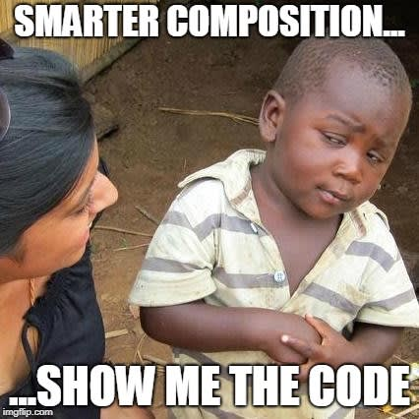



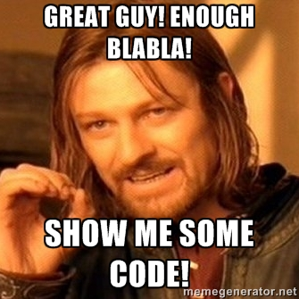
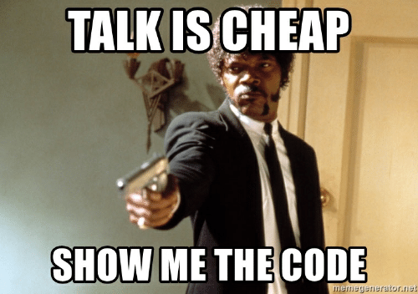
Notes:
Java Eclipse MultiMethodNotModular.java

Slide 25
Relaxed Multi Java
MultiJava: Extension of Java
Features:
External methods
Multimethods
Glue methods
Relaxed MultiJava is more flexible
Possible ‘message dispatch’ errors → warning
Notes:
MultiJava is an extention to Java
Allows adding methods (external methods) to existing classes (open classes)
Allows multimethods
● Methods can be specialised on the type of more than one of its arguments
No free-standing external methods (glue methods)
● Methods that belong to the same operation must be written in a single file

Slide 26
Relaxed Multi Java
More expressive than Java
Reports the same problems as MultiJava
Preloader → checks all statically reachable classes (⬄ Java’s lazy load)
Compiled into Java ByteCode
Notes:
MultiJava is an extention to Java
Allows adding methods (external methods) to existing classes (open classes)
Allows multimethods
● Methods can be specialised on the type of more than one of its arguments
No free-standing external methods (glue methods)
● Methods that belong to the same operation must be written in a single file

Slide 27
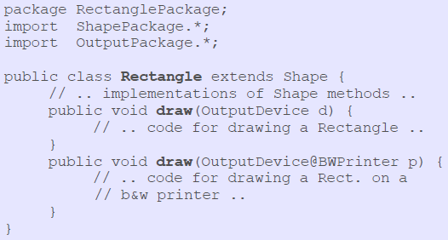
Relaxed Multi Java

Slide 28
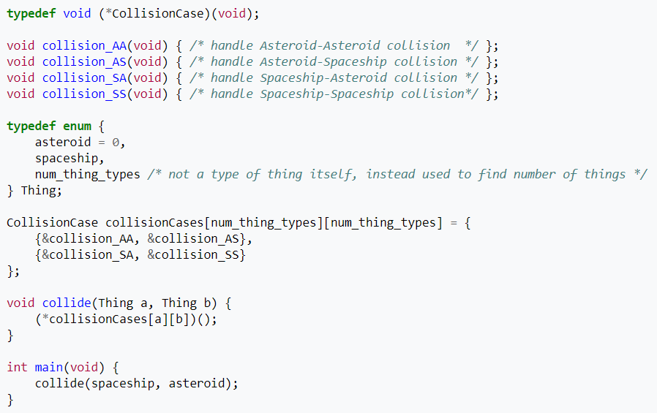
Simulate multimethods in C

Slide 29
Summary
Multimethods can be used in object-oriented programming languages
New challenges but elegant solutions for old problems
More natural, less error-prone

Slide 30

Questions?

Slide 31

Thank you!

Slide 32
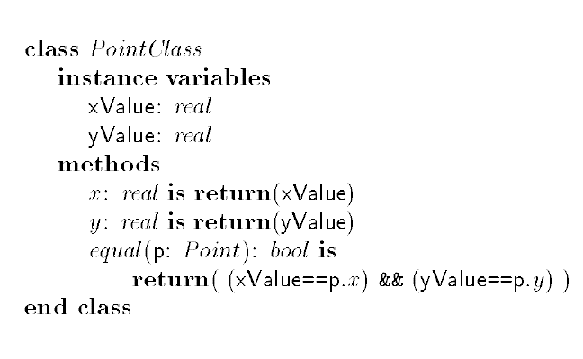
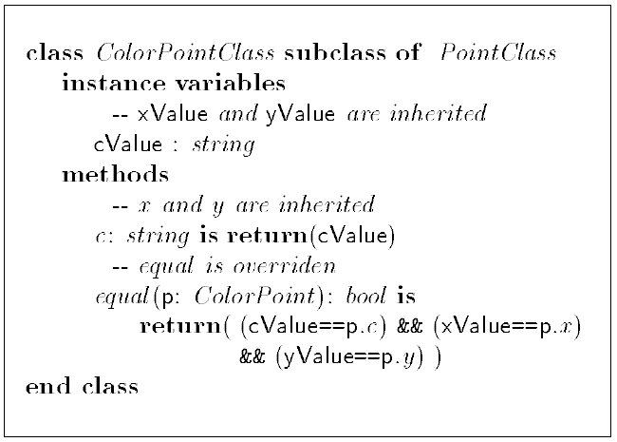
Binary methods

Slide 33

Binary methods - equals

Slide 34
Binary methods - problems
Not symmetric
Access private arguments
Solutions
Avoid binary methods
Use functions instead
Aggregate to a new object
Embrace binary methods
Matching
Multi-methods
Simulate multi-methods
Precise typings
Privileged access

Slide 35
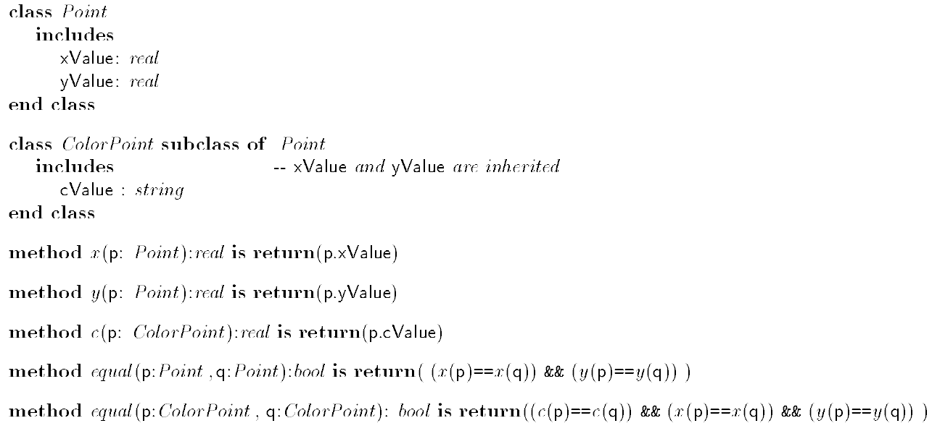

Slide 36
