Slide 1


Analyzing profiles of 2019 general election candidates using attributes like criminal cases, caste category etc.
Team Name – Vision Quest
Lead Name – Kirandeep Kaur

Slide 2

Vision Quest
Kirandeep Kaur 33
Pritika Sarkar 39
Shivam Nanda 50
Vidhi Agrawal 59
Yash Agrawal 60

Slide 3
Problem Statement
We decided to work on 2019 Election data to gain new insights on the political candidates.
The background information on each political candidate provided some stereo type breaking results.

Slide 4
Solution Overview
We cleaned the data by removing unnecessary columns.
Then we handled the missing and null values.
Then we encoded the categorical values.
We tried to implement various machine learning models and finally decided to go with KNN algorithm as it provided good accuracy and learnings.
We designed prediction model for 2024 election winner with groundbreaking 75 % accuracy.

Slide 5
Future Outlook
We can implement the functionality using different algorithms and look for better accuracy.
01
We can use booster models to drive up the accuracy.
02
We can remove multi collinearity in dataset and implement the same solution for better insights.
03

Slide 6
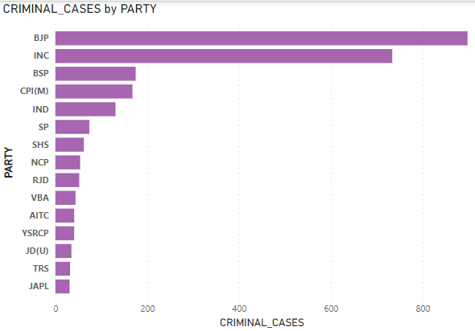
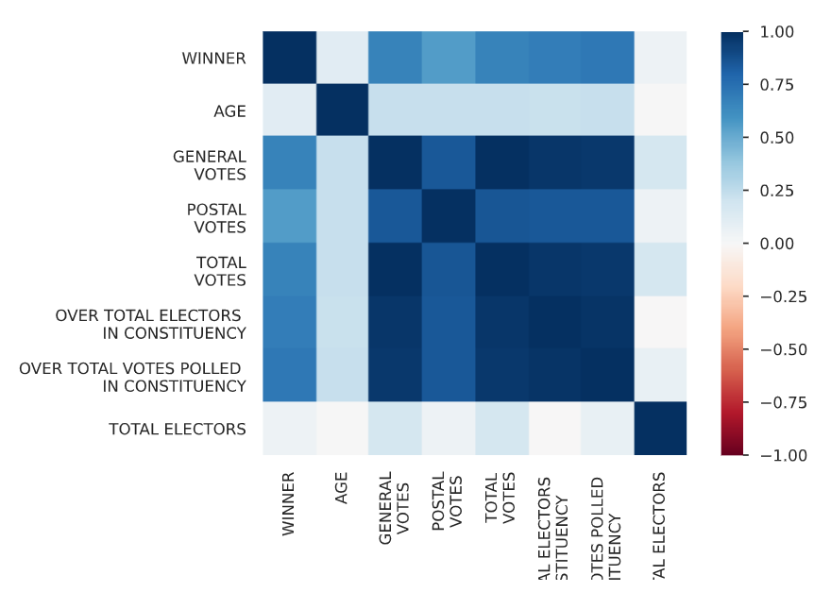
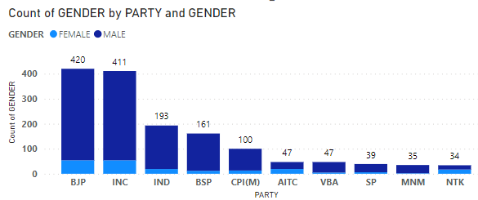
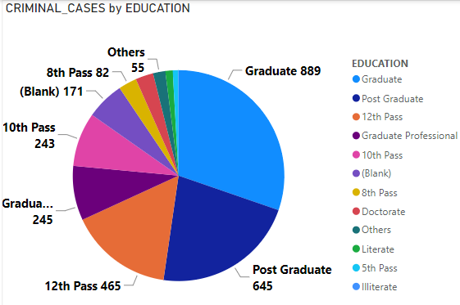
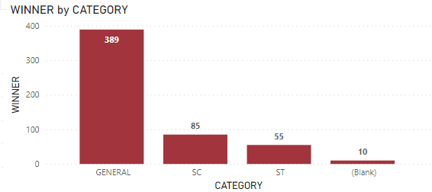
Graphical Representation

