Slide 1


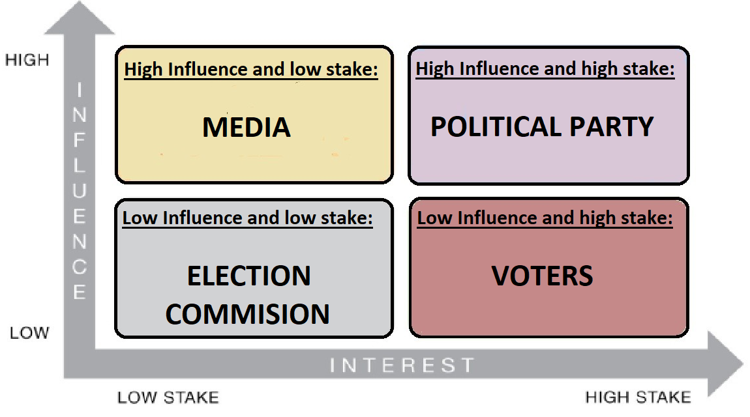
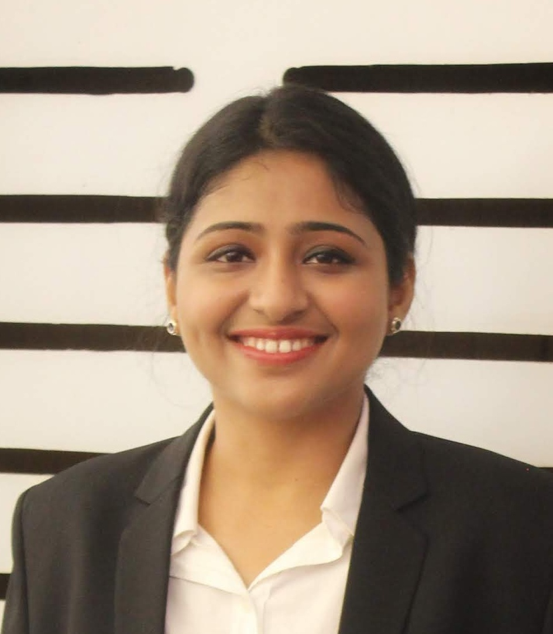
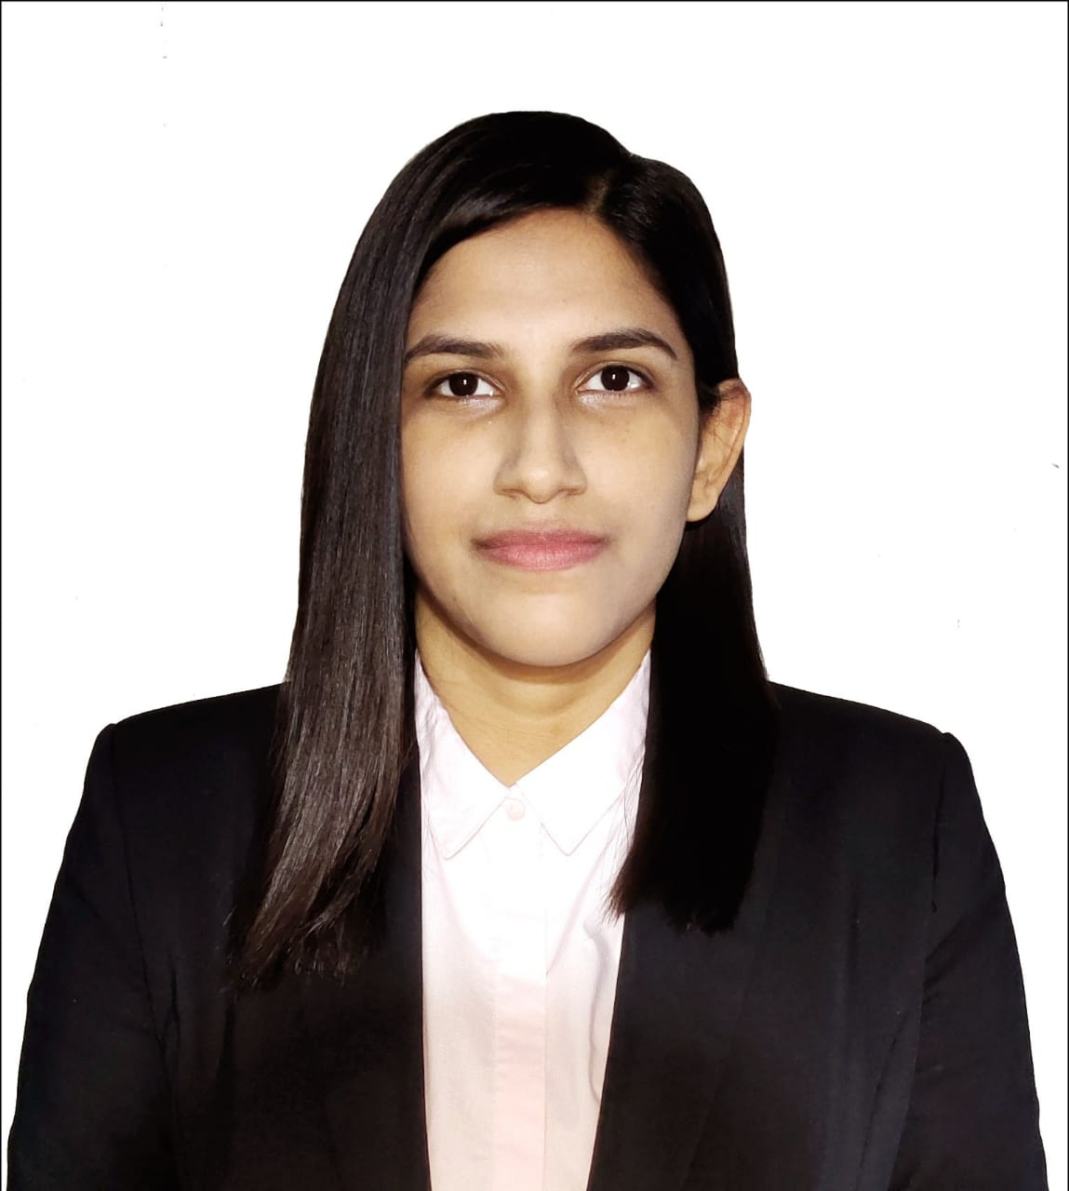
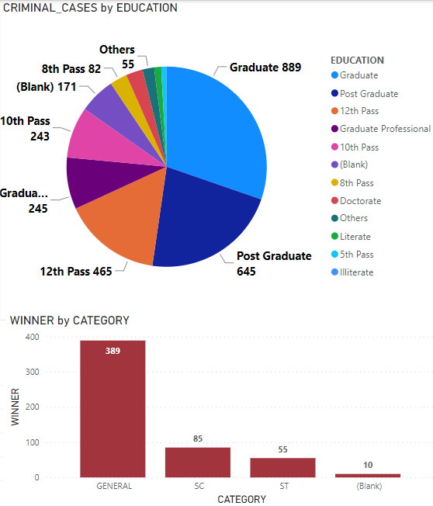
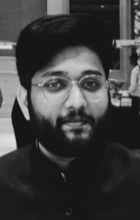
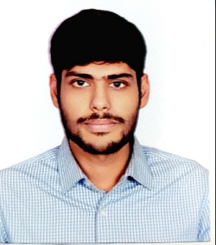
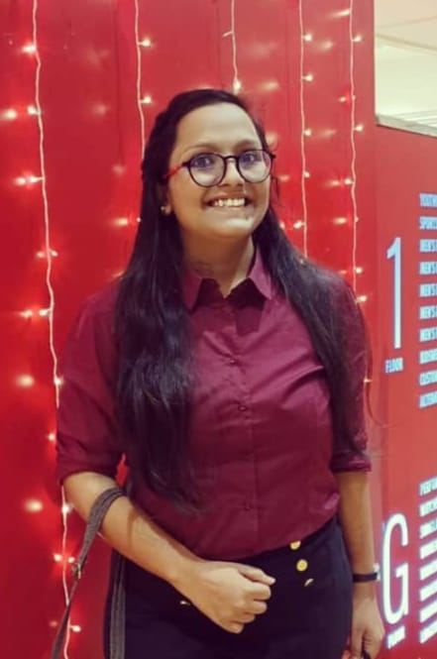
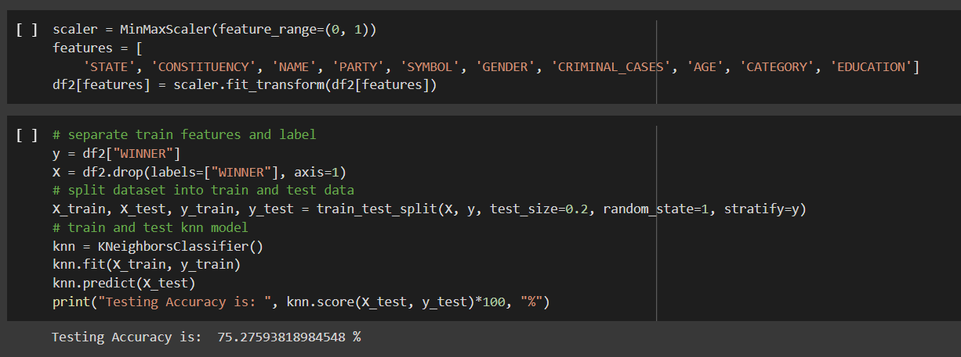
Track Name:
Analytics using Python
Team Name:
Vision Quest
Team Members:
Kirandeep Kaur
Vidhi Agrawal
Shivam Nanda
Pritika Sarkar
Yash Agrawal
Analyzing profiles of 2019 general election candidates using attributes like criminal cases, caste category etc.
Problem Statement
Predicting the winner for General Elections in India using K-Nearest Neighbor (KNN) algorithm.
Stakeholder Map
Secondary Research
General Elections in India
Predictive Analysis
Data Extraction
Data Cleaning
KNN Algorithm
Normalization
Multicollinearity
Insights
According to our prediction, we have an accuracy of 75.27% in estimating the winning participant using KNN model. We will work to improve this model in the future updates.
Our analysis from the prediction gives a complex political landscape of how different attributes like- criminal cases, category, party etc., affect the winning chances of a candidate.
Team Group Pic
Solution
Data Extraction from Kaggle.
Data Cleaning:
1. Removing null values
2. Removing irrelevant attributes from dataset
3. Encoding/Labelling non-numeric data.
Calculating Multicollinearity among the attributes.
Normalization: Using min-max scaler.
Application of KNN Model:
1. Separate train features and labels.
2. Split dataset into train and test data.
3. Train and test KNN model.
Graph
Way Ahead
This prediction model will help political parties design social media campaigns to increase their chances of winning in the future elections.
Prototype/Code

Slide 2
Note -
Please make the Poster in the above template – answering the questions
The Placement can be arranged as per the content of your answers
Please use Arial Font.. With Heading Font Size 112, Sub – Heading 60 and Text as 30
The size of Poster is A1. which 59.4cm Width x 89.1 height
Please find the sample Poster and Make it in that manner
You can either use this ppt format or can use indesign/ photoshop/ illustrator or any software.

