Slide 1
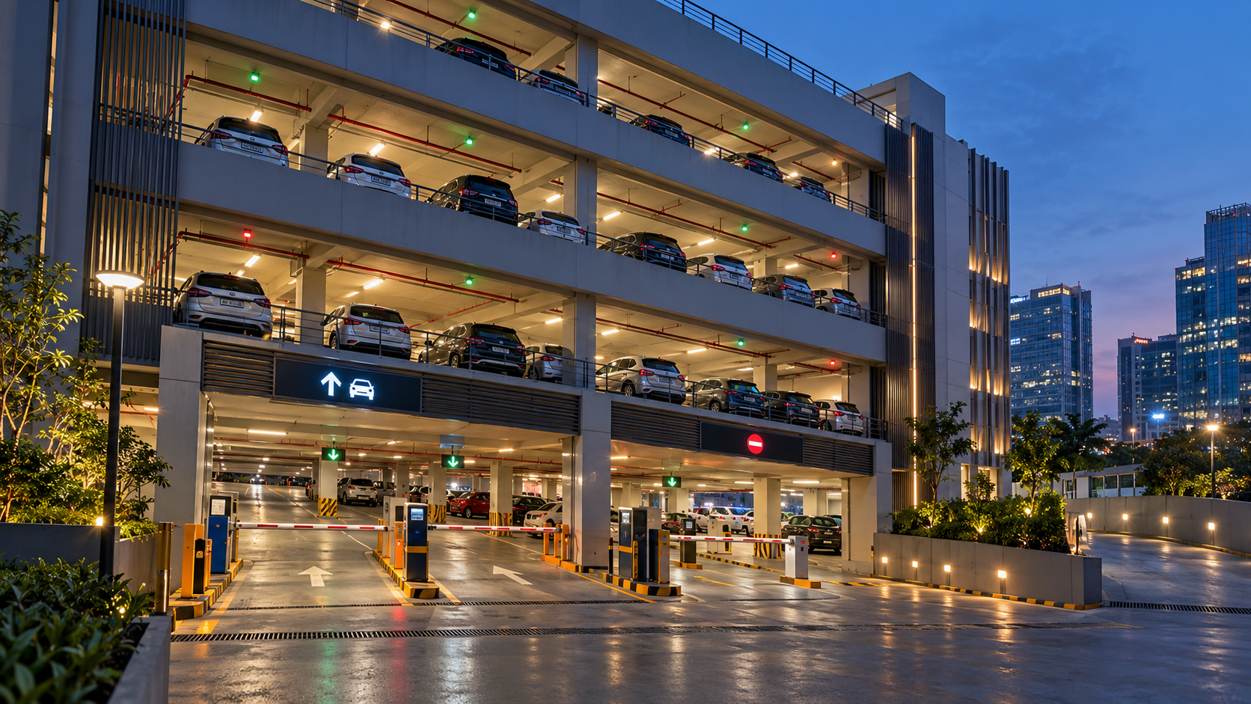

PROJECT BASED LEARNING
MULTI-LEVEL
PARKING SYSTEM
A compact Java prototype that manages 3 floors × 5 slots, allocates the first free space, searches vehicles and keeps a simple text-file log.
3
FLOORS
15
SLOTS
6
MENU ACTIONS
K. DIVYA TEJA · 2620030005
YOGENDRA · 2620040044
Guide · Mr. G Balaiah
16 OCT 2026

Slide 2
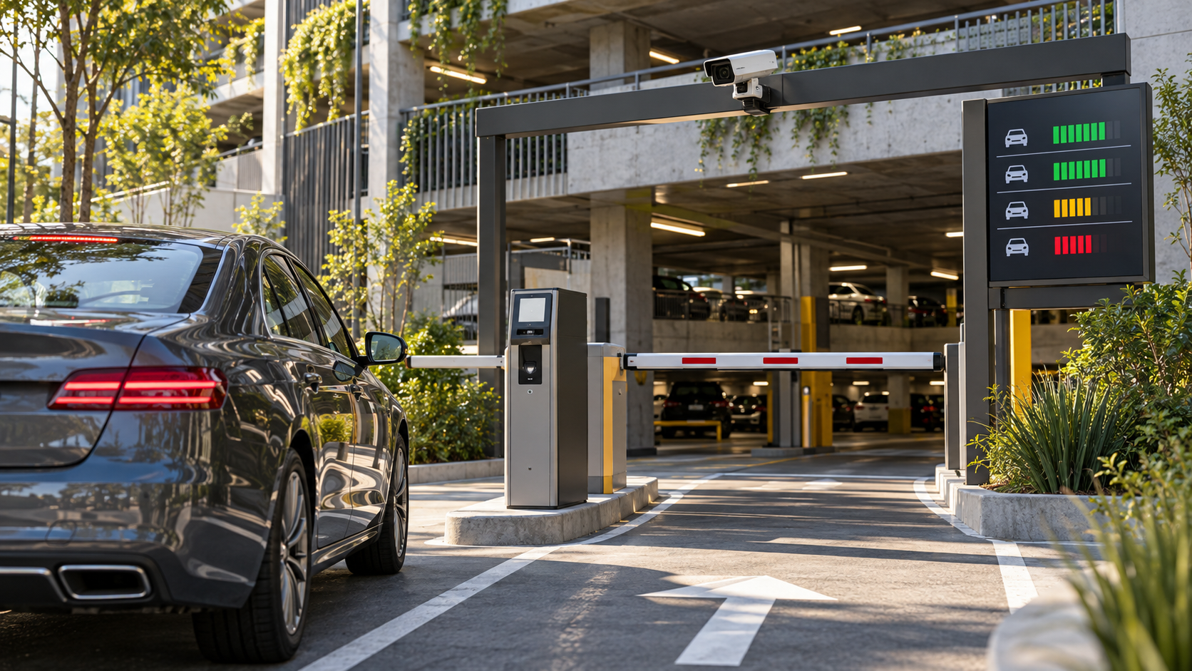
01 · PROJECT OVERVIEW
Abstract
The real parking problem, the student-scale prototype, and what the current code actually does.
Why this project matters
In busy buildings, parking becomes harder when drivers cannot quickly identify free spaces and staff must track vehicles manually.
01
Tracks 3 floors × 5 slots
A 2D array represents the parking layout.
02
Assigns the first free slot
The program checks the grid floor by floor.
CURRENT PROTOTYPE
03
Searches and removes vehicles
A plate number can be located or cleared.
PARK
REMOVE
VIEW
SEARCH
LIST
LOG
04
Keeps a simple entry log
FileWriter appends parked vehicles to a text file.
Real systems may add sensors, barriers, payments and mobile booking. Those are future extensions—not features claimed by this console prototype.
The presentation keeps the real-world idea and the actual Java implementation clearly separated.

Slide 3
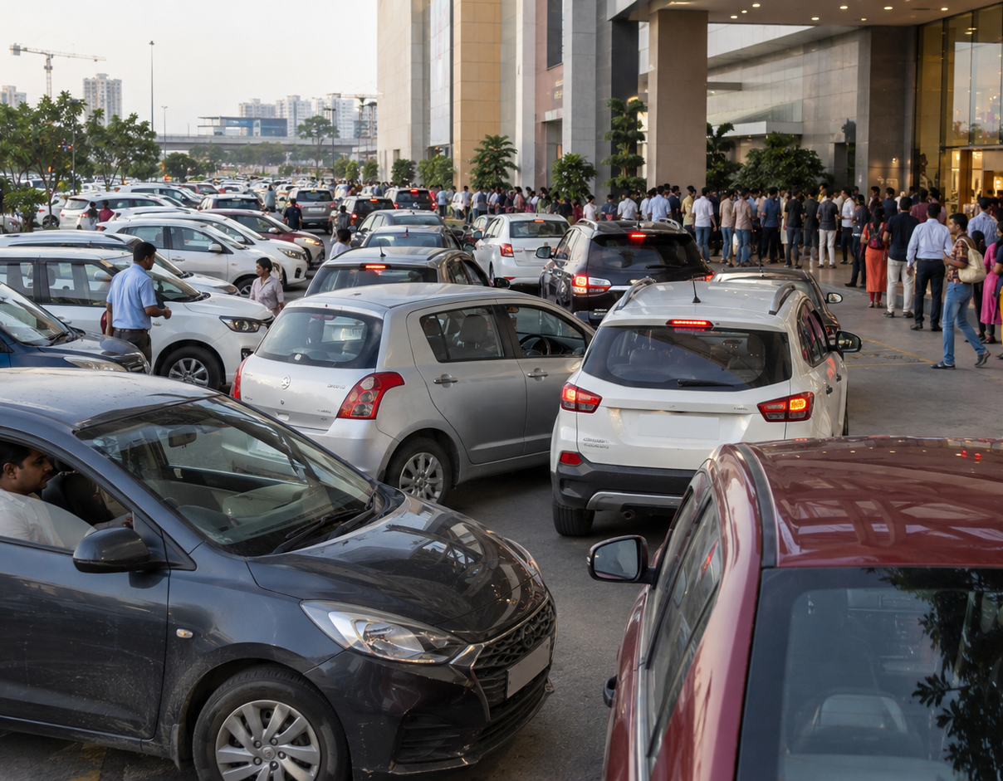
02 · PROBLEM STATEMENT
Understanding the Parking Problem
Why a structured multi-floor system is useful before we even talk about code.
Problem statement
Design a simple system that can track parking spaces across multiple levels, assign an available slot, locate a parked vehicle and free the slot when it exits.
DESIGN OBJECTIVE
1
2
3
4
Vehicle enters
Check first free slot
Park / search / remove
Write entry log
SEARCH TIME
SPACE USE
RECORDS
Keep the solution easy to explain, test and demonstrate manually.
The project focuses on parking management logic—not on pretending the console program has physical sensors or barriers.

Slide 4
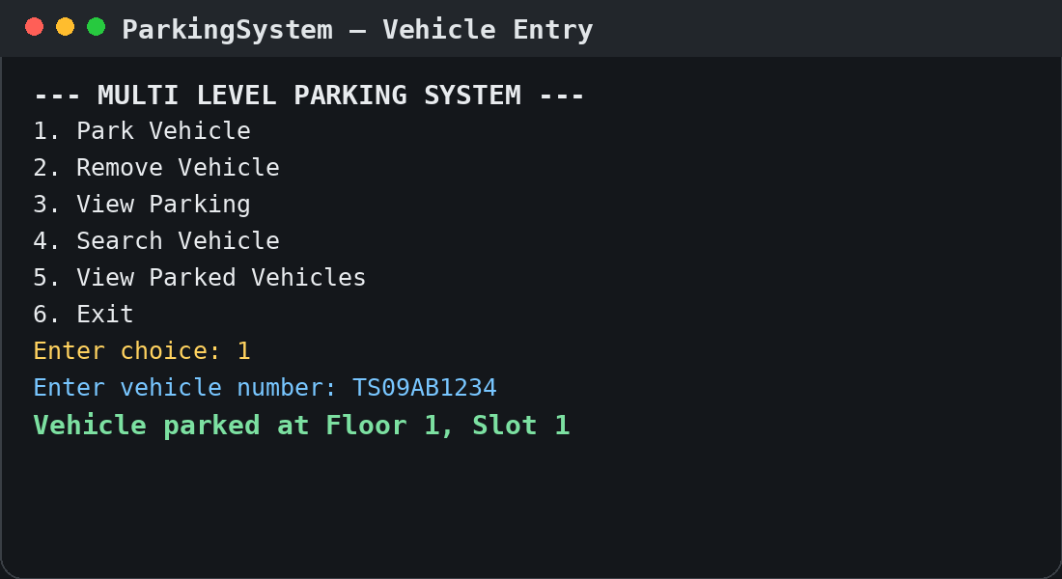
03 · CO1
From Real Problem to Program
CO1 translates the parking task into clear inputs, processing steps and outputs.
01
INPUT
02
PROCESS
03
OUTPUT
Vehicle number
Check slot status
Assigned floor + slot
Menu choice
Park · remove · search
Parking status / search result
What CO1 contributes
The program starts with simple console input using Scanner. The user selects a menu option and enters a vehicle number; the program returns a clear result.
Scanner sc = new Scanner(System.in);
Demonstration: choose option 1, enter a plate number, and show the assigned floor and slot.

Slide 5
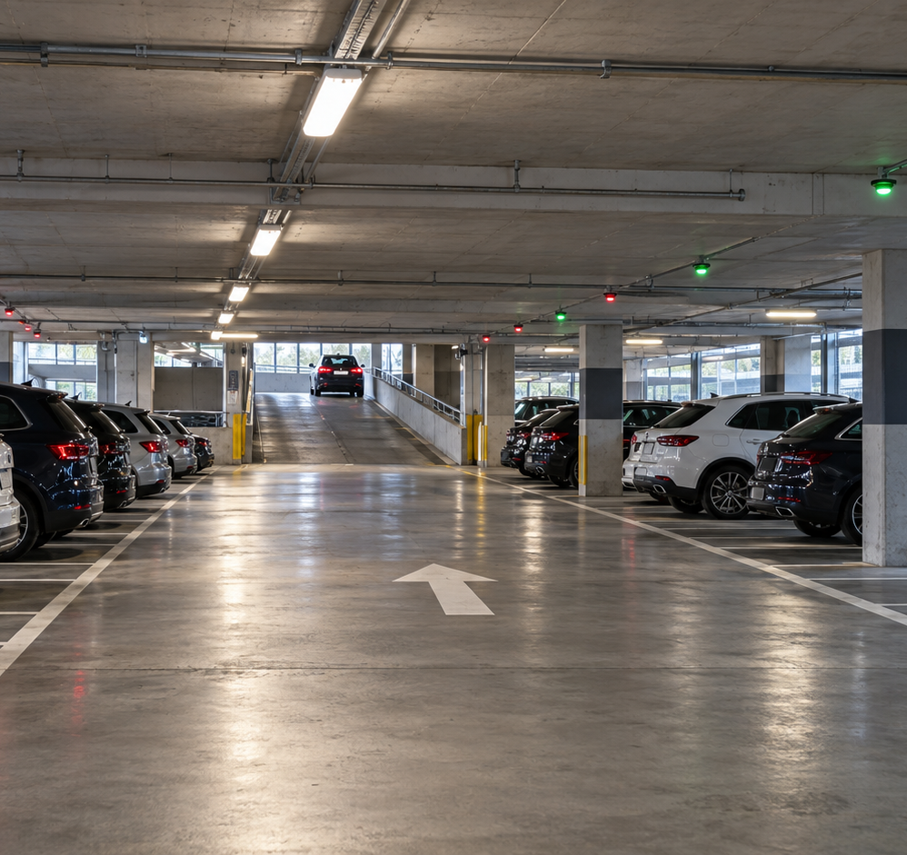
04 · CO2
Control Flow: Decisions + Repetition
The menu keeps running, the selected action is routed, and slot conditions are checked.
One simple control-flow chain
1
WHILE
Keep showing the menu until choice = 6.
while (choice != 6)
2
SWITCH
Send each menu number to the correct action.
switch (choice)
3
IF
Check whether a parking slot is empty or occupied.
if (parking[i][j] == null)
NO do…while · NO advanced control constructs
CO2 is visible every time the menu repeats and the program decides what should happen next.

Slide 6
05 · CO3
Arrays + Methods: Modelling Floors and Slots
A 2D array represents the garage; methods keep each parking action separate and readable.
String[][] parking = new String[3][5];
Methods used in the project
Rows = floors · Columns = slots
1
parkVehicle()
find a free slot + assign plate
F1
TS09
AB1234
AP28
EF9012
FREE
FREE
FREE
2
removeVehicle()
clear the matching slot
F2
FREE
FREE
FREE
FREE
FREE
3
searchVehicle()
locate plate across all floors
F3
FREE
FREE
FREE
FREE
FREE
4
showParking()
display every floor and slot
FIRST FREE SLOT → F1 / S3
CO3 makes the program modular without making it complicated.
The 2D array is the main model of the parking structure in the current code.

Slide 7
06 · CO4
Classes and Objects: One Vehicle Class
Only one simple class is used here—enough to represent a vehicle cleanly without overcomplicating the project.
class Vehicle
How the object is used
DATA
String plate;
Vehicle v
parkVehicle(v)
F1
S1
TS09AB1234
CONSTRUCTOR
Vehicle(String plate)
{ this.plate = plate.toUpperCase(); }
A class groups the vehicle number into one object. The rest of the parking system simply passes that object to the parking method.
CO4: CLASS + OBJECT
Simple enough to explain in viva; directly present in your syllabus.
No inheritance, interfaces or advanced object hierarchy are forced into this project.

Slide 8
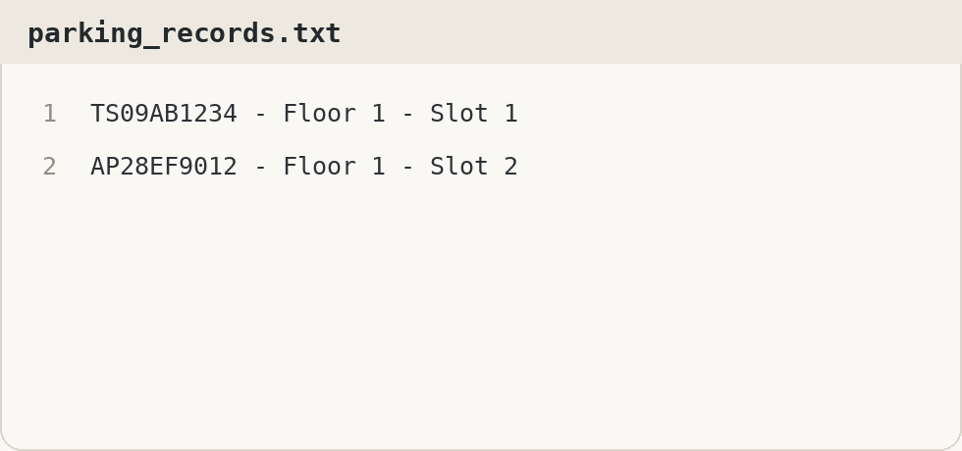
07 · CO5
File Handling: Saving a Parking Entry Log
FileWriter is used for one clear purpose: append the parked vehicle, floor and slot to a text file.
When a vehicle is parked
parkVehicle()
saveRecord()
parking_records.txt
new FileWriter("parking_records.txt", true)
true = append mode → new records are added at the end instead of deleting old log entries.
Important: the current simple version saves a log only.
CO5 · FILE WRITING
It does NOT read the file back to restore parked vehicles after restarting. File reading can be added later as future scope.
This is intentionally kept simple: one FileWriter method demonstrates file handling without making the code much larger.

Slide 9
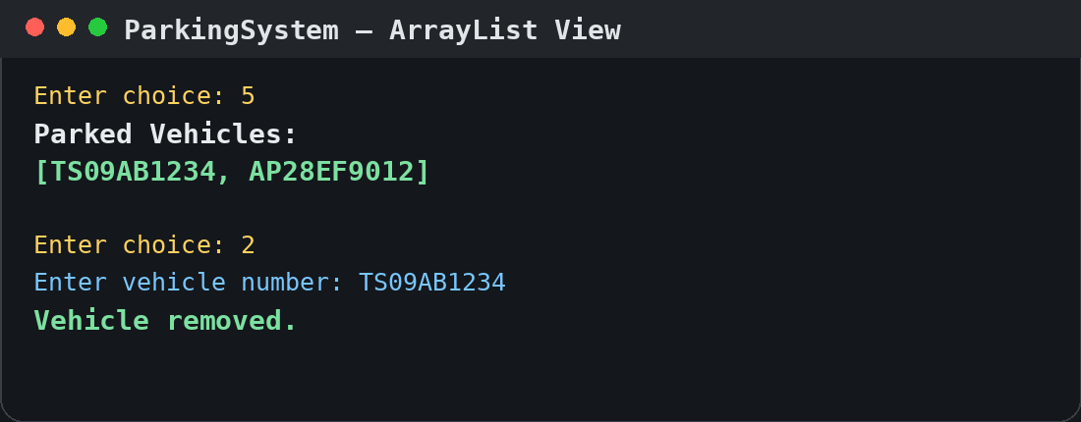
08 · CO6
Collections: A Simple ArrayList Use
The 2D array remains the parking layout; ArrayList is used only for the current list of parked vehicle numbers.
ArrayList<String> vehicles
TS09AB1234
On park
vehicles.add()
AP28EF9012
On remove
TS10CD5678
vehicles.remove()
Menu option 5 prints the list directly.
Why use it here?
It gives one convenient list of currently parked plates without changing the main 3 × 5 array model.
CO6 is demonstrated with one basic collection—ArrayList—rather than streams or advanced functional programming.

Slide 10
09 · OUTCOME
Conclusion + Future Scope
The current version is intentionally small, but its core logic can grow into a real smart-parking application.
WHAT WORKS NOW
✓
3 floors × 5 slots
✓
First-free-slot allocation
✓
Search + remove + view status
✓
Text-file entry log
FUTURE SCOPE
1
Read saved state on startup
2
GUI / dashboard
3
QR or RFID + live sensors
STUDENT-SCALE PROTOTYPE → REAL SMART PARKING
Fee calculation + slot booking
4
The important result is a clear, testable parking-management model that can be extended step by step.

Slide 11
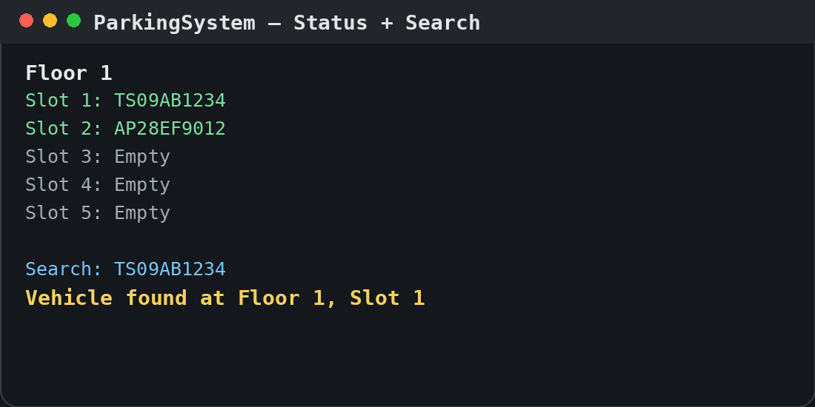
10 · DEMONSTRATION
Screen Shots
Actual console output captured from the current simplified Java program.
1 · Vehicle Entry
2 · Status + Search
3 · Parked Vehicle List
First free slot is allocated.
The vehicle is found by floor + slot.
ArrayList shows the current vehicles.
PARK
SEARCH
ARRAYLIST
All three screenshots are from the same Java program used in the CO slides.

Slide 12


11 · SUBMISSION EVIDENCE
Geo-tag Photo + GitHub Repository
Final submission evidence from the team and project repository.
GEO-TAGGED TEAM PHOTO
GITHUB REPOSITORY
MultiLevelParkingSystem
github.com/KDivya-Teja/
KLH_CSE_PSPJAVA_T16_MultiLevelParkingSystem
Scan to open
REPOSITORY CONTENTS
✓
ParkingSystem.java
✓
parking_records.txt sample
✓
README / run instructions
K. Divya Teja · 2620030005
Yogendra · 2620040044
Repository URL preserved from your current submission slide.

