Slide 1



APTOS GAMING CLUB
BUILD ON APTOS
HACKATHON
TEAM: k Dhanu venkatesh
Sk Ishaq
021+`0

Slide 2

Introduction
This project focuses on developing an engaging and interactive online game.
It aims to provide entertainment while integrating modern gameplay mechanics.
It have different types of games
player will earn aptos coins

Slide 3

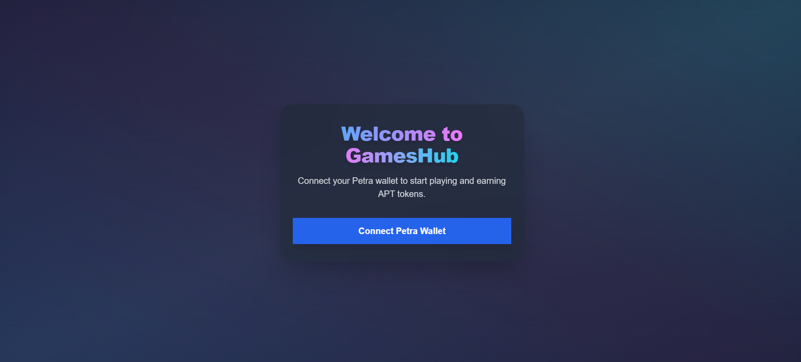
Connection to petra wallet

Slide 4
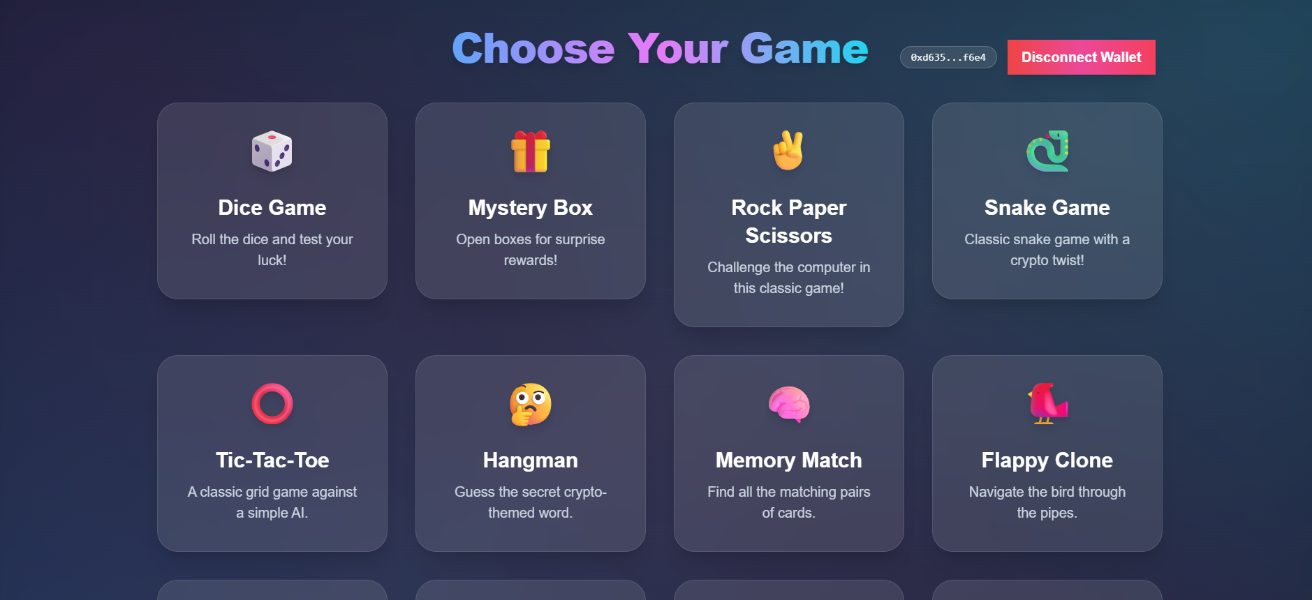
GAMES UI

Slide 5
Technology Stack
• Programming Language: React , typescript
• smart contract :
MOVE
• Stored on :
On chain
• Hosting: vercel /netfly

Slide 6
THANK YOU

