Slide 1

More Flow of Control
Adam Sweeney
Engineering Educator, EECS
Fall 2017

Slide 2

Introduction
Most of Chapter 3 from textbook
Talk more about branching and loops
Introduce some new methods

Slide 3
Agenda
Boolean Expression review
Multiway branches
More on loops

Slide 4

BOOLEAN EXPRESSION REVIEW

Slide 5
Boolean Expression Review
Evaluate the following: !(false || true)

Slide 6
Boolean Expression Review (cont.)
Evaluate the following: !(false || true)
(false || true) → true
!(true)
false

Slide 7
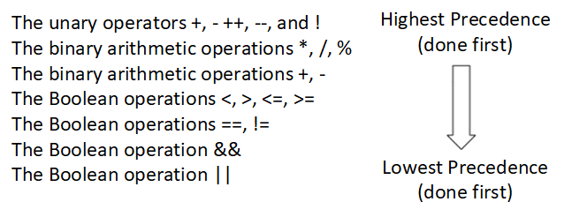
Boolean Expression Review (cont.)
Precedence

Slide 8
Boolean Expression Review (cont.)
Consider the following:
An if-else block that requires checking a timer, and ensuring it is under a certain limit
Implemented like so:
Assume time is 36 and limit is 60
How does the Boolean expression evaluate? Why?
if (!time > limit)
[Something]
else
[Something_else]

Slide 9
Boolean Expression Review (cont.)
Consider the precedence
! is evaluated first
!36 evaluates to false
36 evaluates to true, since it is non-zero
false is converted to 0 for the integer comparison
0 > 60 is false
So, (!time > limit) evaluates to false
How can we fix it?

Slide 10
Boolean Expression Review (cont.)
Ensure proper precedence is used
(!time > limit) → (!(time > limit))

Slide 11
Boolean Expression Review (cont.)
Ensure proper precedence is used
(!time > limit) → (!(time > limit))
Avoid ! altogether
(time <= limit)
This is easier to read and understand as well

Slide 12
MULTIWAY BRANCHES

Slide 13
Multiway Branches
Last week covered if-else branching
What if there are more than three branches?

Slide 14
Multiway Branches
Last week covered if-else branching
What if there are more than three branches?
We can use nested if-else blocks

Slide 15
Multiway Branches (cont.)
See the nested example of a four branch scenario
This is cumbersome to read
Takes up a lot of space
if (BOOLEAN_EXPRESSION) {
STEPS
}
else {
if (BOOLEAN_EXPRESSION) {
STEPS
}
else {
if (BOOLEAN_EXPRESSION) {
STEPS
}
else {
STEPS
}
}
}

Slide 16
Multiway Branches (cont.)
Remember the properties of if-else
if and else will execute a single statement
Without the need for braces
What would it look like if the else’s single statement was an if statement?

Slide 17
Multiway Branches (cont.)
Better way to implement nested if-else
Much easier to read
Takes up less space
Preferred style is shown
if (BOOLEAN_EXPRESSION) {
STEPS
} else if (BOOLEAN_EXPRESSION) {
STEPS
} else if (BOOLEAN_EXPRESSION) {
STEPS
} else {
STEPS
}

Slide 18
Multiway Branches (cont.)
Switch
Another way to handle multiway branching
Some restrictions in comparison to if-else
More elegantly handles certain scenarios

Slide 19
Multiway Branches (cont.)
Demo time

Slide 20
MORE ON LOOPS

Slide 21
More on Loops
The while loop is really all we need
Once a while and do-while are in the middle of their iterations, they are essentially indistinguishable
But sometimes the syntax doesn’t gel as cleanly as we would like
These extra ways to do the same thing are called ‘syntactic sugar’
I prefer to take advantage if I feel it suits me
Discuss a new loop syntax

Slide 22
More on Loops (cont.)
The for loop
Invoke with ‘for’, three expressions in parentheses
Note where a semicolon is and is not used
By default, for loop can execute a single statement
Use { } to create a compound statement
for (INITIALIZATION_ACTION; BOOLEAN_EXPRESSION; UPDATE_ACTION)
[Statement];

Slide 23
More on Loops (cont.)
Demo!

