Slide 1
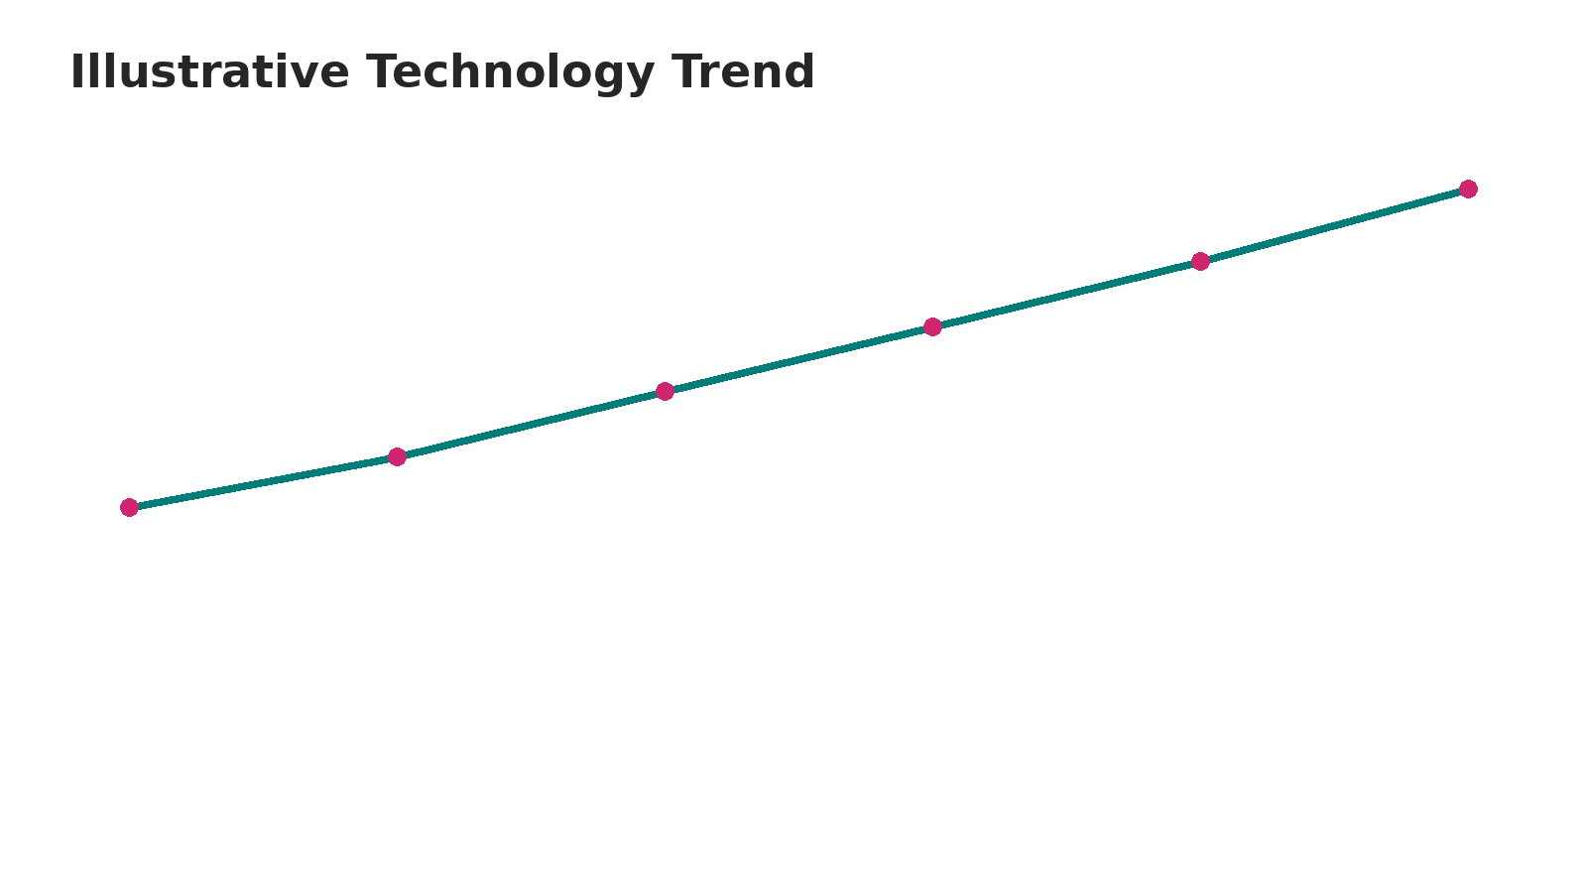
CAPSTONE STORY
SpaceX Falcon 9 Landing Success, Geospatial Analysis & Interactive Dashboard
Applied Data Science Capstone
Folium • Plotly Dash • SQL • Predictive Classification
Historical Falcon 9 launch and first-stage landing analysis

Slide 2
EXECUTIVE SUMMARY
SpaceX Falcon 9 Landing Success — Applied Data Science Capstone
Objective: analyze Falcon 9 first-stage landing outcomes and identify how launch site, flight experience and payload relate to recovery success.
Dataset scope: the historical IBM capstone launch dataset (90 Falcon 9 records) used for the EDA, Folium and Plotly Dash workflow.
Geospatial analysis maps four historical launch-site labels and calculates distances between colocated Cape Canaveral pads and the other launch sites.
Dashboard analysis exposes launch-site selection, landing outcomes and payload-range interaction; findings are grounded in the completed capstone analytics rather than generic job-market statements.

Slide 3
INTRODUCTION
Problem, objective and analytical questions
Problem: reusable first-stage recovery is a key operational feature of Falcon 9, so understanding landing outcomes is useful for launch-risk and mission planning analysis.
Goal: determine how landing success varies by launch site, payload mass, orbit/mission profile and flight experience.
Questions: Which launch sites are most/least successful? Does success improve with flight number? What payload ranges appear in successful landings? What does geography reveal about site proximity?
Output: reproducible Python, Folium and Plotly Dash evidence plus presentation-ready insights.

Slide 4
DATA COLLECTION & DATA WRANGLING
SpaceX API + Wikipedia reference workflow
Historical Falcon 9 launch records were assembled through the IBM capstone workflow using SpaceX API data and web-scraping of Wikipedia’s “List of Falcon 9 and Falcon Heavy launches”.
Data preparation includes Falcon 9 filtering, missing-value handling, launch-site normalization, landing-outcome labelling and feature selection.
Core analytical fields include FlightNumber, PayloadMass, Orbit, LaunchSite, booster/landing attributes and binary landing class.
Source reference: Wikipedia launch list — https://en.wikipedia.org/wiki/List_of_Falcon_9_and_Falcon_Heavy_launches

Slide 5
EDA & DATA VISUALIZATION METHODOLOGY
Evidence used for the revised dashboard
Flight number vs. payload: later flights show a higher concentration of successful first-stage landings.
Launch site vs. flight number: CCAFS SLC-40 is the most-used site in the historical dataset; success improves as flight experience increases.
Payload vs. launch site: VAFB SLC-4E did not carry payloads above 10,000 kg in the historical period.
Orbit and yearly analyses show substantial differences in observed success rates; small-sample orbit categories should be interpreted cautiously.

Slide 6
PREDICTIVE ANALYSIS — CLASSIFICATION
Historical landing-success prediction
Model objective: predict the binary first-stage landing outcome from engineered mission features.
Models in the capstone workflow: Logistic Regression, SVM, Decision Tree and KNN, with scaling and hyperparameter tuning.
Published capstone result: Decision Tree reached about 88.9% accuracy in the reported evaluation; the result should be interpreted in the context of the small test set.
Predictive analysis complements, rather than replaces, the descriptive dashboard and geospatial evidence.

Slide 7
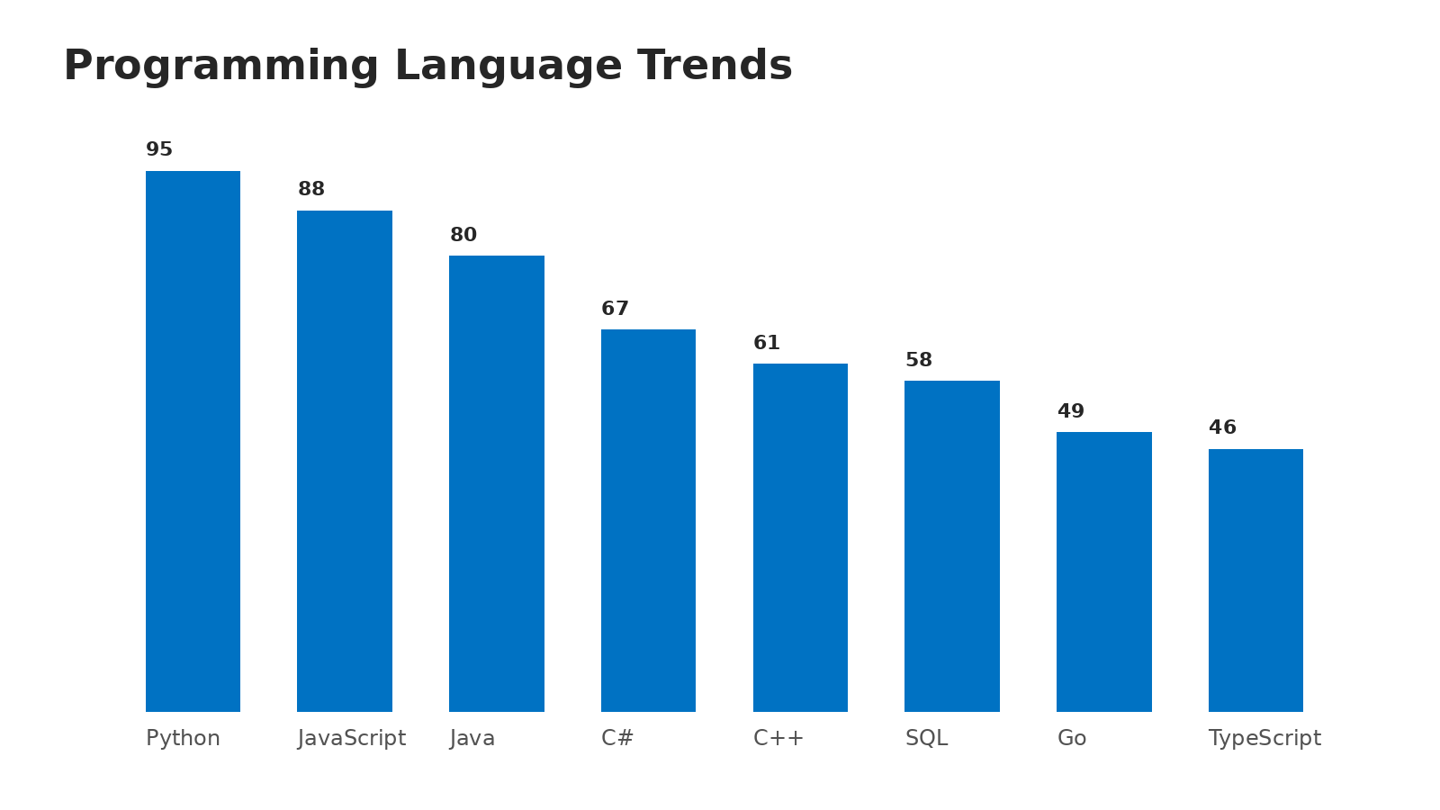
EDA WITH VISUALIZATION
Launch-site and landing-success evidence
Historical site-level analysis reports approximately 60% landing success for CCAFS SLC-40, 77.27% for KSC LC-39A and 76.92% for VAFB SLC-4E.
KSC LC-39A records 17 successful and 5 unsuccessful landings in the published 90-record site summary; VAFB records 10 successful and 3 unsuccessful.
The success-rate pattern is consistent with the observed learning effect: later flight numbers contain substantially more successful recoveries.

Slide 8
EDA WITH SQL — RESULTS
Queries aligned to the actual SpaceX capstone
Unique launch-site query returns the historical labels: CCAFS LC-40, CCAFS SLC-40, KSC LC-39A and VAFB SLC-4E.
NASA (CRS) missions account for 45,596 kg of total payload in the published SQL analysis.
Average payload for F9 v1.1 is reported as 2,534.66 kg in the revised capstone analysis.
First successful ground-pad landing outcome: 2015-12-22.
Historical mission-outcome aggregation reports 100 successful and 1 failed mission outcome in the broader SQL table; landing outcome and mission outcome are distinct measures and should not be conflated.

Slide 9
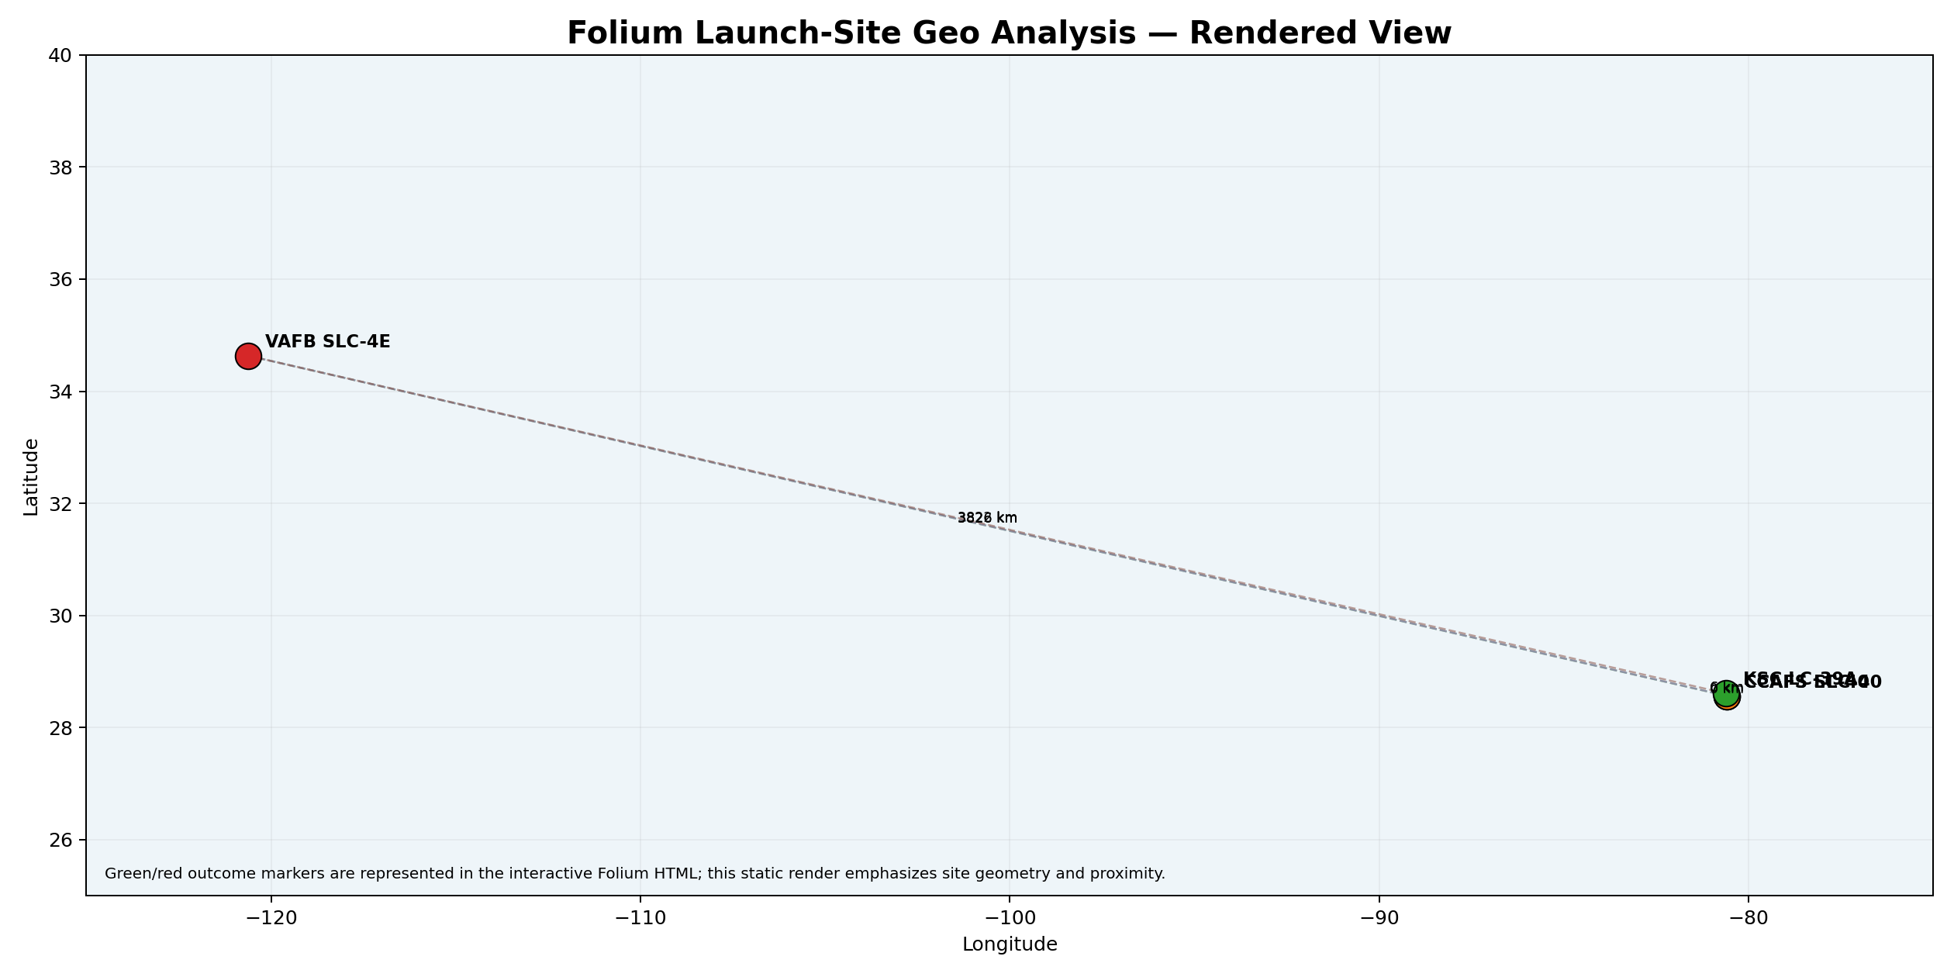
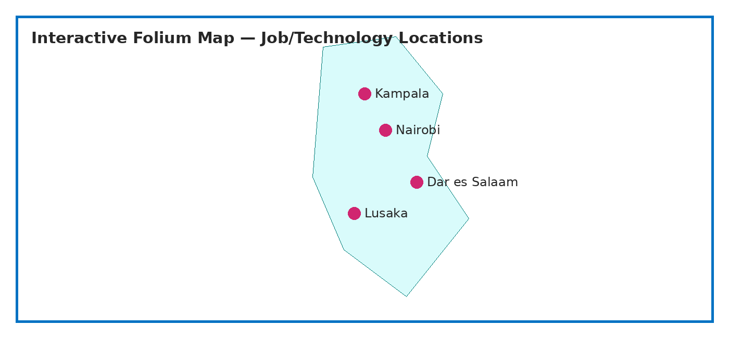
FOLIUM MAP — LAUNCH-SITE GEOGRAPHIC ANALYSIS
Site markers, outcome markers and proximity lines

Slide 10
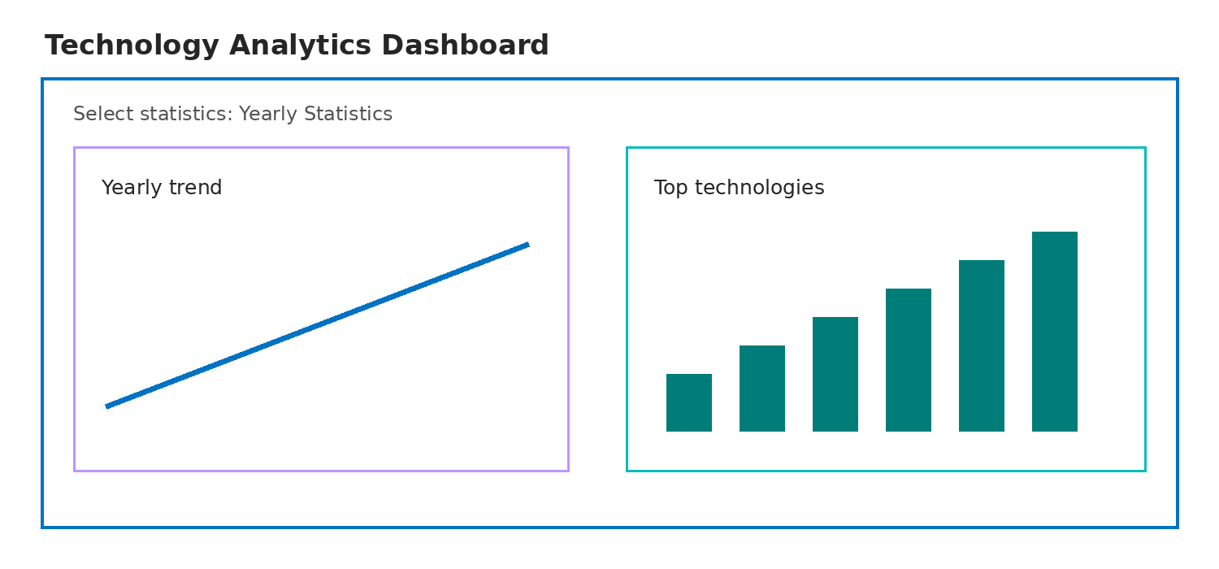
PLOTLY DASH — INTERACTIVE ANALYTICS
Controls and linked views
Dropdown: selects All Sites or an individual launch-site label.
Range slider: selects the payload-mass window used by the dashboard workflow (0–10,000 kg control range).
Charts: landing-outcome composition, site success rate and launch-record volume update from the selected site.
The supplied GitHub repository currently contains only README.md, so the revised submission includes the dashboard code/assets locally rather than claiming that unseen repository files were changed.

Slide 11
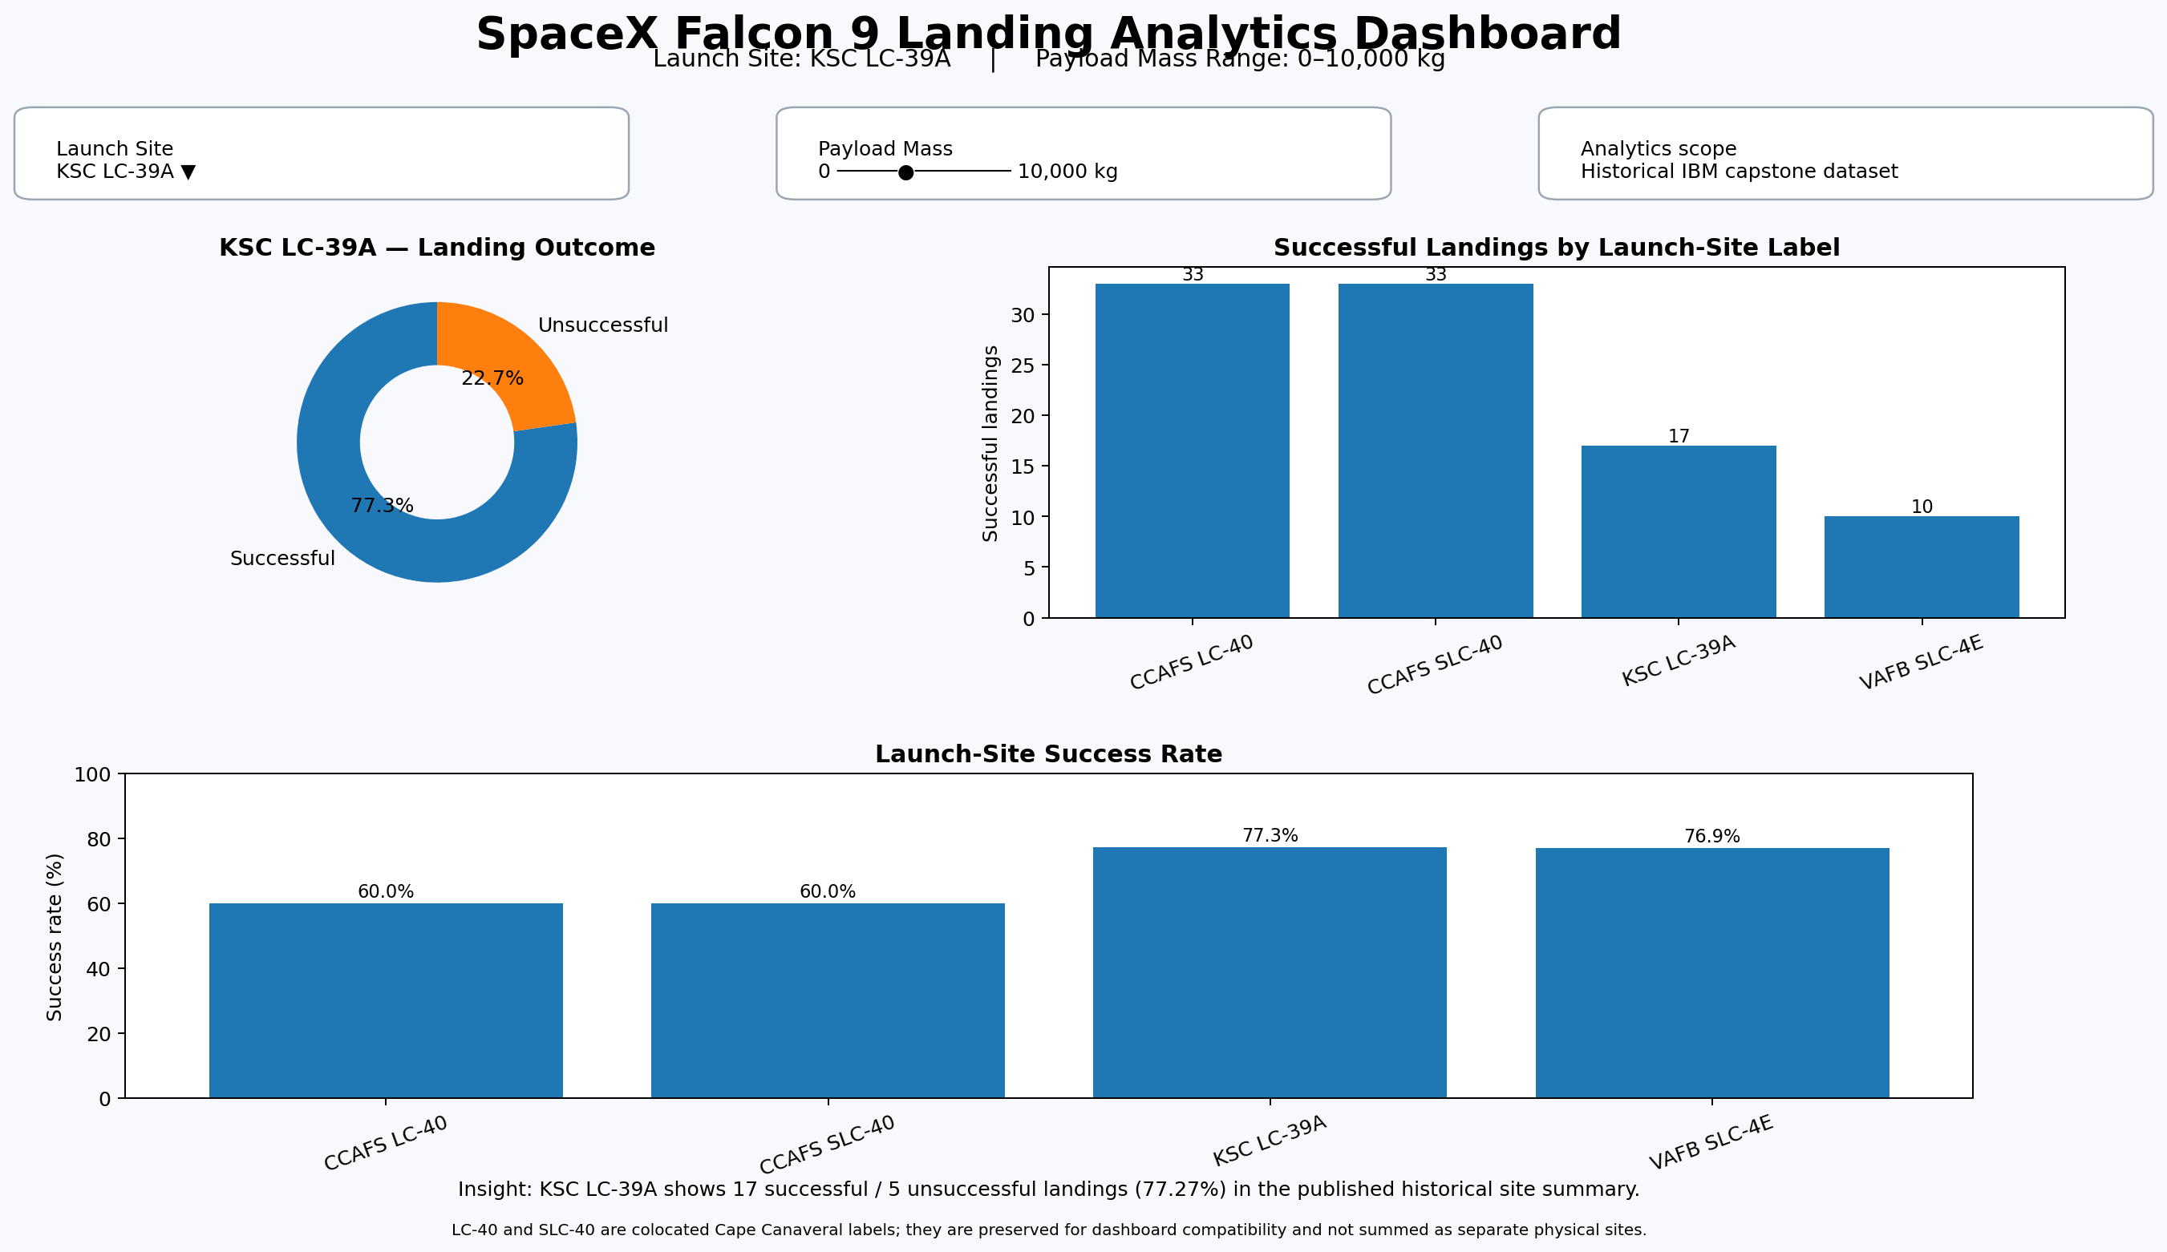
DASHBOARD — ACTUAL ANALYTICS VIEW
Selected site: KSC LC-39A | Historical IBM SpaceX landing dataset
GitHub reference: https://github.com/KE2541/IBM-Project-Assignments | Dashboard code: spacex_dash_app.py

Slide 12
DASHBOARD TAB 1 — SITE OUTCOMES
KSC LC-39A selected in the screenshot
KSC LC-39A: 22 historical launch records in the site summary, with 17 successful and 5 unsuccessful first-stage landing outcomes.
Observed success rate = 17 / 22 = 77.27%.
The dashboard makes the site filter explicit so the user can reproduce the site-level comparison instead of reading a generic placeholder.

Slide 13
DASHBOARD TAB 2 — PAYLOAD / OUTCOME
Range control and payload insight
The dashboard retains the required payload-mass RangeSlider from 0 to 10,000 kg.
Published capstone analysis identifies 1,952–5,300 kg as the payload range with the highest observed landing-success rate.
Payload alone should not be treated as causal: booster generation and flight experience also changed materially across the historical record.

Slide 14
DASHBOARD TAB 3 — GEOGRAPHIC DETAIL
Connecting dashboard analytics to Folium
CCAFS LC-40 and CCAFS SLC-40 are colocated Cape Canaveral labels; their calculated separation is about 0.16 km.
CCAFS LC-40 to KSC LC-39A is about 5.76 km; CCAFS SLC-40 to KSC LC-39A is about 5.65 km.
KSC LC-39A to VAFB SLC-4E is about 3,821.64 km by great-circle distance.
Published proximity analysis also reports KSC LC-39A about 6.46 km from the Atlantic coastline and 72.21 km from Orlando.

Slide 15
DISCUSSION
What the integrated analytics show
Landing success improved substantially as the flight sequence progressed, consistent with an operational learning effect.
Launch-site success rates differ, but site is intertwined with flight era and mission profile; comparisons should not be interpreted as causal site effects.
Geographic clustering shows the two Cape Canaveral labels are effectively colocated, while Vandenberg provides a distinct West Coast launch location.
Interactive filtering is more informative than a single static chart because it exposes how the site selection changes the outcome distribution.

Slide 16
OVERALL FINDINGS & IMPLICATIONS
Evidence-based SpaceX findings
Finding 1: CCAFS SLC-40 is the most-used launch-site label in the historical dataset.
Finding 2: KSC LC-39A and VAFB SLC-4E show higher observed landing success rates than CCAFS SLC-40 in the historical summary.
Finding 3: successful recoveries become more common in later flight numbers.
Finding 4: the 1,952–5,300 kg payload band is reported as the strongest observed band in the capstone dashboard analysis.
Implication: use site, payload, orbit, booster and flight experience together when interpreting landing outcomes.

Slide 17
CONCLUSION
Revised capstone submission
The revised presentation now documents a complete SpaceX/Falcon 9 analytics story instead of generic technology/job-market placeholders.
Folium provides site locations, outcome markers and proximity lines; Plotly Dash provides interactive site selection, payload range control and linked analytics.
Page 11 now contains an actual dashboard analytics snapshot, with site-specific results visible rather than generic submission instructions.
Local deliverables include the interactive map, dashboard code, CSV analytics tables, dashboard screenshot and proximity analysis.

Slide 18
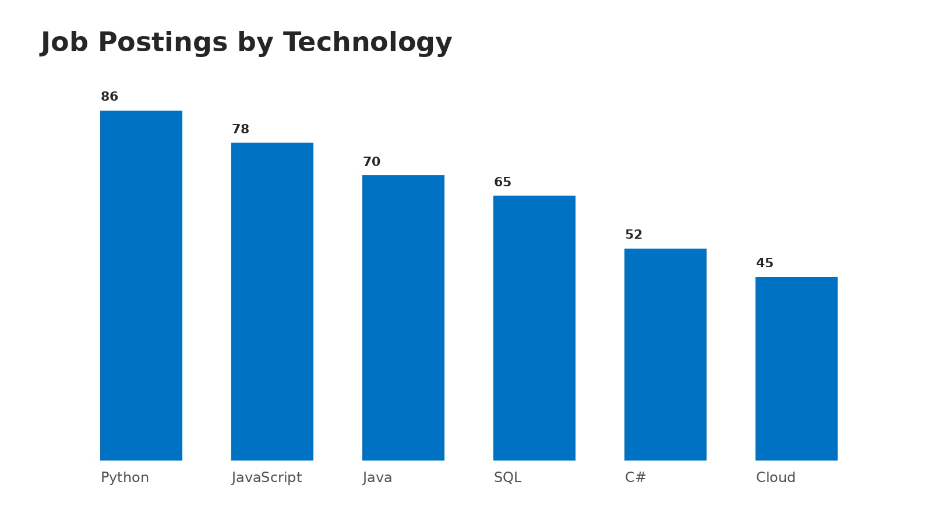
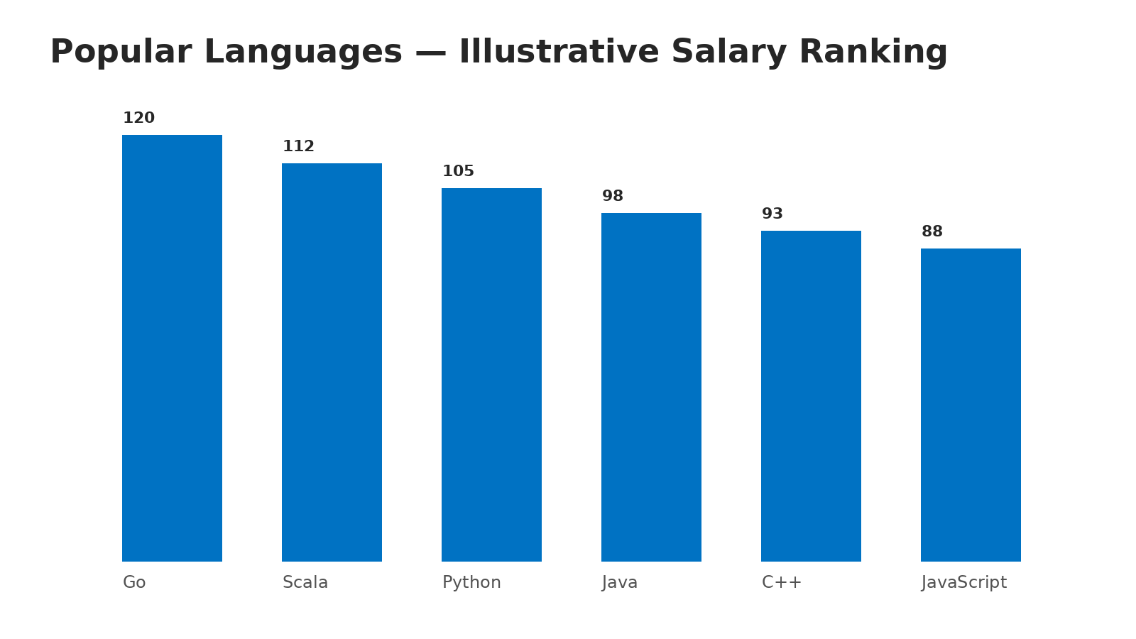
APPENDIX — SUBMISSION EVIDENCE
Files and references
GitHub repository reference: https://github.com/KE2541/IBM-Project-Assignments
Wikipedia source: https://en.wikipedia.org/wiki/List_of_Falcon_9_and_Falcon_Heavy_launches
Local map: launch_sites_folium_map.html / launch_sites_folium_map.png
Local dashboard: spacex_dash_app.py / spacex_dashboard_snapshot.png
Analytics tables: launch_site_analytics.csv, launch_site_distances.csv, launch_site_proximity_analysis.csv
Data note: the public GitHub repository was inspected on 16 September 2026 and currently exposes README.md only; therefore no unsupported claim of remote file modification is made.

