Slide 1
AIR QUALITY MONITORING

Slide 2
INTRODUCTION:
To provide adequate environmental and health protection, an effective air quality monitoring system is a necessary instrument. It is desirable that the system is simple, reliable, sensitive and cost-effective. In addition, this system must be highly sensitive to low concentrations of gaseous air contaminants such as hydrogen and carbon monoxide which exist in cigarette smoke.
In present paper the investigation of tin dioxide gas sensor for air contaminants is introduced. Based on such semiconducting sensor, supported by temperature and humidity integrated sensors, the design and implementation of virtual system for air quality monitoring is suggested.

Slide 3
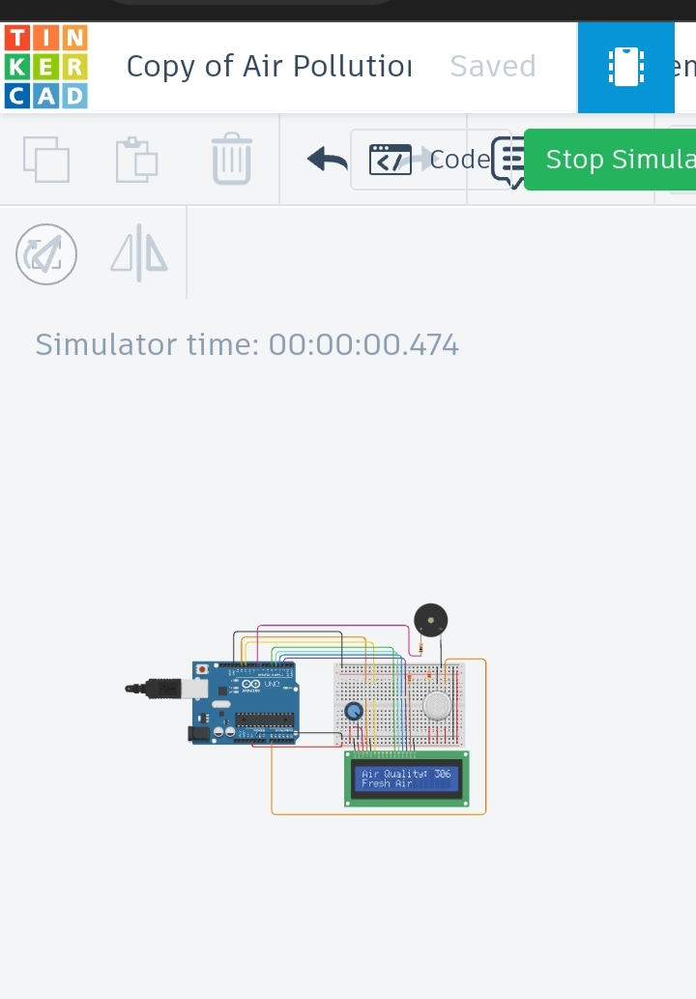
CONNECTION IN TINKERCAD:

Slide 4

CODING IN TINKERCAD:

Slide 5
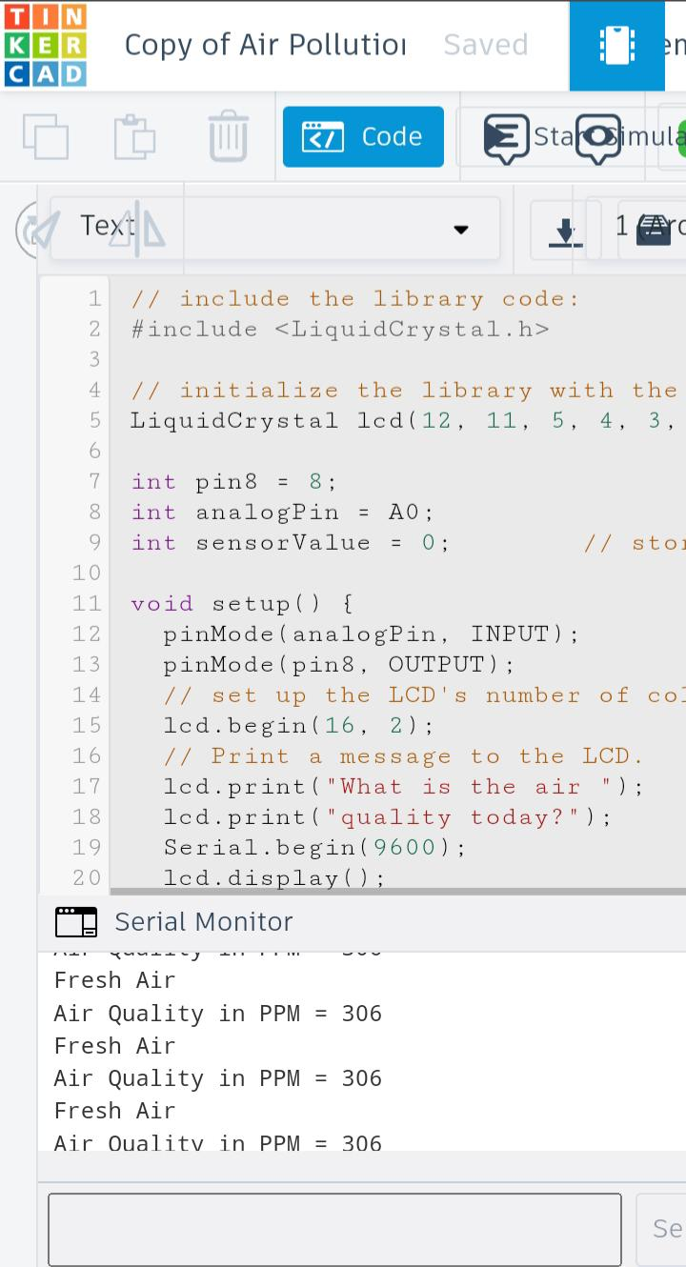
OUTPUT:

Slide 6

MIT INVERTER OPERATION:

Slide 7


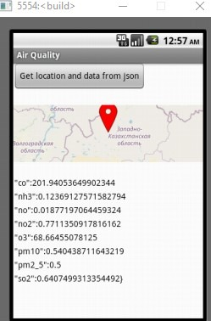

Slide 8

MIT OUTPUT OPERATION:

