Slide 1
Employee Data Analysis using Excel
STUDENT NAME: KEERTHANA P
REGISTER NO: 859844975781A8E9F2A4E06B118FB8B2,312208706 DEPARTMENT: B.COM(GENERAL)
COLLEGE: MEENAKSHI COLLEGE FOR WOMEN

Slide 2
PROJECT TITLE
Employee Performance Analysis Based On Departments, Employee Type And FTE using Excel

Slide 3


AGENDA
1.Problem Statement 2.Project Overview 3.End Users
4.Our Solution and Proposition 5.Dataset Description 6.Modelling Approach 7.Results and Discussion 8.Conclusion
3/21/2024 Annual Review

Slide 4

PROBLEM
STATEMENT
Kaggle is a platform for data science and machine learning. It offers datasets, competitions, and tools to help users practice, build, and deploy models. It's widely used for learning, sharing code, and collaborating on data-driven projects.

Slide 5

PROJECT OVERVIEW
Kaggle benefits include access to diverse datasets, the ability to participate in competitive challenges, opportunities for learning and improving data science skills, and collaboration with a global community of data scientists and machine learning enthusiasts.

Slide 6

WHO ARE THE END USERS?
HUMAN RESOURCE DEPARTMENTS
MANAGEMENT AND LEADERSHIP
TEAM LEADERS AND SUPERVISORS
EMPLOYEES
EXECUTIVE LEADERSHIP
BUSINESS ANALYSTS
RECRUITERS

Slide 7

OUR SOLUTION AND ITS VALUE PROPOSITION
FILTERING- REMOVE VALUES
PIVOT TABLE - SUMMARY OF EMPLOYEE PERFORMANCE
GARPH DIAGRAM - FINAL REPORT
6

Slide 8
Dataset Description
Employee ID: GEETHA
Age: 30
Gender: female
Years at Company: 10 years
Job Role: finance and media
Number of Promotions: 30
Distance from Home: 30 miles
Job Level: senior
Leadership Opportunities: yes
Company Reputation: excellent
Employee Recognition: high

Slide 9

THE "WOW" IN OUR SOLUTION
To solve a Kaggle competition, start by thoroughly understanding the problem statement, the data provided, and the evaluation metric. Begin with data cleaning and preprocessing, addressing missing values, and transforming features as needed. Perform Exploratory Data Analysis (EDA) to uncover patterns, relationships, and potential feature engineering opportunities. Train a baseline model to establish a performance benchmark, then experiment with more advanced models such as XGBoost or neural networks, and use techniques like cross-validation to assess their performance. Hyperparameter tuning is crucial to optimize model performance. Once satisfied with the model, consider ensembling different models to boost accuracy. Submit your predictions, analyse the results on the leaderboard, and iterate to refine your approach.
3/21/2024 Annual Re
view
9

Slide 10
MODELLING
STEP -1
DOWNLOAD THE EMPLOYEE DATASET IN KAGGLE
STEP -2
SELECT THE ENTIRE DATA AND CLICK ON DATA AND CLICK ON FILTER OPTION.
STEP -3
FILTER FTP FROM A TO Z ORDER.
STEP -4
SELECT THE ENTIRE DATA AND CLICK ON INSERT AND CLICK ON PIVOT TABLE TO CREATE PIVOT TABLE.
10

Slide 11
STEP -5
DRAG THE NEEDED DATA AND CREATE A PIVOT TABLE.
STEP -6
SELECT THE PIVOT TABLE AND CLICK ON INSERT.
STEP-7
NOW CLICK ON THE CHART THAT YOU WANT.
STEP -8
THE CHART IS CREATED.

Slide 12
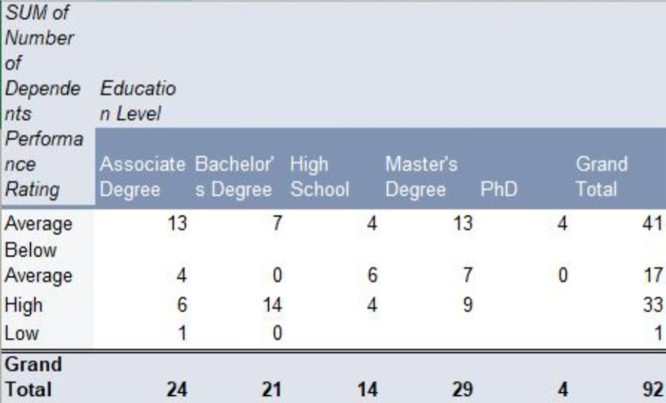
RESULTS
1.TABLE
12

Slide 13
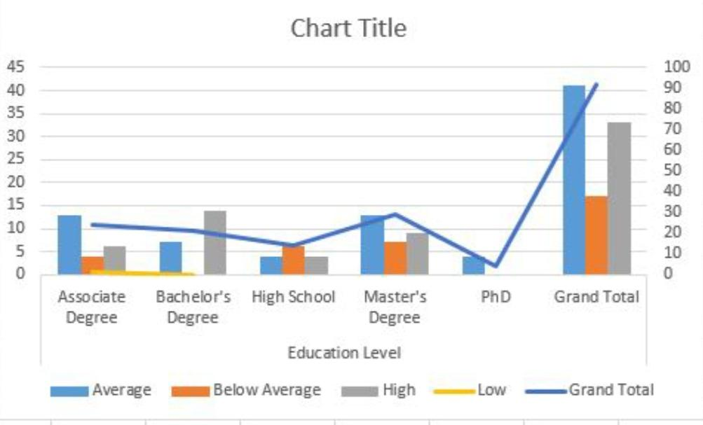
2.GRAPH DIAGRAM

Slide 14
conclusion
Could you clarify what you mean by "Kaggle conclusion"? Are you asking about how to write a conclusion for a Kaggle competition, project, or analysis, or do you need information on something specific related to Kaggle? Let me know so I can assist you better!

