Slide 1
BANKER’S ALGORITHM
GROUP 13

Slide 2
TEAM MEMBERS
G. KEERTHI TEJ
K. YADHU VAMSI
AM.EN.U4AIE20027
AM.EN.U4AIE20039
M. SRINIVAS
P. SATHWIK GOWTHAM
AM.EN.U4AIE20047
AM.EN.U4AIE20064

Slide 3
TABLE OF CONTENTS
01
02
03
04
INTRODUCTION
METHODOLOGY
ALGORITHM
RESULTS
&
DISCUSSION

Slide 4
INTRODUCTION
In the programming environment, many processes fight for the resources they are in need of to complete the following process.
Requested resources by a process may not be available at demand, and then the process enters in a wait state.
If a process is unable to change its own state indefinitely because the resources requested by it are being used by another waiting process, then the system is said to be in a deadlock.
We hereby try to explain our view of bankers’ algorithms to avoid deadlock situations.

Slide 5
A deadlock situation can also be described as a set of processes that are blocked because each process is holding a resource and waiting for another resource acquired by some other process.
Out of common algorithms, Banker’s algorithm by Dijkstra for resource allocation guarantees freedom from deadlock by denying requests for resources that lead to unsafe states.
In the banker’s algorithm, each process is required to predetermine its potential maximum resource requirement, though the process may be able to proceed satisfactorily with less than this amount.
Every process must guarantee that if the maximum number of resources is made available to it then it will complete its processing and return its resources to the system.

Slide 6
OVERVIEW
Banker’s algorithm can further be elaborated as a deadlock avoidance and resource allocation algorithm which ensures execution safety by simulating the allocation of the already determined resources and checking the possible deadlock conditions for pending processes.

Slide 7

The name of the algorithm, banker’s algorithm justifies itself as it is used before sanctioning loans to the customers. Consider there are ‘n’ account holders in a bank and the sum of the money in all their accounts is ‘S’. Every time a loan must be granted by the bank, it subtracts the loan amount from the total money the bank has. Then it checks if that difference is greater than ‘S’. It is done because if another person applies for a loan or withdraws some amount from the bank, it helps the bank manage and operate all things without any restriction in the functionality of the banking system
— Edsger Dijkstra

Slide 8
DEADLOCK
Deadlock condition is noticed if the following situations occur simultaneously.
Mutual exclusion condition: Only a single process at a time can execute and utilize a non-sharable resource. Either each resource is allocated to a process or is available for usage.
Hold and wait condition: A process holding at least one resource can request additional resources.
No preemption condition: A resource can be released only voluntarily by the process of holding it. That is previously granted resources cannot be forcibly taken away.

Slide 9
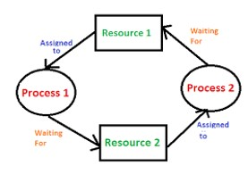
DEADLOCK
iv. Circular wait condition: There exists a process 1 which is already using resource 1 and is in further need of resource 2. Resource 2 is entangled with another process 2, process 2 is waiting for resource 1 which is held with process 1, for completion and followed by relieving resource 1 to make it available for equipment. This situation can be termed as circular wait conditions.

Slide 10
TABLE OF CONTENTS
01
02
03
04
INTRODUCTION
METHODOLOGY
ALGORITHM
RESULTS
&
DISCUSSION

Slide 11
METHODOLOGY
The Methods for handling deadlock situations are as follows
1) Deadlock Avoidance:
The idea is to not let the system into a deadlock state. Prevention is done by negating one of the above-mentioned necessary conditions for deadlock.
We need to ensure that all information about resources which process will need is known to us prior to execution of the process.
We use Banker’s algorithm in order to avoid deadlock.
Deadlock detection and recovery:
Let deadlock occur, then do preemption to handle it once occurred.
Ignore the problem altogether:
If a deadlock is very rare, then let it happen and reboot the system.
This is the approach that both Windows and UNIX take.

Slide 12
CHARACTERISTICS OF ALGORITHM
If any process requests a resource, then it must wait.
The algorithm consists matrix which holds the maximum number of resources in a process for the system
Each process should provide information for upcoming resource requests, the number of resources, and how long the resources will be held.
It helps in control process requests for each type of resource in the computer system
In this algorithm, if any process gets all the needed resources, then it is that it should return the resources in a restricted period.
Various resources are maintained in this algorithm that can fulfill the needs of at least one client.

Slide 13
BASIC TERMINOLOGY
1
[MAX]
How much each process can request for each resource in the system
2
[ALLOCATED]
How much each process is currently holding each resource in a system
3
[AVAILABLE]
How many numbers of each resource are currently available in the system

Slide 14
USED DATA STRUCTURES
AVAILABLE
MAX
The size of the 1-D array is ‘m’ which is used to determine the number of available resources of each kind.
The size of the array is ‘n*m’. The max data structure is used to determine the maximum number of resources that each process requests.
ALLOCATION
NEED
the size of the 2-D array is ‘n*m’, which is used to define the number of resources of each kind presently assigned to each process.
The size of the 2-D array is ‘n*m’. Need is used to define the remaining resources which are required for each process.

Slide 15
TABLE OF CONTENTS
01
02
03
04
INTRODUCTION
METHODOLOGY
ALGORITHM
RESULTS
&
DISCUSSION

Slide 16
OVERVIEW
Banker’s algorithm consists of Safety algorithm and Resource request algorithm
Safety Algorithm: The algorithm for finding out whether a system is in a safe state.
Resource Request Algorithm: The algorithm is mainly used to determine whether requests can be safely granted or not.

Slide 17
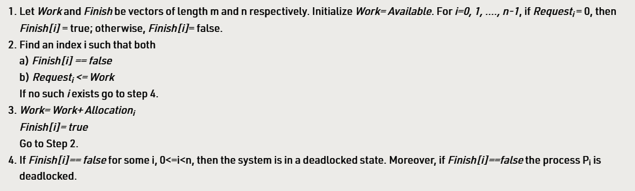
SAFETY ALGORITHM

Slide 18
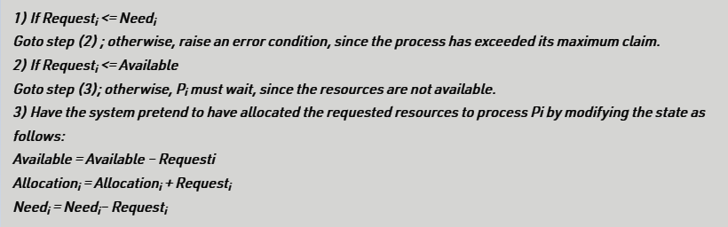
RESOURCE REQUEST ALGORITHM

Slide 19
GITHUB LINK

Slide 20
TABLE OF CONTENTS
01
02
03
04
INTRODUCTION
METHODOLOGY
ALGORITHM
RESULTS
&
DISCUSSION

Slide 21
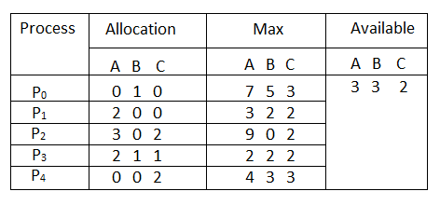
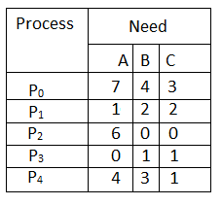
RESULTS
Need [i, j] = Max [i, j] – Allocation [i, j]
Need Matrix is:
Considering the example, to understand the algorithm.

Slide 22
Similarly, we examine another process P5.
Step 5: For Process P4:
P4 Need <= Available
4, 3, 1 <= 7, 4, 3 condition is true
New available resource = Available + Allocation
7, 4, 3 + 0, 0, 2 => 7, 4, 5
Now, we again examine each type of resource request for processes P0 and P2.
Step 6: For Process P0:
P1 Need <= Available
7, 4, 3 <= 7, 4, 5 condition is true
New Available Resource = Available + Allocation
7, 4, 5 + 0, 1, 0 => 7, 5, 5
So, we examine another process P2.
Step 7: For Process P2:
P3 Need <= Available
6, 0, 0 <= 7, 5, 5 condition is true
New Available Resource = Available + Allocation
7, 5, 5 + 3, 0, 2 => 10, 5, 7
Hence, the banker's algorithm to find the safe state and the safe sequence P1, P3, P4, P0 and P2.
Step 1: For Process P0:
Need <= Available
7, 4, 3 <= 3, 3, 2 condition is false.
So, we examine another process, P1.
Step 2: For Process P1:
Need <= Available
1, 2, 2 <= 3, 3, 2 condition true
New available = available + Allocation
(3, 3, 2) + (2, 0, 0) => 5, 3, 2
Similarly, we examine another process P2.
Step 3: For Process P2:
P3 Need <= Available
6, 0, 0 < = 5, 3, 2 condition is false.
Similarly, we examine another process, P3.
Step 4: For Process P3:
P4 Need <= Available
0, 1, 1 <= 5, 3, 2 condition is true
New Available resource = Available + Allocation
5, 3, 2 + 2, 1, 1 => 7, 4, 3

Slide 23
LIMITATIONS OF ALGORITHM
The limitations for the algorithm are as follows:-
During the time of Processing, this algorithm does not permit a process to change its maximum need.
Another disadvantage of this algorithm is that all the processes must know in advance about the maximum resource needs.
This algorithm permits the requests to be provided in constrained time, but for one year which is a fixed period.

Slide 24

CONCLUSION
The banker’s algorithm is a resource allocation and deadlock avoidance algorithm that tests for safety by simulating the allocation for predetermined maximum possible amounts of all resources, then makes an “s-state” check to test for possible activities, before deciding whether allocation should be allowed to continue. It helps the operating system manage and control process requests for each type of resource in the computer system. The algorithm has a Max resource attribute that represents indicates each process can hold the maximum number of resources in a system. We implement the code for finding a safe sequence using allocation, available, need a matrix. We discuss the limitations and characteristics of the algorithm.

Slide 25
THANK YOU!

