Slide 1

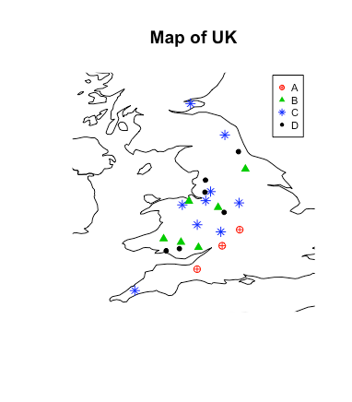
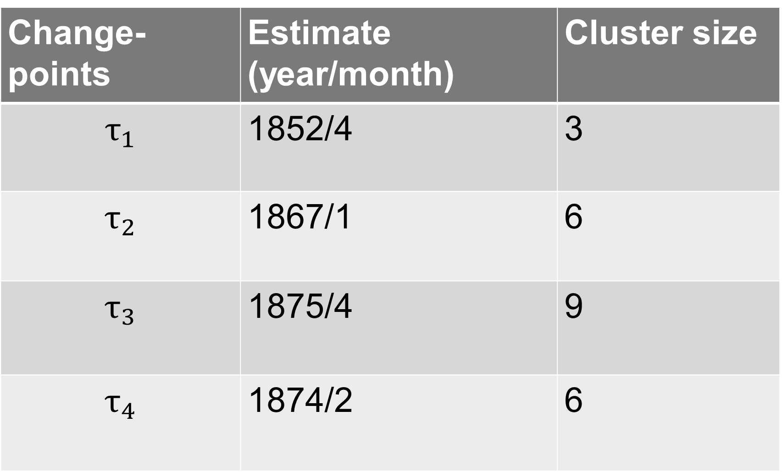
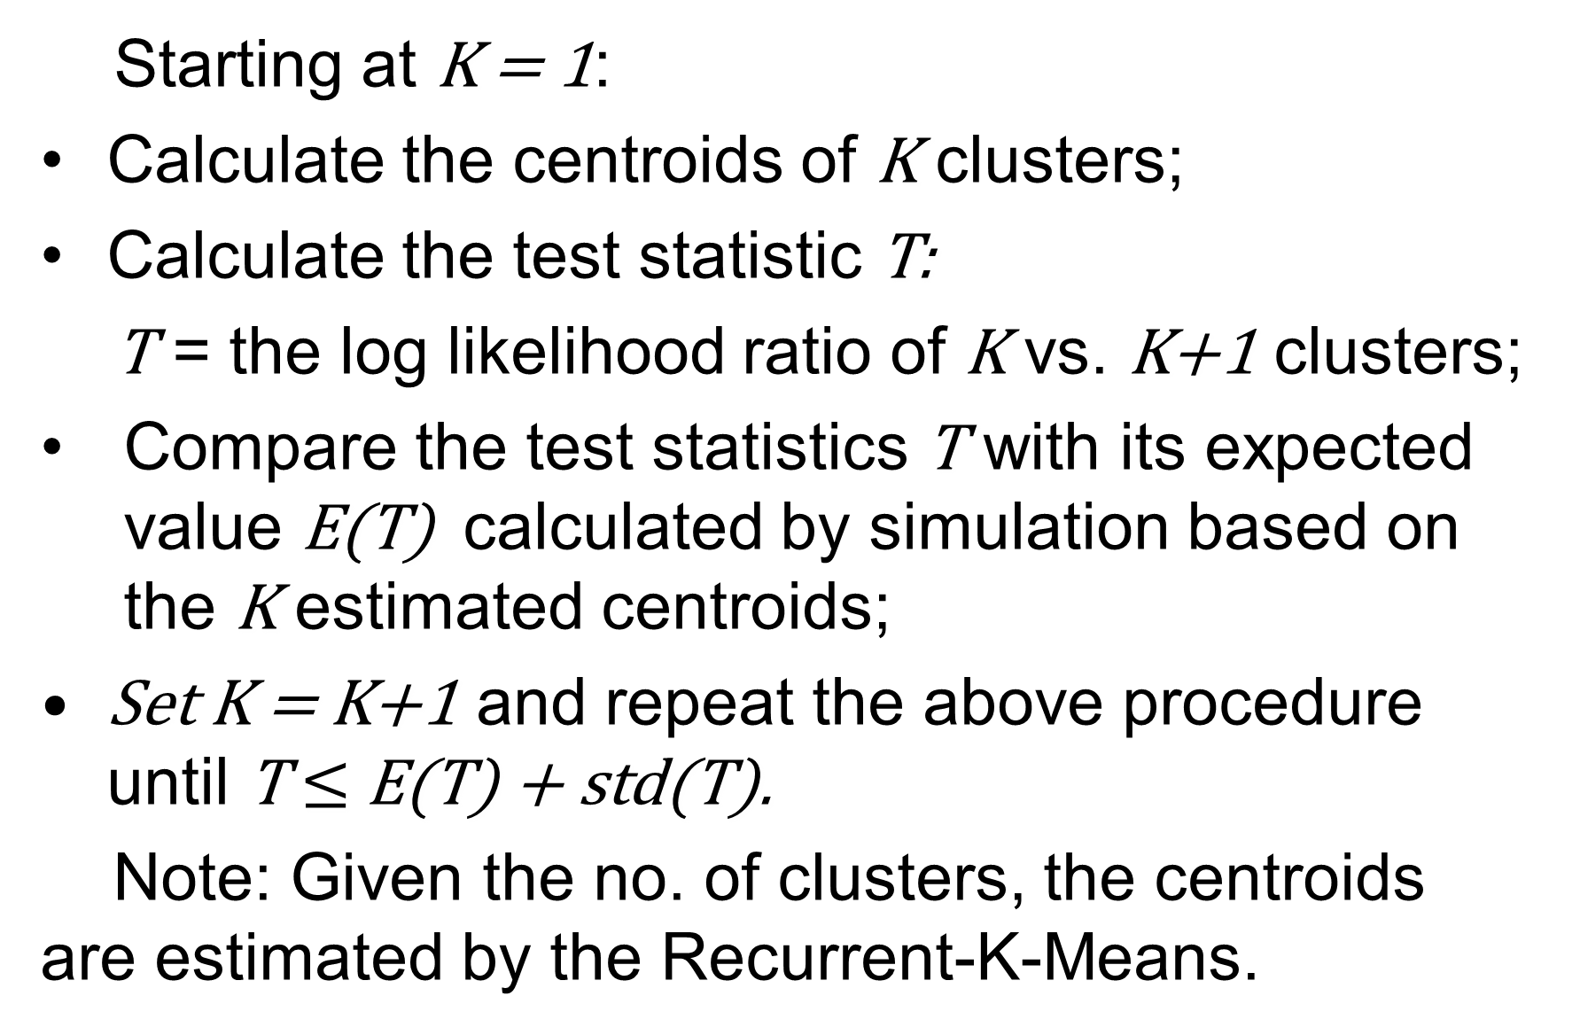
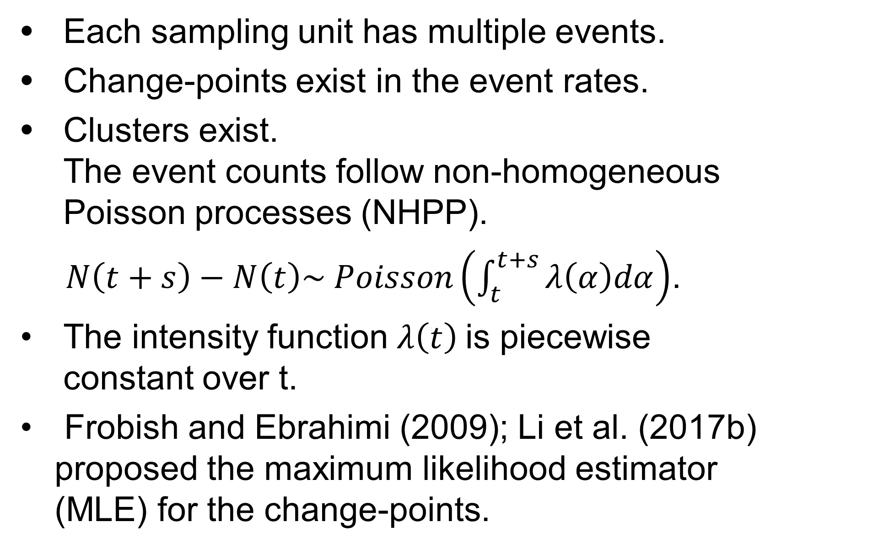
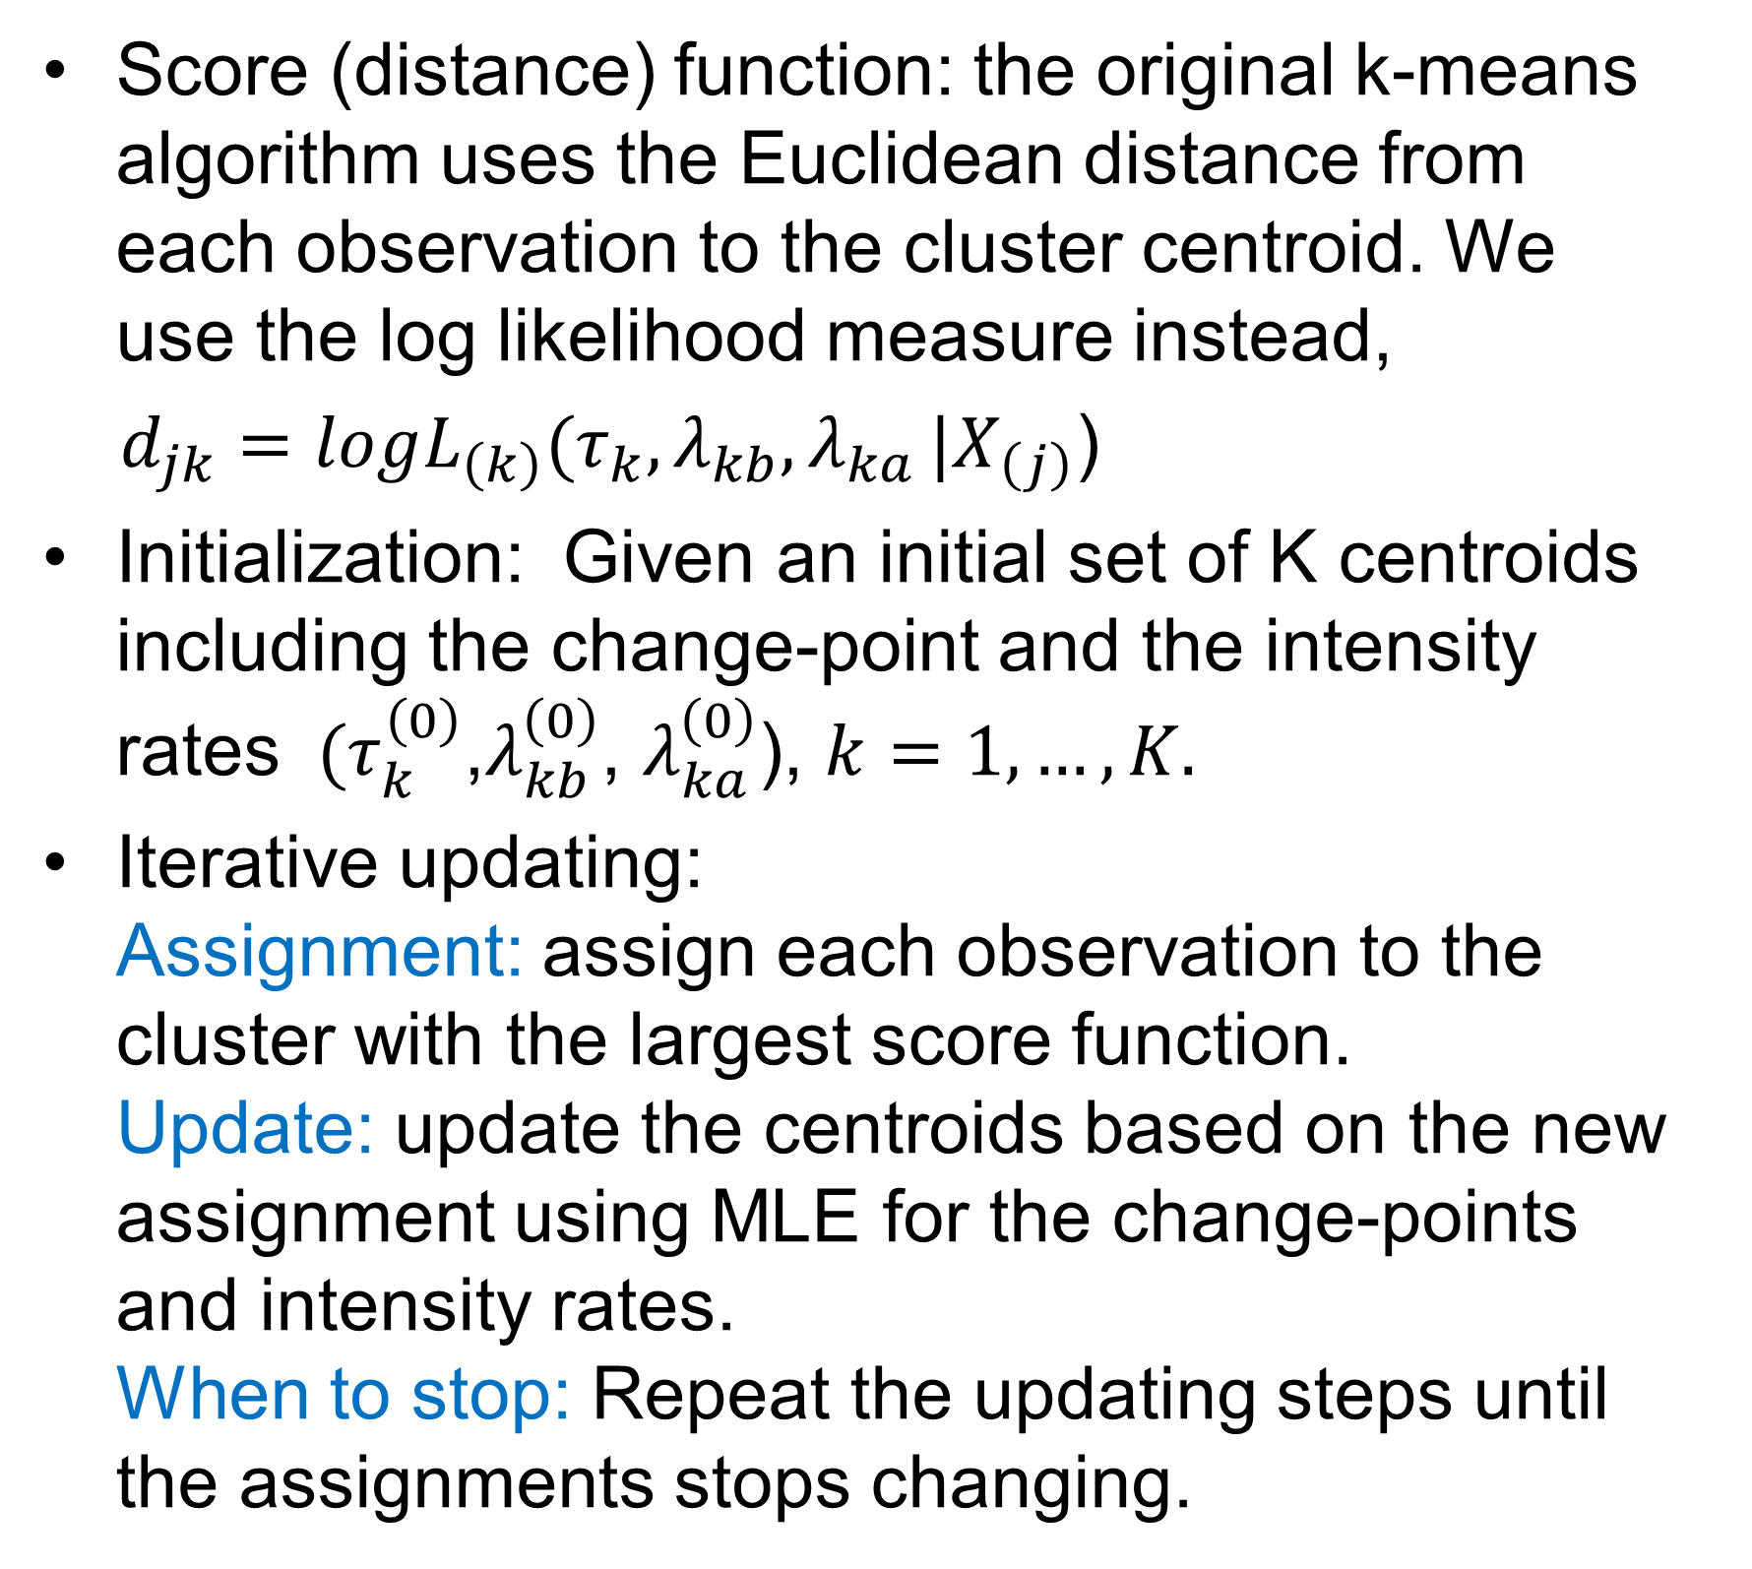
A Change-Point Detection and Clustering Method
in the Recurrent-Event Context
Qing Li^{1,2}, Kehui Yao¹, Xinyu Zhang¹
University of Wisconsin-Madison¹, Iowa State University²
kyao24@wisc.edu
Introduction
Determine the No. of Clusters
Coal Mining Data Analysis
Conclusion
Each sampling unit has multiple events.
Change-points exist in the event rates.
Clusters exist. The event counts follow non-homogeneous Poisson processes (NHPP).
$N\left(t+s\right)−N\left(t\right)\sim Poisson\left(\int_{t}^{t+s}{λ\left(α\right)dα}\right)$.
The intensity function $λ\left(t\right)$is piecewise constant over t.
Frobish and Ebrahimi (2009); Li et al. (2017b) proposed the maximum likelihood estimator (MLE) for the change-points.
Starting at K = 1:
Calculate the centroids of K clusters;
Calculate the test statistic T:
T = the log likelihood ratio of K vs. K+1 clusters;
Compare the test statistics T with its expected value E(T) calculated by simulation based on the K estimated centroids;
Set K = K+1 and repeat the above procedure until T $≤$ E(T) + std(T).
Note: Given the no. of clusters, the centroids are estimated by the Recurrent-K-Means.
This data is obtained from the coal mining history resource center, which records the mining disasters happened in UK from 1850 to 1901.
342 disasters in total in 24 locations.
Subgroups exists.
Simulation shows the method is accurate in estimation and clustering under various situations.
The method is straightforward to implement and is an efficient alternative for the Bayesian finite mixture model (BFMM) in Li, et al. (2017b).
The data analysis result is reasonable: The clustering result is consistent with the geological pattern; The estimated change points for cluster 2,3 and 4 were during the Second Industrial Revolution, when there was a peak development in the mining industry.
The algorithm is relatively sensitive to outliers, so our future work will be making the algorithm more robust.
Data generated from two clusters, test K=1.
Reference
Change-points | Estimate (year/month) | Cluster size
$$τ_{1}$$ | 1852/4 | 3
$$τ_{2}$$ | 1867/1 | 6
$$τ_{3}$$ | 1875/4 | 9
$$τ_{4}$$ | 1874/2 | 6
Frobish, D. and Ebrahimi, N. (2009). Parametric estimation of change-points for actual event data in recurrent events models. Computational Statistics and Data Analysis, 53:671–682.
Li, Q., Guo, F., Kim, I., Klauer, S., and Simons-Monton, B. (2017a). A Bayesian finite mixture change-point model for assessing the risk of novice teenage drivers. Journal of Applied Statistics, 45:604–625.
Li, Q., Guo, F., Klauer, S., and Simons-Monton, B. (2017b). Evaluation of risk change-point for novice teenage drivers. Accident Analysis & Prevention, 108:139–146.
Simulation
Clustering Given the No. of
Clusters: Recurrent-K-Means
Check the model performance under different simulation settings.
The two percentages from several simulation settings are as follows: P1 (%): the percentage of correctly estimated number of clusters out of 200 data sets.
P2 (%): the average percentage of correctly grouped subjects.
Score (distance) function: the original k-means algorithm uses the Euclidean distance from each observation to the cluster centroid. We use the log likelihood measure instead,
$d_{jk}=logL_{\left(k\right)}(τ_{k},λ_{kb}{,λ}_{ka}|X_{\left(j\right)}$)
Initialization: Given an initial set of K centroids including the change-point and the intensity rates ${ (τ}_{k}^{\left(0\right)}$,$λ_{kb}^{\left(0\right)}$, $λ_{ka}^{\left(0\right)}$), $k=1,…,K.$
Iterative updating: Assignment: assign each observation to the cluster with the largest score function. Update: update the centroids based on the new assignment using MLE for the change-points and intensity rates. When to stop: Repeat the updating steps until the assignments stops changing.
Acknowledgement
Setting | 1 | 2 | 3 | 4
P1 | 97.50 | 97.50 | 80.00 | 97.05
P2 | 98.65 | 98.65 | 88.05 | 98.21
Special thanks given to Dr. Qing Li, who gave this research project professional guidance and valuable support.
Contact Information
Kehui Yao: Department of Statistics, University of Wisconsin Madison. Email: kyao24@wisc.edu

