Slide 1
Confidence Intervals
R-Training workshop, Pwani University
17TH February 2016
Dr. David Mburu (PhD)

Slide 2
Point Estimation:
Provides a single value, based on observations from one sample
Gives no information about how close the value is to the unknown population parameter
Example: Sample mean x = 3 is point estimate of unknown population mean

Slide 3
Interval estimation:
Provides a range of values based on observations from one sample
Gives information about closeness to unknown population parameter,
Stated in terms of probability,
Knowing exact closeness requires knowing unknown population parameter
Example: The range between 50 and 70 contains the true unknown parameter value with 95% confidence]

Slide 4
Importance of confidence intervals
The confidence interval quantifies our uncertainty in an estimate.
A survey of haemoglobin status in children <5yrs in Kilifi district.
30 children gave a finger prick blood sample. Mean Hb was 9.6g/dl
How reliable is this estimate?
Confidence intervals quantify the magnitude of treatment benefit in a clinical trial
The confidence interval is the range of plausible values for the true vaccine efficacy
Design studies to ensure confidence intervals are narrow enough to draw conclusions. The confidence interval for vaccine efficacy is too wide to be useful. It includes useful benefit (52%) and no effect (0%) as plausible values
The larger the study the narrower the confidence interval

Slide 5
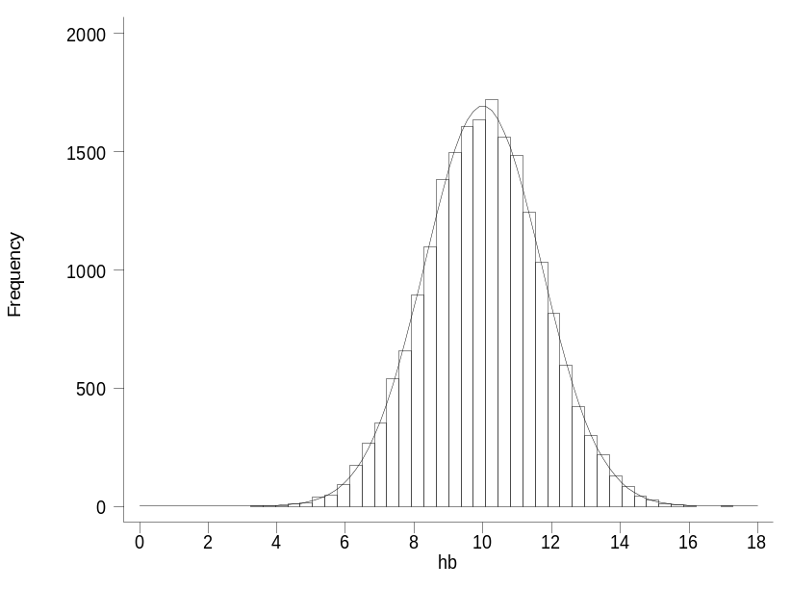
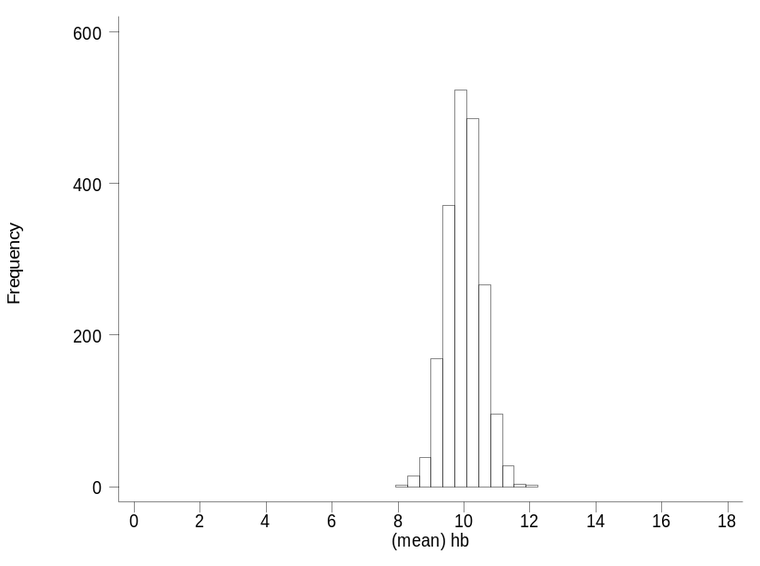
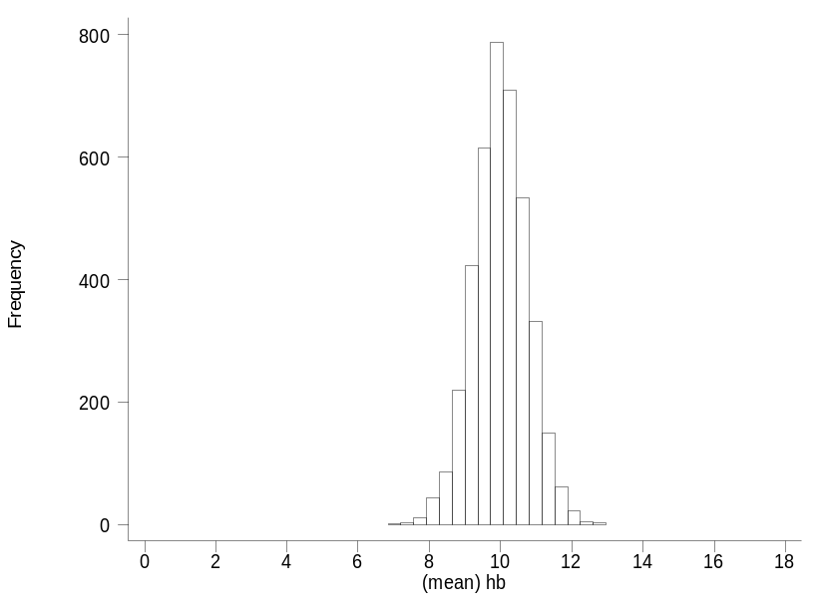
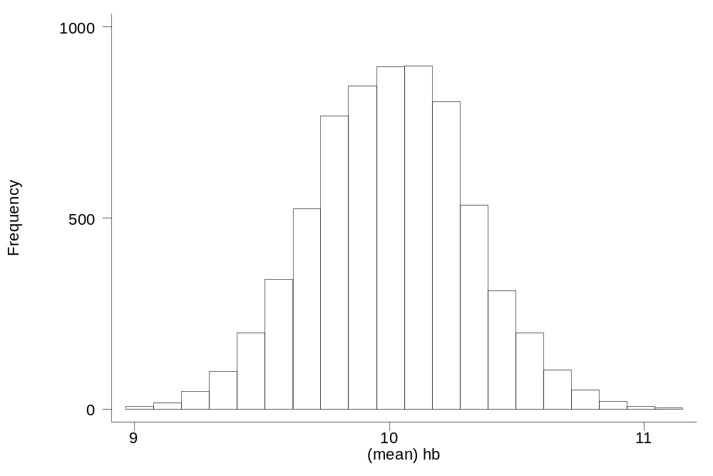
Distribution of Hb in the population
Mean 10 g/dl
SD 1.7 g/dl
Sampling distribution of the mean sample size n=10
Standard error
1.7/√10
=1.7/3.2
Standard error SD/√n
1.7/√5
1.7/2.2
Sampling distribution of the mean sample size n=30
Sampling distribution of the mean sample size n=5
Bigger sample size, less variability in sample means: s.e.=SD√n
Average value of sample means is equal to the population mean
Sample means follow normal distribution if the distribution in the population is normal
and if n is large, is roughly normal even if the population is not normal

Slide 6
95% of sample means lie within 2 standard errors
If we repeated our sampling many times, 95% of sample means would be within 2 standard errors of the population mean.
In practice we usually have only one sample but we can use the sample data to quantify the uncertainty in our single estimate
µ - 2 s.e.
µ + 2 s.e.
Population mean µ

Slide 7
95% of sample means lie within 2 s.e. of the population mean
so we can also say:
95% of the time the population mean will lie within 2 s.e. of the our sample mean
Population mean, µ
2 s.e.
2 s.e.
Sample mean, x
2 s.e.
2 s.e.

Slide 8
Population mean, µ
2 s.e.
2 s.e.
Sample mean, x
2 s.e.
2 s.e.
Sample estimate of the SD: 1.5 g/dl
Standard error s.e. = SD/√n
s.e.=1.5/√30 = 1.5/5.477 = 0.274
95% confidence interval 9.6 – 2x0.274 to 9.6 + 2x0.274
9.1 g/dl to 10.1 g/dl
Interpretation: we can say with 95% confidence that the mean Haemoglobin concentration in children in the population could be as small as 9.1 or as big as 10.1 g/dl

Slide 9
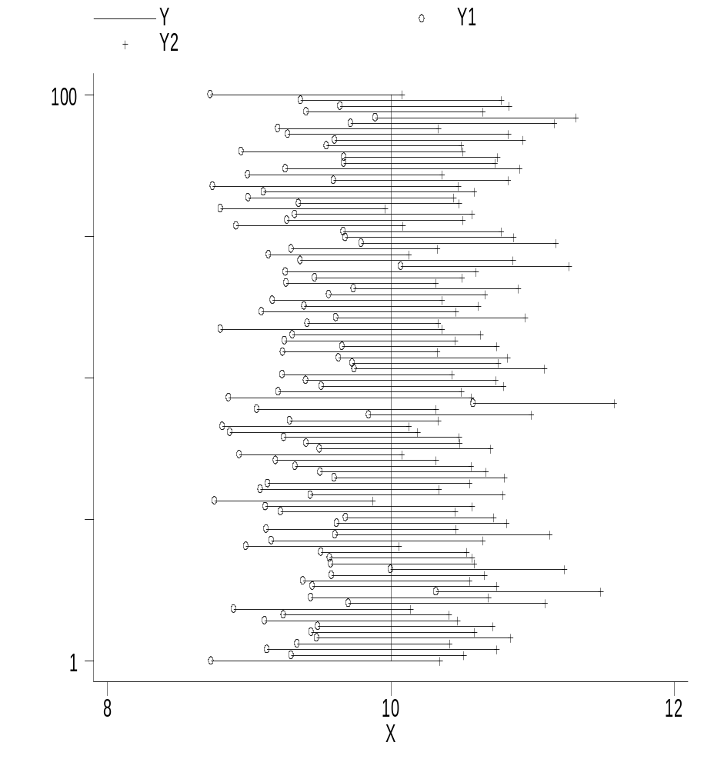
95% confidence intervals for mean haemoglobin from 100 random samples of size 30
Population mean 10g/dl Population SD 1.7g/dl
On average 95% of the intervals include the population mean
Small chance the interval will not include the population mean
We will not know for certain whether the interval we calculate includes the population mean

Slide 10
Now consider what will change if we increase the sample size to n=100:
What happens to the width of the interval?
What proportion of intervals will include the population mean?

Slide 11
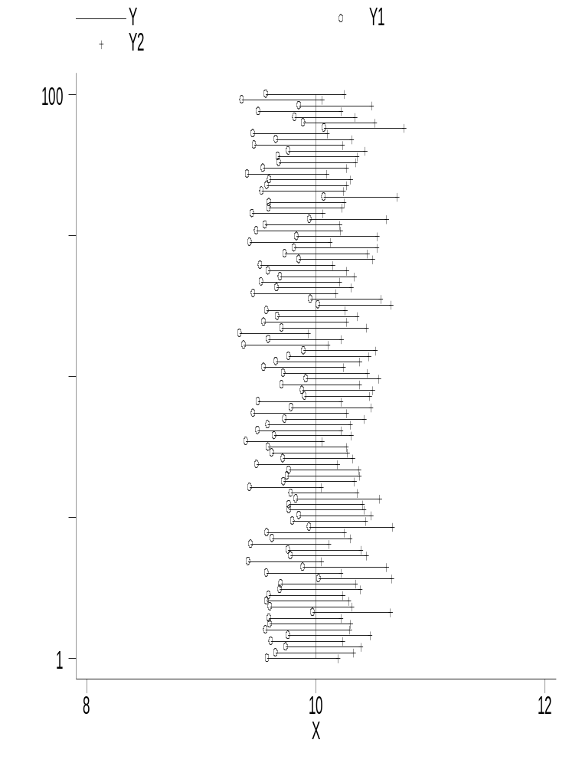
95% confidence intervals from 100 samples size 30 and 100 samples size 100
n=100
n=30
5% do not include the population mean
95% of the intervals include the population mean
Larger sample size -> narrow confidence interval
We can improve the probability of including the population mean by using 99% confidence intervals, at the cost of having wider intervals and so more uncertainty

Slide 12
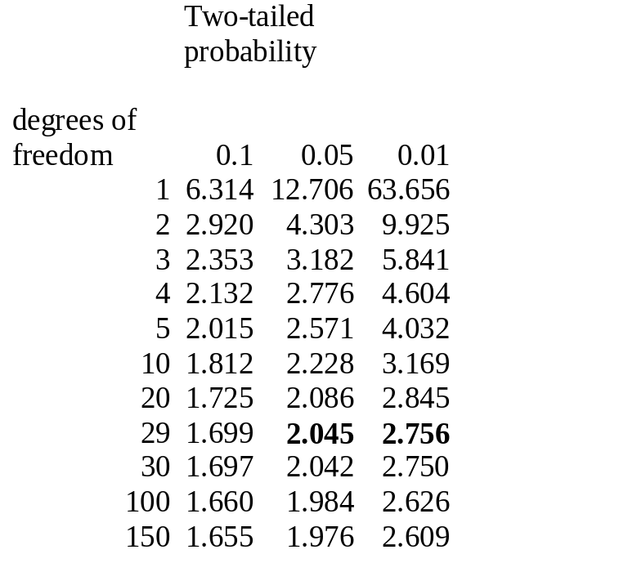
For large samples: x+/- 1.96 s.e.
With continuous data, if samples are small the estimated standard error tends to be an underestimate. To correct for this we use t-tables to find the multiplier:
Sample mean 9.6 Sample SD 1.5
Standard error 1.5/√30=0.274
95% confidence interval:
9.6 – 2.045 x 0.274 to 9.6 + 2.045x0.274
9.04 to 10.16 g/dl
99% confidence interval:
9.6 – 2.756 x 0.274 to 9.6 + 2.756x0.274
8.85 to 10.35 g/dl

Slide 13
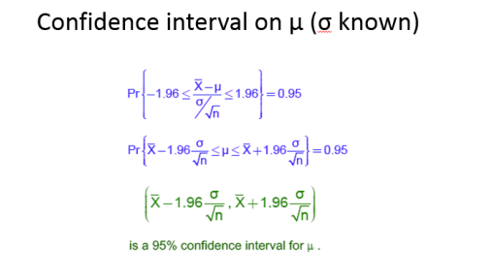

Slide 14
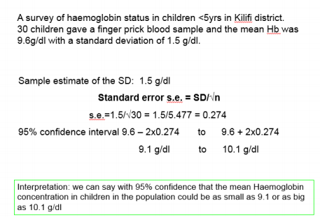

Slide 15
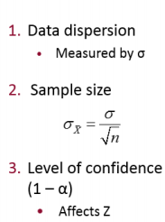


Slide 16
Confidence intervals: summary
The confidence interval expresses the uncertainty in sample estimates of means, proportions, treatment efficacy, dose response,,,
Larger the sample, the narrower the CI
Can improve the probability of including the population mean by calculating 99% interval but at a cost of having a wider interval and thus greater uncertainty
Should design studies to yield CI’s that are narrow enough to draw replicative conclusions
Interpretation depends on the assumption that the sample was representative of the population

