Slide 1
PHASE 3 PROJECT

Slide 2
Syriatel Customer Churn Prediction Project

Slide 3
BUSINESS UNDERSTANDING
Syriatel faces a challenge: a significant number of customers are departing for rival companies. To tackle this, they aim to develop a tool capable of forecasting customer churn. By analyzing their data to discern the reasons behind customer departures, they plan to construct a predictive model to anticipate when a customer might defect. This initiative is designed to empower Syriatel to proactively address customer concerns, enhance satisfaction, and prevent churn.

Slide 4
BUSINESS OBJECTIVE
Main objective
The primary objective of this project is to pinpoint the factors driving customer churn and build a classifier capable of forecasting which customers are at risk of leaving. This predictive tool will enable Syriatel to take timely and targeted actions to mitigate customer attrition and enhance retention efforts.

Slide 5
Specific objective
To find out why customers are leaving.
To see which factors affect customer leaving the most.
- To make a model that can predict if a customer might leave.
- To check how well the model works and compare it with others.
To find ways to stop customers from leaving and keep more of them.
To make a plan to use the ideas from the model to stop customers from leaving.
- To watch and see how well the plan works over time in stopping customers from leaving and how it affects the business.

Slide 6
DATA PREPARATION
Data cleaning
Data Analysis (Univariate Analysis , Bivariate Analysis and Multivariate Analysis)
Handling categorical features

Slide 7
MODELING AND EVALUATION

Slide 8
The dataset was analyzing presents a binary classification challenge aimed at predicting churn, i.e., whether a customer will leave or not. My approach involves utilizing a basic logistic regression model, with evaluation based on the recall score. Success criteria are set at achieving a recall score of 75% or higher. To fulfill the objectives outlined in the project proposal, I intended to utilized a variety of machine learning algorithms. These selected algorithms offerred distinct advantages and are tailored to address different aspects of the project requirements. The algorithms I employed include:
Logistic Regression
Decision Tree
Random Forest

Slide 9
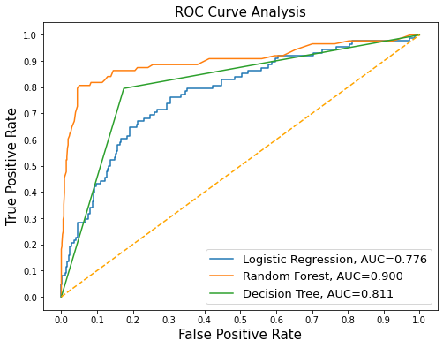
The analysis of ROC curves reveals varying performance levels among the classifiers, with RandomForestClassifier demonstrating the most robust performance, followed by DecisionTreeClassifier and LogisticRegression, in descending order. Notably, RandomForestClassifier achieves the highest AUC score of 0.900, indicating superior discrimination between positive and negative instances. Conversely, the LogisticRegression model attains the lowest AUC score at 0.776.

Slide 10
CONCLUSION

Slide 11
Based on the findings, the business conclusion is as follows:
- Emphasis on Recall: In the realm of predicting customer churn, priority was given to optimizing for Recall. This strategy aimed to minimize the misclassification of churners as non-churners, ensuring that the model effectively identifies customers at risk of leaving.
- Optimal Model: Among the explored models, the Random Forest classifier stood out as the top performer,
- Key Churn Influencers: Factors such as total day charge, customer service calls, and the number of voice mail messages emerged as significant contributors to customer churn.

Slide 12
- With additional time, there's an opportunity to conduct a thorough exploration of potential features and their influence on the model. This may involve analyzing customer behavior, transaction patterns, or other relevant variables that could contribute valuable information for predicting churn. - Continuous Improvement: Predicting customer churn is an ongoing endeavor, necessitating constant refinement of the model. Regular monitoring, data collection, and incorporating feedback from stakeholders are crucial for enhancing predictive accuracy and identifying at-risk customers effectively

Slide 13
RECOMMENDATIONS

Slide 14
- To address the observed higher churn rates in area codes 415 and 510, it's advised to deploy focused promotional tactics. This entails extending targeted discounts and promotional deals to customers within these regions. By offering incentives like exclusive discounts, the objective is to cultivate customer loyalty and deter churn. This tailored strategy acknowledges the distinct attributes and issues associated with these particular geographical areas. - In states exhibiting notably elevated churn rates like Texas, New Jersey, Maryland, Miami, and New York, it's recommended to adopt a targeted approach to customer retention. This could include executing personalized marketing efforts, customized promotional deals, and improved customer support programs. Identifying and catering to the unique requirements and preferences of customers in these states is essential for building stronger relationships and mitigating churn.

Slide 15
- An assessment of the current pricing framework for day, evening, night, and international rates is advised. Given the influence of charges on customer churn decisions, it's proposed to examine potential modifications to pricing schemes or the introduction of discounted bundles. This strategic review of pricing aims to rectify any inconsistencies and enhance the competitiveness of the company's offerings, thereby alleviating factors contributing to customer churn. - The company should ensure continous prediction of the factors influencing churn by continously collecting new data and improving the model as prediction is an ongoing process.

Slide 16
THANK YOU

