Slide 1
MAJOR PROJECT – 1 CREDIT CARD FRAUD DETECTION
UNDER THE GUIDENCE OF: BY:
Dr.R.UMAGANDHI [MCA, MPHIL, NET., PHD] SANJAY.K
DEPT OF SOFTWARE SYSTEMS 20MSS040
PSG COLLEGE OF ARTS & SCIENCE DEPT OF SOFTWARE SYSTEMS
COIMBATORE DATE:30.10.2023

Slide 2
AGENDA
ABSTRACT
MODULES
EXISTING SYSTEM VS PROPOSED SYSTEM
HARDWARE AND SOFTWARE SPECIFICATIONS
STRUCTURE DIAGRAM
PROCESS DIAGRAM
SCREENSHOTS
SAMPLE CODE

Slide 3
ABSTRACT
The challenge is to recognize fraudulent credit card transactions so that the customers of credit card companies are not charged for items that they did not purchase.
Main challenges involved in credit card fraud detection are:
Enormous Data is processed every day and the model build must be fast enough to respond to the scam in time.
Imbalanced Data i.e most of the transactions (99.8%) are not fraudulent which makes it really hard for detecting the fraudulent ones.
Data availability as the data is mostly private. Misclassified Data can be another major issue, as not every fraudulent transaction is caught and reported.
Adaptive techniques used against the model by the scammers. The model used must be simple and fast enough to detect the anomaly and classify it as a fraudulent transaction as quickly as possible.
We can make the model simple and interpretable so that when the scammer adapts to it with just some changes we can have a new model up and running to deploy.

Slide 4
MODULES
Collection of Dataset
Checking the Dataset for empty values and Noisy or unwanted data
Splitting the data into Training data and Test data
Training the model and testing the model with highest accuracy ratio
Printing the predicted values with accuracy ratio

Slide 5
EXISTING SYSTEM
In existing system, the user cannot access the working process of the machine learning model through a webpage.
The existing system does not provide adequate amount of visualrepresentation to help the users understand the problem and dataset.
The accuracy provided bythe existing system is low compared to the proposed system.
The existing system consists ofmachine learning model that are made complicated and it takes lot of effort to understand.

Slide 6
PROPOSED SYSTEM
The proposed system can be accessed through online. It will give easy access over any user through online.
The whole working process along with the visual representation is available in one place.
Minimal amount of manpower is required as this fully controlled over internet.
It is easy and simple to use.. With simple changes we can cope up with increasing adaptation among the scammers.
The response time taken to provide the output is lesser compared to the existing system.
The user can spend less amount of time trying to figure out where the amount has gone after various transactions.
With this website, even a user without machine learning knowledge can access the machine learning model and understand the background process
In this website, the user can get a detailed explanation about the working process and visual representations of the process and dataset.

Slide 7
HARDWARE SPECIFICATIONS
Processor : Intel core i3 or above and AMD Ryzen 3 or above
Hard disk : 100 GB
Ram : 4 GB
Keyboard : 104 Standard keys
Mouse : Optimal Mouse

Slide 8
SOFTWARE SPECIFICATIONS
Supported Environment : Windows 7 or above, Linux OS, Mac OS
Third party tools : Google Colab, VS code
Coding Language : Python

Slide 9
STRUCTURE DIAGRAM
Dataset
Validating dataset
Splitting data
Training data
Testing data
Applying ML model
prediction
accuracy

Slide 10
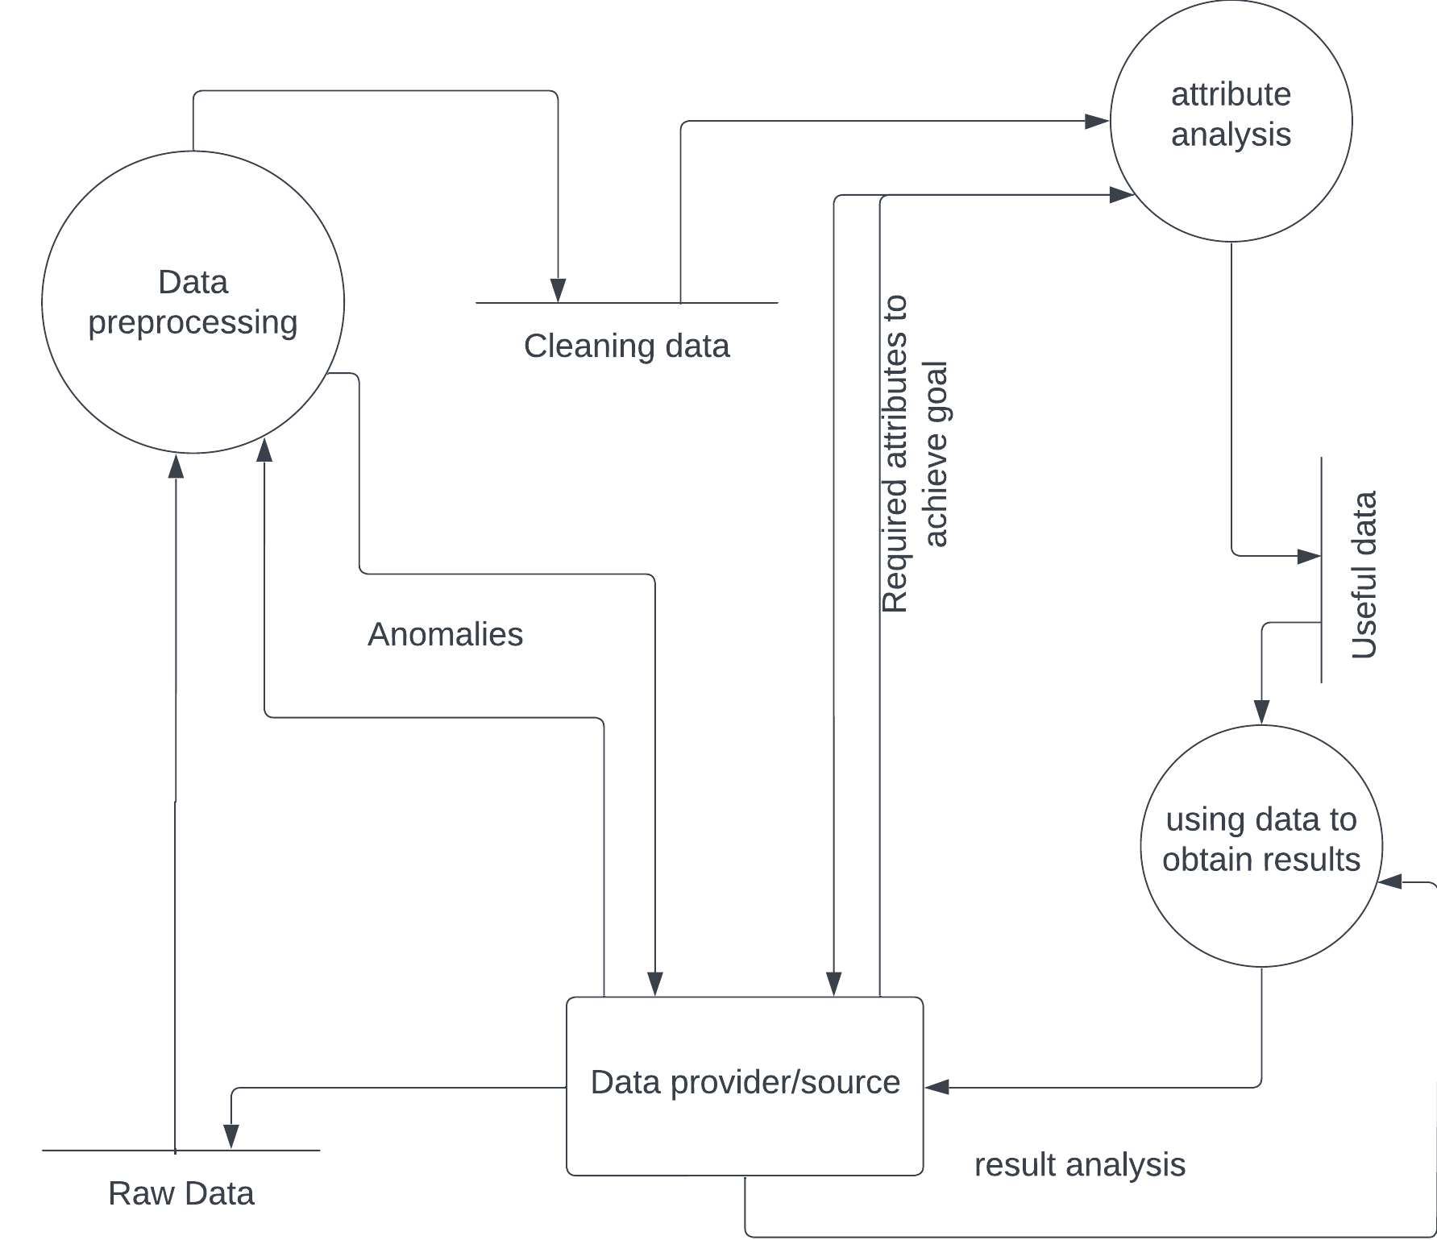
PROCESS DIAGRAM

Slide 11
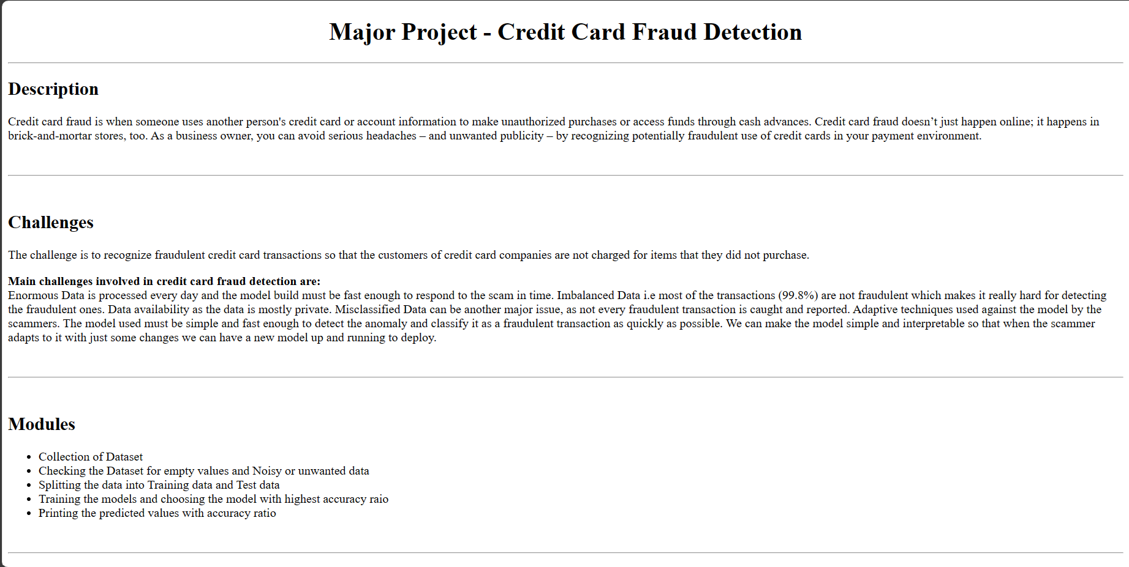
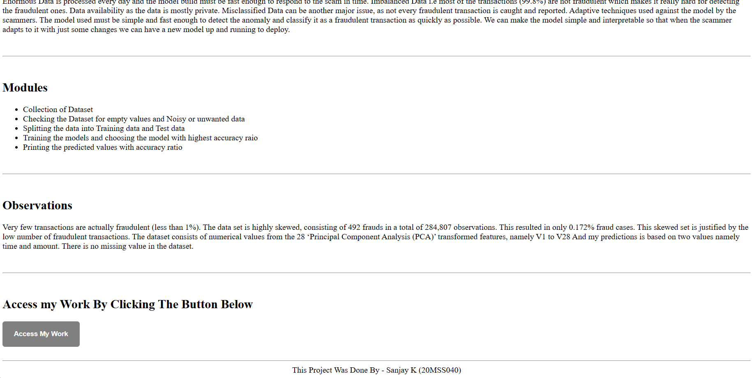
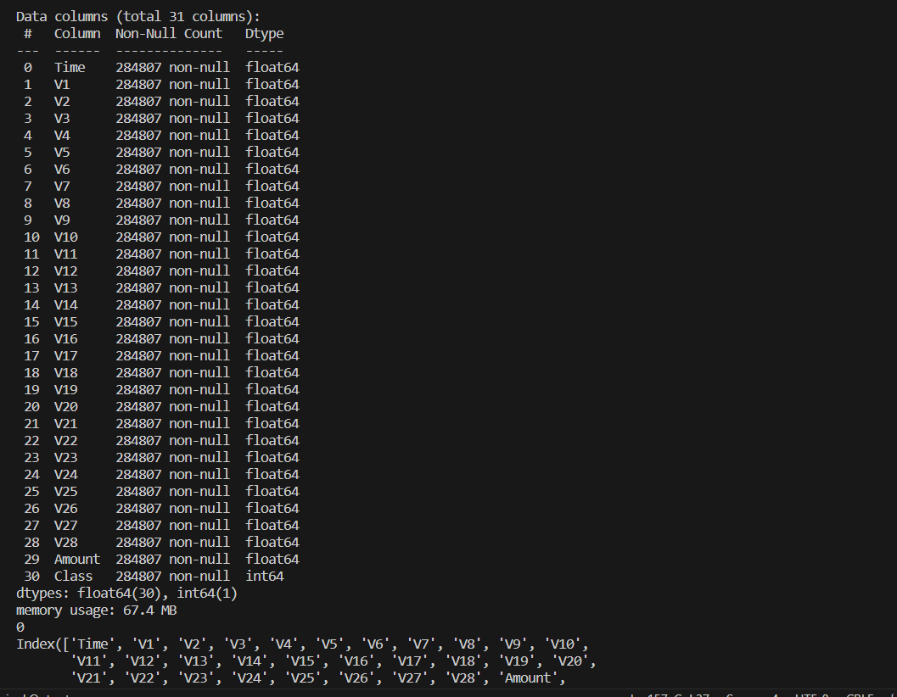
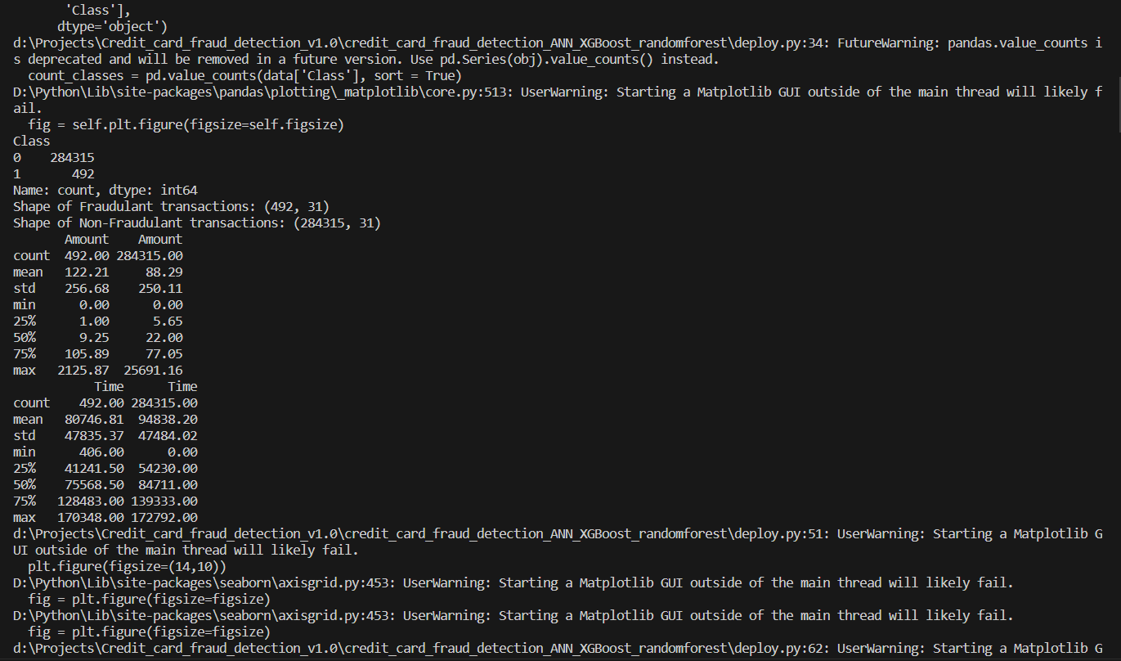
SCREENSHOTS

Slide 12
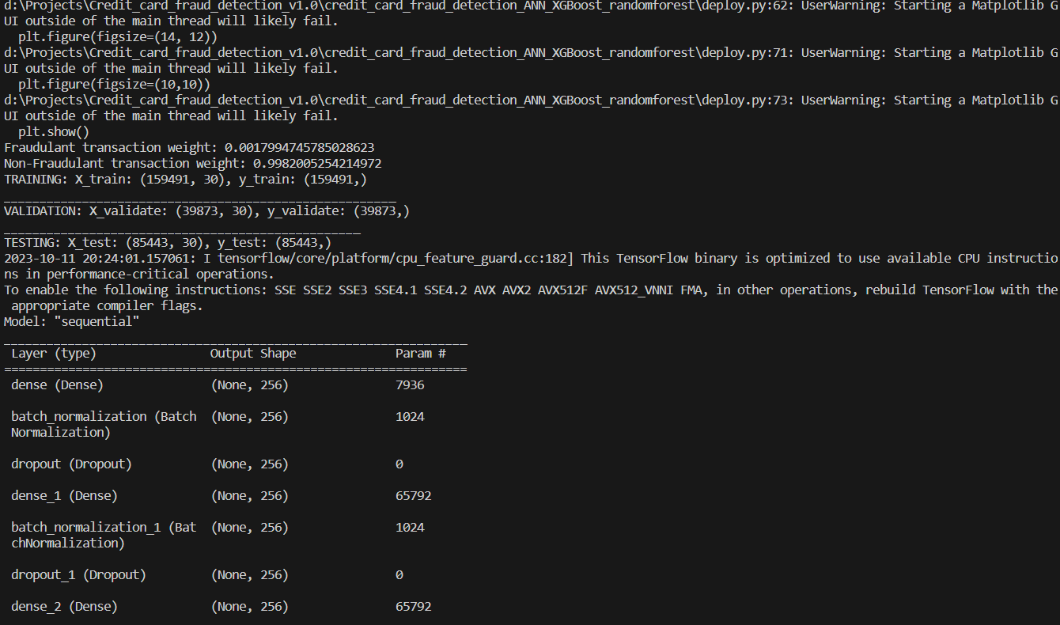
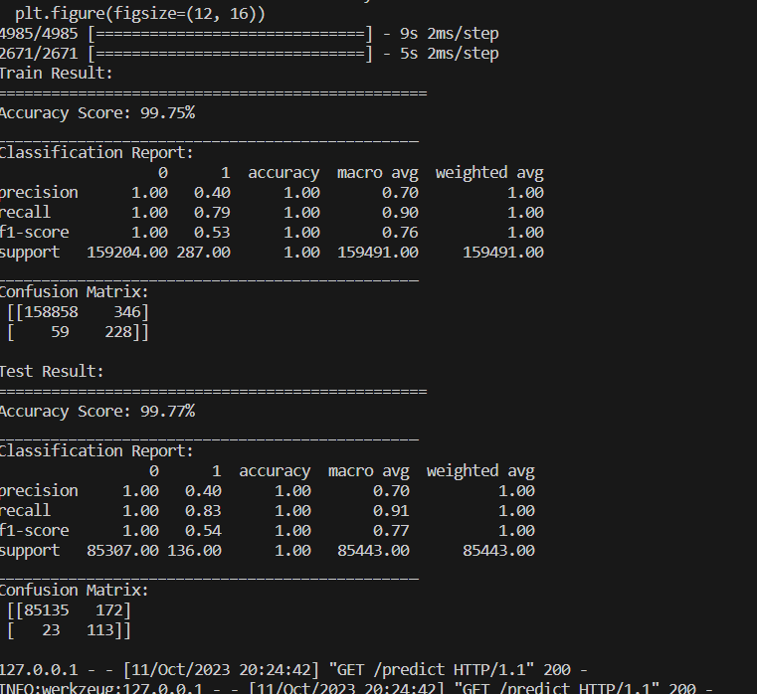
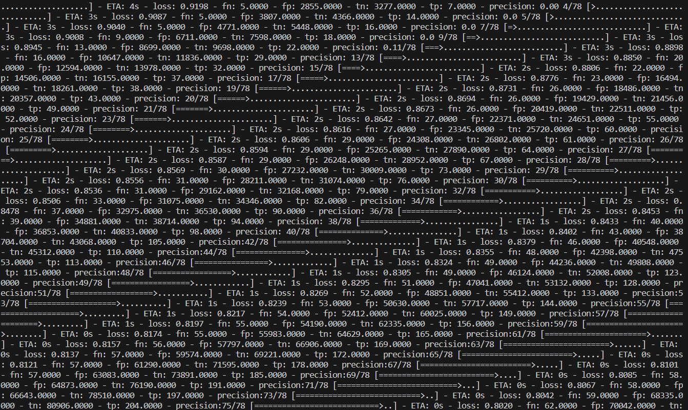
SCREENSHOTS

Slide 13
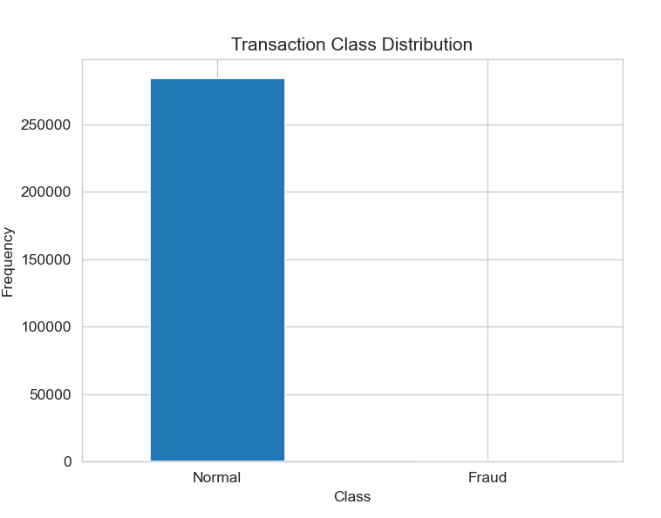
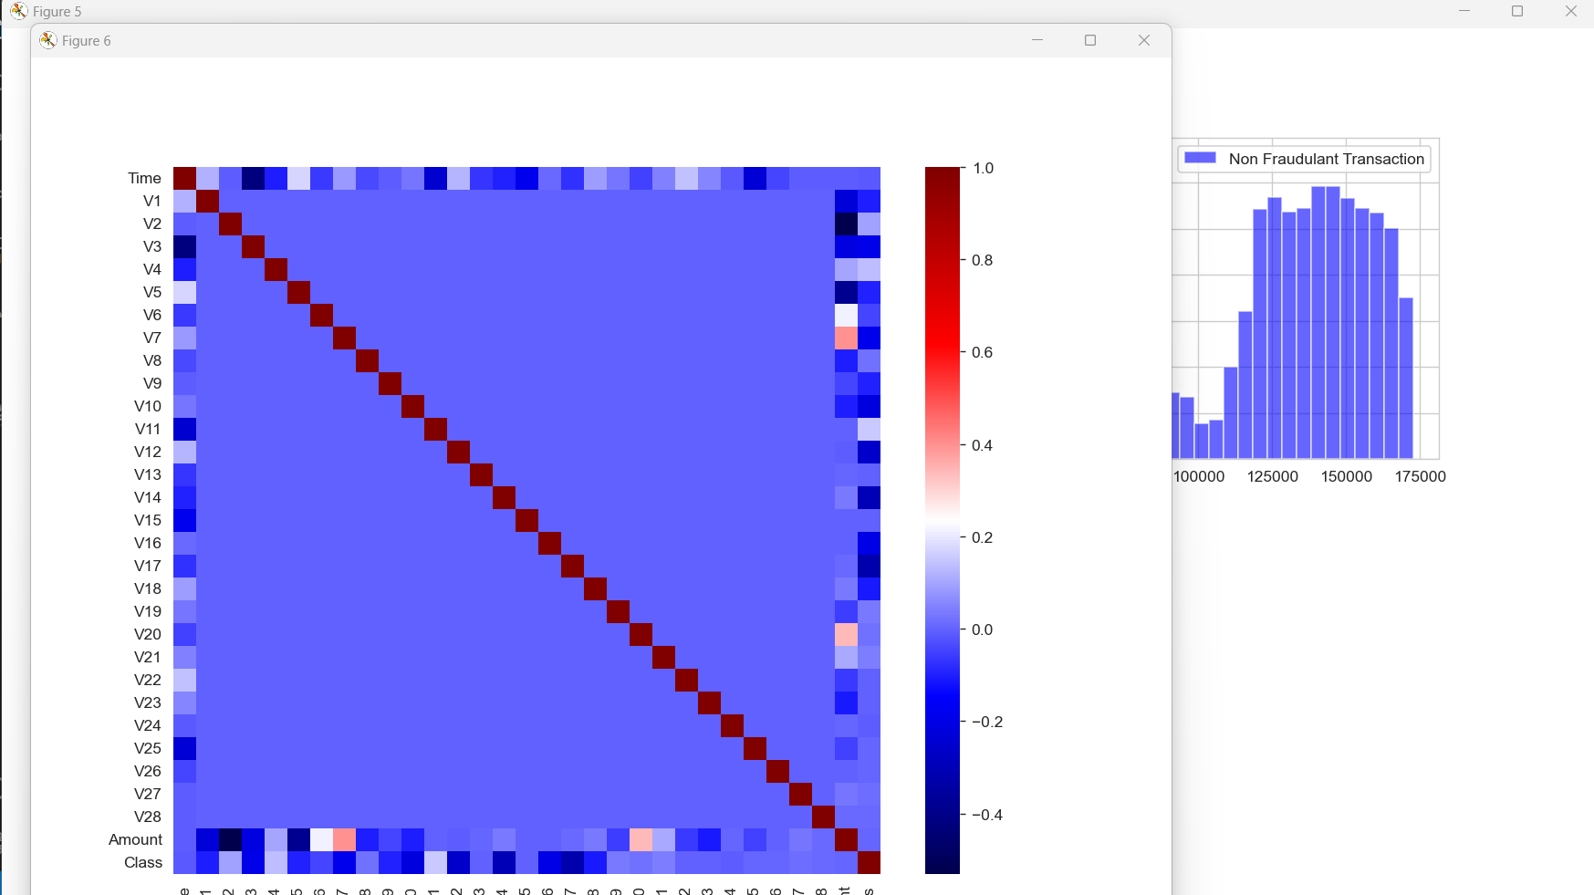
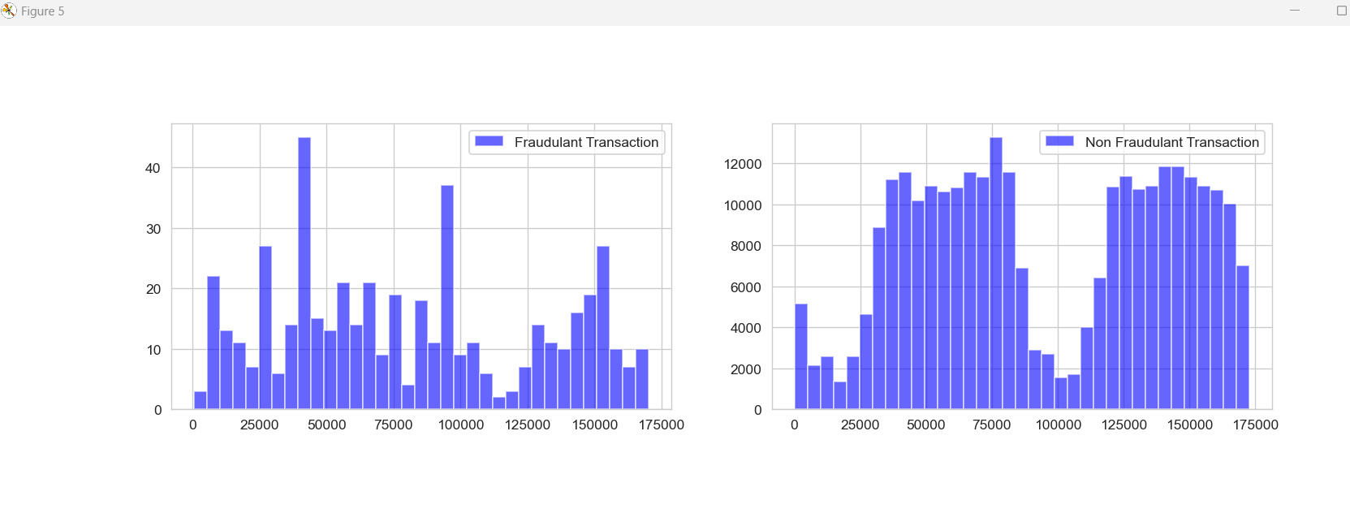
SCREENSHOTS

Slide 14
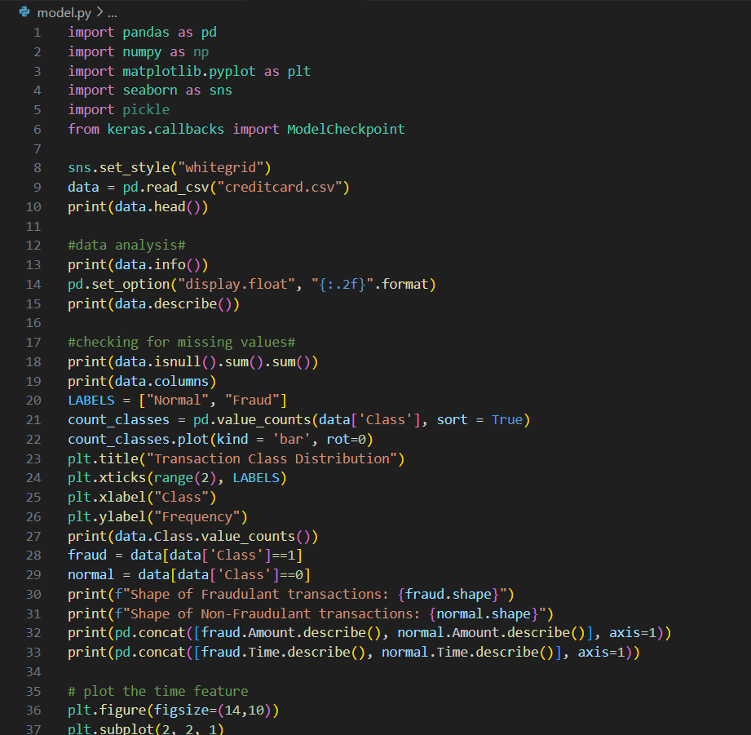
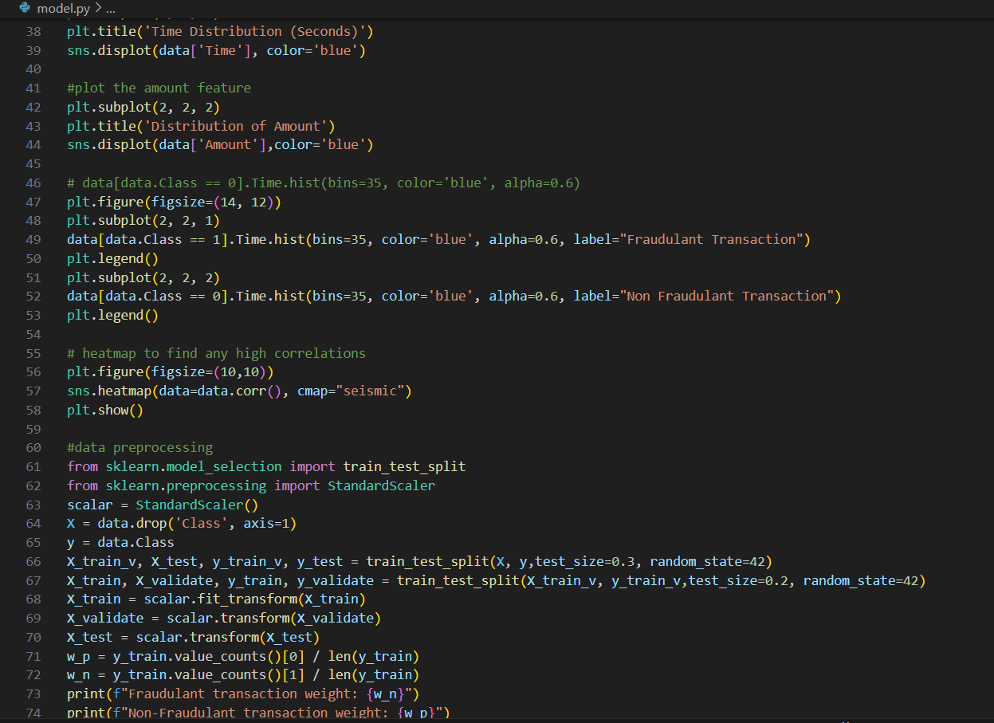
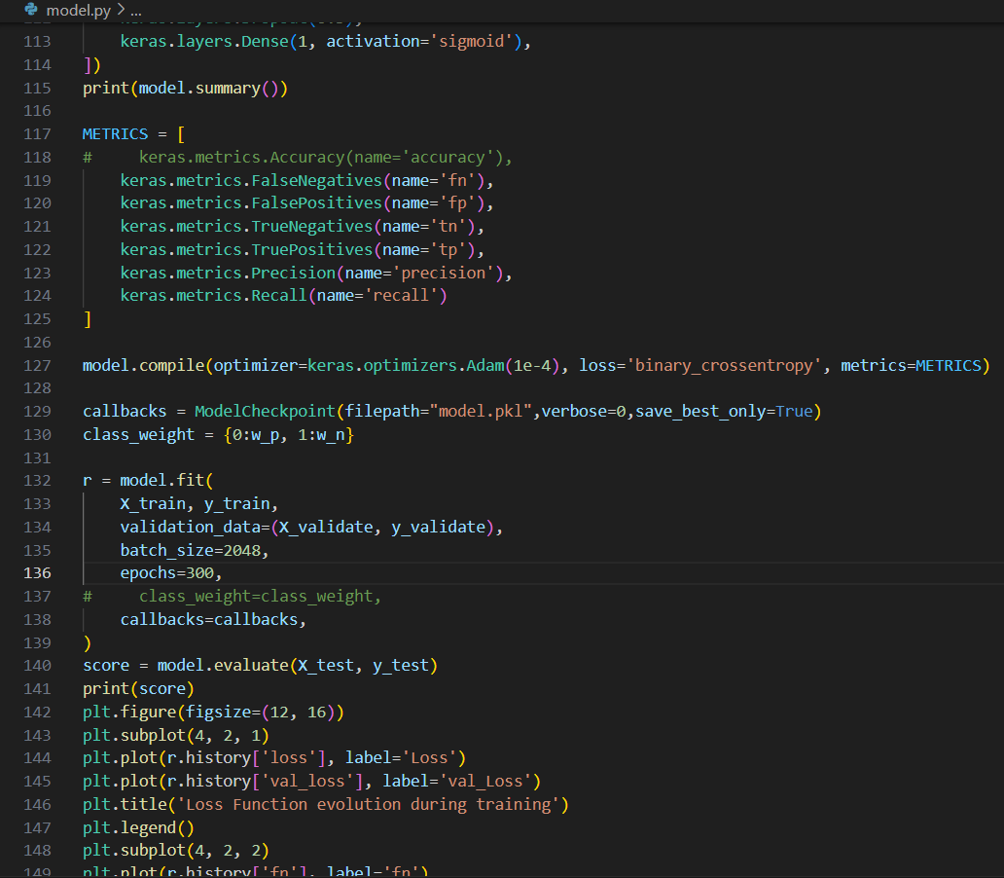
SAMPLE CODE

Slide 15
SAMPLE CODE

Slide 16
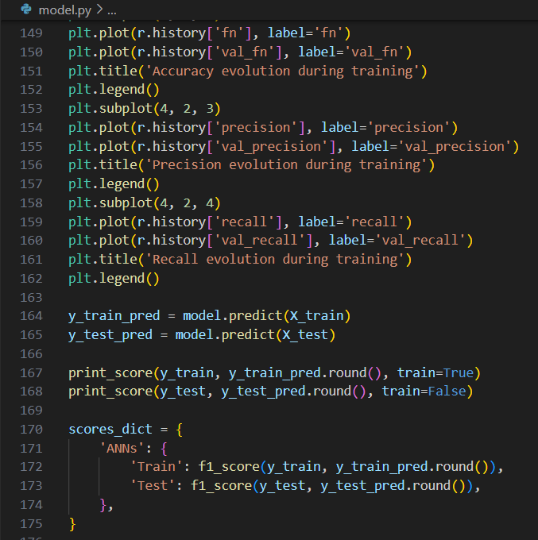
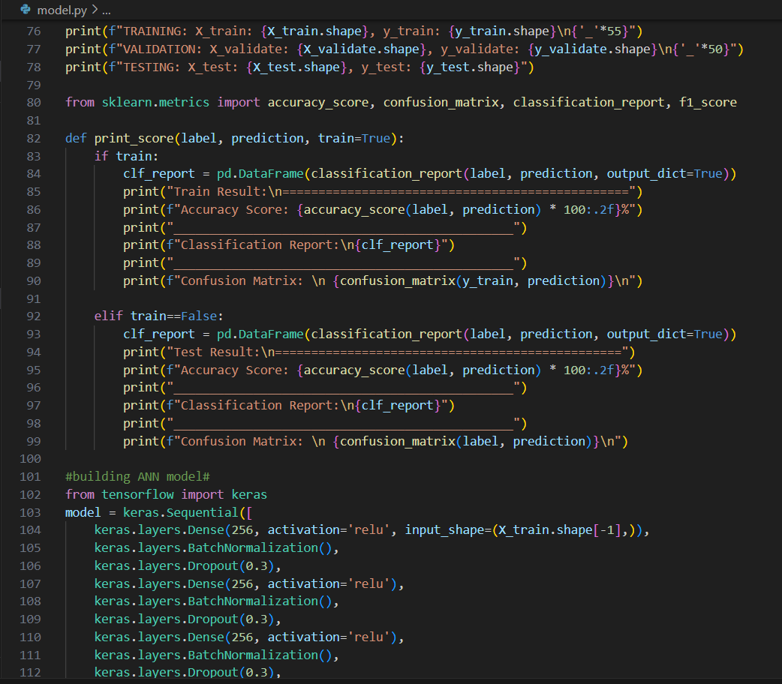
SAMPLE CODE

