Slide 1
How to survive a medieval battle
By Kenan Palmer

Slide 2
Don’t be in one

Slide 3
Simulating A Battle
Model of a soldier
Model of a fight
Model of a battle

Slide 4
Model of a soldier
ATTRIBUTES:
Health
Speed
Weapon type
(ranged or melee)
Range
Moral
ACTIONS
Move closer to enemy
Hit enemy
Run away

Slide 5
Process of fighting
Win and find next enemy
JOIN
MOVE
HIT
Once in range
Lose
DIE
RUN AWAY
Once a soldier has hit or moved closer to another soldier, or dies, the process ends and the next soldier completes their process.

Slide 6
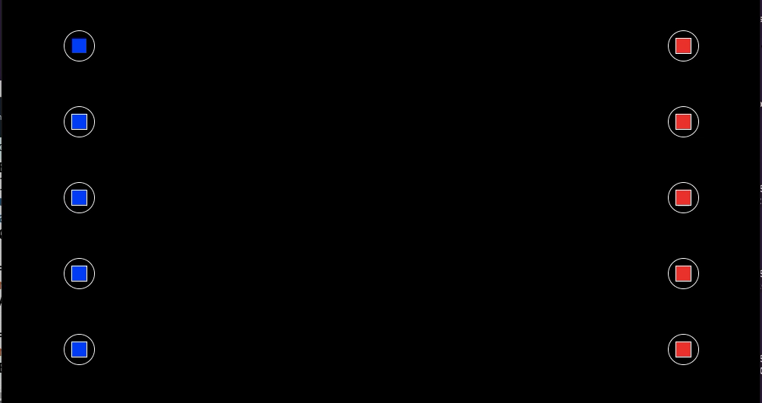
simulated fights
*In these engagements, the soldiers do not have the ability to run away*

Slide 7
Basically red wins
TEAM | WINS
RED | 50
BLUE | 0

Slide 8
Why does red always win?
Each side goes through their process one by one
Blue always goes through process of fighting first
Blue cannot hit red so takes a step forward
Blues process ends
This movement puts him inside the radius of reds attack range
Reds process begins
Red Hits blue and their process ends
The two exchange hits and as red hits first, blue’s health reaches 0 first

Slide 9
Fixing The Problem
Possible solutions to process problem:
Ignore it- easy
Randomly set which team goes first- Does produce alternate results but just replicates the problem on either side
Randomise which team goes through their process - This will create different results, with each side winning the same type of engagement. But it will create scenarios where on side will be able to go through their process several times before the other side creating a huge bias.
Randomly pick a Soldier to complete his process -

Slide 10
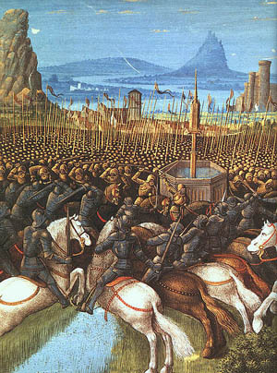
Organised Fights
Soldiers in columns of line

