Slide 1


NCCI Policy-to-Rules
policy
rule
Converting CMS coding policy into verifiable, source-grounded payment-integrity rules
Keshav Girish Adkar Northeastern University
Cotiviti GenAI Intern Assessment · Content Management in Health Care
Notes:
Title. One line: this is an agent that turns written CMS coding policy into structured, verified rules, with a hallucination guardrail. Built for the Cotiviti content-management topic.

Slide 2
The problem: policy is prose, adjudication needs logic
Written policy (prose)
Executable rule (logic)
“If an E&M service is performed on the same date as a major surgical procedure to decide whether to perform the surgery, the E&M service is separately reportable with modifier 57.”
{ "condition": "E&M same day as a 090-day procedure, for the decision to operate", "action": "allow", "modifier": "57", "source": "Section D" }
Converting one to the other is core content-management work, performed by hand today.
Notes:
The core tension: policy is written as prose, but a claims engine can only act on a rule. Bridging that gap is what content management does, and it is manual and expert-intensive today.

Slide 3



Why this matters to Cotiviti
Payment integrity is the core
Cotiviti builds the coding edits that catch improper payments for health plans. Policy-to-rules is its daily work.
The policy never stops moving
CMS revises NCCI guidance annually and its edit tables quarterly. Automation has to track change, not a snapshot.
Accuracy is non-negotiable
A wrong edit denies a valid claim or misses an improper one. A hallucinated rule is a compliance failure.
Notes:
Three reasons this is a fit for Cotiviti: payment integrity is their business, the source policy changes constantly, and accuracy is everything, which makes the grounding guardrail the key piece.

Slide 4


How it works: an agent that reads, extracts, and verifies
CMS NCCI
Policy Manual
Agent
retrieve, extract
Grounding
check
Structured rules
+ version diff
Tools are deterministic Python (retrieval, section lookup, version diff). The model decides which to call. Every extracted rule carries a verbatim source quote.
Model-agnostic: runs on a free open model today, swaps to any production model unchanged.
Notes:
Walk the flow left to right: take a policy section, the agent retrieves and extracts rules, a deterministic check grounds each rule, and out come structured rules plus a version diff. The tools are plain Python; the model just orchestrates.

Slide 5



Three capabilities, one workflow
Summarize
Extract & verify
Compare versions
Plain-language summary of any policy section for a payment-integrity analyst.
Structured coding rules, each with an action and a grounding badge confirming its source.
Automatic 2024 vs 2025 diff that surfaces what actually changed between editions.
Notes:
These map exactly to the three pillars the assessment named for this topic: summarization, conversion to rules, and comparison of content changes.

Slide 6
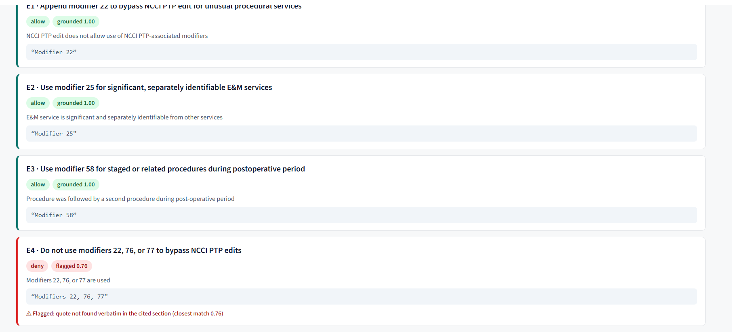
The guardrail: every rule cites its source
Green grounds, red flags. A hallucinated coding rule is a compliance failure, so every citation is verified against the policy text before a rule is trusted.
Notes:
This is the differentiator. Generation and verification are separated: the model proposes rules, a deterministic check confirms each quote is real. Green grounds, red flags. This is a real screenshot of the app's extracted rules.

Slide 7
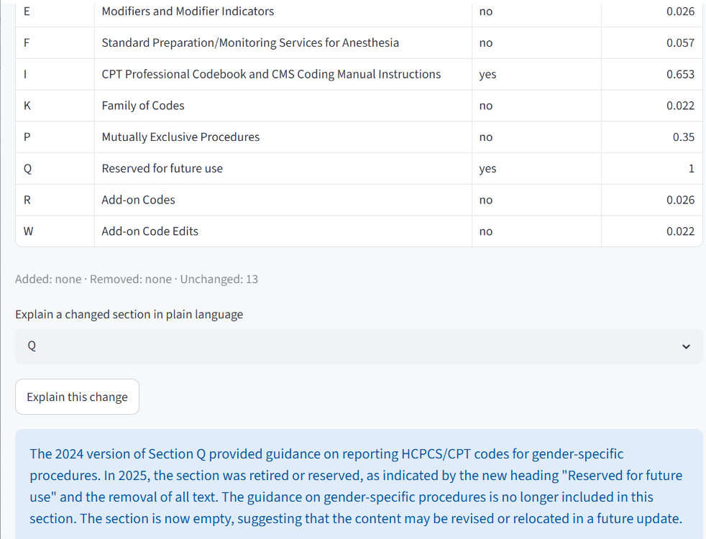
Catching policy change before it breaks a rule
What this shows
The version diff flags every section that changed between the 2024 and 2025 editions, the trigger to review a coding rule.
Pick any changed section and the agent explains the change in plain language.
Example: Section Q went from “Gender-Specific Procedures” (2024) to “Reserved for future use” (2025). The system catches the retirement and explains it.
Notes:
This proves the third capability, change detection. The diff is deterministic; the explanation is the one LLM touch. Section Q is a real retirement: Gender-Specific Procedures became Reserved for future use in 2025. In production this is the signal that a rule tied to Q should be reviewed.

Slide 8


Live demo
Switching to the application
Summarize a policy section
Extract rules and check the grounding badges
Compare the 2024 and 2025 editions
Notes:
Hand-off slide. Stop sharing slides, share the app. Run the three steps in order. If anything glitches, the static slides ahead still convey the results.

Slide 9
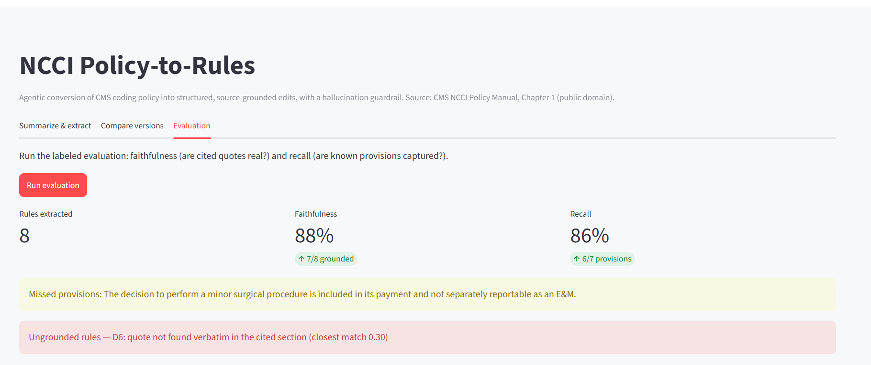
Results: honest, measured, reproducible
From the evaluation harness (live)
The agent reached 100% on some runs; a representative run scored 88% faithfulness and 86% recall. We report the range, not a single best run, and the harness shows exactly what was missed and what was flagged. The evaluation set is small by design (7 labeled provisions).
Notes:
We hit 100% on good runs, but the model varies, so we report the range. The screenshot is real output from the evaluation harness, showing the metrics plus the honest failure analysis: one missed provision and one flagged ungrounded rule.

Slide 10




Limitations and what is next
Keyword retrieval
Small evaluation set
Uses keyword matching today; semantic embeddings are the next upgrade.
Seven labeled provisions: a feasibility signal, not a production accuracy claim.
Model-agnostic by design
Scope: one chapter
Ran on a free open model; the same pipeline runs on any production model.
Demonstrated on Chapter 1 of the NCCI manual; the same approach generalizes to the full manual and other policy sources.
Notes:
Stated limits read as competence: keyword retrieval, small eval set, model-agnostic, and the deliberate decision not to train a model for a POC, with where training fits in a v2.

Slide 11



A deliberate choice: we did not train a model (yet)
Knowing when not to reach for the heavier tool
What we considered
Why we deferred it
A supervised model: for example, to route a claim to the right policy section, or to predict the edit action (allow, deny, flag) directly from text.
We stayed within the actual ask: a working POC, not a production model.
A POC proves feasibility, and the agent plus grounding already does that, without training.
Supervised training needs labeled data at a scale we do not have yet.
A learned prediction is harder to ground than a cited quote, and the citation is what earns trust here.
When it becomes the right call
Once the human-in-the-loop workflow runs at scale and accumulates verified extractions, we will have the labeled, trustworthy data to train and properly evaluate a model. I am happy to build that as a separate piece and walk through it in the interview if it would be useful.
Notes:
The judgment slide. We stayed within the actual ask, a working POC rather than a production model. A POC's job is to prove feasibility, and the agent plus grounding already does that. Training needs labeled data we do not have yet, and a learned prediction is harder to ground than a cited quote, which is the whole trust mechanism. Once the workflow runs at scale and produces verified data, a trained model becomes a natural v2, and I am open to building it separately and discussing it in the interview.

Slide 12


Recommendation
Pilot an agent-assisted policy-to-rules workflow: subject-matter experts verify machine-extracted, source-cited edits instead of authoring them by hand.
The payoff: expert time shifts from writing rules to checking them, shortening the path from a published guideline change to a live, audited claim edit.
Accelerate the work. Hold the line on trust.
github.com/KESHAV8087/cotiviti-policy-to-rules
adkarkeshav@gmail.com
Keshav Girish Adkar · Northeastern University
Notes:
Close on the recommendation: keep the expert, change their job from authoring rules to verifying source-cited drafts. The business payoff is a shorter path from a guideline change to a live claim edit, with an audit trail. Repo and email are on screen. Thank you.

