Slide 1

TOPIC:
CLASS IMBALANCE AND FEW-SHOT LEARNING
WITH OBJECT DETECTION ALGORITHM YOLO3

Slide 2
Table of Contents
Background
YOLO3 algorithms details
Data, Class Imbalance and Few-Shot learning
Results
Conclusion and Discussions

Slide 3
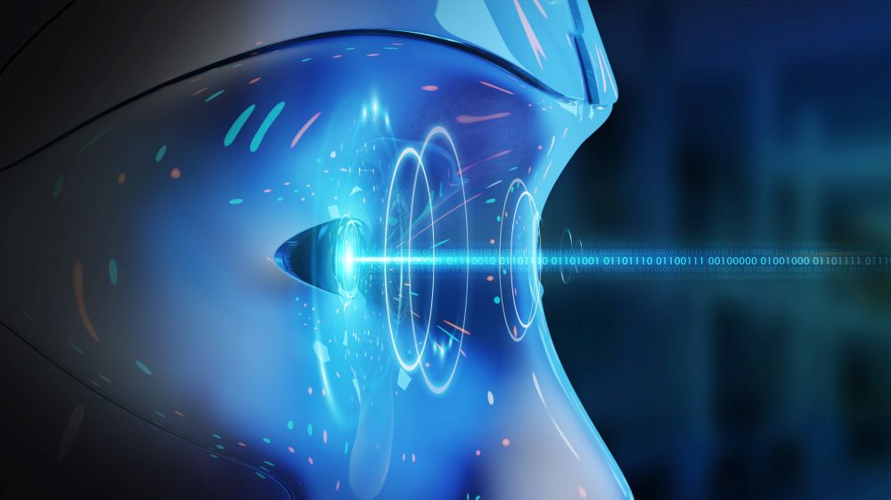
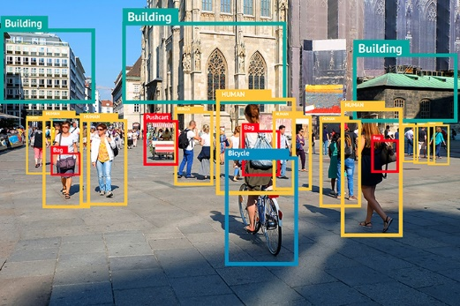
1. Background
Computer Vision:
- An area of artificial intelligence which enable computers to derive information from images
- Two essential technologies: deep learning and convolutional neural network (CNN)
Object detection:
- A branch of computer vision: identify object types and their locations in images
- Highly practical fields: autonomous driving, video surveillance, anomaly detection
- Emerged since 2000 due to deep learning and power of GPU

Slide 4
1. Background
Object Detection
- Two categories of algorithms:
+ One stage: YOLO , SSD (2016), RetinaNet(2017), YOLO3 (2018), YOLO5(2020), YOLOR(2021)
+ Two stages: RCNN, Fast RCNN, Faster RCNN
YOLO3 developed by Joseph Redmon in 2018: Main focus of this dissertation together with class imbalance and few-shot learning.

Slide 5
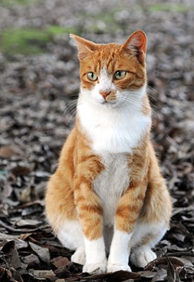
2. YOLO algorithms details
Images are divided into NxN grid then pass through a CNN network. This network will detect objects in each cell
- Each cell go through CNN will output three vector objects : ( t_{x}, t_{y}, t_{w}, t_{h}, p_{c} , C₁,…,C_{k} )
( t_{x}, t_{y}, t_{w}, t_{h}, p_{c} , C₁,…,C_{k} )
CNN
NxNx3x(5+nb_classes)
Image pre-processing unit
NxN
List of objects in images
Output processing unit
t_{x}, t_{y} : center coordinates of object
t_{w}, t_{h} : width and height of object
P_{c} : probability that an object exist in the cell
C₁, C₂,…, C_{k}: probability that detected object is class 1,…, class k

Slide 6
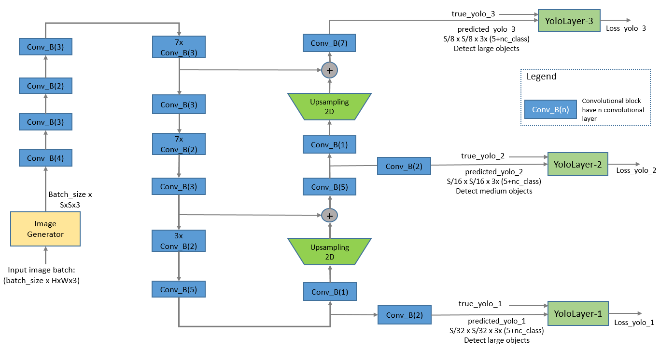
2. YOLO algorithms details
Details of image pre-processing unit and CNN
Loss calculation: serving for training process
Image pre-processing unit and CNN

Slide 7
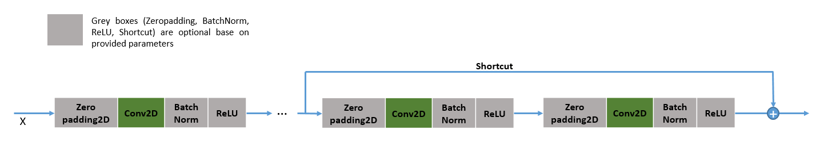
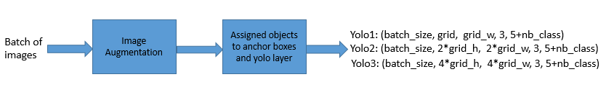
2. YOLO algorithms details
Details of image pre-processing unit and CNN
Convolutional Block details:
Generator unit: Adjust size of image, augment images and assign objects to YOLO layer

Slide 8
2. YOLO algorithms details
Output processing unit details:
Output processing unit
Decode_netout:
- Calculating objectness score
- Removing boxes with objectness score
which is less than 0.5
- Returning a list of boundbox object
(x_{min}, y_{min}, x_{max}, y_{max}, objectness, label)
Non_max Suppression:
Removing duplicated/overlap bounding boxes to ensure that each object is detected only one.

Slide 9
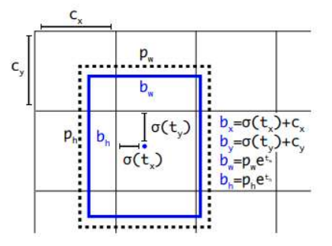
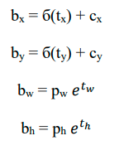
2. YOLO algorithms details
Relations between vector ( t_{x}, t_{y}, t_{w}, t_{h}) and coordinates of objects are represented by following formulas:
b_{x}, b_{y} : centered coordinates of bounding box on (0, N) scale
b_{w}, b_{h}: width and height of bounding box on standardized image scale.
p_{w}, p_{h}: width and height of assigned anchor box
б: sigmoid function
sigmoid(x)= 1/(1+exp(-x))
NxN grid

Slide 10

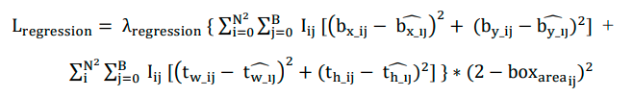
2. YOLO algorithms details
Loss function has three components: Classification loss, Regression Loss, Confidence Loss
Classification Loss penalize for incorrect classification:
Regression loss penalize for the difference between predicted coordinate and actual coordinate of objects

Slide 11

2. YOLO algorithms details
Confidence loss penalizes for difference between predicted and actual confidence(actual confidence is one when an object is present, otherwise zero)
Total loss:
N, B: grid size and number of anchor boxes per cell, B =3 for YOLO3
b_{x_ij}, b_{y_ij}: center coordinates of bounding box at cell i for anchor box j
t_{x_ij}, t_{y_ij}: the width and height of the bounding box at cell I, anchor box j
I_{ij}: equal to 1 if an object exist in cell I and anchor j, otherwise equal to 0
p_{groundtruth}: predicted probability of groundtruth label

Slide 12
3. Data, Class Imbalance and Few-Shot learning
In machine learning and computer vision both data quality and quantity has impacts to performance of models. We investigate two common issues: class imbalance and few-shot learning:
Class imbalance:
- Some classes have dominant representation in the dataset while others have much lower.
- Solution: collecting more data for under-represented classes, down- sampling, up-sampling, generate synthetic data
Few-shot learning:
- Situations that we have only a limited number of samples for training
- Reason: It is difficult to collect more data or it is high cost to gather data
- More popular in classification problems but object detection also get the attention recently

Slide 13
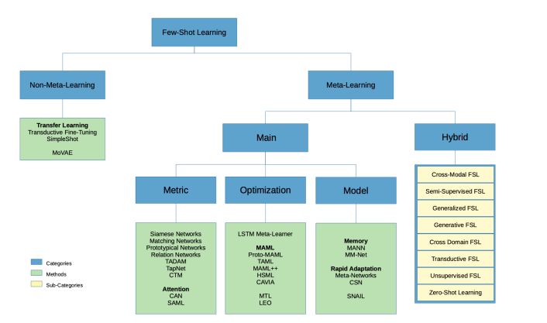
3. Data, Class Imbalance and Few-Shot learning
Approaches to few-shot learning
We stick with YOLO3 then “Generative FSL” will be used in this project.

Slide 14
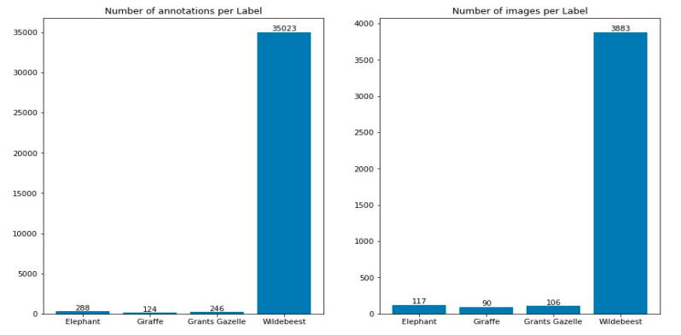
3. Data, Class Imbalance and Few-Shot learning
Data used for the project
Subset of Camera trap dataset:
4 classes
Multiple objects in one image
Diversity of object sizes:
large, medium and many
small objects
High resolution: 2592x1944
or 3264x2448
- Highly imbalance

Slide 15
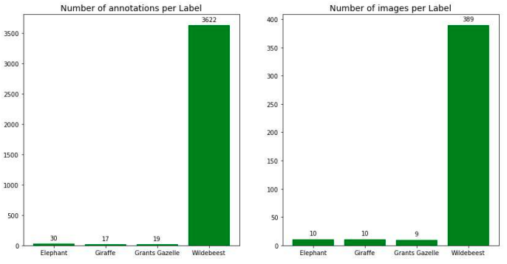
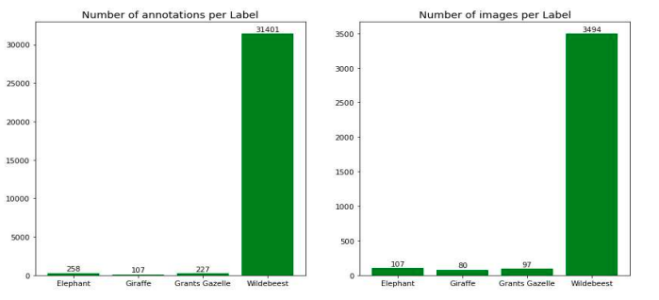
3. Data, Class Imbalance and Few-Shot learning
Train and test sets are split into one to nine ratio
Class imbalance still remains in training and test set
Data distribution - training set
Data distribution - test set

Slide 16
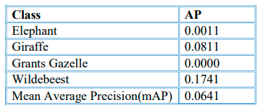
4. Results
Class imbalance:
Trained model and evaluate it on test set, the results is surprised poor. Strongest signal is at Wildebeest class, the dominant class in the dataset
This poor performance is caused by strong class imbalanced. We use image augmentation technique to address this issue.
Using relative coordinates to the width and height of images, we crop 48 images of each image in training set. Locations of cropped images are identified by vector (x₁, y₁, x₂, y₂):
(i/20, 0, 1 1), (0, 0, 1-1.2*(8-i)/20, 1), (i/17, i/25, 1, 1), (0, 0, 1-(8-i)/20, 1-(8-i)/25), (i/30, i/35, 1-(8-i)/30, 1-(8-i)/35) , (i/20, i/20, i/20+0.5, i/20+0.5), for i in {0, 1, 2, 3, 4 ,5 ,6, 7}

Slide 17
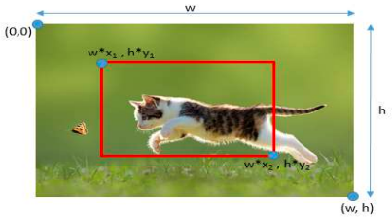
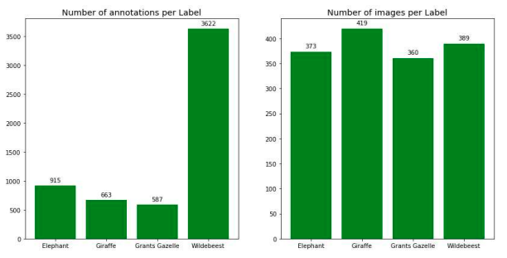
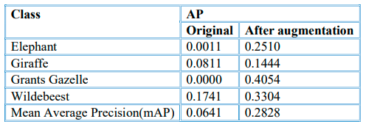
4. Results
Class imbalance:
New training set is more balanced in number of images per class. Number of annotations per label also improves. Model performance improve from 0.06 to 0.28mAP

Slide 18
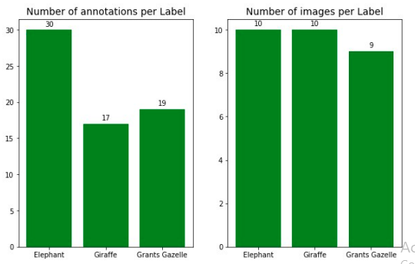
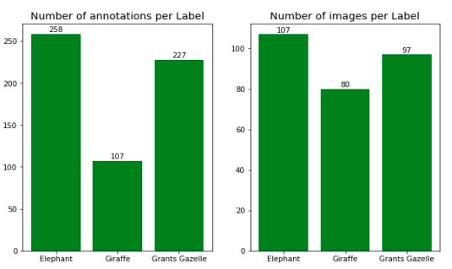
4. Results
Few-shot learning:
The same data in class imbalance but remove Wildebeest class. Number of images per class in training set is limited at 10.
Data distribution in training set
Data distribution in test set

Slide 19
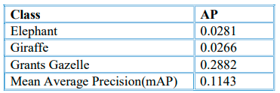
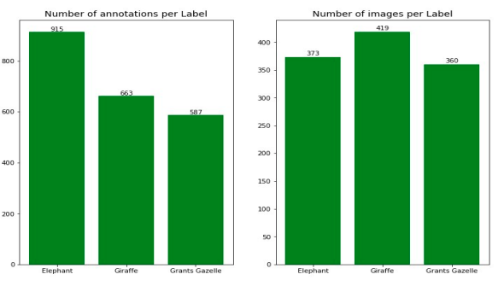
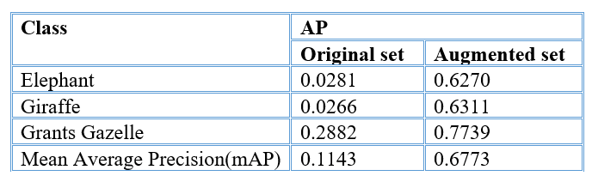
4. Results
Few-shot learning:
Training model and evaluate it on test set, we get a result at 0.114 mAP
Using the same image augmentation technique in class imbalance class to address this issue. The performance raise from just at 0.11mAP to 0.77mAP

Slide 20
5. Conclusion and Discussions
Conclusion:
Image augmentation is simple but effective to deal with both class imbalance and few-shot learning. This technique boosts the performance of the model from just 0.06 to 0.28mAP for class imbalance data and from 0.11 to 0.37mAP.
Training time and computational cost also raise significantly when use this method.
Limitation:
YOLO3 only predicts up to three objects in the same cell.
Two objects are assigned to the same anchor box then only one is detected
Future work:
Research newer models: YOLO4, YOLO5, YOLO6
Generative Adversarial Network (GANs) for generating new images
Meta-learning algorithms for Few-Shot learning: Siamese Networks, Matching Networks, Meta-Networks, Cross Domain FSL…

