Slide 1
机器学习之手写识别
yunp.top

Slide 2
机器学习程序工作流程
收集数据
训练
预测

Slide 3
识别照明灯范例讲解
决策树分类器的应用

Slide 4
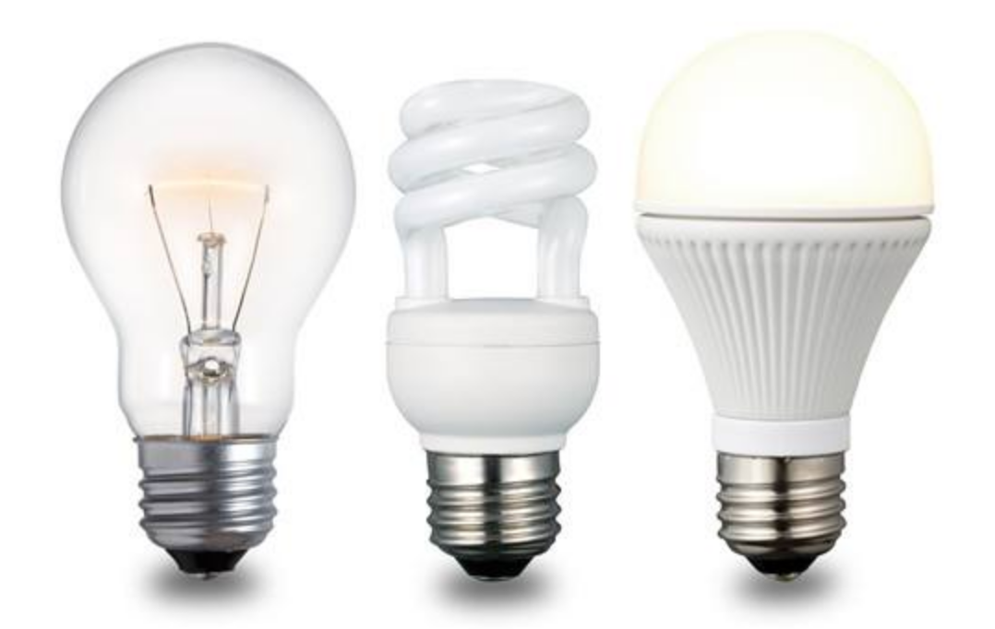
区分照明灯
白炽灯
节能灯
LED灯

Slide 5
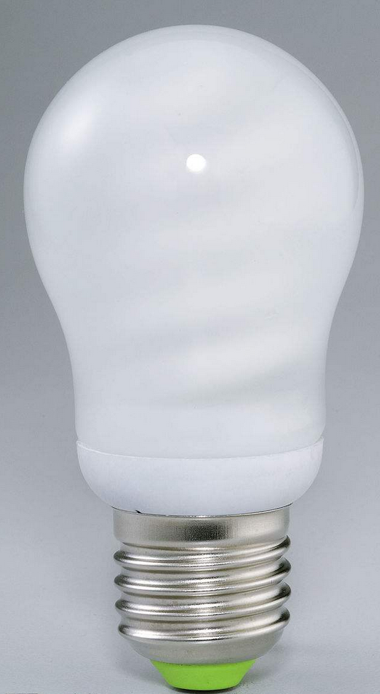
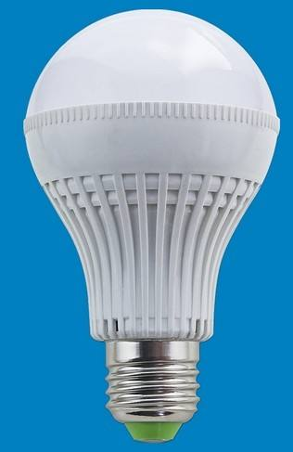
通过外观不容易区分的照明灯
节能灯
LED灯

Slide 6
照明灯特征参数
照明灯 | 功率（W） | 光通量（LM）
LED灯 | 3.5 | 300
LED灯 | 5 | 500
LED灯 | 6.5 | 600
节能灯 | 8 | 150
节能灯 | 11 | 200
节能灯 | 13 | 240
白炽灯 | 25 | 280
白炽灯 | 40 | 450
白炽灯 | 60 | 680

Slide 7
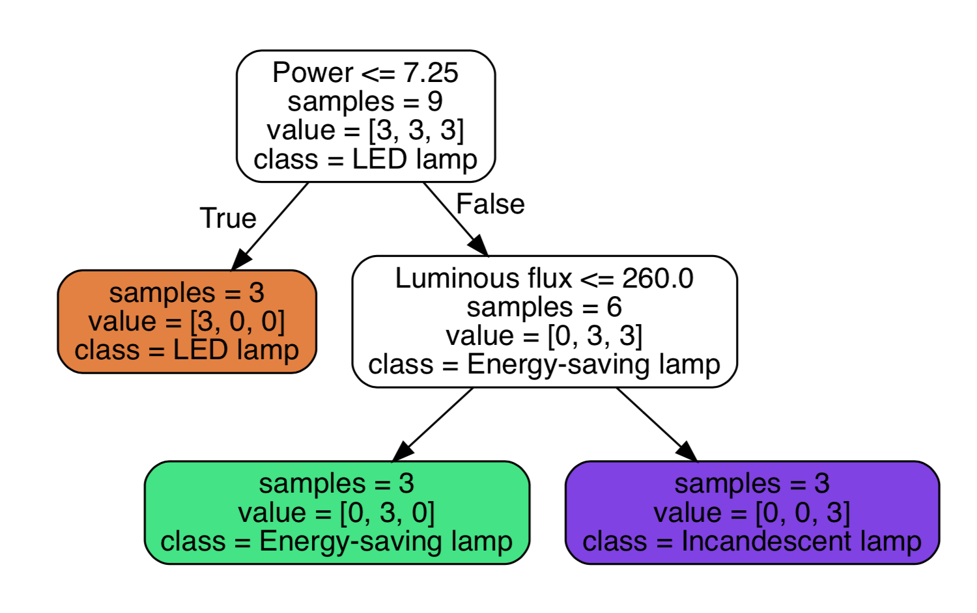
对特征样本[30W,400LM]进行预测

Slide 8
位图
理解计算机存储及呈现图像的原理

Slide 9
三原色

Slide 10
红绿

Slide 11
红蓝

Slide 12
蓝绿

Slide 13
三原色不同比例可以搭配出所有颜色

Slide 14
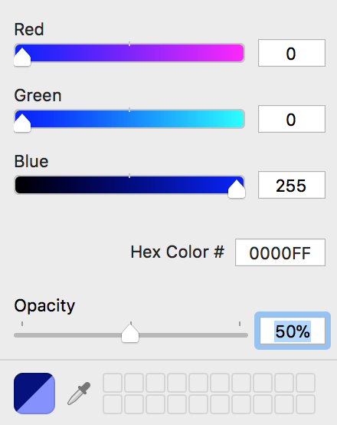
图像叠加

Slide 15
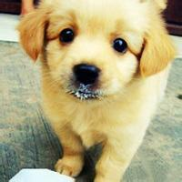

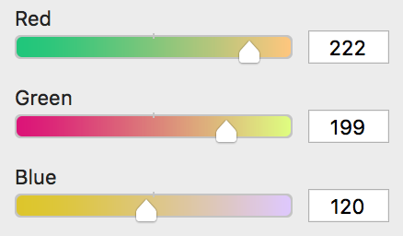
位图放大

Slide 16
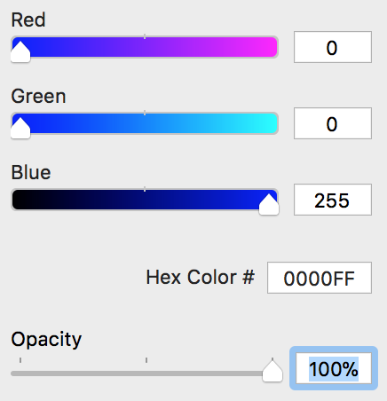
总结
计算机存储颜色用4个数值，分别为RGBA(Red,Green,Blue,Alpha)四个颜色通道的值
一个通道用一个字节存储
一个字节8个位，取值范围为 [0,256)
一个颜色值用4个字节存储，也称用32位存储，这种方式存储的颜色称为32位颜色
00000000
00000000
11111111
11111111

Slide 17
延伸
jpeg
200x200=40000px
压缩
png
40000x4=160000b
gif
160000/1024 = 156.25kb
webp
图片实际大小8kb

Slide 18
手写识别原理

Slide 19
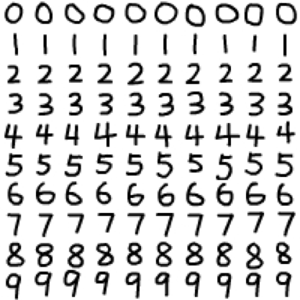
定义图片规格
[255,255,255,255,255,255,255,255,
255,255,255,255,255,255,255,255,
255,255,255,255,255,255,255,255,
255,255,255,255,192,208,255,255,
255,255,255,255,255,255,255,255,
255,255,255,255,255,255,255,112,
0,0,16,80,160,255,255,255,255,255,
255,255,255,255,255,255,255,240,
96,0,0,0,0,0,0,80,255,255,255,255,
255,255,255,255,255,255,255,64,0,
48,176,255,208,144,32,0,128,255,
255,255,255,255,255,255,255,255,
160,0,80,255,255, 255,255,255,224,
0,0,255,255, 255,255,255,255,255,
255,240,16,0,224,255,255,255,255,
255,255,48,0,192,255,
...
...
...
255,255,255,255,255,255,255,255,
255,255,255,255,255,255,255,255,
255,255,255,255,255,255,255,255]
20px
20px

Slide 20
数据对应
训练数据
[[…],[…],[…],…[…]]
0
[[…],[…],[…],…[…]]
1
[[…],[…],[…],…[…]]
2
[[…],[…],[…],…[…]]
3
[[…],[…],[…],…[…]]
4
[[…],[…],[…],…[…]]
5
[[…],[…],[…],…[…]]
6
[[…],[…],[…],…[…]]
7
[[…],[…],[…],…[…]]
8
[[…],[…],[…],…[…]]
9

Slide 21
数据合并训练
训练数据 train_data
目标数据 target_data
[[…],[…],[…],…[…]]
0
[[…],[…],[…],…[…]]
[
[…],[…],[…], …,[…], //10个0
[…],[…],[…], …,[…], //10个1
[…],[…],[…], …,[…], //10个2
[…],[…],[…], …,[…], //10个3
[…],[…],[…], …,[…], //10个4
[…],[…],[…], …,[…], //10个5
[…],[…],[…], …,[…], //10个6
[…],[…],[…], …,[…], //10个7
[…],[…],[…], …,[…], //10个8
[…],[…],[…], …,[…] //10个9
]
1
[
0,
1,
2,
3,
4,
5,
6,
7,
8,
9
]
[[…],[…],[…],…[…]]
2
[[…],[…],[…],…[…]]
3
classify.fit(train_data,target_data)
4
[[…],[…],[…],…[…]]
5
[[…],[…],[…],…[…]]
6
[[…],[…],[…],…[…]]
7
[[…],[…],[…],…[…]]
8
[[…],[…],[…],…[…]]
9
[[…],[…],[…],…[…]]

Slide 22
预测
[255,255,255,255,255,255,255,255,
255,255,255,255,255,255,255,255,
255,255,255,255,255,255,255,255,
255,255,255,255,192,208,255,255,
255,255,255,255,255,255,255,255,
255,255,255,255,255,255,255,112,
0,0,16,80,160,255,255,255,255,255,
255,255,255,255,255,255,255,240,
...
...
...
255,255,255,255,255,255,255,255,
255,255,255,255,255,255,255,255]
classify.predict( )
= 0
image_data

