Slide 1
机器学习之手写识别
yunp.top

Slide 2
机器学习程序工作流程
收集数据
训练
预测

Slide 3
识别照明灯范例讲解
决策树分类器的应用

Slide 4
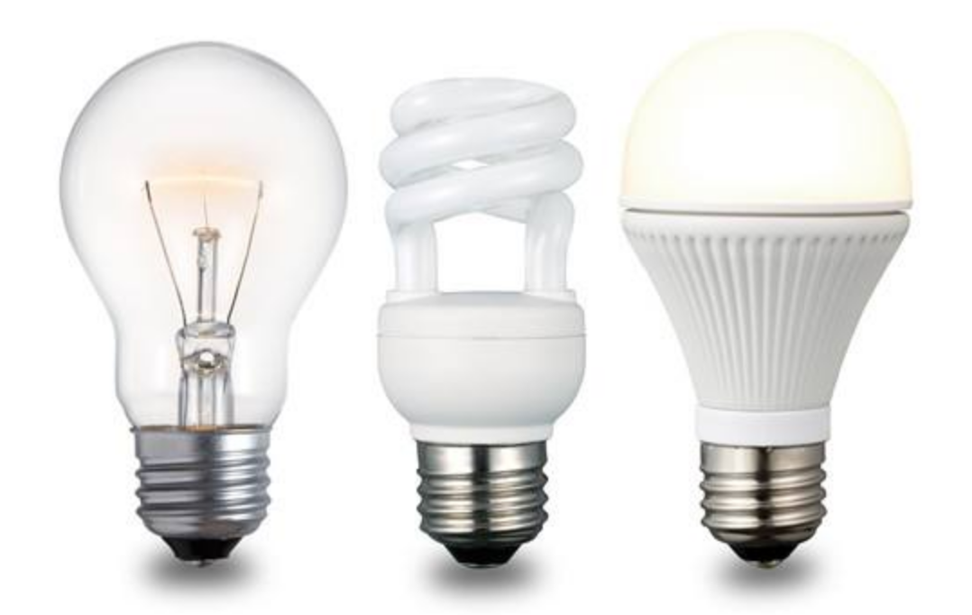
区分照明灯
白炽灯
节能灯
LED灯

Slide 5
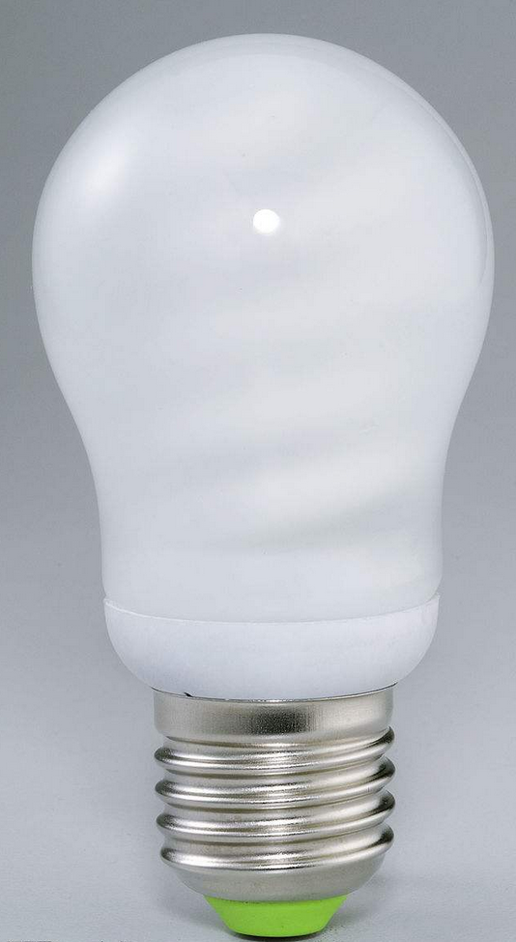
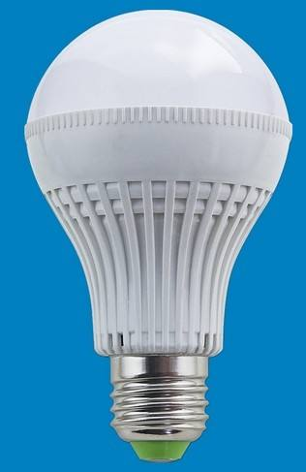
通过外观不容易区分的照明灯
节能灯
LED灯

Slide 6
照明灯特征参数
照明灯 | 功率（W） | 光通量（LM）
LED灯 | 3.5 | 300
LED灯 | 5 | 500
LED灯 | 6.5 | 600
节能灯 | 8 | 150
节能灯 | 11 | 200
节能灯 | 13 | 240
白炽灯 | 25 | 280
白炽灯 | 40 | 450
白炽灯 | 60 | 680

Slide 7
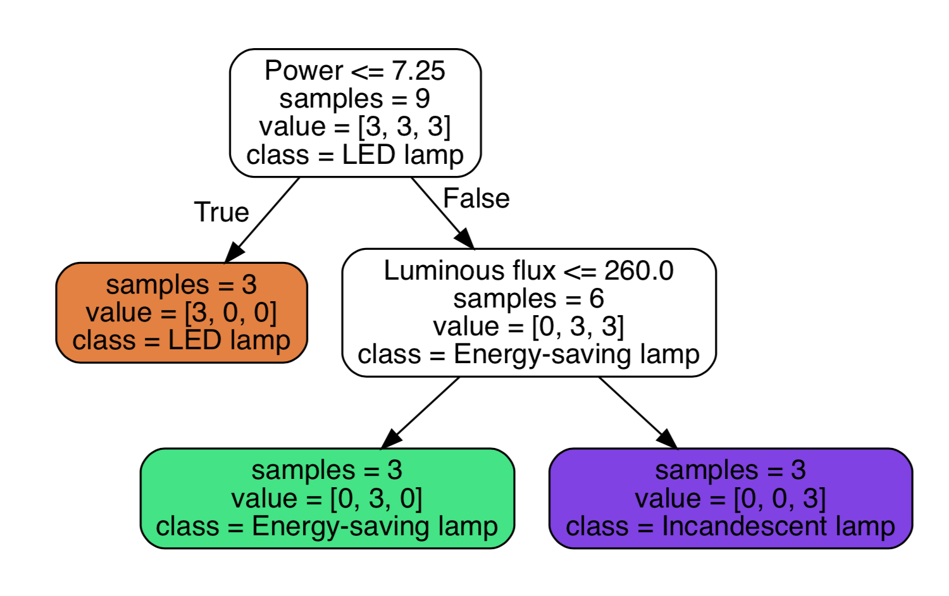
对特征样本[30W,400LM]进行预测

Slide 8
位图
理解计算机存储及呈现图像的原理

Slide 9
三原色

Slide 10
红绿

Slide 11
红蓝

Slide 12
蓝绿

Slide 13
三原色不同比例可以搭配出所有颜色

Slide 14
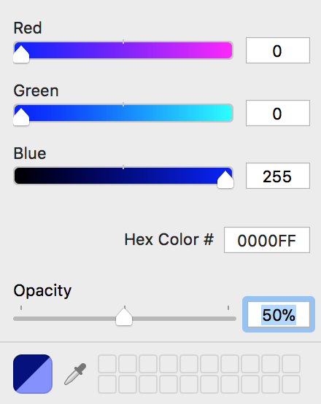
图像叠加

Slide 15
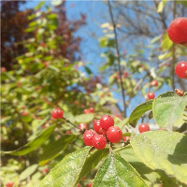

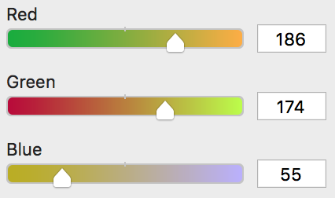
位图放大

Slide 16
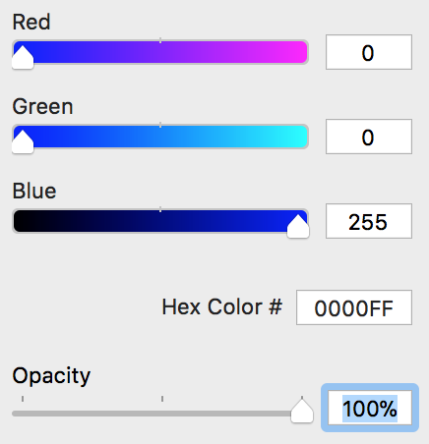
总结
计算机存储颜色用4个数值，分别为RGBA(Red,Green,Blue,Alpha)四个颜色通道的值
一个通道用一个字节存储
一个字节8个位，取值范围为 [0,256)
一个颜色值用4个字节存储，也称用32位存储，这种方式存储的颜色称为32位颜色
00000000
00000000
11111111
11111111

Slide 17
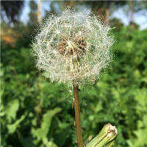
延伸
jpeg
200x200=40000px
压缩
png
40000x4=160000b
gif
160000/1024 = 156.25kb
webp
图片实际大小8kb

Slide 18
JavaScript获取图片数据

Slide 19
JavaScript获取图片数据流程
加载图片
将图片绘制到Canvas上
通过Canvas获取图片数据

Slide 20
手写识别原理

Slide 21
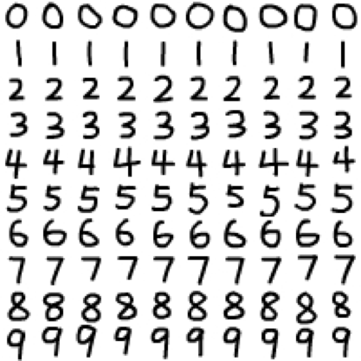
定义图片规格
[255,255,255,255,255,255,255,255,
255,255,255,255,255,255,255,255,
255,255,255,255,255,255,255,255,
255,255,255,255,192,208,255,255,
255,255,255,255,255,255,255,255,
255,255,255,255,255,255,255,112,
0,0,16,80,160,255,255,255,255,255,
255,255,255,255,255,255,255,240,
96,0,0,0,0,0,0,80,255,255,255,255,
255,255,255,255,255,255,255,64,0,
48,176,255,208,144,32,0,128,255,
255,255,255,255,255,255,255,255,
160,0,80,255,255, 255,255,255,224,
0,0,255,255, 255,255,255,255,255,
255,240,16,0,224,255,255,255,255,
255,255,48,0,192,255,
...
...
...
255,255,255,255,255,255,255,255,
255,255,255,255,255,255,255,255,
255,255,255,255,255,255,255,255]
20px
20px

Slide 22
数据对应
训练数据
[[…],[…],[…],…[…]]
0
[[…],[…],[…],…[…]]
1
[[…],[…],[…],…[…]]
2
[[…],[…],[…],…[…]]
3
[[…],[…],[…],…[…]]
4
[[…],[…],[…],…[…]]
5
[[…],[…],[…],…[…]]
6
[[…],[…],[…],…[…]]
7
[[…],[…],[…],…[…]]
8
[[…],[…],[…],…[…]]
9

Slide 23
数据合并训练
训练数据 train_data
目标数据 target_data
[[…],[…],[…],…[…]]
0
[[…],[…],[…],…[…]]
[
[…],[…],[…], …,[…], //10个0
[…],[…],[…], …,[…], //10个1
[…],[…],[…], …,[…], //10个2
[…],[…],[…], …,[…], //10个3
[…],[…],[…], …,[…], //10个4
[…],[…],[…], …,[…], //10个5
[…],[…],[…], …,[…], //10个6
[…],[…],[…], …,[…], //10个7
[…],[…],[…], …,[…], //10个8
[…],[…],[…], …,[…] //10个9
]
1
[
0,0,0,0,0,0,0,0,0,0,
1,1,1,1,1,1,1,1,1,1,
2,2,2,2,2,2,2,2,2,2,
3,3,3,3,3,3,3,3,3,3,
4,4,4,4,4,4,4,4,4,4,
5,5,5,5,5,5,5,5,5,5,
6,6,6,6,6,6,6,6,6,6,
7,7,7,7,7,7,7,7,7,7,
8,8,8,8,8,8,8,8,8,8,
9,9,9,9,9,9,9,9,9,9
]
[[…],[…],[…],…[…]]
2
[[…],[…],[…],…[…]]
3
classify.fit(train_data,target_data)
[[…],[…],[…],…[…]]
4
5
[[…],[…],[…],…[…]]
6
[[…],[…],[…],…[…]]
7
[[…],[…],[…],…[…]]
8
[[…],[…],[…],…[…]]
9
[[…],[…],[…],…[…]]

Slide 24
预测
[255,255,255,255,255,255,255,255,
255,255,255,255,255,255,255,255,
255,255,255,255,255,255,255,255,
255,255,255,255,192,208,255,255,
255,255,255,255,255,255,255,255,
255,255,255,255,255,255,255,112,
0,0,16,80,160,255,255,255,255,255,
255,255,255,255,255,255,255,240,
...
...
...
255,255,255,255,255,255,255,255,
255,255,255,255,255,255,255,255]
classify.predict( )
= 0
image_data

Slide 25
提取图片数据

Slide 26
提取数据流程
[255,255,255,255,255,255,255,255,
255,255,255,255,255,255,255,255,
255,255,255,255,255,255,255,255,
255,255,255,255,192,208,255,255,
255,255,255,255,255,255,255,255,
255,255,255,255,255,255,255,112,
0,0,16,80,160,255,255,255,255,255,
255,255,255,255,255,255,255,240,
96,0,0,0,0,0,0,80,255,255,255,255,
255,255,255,255,255,255,255,64,0,
48,176,255,208,144,32,0,128,255,
255,255,255,255,255,255,255,255,
160,0,80,255,255, 255,255,255,224,
0,0,255,255, 255,255,255,255,255,
255,240,16,0,224,255,255,255,255,
255,255,48,0,192,255,
...
...
...
255,255,255,255,255,255,255,255,
255,255,255,255,255,255,255,255,
255,255,255,255,255,255,255,255]
[255,255,255,255,255,255,255,255,255,255,255,255,255,255,255,255,255,255,255,255,
255,255,255,255,255,255,255,255,192,208,255,255,255,255,255,255,255,255,255,255,
255,255,255,255,255,255,255,112,0 ,0. ,16. ,80. ,160,255,255,255,255,255,255,255,
255,255,255,255,255,240,96 ,0. ,0. ,0. ,0. ,0. ,0. ,80 ,255,255,255,255,255,255,
255,255,255,255,255,64 ,0. ,48. ,176,255,208,144,32 ,0. ,128,255,255,255,255,255,
255,255,255,255,160,0 ,80. ,255,255,255,255,255,224,0. ,0. ,255,255,255,255,255,
255,255,255,240,16 ,0. ,224,255,255,255,255,255,255,48. ,0. ,192,255,255,255,255,
255,255,255,160,0. ,96. ,255,255,255,255,255,255,255,64. ,0. ,192,255,255,255,255,
255,255,255,80 ,0. ,160,255,255,255,255,255,255,255,64. ,0. ,192,255,255,255,255,
255,255,255,64 ,0. ,192,255,255,255,255,255,255,255,16. ,0. ,240,255,255,255,255,
255,255,255,64 ,0. ,192,255,255,255,255,255,255,208,0. ,48. ,255,255,255,255,255,
255,255,255,96 ,0. ,112,255,255,255,255,255,255,96. ,0. ,144,255,255,255,255,255,
255,255,255,192,0. ,16 ,208,255,255,255,255,144,0. ,32. ,240,255,255,255,255,255,
255,255,255,255,64. ,0. ,16. ,112,192,192,112,0 ,16. ,208 ,255,255,255,255,255,255,
255,255,255,255,240,80 ,0. ,0. ,0. ,0. ,0. ,32. ,208,255,255,255,255,255,255,255,
255,255,255,255,255,255,176,64 ,64 ,64. ,112,240,255,255,255,255,255,255,255,255,
255,255,255,255,255,255,255,255,255,255,255,255,255,255,255,255,255,255,255,255,
255,255,255,255,255,255,255,255,255,255,255,255,255,255,255,255,255,255,255,255,
255,255,255,255,255,255,255,255,255,255,255,255,255,255,255,255,255,255,255,255,
255,255,255,255,255,255,255,255,255,255,255,255,255,255,255,255,255,255,255,255]
20px
20px

Slide 27
选择合适的分类器

Slide 28
决策树
人工智能
垃圾邮件
邮件
非垃圾邮件
人工智能
白炽灯
照明灯
节能灯
LED灯
人工智能
男
用户消费习惯
女

Slide 29
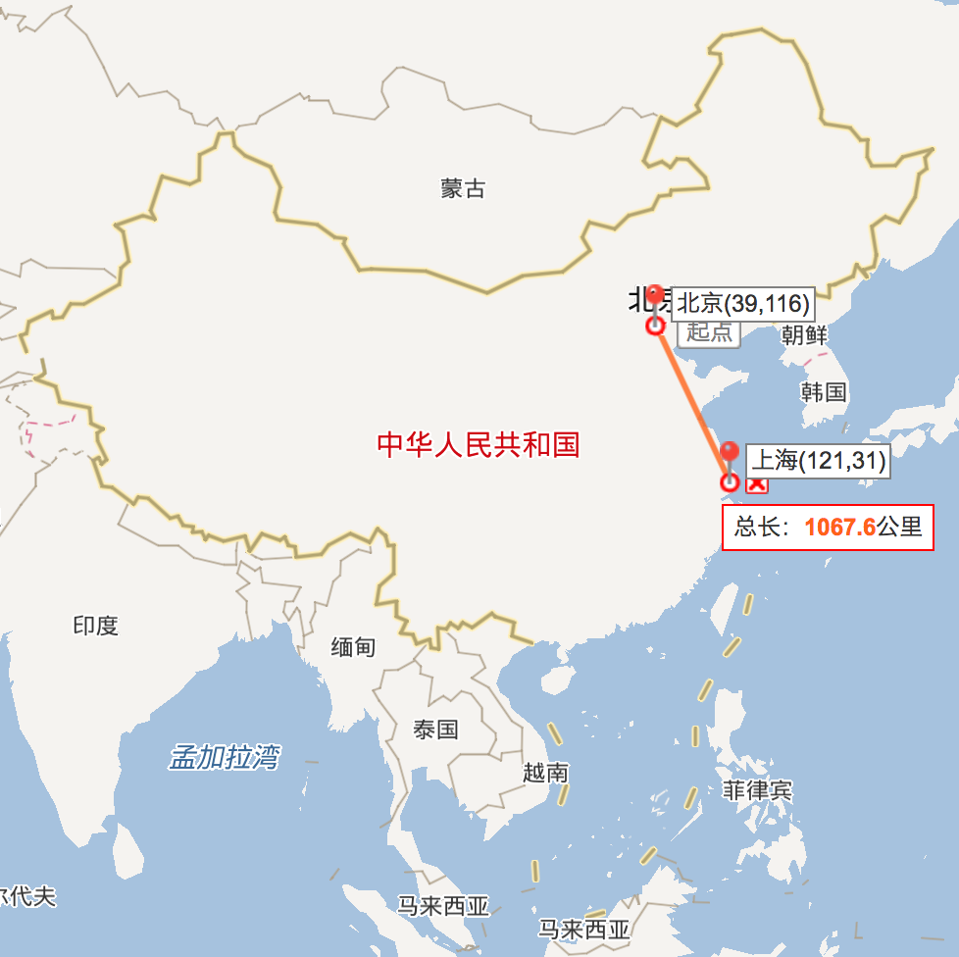
邮递时间预测

Slide 30
近邻分类器
y
?
x

Slide 31
计算两点之间距离
y
(x1,y1)
distance²
=d1²+d2²
d2=y1-y2
(x2,y2)
d1=x1-x2
x
二维点距离 distance²=d1²+d2²

Slide 32
三维坐标系中两点距离
y
(x1,y1,z1)
distance²=d1²+d2²+d3²
d3=y1-y2
(x2,y2,z2)
d1=x1-x2
x
d2=z1-z2
z
三维点距离 distance²=d1²+d2²+d3²

Slide 33
距离公式
二维点距离 distance²=d1²+d2²
三维点距离 distance²=d1²+d2²+d3²
多维点距离 distance²=d1²+d2²+d3²+…+dn²

Slide 34
图片数据
[255 255 255 255 255 255 255 255 255 255 255 255 255 255 255 255 255 255 255 255 255 255 255 255 255 255 255 255 192 208 255 255 255 255 255 255 255 255 255 255 255 255 255 255 255 255 255 112 0 0 16 80 160 255 255 255 255 255 255 255 255 255 255 255 255 240 96 0 0 0 0 0 0 80 255 255 255 255 255 255 255 255 255 255 255 64 0 48 176 255 208 144 32 0 128 255 255 255 255 255 255 255 255 255 160 0 80 255 255 255 255 255 224 0 0 255 255 255 255 255 255 255 255 240 16 0 224 255 255 255 255 255 255 48 0 192 255 255 255 255 255 255 255 160 0 96 255 255 255 255 255 255 255 64 0 192 255 255 255 255 255 255 255 80 0 160 255 255 255 255 255 255 255 64 0 192 255 255 255 255 255 255 255 64 0 192 255 255 255 255 255 255 255 16 0 240 255 255 255 255 255 255 255 64 0 192 255 255 255 255 255 255 208 0 48 255 255 255 255 255 255 255 255 96 0 112 255 255 255 255 255 255 96 0 144 255 255 255 255 255 255 255 255 192 0 16 208 255 255 255 255 144 0 32 240 255 255 255 255 255 255 255 255 255 64 0 16 112 192 192 112 0 16 208 255 255 255 255 255 255 255 255 255 255 240 80 0 0 0 0 0 32 208 255 255 255 255 255 255 255 255 255 255 255 255 255 176 64 64 64 112 240 255 255 255 255 255 255 255 255 255 255 255 255 255 255 255 255 255 255 255 255 255 255 255 255 255 255 255 255 255 255 255 255 255 255 255 255 255 255 255 255 255 255 255 255 255 255 255 255 255 255 255 255 255 255 255 255 255 255 255 255 255 255 255 255 255 255 255 255 255 255 255 255 255 255 255 255 255 255 255 255 255 255 255 255 255 255 255 255]
400维坐标

