Slide 1

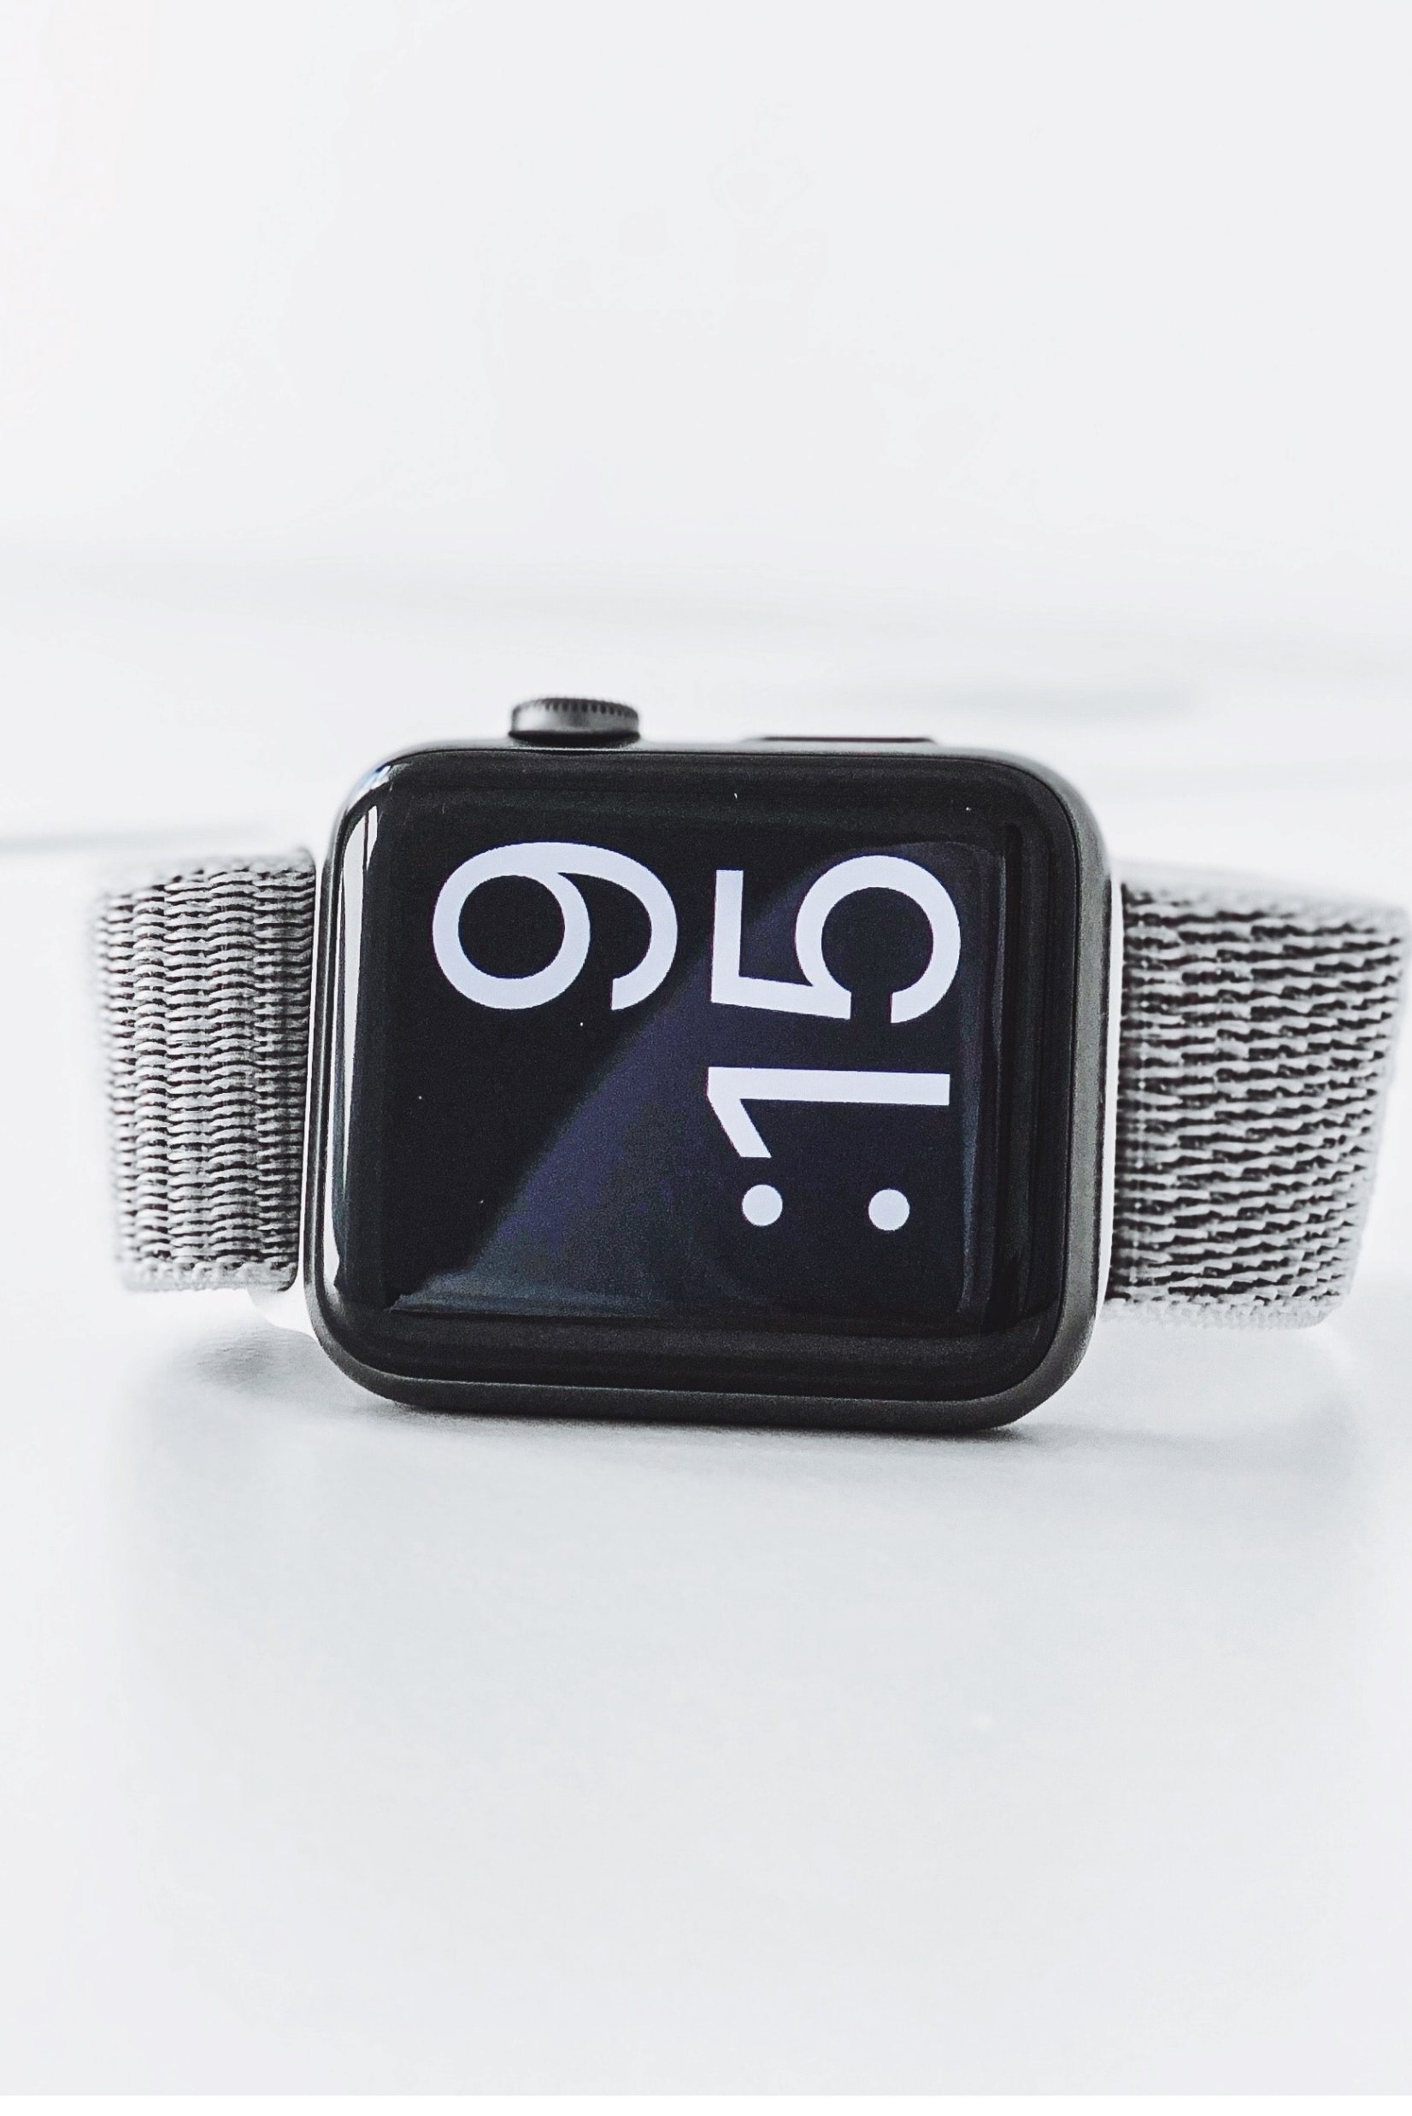
K.E.Y.S. Base
Price : $ 749
Features:
- Time keeping
- 5 liters of storage
- Digital password and interface
- 1 year warranty

Slide 2
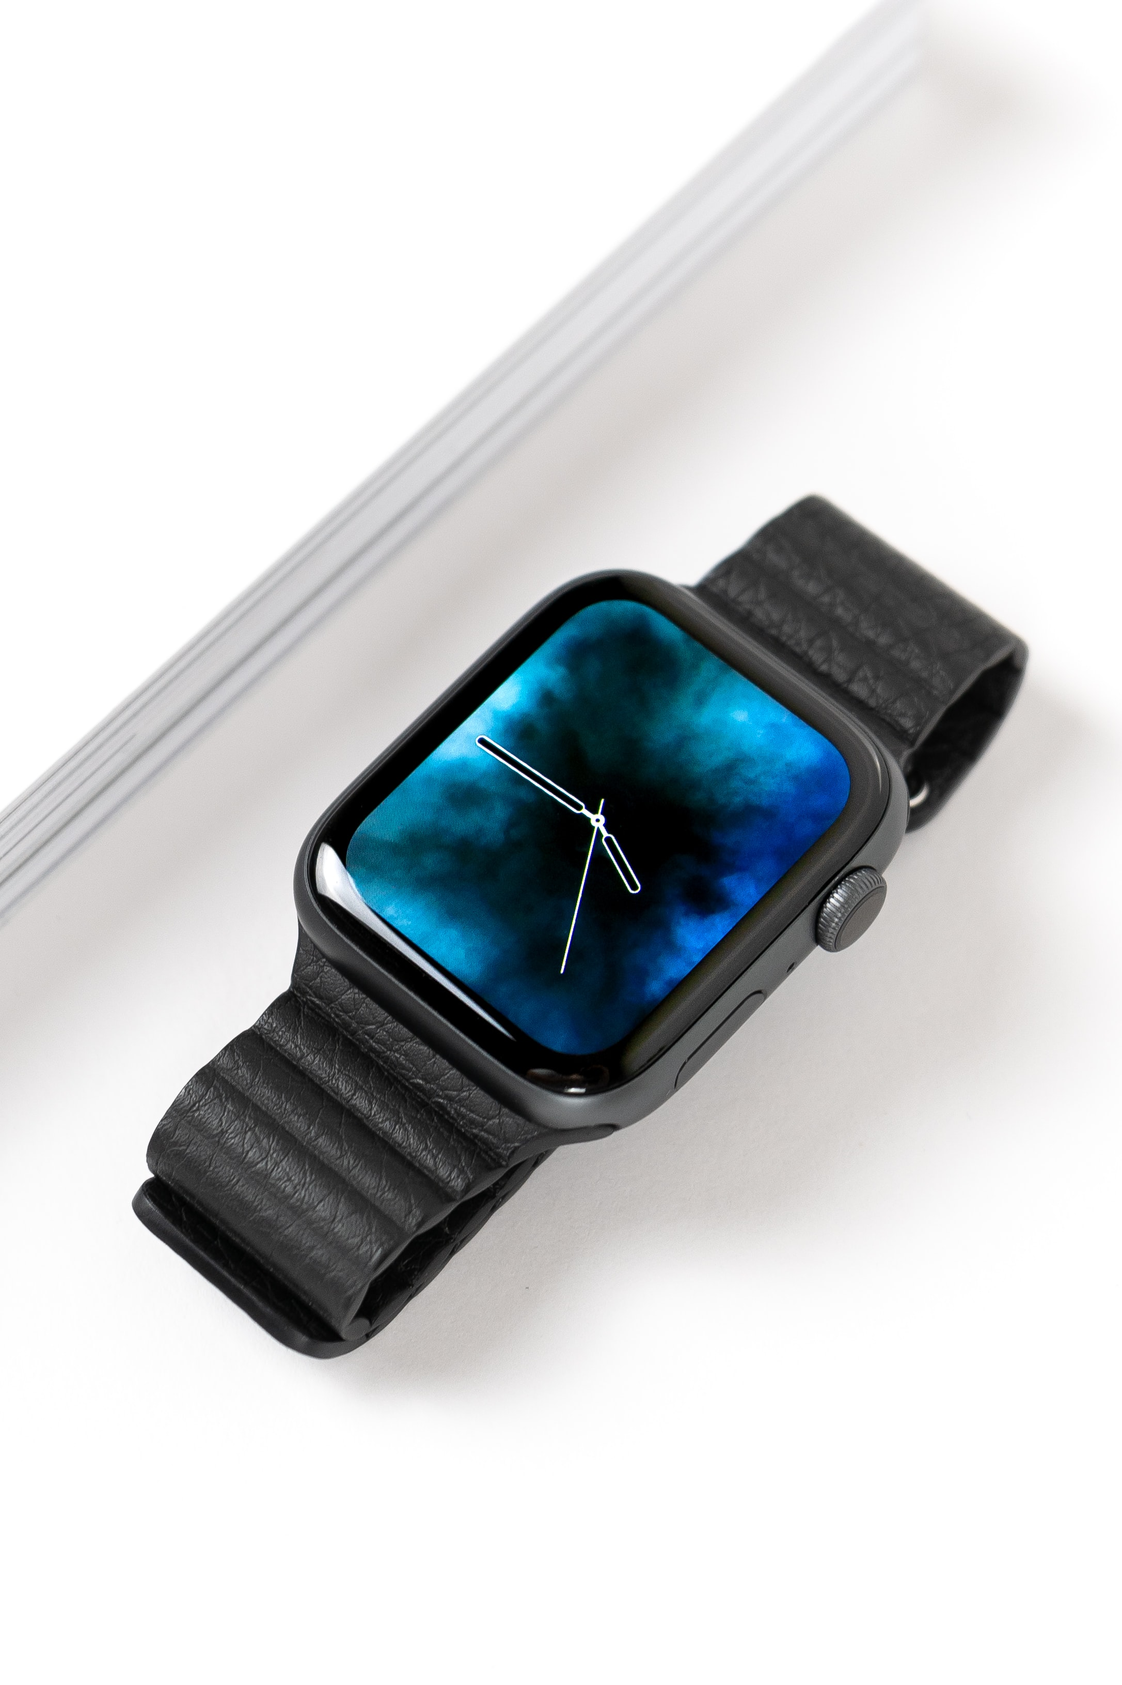
K.E.Y.S. Upgraded
Price : $ 999
Features :
- Time keeping
- 10 liters storages
- Face recognition
- Holographic interface
- 2 years warranty

Slide 3
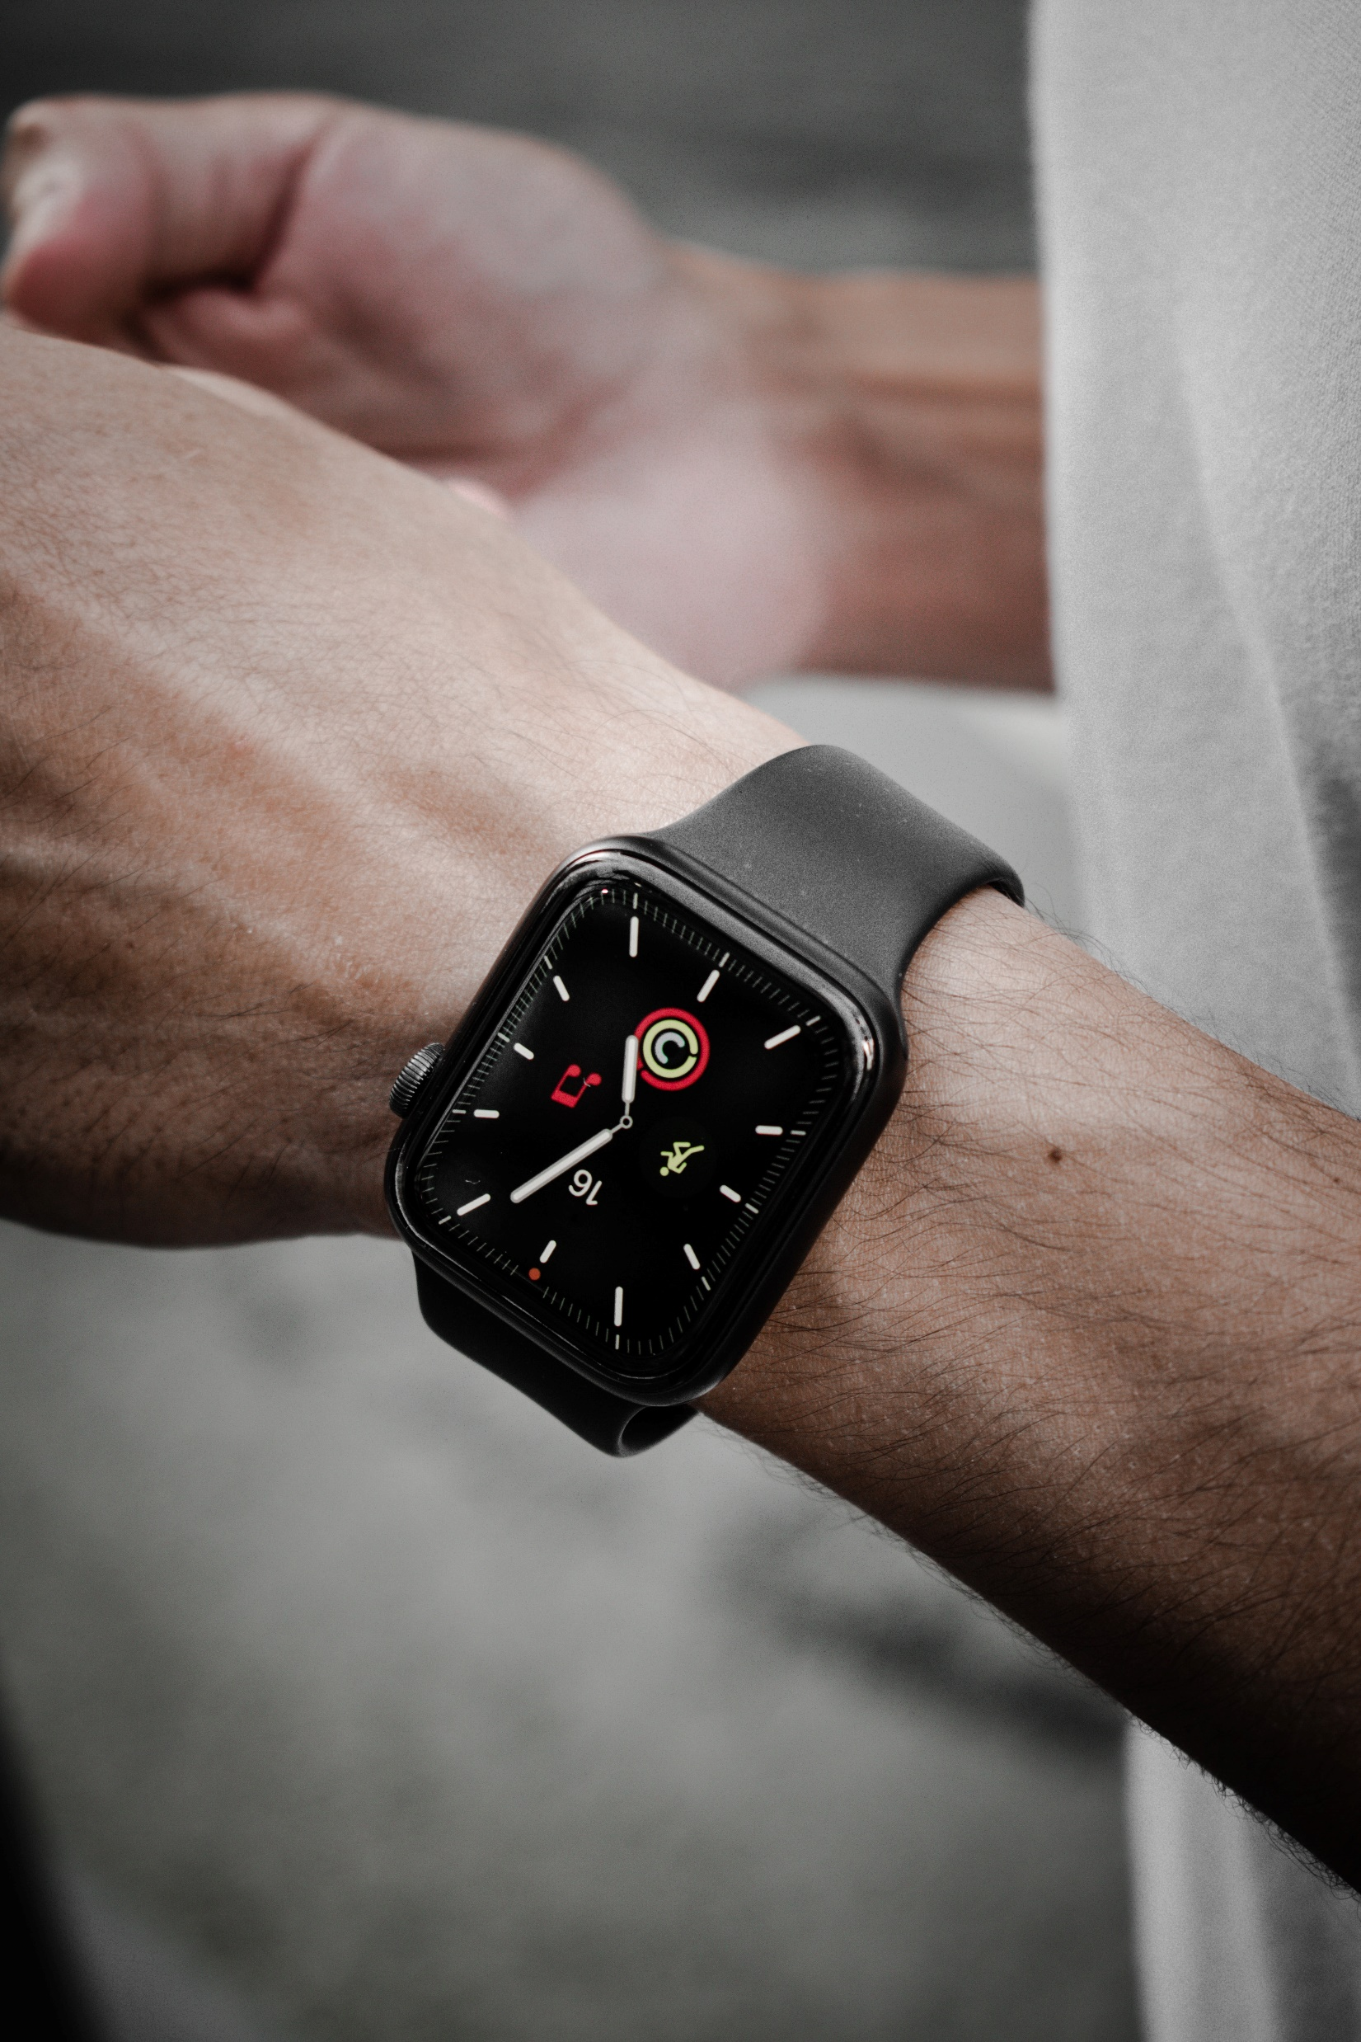
K.E.Y.S. Pro
Price : $ 1299
Features :
- 20 liters of storage
- Face recognition
- Holographic interface
- Longer battery life (48 hours)
- Storage can be shared with another user
- Wireless charging
- 3 years warranty

Slide 4
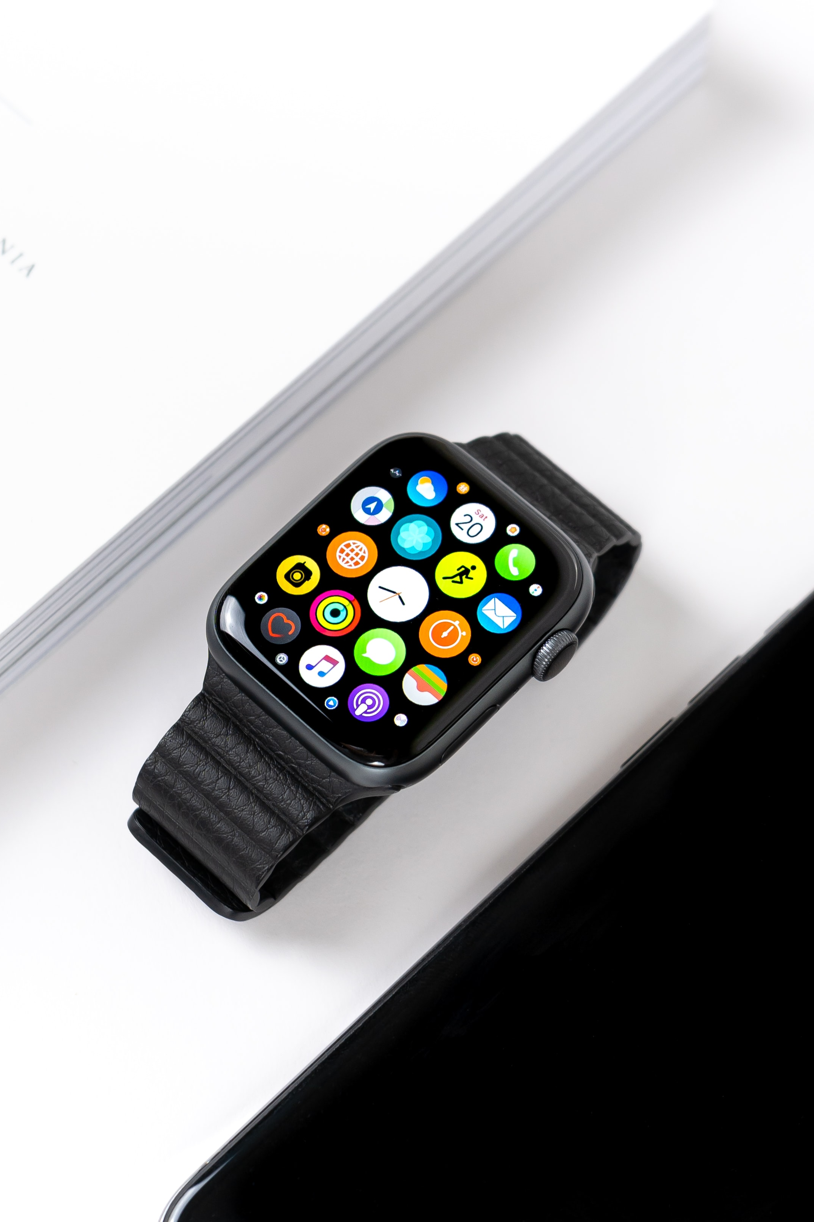
K.E.Y.S. Pro X
Price : $ 1999
Features :
- 35 liters of storage
- Face recognition and holographic interface
- Extra long battery life (168 hours)
- Storage can be connected up to seven users
- Wireless charging
- 4 years warranty

Slide 5
Holidays Edition
Pumpkin Spice
Santa’s Time
Cupid Arrow
Price : $ 999
Same device as the Upgraded Edition but with a spooky twist for Halloween !
Price : $ 999
Same device as the Upgraded Edition but
now with some Christmas Spirit !
Price : $ 999
Same device as the Upgraded Edition but with a special theme to celebrate the holiday of Love !

