Slide 1

SMART INDIA HACKATHON 2026
GAPMAP
Problem Statement ID - SIH26207
Problem Statement Title - Student Innovation: Smart Education
Theme - Smart Education
PS Category - Software
Team ID - [TO ADD]
Team Name - Bravo 404
Curriculum Transition and Learning Recovery System

Slide 2
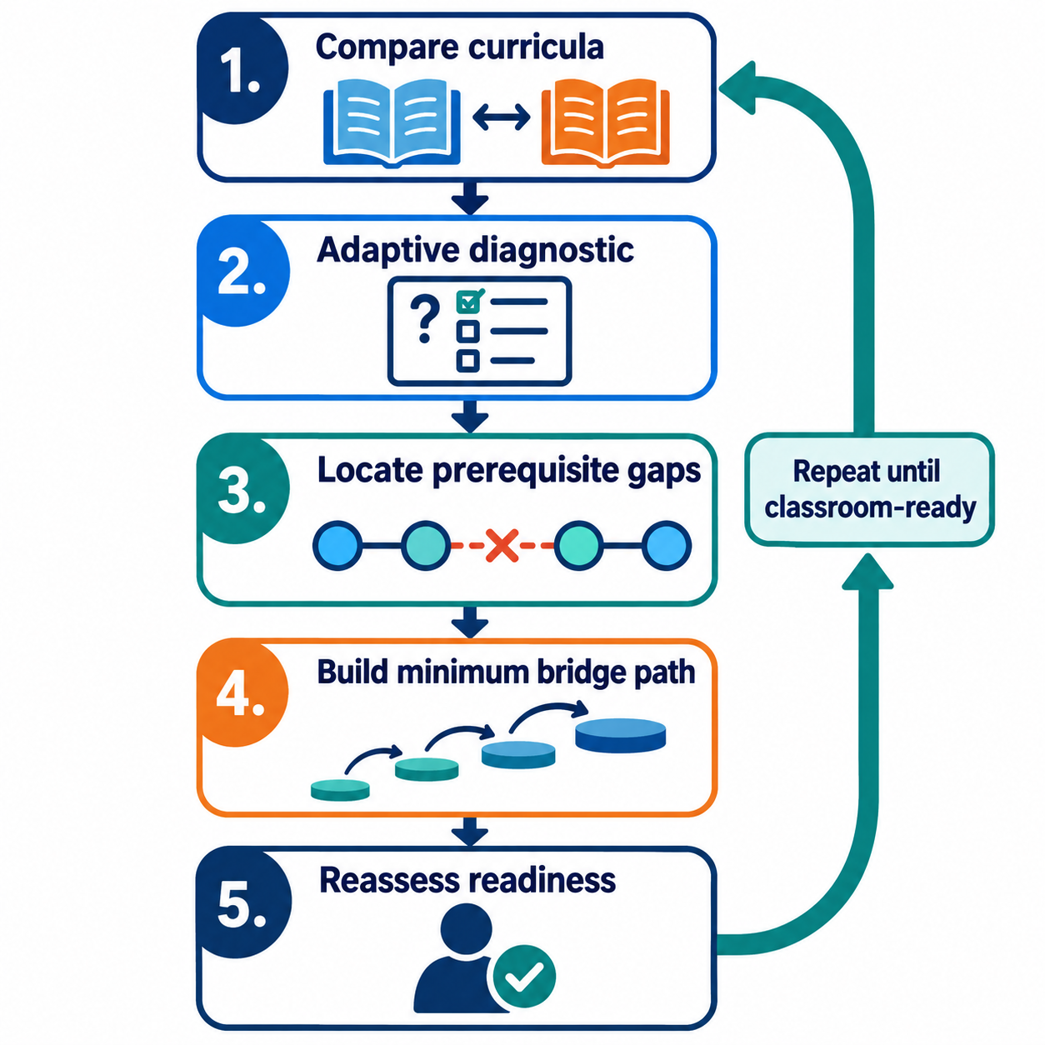
GAPMAP
Bravo 404
THE PROBLEM
Enrollment can continue while learning readiness breaks
• Board or institution change
• Medium-of-instruction change
• Interrupted learning
• Different topic sequence
WHAT IS MISSED
Low score ≠ root cause
A test shows that a learner is struggling, but not:
• which prerequisite failed
• whether language caused the error
• what to teach next
GAPMAP RESPONSE
Find the earliest missing prerequisite and build the shortest teacher-reviewed bridge.
Notes:
Sources:
UDISE+ 2024-25 dropout data: https://www.education.gov.in/sites/upload_files/mhrd/files/parliament_annexure_en/RSUQ_2133_en.pdf
UNICEF child migration research: https://www.unicef.org/india/reports/understanding-child-migration-india

Slide 3
GAPMAP DOMAIN
Bravo 404
SCHOOL CURRICULUM TRANSITION
Source + target curriculum
Target topic
Prerequisite graph
Adaptive diagnostic
Bridge + reassess
>
>
>
>
PROTOTYPE INPUTS
ASSISTED, NOT AUTOMATED
• Class 8 → 9 mathematics
• Source and destination curricula
• About 25 concepts
• English and Hindi prompts
• Synthetic learner profiles
• Suggests mappings and language variants
• Retrieves approved evidence
• Shows reasoning and confidence
• Teacher remains the final reviewer
Prototype: React dashboard + Django API + deterministic graph logic + guarded RAG

Slide 4
PROJECT DOMAIN
Bravo 404
One bounded transition proves the core idea
DOMAIN BOUNDARY
OUT OF SCOPE
• Maharashtra Grade 8 → CBSE Grade 9 mathematics
• Target topic: linear equations
• Concepts include integers, ratios and algebra
• Reviewed questions and prerequisite edges
• Synthetic learner profiles
• Admission, promotion or retention decisions
• Disability or intelligence diagnosis
• Live government-system integration
• Unreviewed AI mappings or questions
CURRENT PROTOTYPE
Django APIs support adaptive diagnosis, gap maps, bridge plans and guarded RAG retrieval. The presenter runs the prototype locally.

Slide 5
EVALUATION METHOD
Bravo 404
Measure whether GapMap finds the right gap with fewer, useful questions
TEST DESIGN
KEY MEASURES
• Run prepared synthetic scenarios
• Compare expected and observed results
• Inspect the evidence behind each gap
• Reassess the destination topic
Root-gap accuracy
Questions used vs fixed test
Bridge steps vs full remediation
Teacher agreement
Readiness after reassessment
SUCCESS CRITERIA
Find the intended gap, avoid unnecessary reteaching, and return “ready” when no bridge is needed.
Evaluation uses synthetic cases; results are prototype evidence, not population impact.

Slide 6
EVALUATION SCENARIOS
Bravo 404
Four scenarios test different failure modes
SCENARIOS 1–2
SCENARIOS 3–4
1. READY
Same standard; prerequisites mastered.
Expected: no academic gap.
2. MASTERY GAP
Interrupted learning; algebra weak, integers strong.
Expected: focused algebra bridge.
3. LANGUAGE BARRIER
Concept works symbolically; English terminology fails.
Expected: terminology support, not full reteaching.
4. CROSS-BOARD GAP
Target fails; an earlier prerequisite is weak.
Expected: shortest prerequisite path.
DECISION RULE
Accept a gap only when evidence supports it; route uncertainty to teacher review.
Notes:
Official references:
https://www.education.gov.in/sites/upload_files/mhrd/files/parliament_annexure_en/RSUQ_2133_en.pdf
https://www.unicef.org/india/reports/understanding-child-migration-india
https://apaar.education.gov.in/
https://scholarships.gov.in/

