Slide 1

SMART INDIA HACKATHON 2026
GAPMAP
Problem Statement ID - SIH26207
Problem Statement Title - Student Innovation: Smart Education
Theme - Smart Education
PS Category - Software
Team ID - [TO ADD]
Team Name - Bravo 404
Curriculum Transition and Learning Recovery System

Slide 2
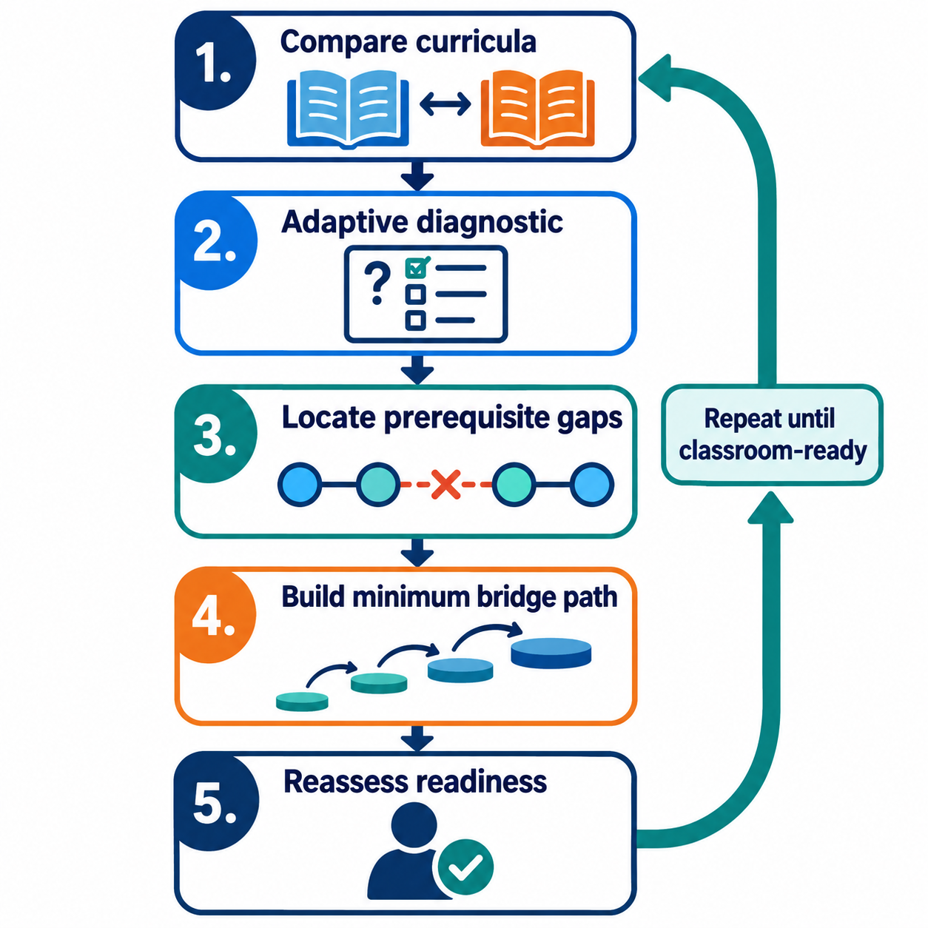
GAPMAP
Bravo 404
PROPOSED SOLUTION
Curriculum transitions create invisible prerequisite gaps
Students who change board, medium or institution, or return after an absence, may be enrolled but unable to follow the current lesson. A low score shows the difficulty, but rarely identifies the earliest missing concept or separates a language gap from a concept gap.
4 transition risks
Board, medium, institution and interrupted learning
GapMap compares the source and destination curricula, runs a short adaptive diagnostic and traces errors through a prerequisite graph. It creates the minimum bridge path a student needs, then reassesses readiness for the current classroom.
WHY IT IS DIFFERENT
Cross-curriculum mapping + root-gap diagnosis + minimum bridge path + readiness evidence
Notes:
Sources:
UDISE+ 2024-25 dropout data: https://www.education.gov.in/sites/upload_files/mhrd/files/parliament_annexure_en/RSUQ_2133_en.pdf
UNICEF child migration research: https://www.unicef.org/india/reports/understanding-child-migration-india

Slide 3
TECHNICAL APPROACH
Bravo 404
LEARNING RECOVERY PIPELINE
Map curricula
Diagnose learner
Trace prerequisites
Build bridge
Reassess
>
>
>
>
PLATFORM
AI ASSISTANCE
â€¢ Source and destination board, grade and medium profiles
â€¢ Learning outcome and concept dependency graph
â€¢ Adaptive diagnostic built from a verified question bank
â€¢ Student bridge plan with teacher review
â€¢ Progress evidence and classroom readiness history
â€¢ Maps equivalent concepts across curricula and languages
â€¢ Produces diagnostic variants from verified learning outcomes
â€¢ Separates terminology difficulty from concept misunderstanding
â€¢ Grounds explanations in approved textbooks for teacher review
Prototype stack: React, Django REST, PostgreSQL with pgvector, concept graph, grounded language model and role-based access

Slide 4
FEASIBILITY AND VIABILITY
Bravo 404
A mathematics pilot can prove the diagnosis before expansion
PILOT BOUNDARY
RISKS AND CONTROLS
â€¢ One transition: state board to CBSE or a medium change
â€¢ One scope: Class 8 to 9 mathematics
â€¢ About 25 prerequisite concepts
â€¢ English and Hindi diagnostic prompts
â€¢ Synthetic learner profiles with teacher review
Curriculum mapping error
Teacher validates every concept link
Question-generation error
Verified question bank with source references
Language gap mistaken for concept gap
Bilingual prompts and separate scoring
Weak bridge recommendation
Teacher approves the final path
Viability
Uses official learning outcomes and open curriculum resources. DIKSHA can supply learning material while GapMap provides transition diagnosis, sequencing and reassessment.

Slide 5
IMPACT AND BENEFITS
Bravo 404
Students catch up on the right concepts instead of repeating an entire syllabus
STUDENT OUTCOMES
INSTITUTION OUTCOMES
â€¢ Shorter route from the missing prerequisite to the current lesson
â€¢ Support in a familiar language without hiding academic terminology
â€¢ Visible mastery and classroom readiness instead of one low score
â€¢ Root-gap map instead of marks alone
â€¢ Reviewed bridge path for each transitioning learner
â€¢ Cohort view for students who share the same missing prerequisite
MEASURABLE PILOT INDICATORS
Teacher-validated diagnosis Bridge completion Mastery improvement Time to classroom readiness Recurring gaps
Primary beneficiaries: students changing board, medium or institution, and learners returning after interrupted education

Slide 6
RESEARCH AND REFERENCES
Bravo 404
Evidence base and systems considered
CURRENT EVIDENCE
EXISTING SYSTEMS AND GAP
1. Ministry of Education, ABSS 2025 Outcome Document
Students changing from home-language learning to English-medium higher education require transition support
education.gov.in/sites/upload_files/mhrd/files/nep/ABSS_2025_Outcome_Document.pdf
2. NCERT Learning Outcomes
Grade and subject learning outcomes provide the basis for a curriculum concept graph
ncert.nic.in
3. APAAR
Academic identity, records, credits and mobility
apaar.education.gov.in
4. DIKSHA
Curriculum content, quizzes and multilingual learning resources
diksha.gov.in
5. PRABANDH
Tracks out-of-school learners until mainstreaming
samagrashiksha.in
GapMap focus: cross-curriculum prerequisite diagnosis and a minimum recovery path
Notes:
Official references:
https://www.education.gov.in/sites/upload_files/mhrd/files/parliament_annexure_en/RSUQ_2133_en.pdf
https://www.unicef.org/india/reports/understanding-child-migration-india
https://apaar.education.gov.in/
https://scholarships.gov.in/

