Slide 1


G.H. RAISONI UNIVERSITY, SAIKHEDA
School of Engineering & Technology
Real-Time Indian Sign Language Communication Assistant
Progress Presentation
Guide:
Dr.Rahul Khokale
Name of Projectees
Keyur Sherke Divya Lonare
Lucky Dhepe Alkesh Soni

Slide 2


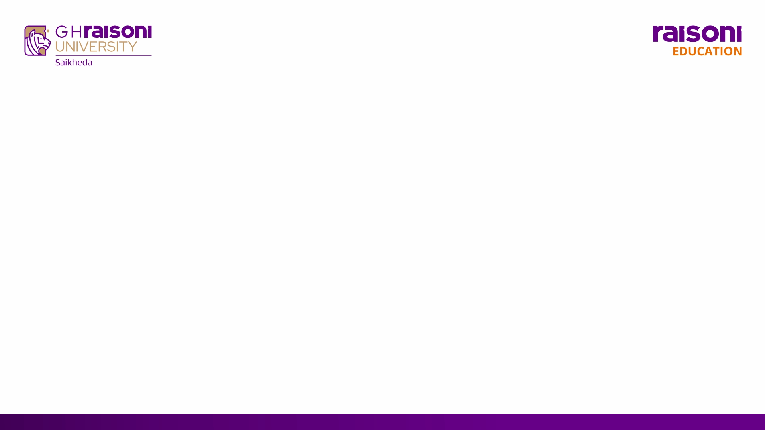
Contents
  Abstract
  Introduction
  Literature Survey
  Problem Statement
  Motivation
  Objectives
  Work Progress
  Block Diagram
  References

Slide 3
Abstract
  Problem: ISL users face communication difficulties when interacting with people who do not understand sign language.
  Proposed Solution: The project develops a webcam-based system to recognize selected Indian Sign Language signs in real time.
  Methodology: MediaPipe extracts hand and body landmarks, which are classified using a trained machine learning or deep learning model.
  Output: Recognized signs are converted into readable text and optional speech.
  Aim: The system provides an affordable and accessible communication aid without requiring specialised hardware.

Slide 4
Introduction
  Indian Sign Language: ISL is a visual language that uses hand shapes, movements, facial expressions and body posture to communicate.
  Communication Gap: Many people do not understand ISL, which creates communication barriers for Deaf and hard-of-hearing individuals.
  Technology-Based Support: Computer vision and artificial intelligence can identify signs through a standard webcam without requiring wearable sensors.
  Project Approach: The proposed system uses MediaPipe for landmark extraction and a trained model for real-time sign recognition.
  Expected Benefit: The system converts recognized signs into text and optional speech, supporting more accessible communication between ISL users and non-signers.

Slide 5
Literature Review
Sr. No. | Paper or Source | Publication | Main finding
1 | INCLUDE | ACM MM, 2020 | 263 isolated ISL signs
2 | iSign | ACL Findings, 2024 | Large ISL benchmark
3 | ISLTranslate | Research dataset, 2023 | 31K sentence pairs
4 | ISL Grammar, Sinha | Gallaudet UP, 2018 | Space and grammar matter
5 | MediaPipe Hands | Google AI Edge | 21 landmarks per hand
6 | FastAPI WebSockets | FastAPI documentation | Live two-way events
Notes:
[Sources]
https://doi.org/10.1145/3394171.3413528
https://aclanthology.org/2024.findings-acl.643/
https://arxiv.org/abs/2307.05440
https://doi.org/10.2307/j.ctv2rcnfqg
https://developers.google.com/mediapipe/solutions/vision/hand_landmarker/python
https://fastapi.tiangolo.com/advanced/websockets/

Slide 6
Problem Statement
  Communication Barrier: Indian Sign Language users often face difficulties communicating with people who do not understand ISL.
  Limited Accessibility: Professional sign-language interpreters may not always be available in educational, healthcare and public environments.
  Limitations of Existing Systems: Many existing student projects recognize only alphabets or static hand gestures and do not adequately handle movement-based ISL signs.
  Hardware Dependency: Sensor gloves and specialised devices can be expensive, uncomfortable and difficult to maintain.
  Required Solution: An affordable, webcam-based system is needed to recognize selected ISL signs in real time and convert them into text and optional speech.

Slide 7
Motivation
  Inclusive Communication: Reduce the communication gap between ISL users and people who do not understand sign language.
  Improved Accessibility: Support communication in education, healthcare and other everyday environments.
  Affordable Solution: Build a software-based system that works with a standard webcam without requiring specialised hardware.
  Practical Use of AI: Apply computer vision and deep learning to solve a meaningful real-world problem.
  Future Potential: Create a foundation for larger-vocabulary recognition and continuous ISL interpretation.

Slide 8
Objectives
  Real-Time Recognition: Develop a webcam-based system that recognizes selected Indian Sign Language signs in real time.
  Feature Extraction: Use MediaPipe to extract relevant hand and upper-body landmarks from video frames.
  Model Development: Train and evaluate a machine learning or deep learning model using a prepared ISL dataset.
  Accessible Output: Convert recognized signs into readable text and optional speech.
  Reliable Performance: Build an affordable and user-friendly system with suitable accuracy, confidence control and response time.

Slide 9
Work Progress
Completed
  Project Scope: Finalized the software-based ISL recognition system.
  Research: Studied ISL concepts, datasets and existing recognition methods.
  System Design: Prepared the architecture, workflow and technology stack.
  Planning: Defined the data collection and model development process.
Upcoming
  Prototype: Develop MediaPipe landmark extraction.
  Dataset: Collect and prepare selected ISL sign samples.
  Model: Train and evaluate the recognition model.
  Integration: Connect real-time text and speech output.

Slide 10
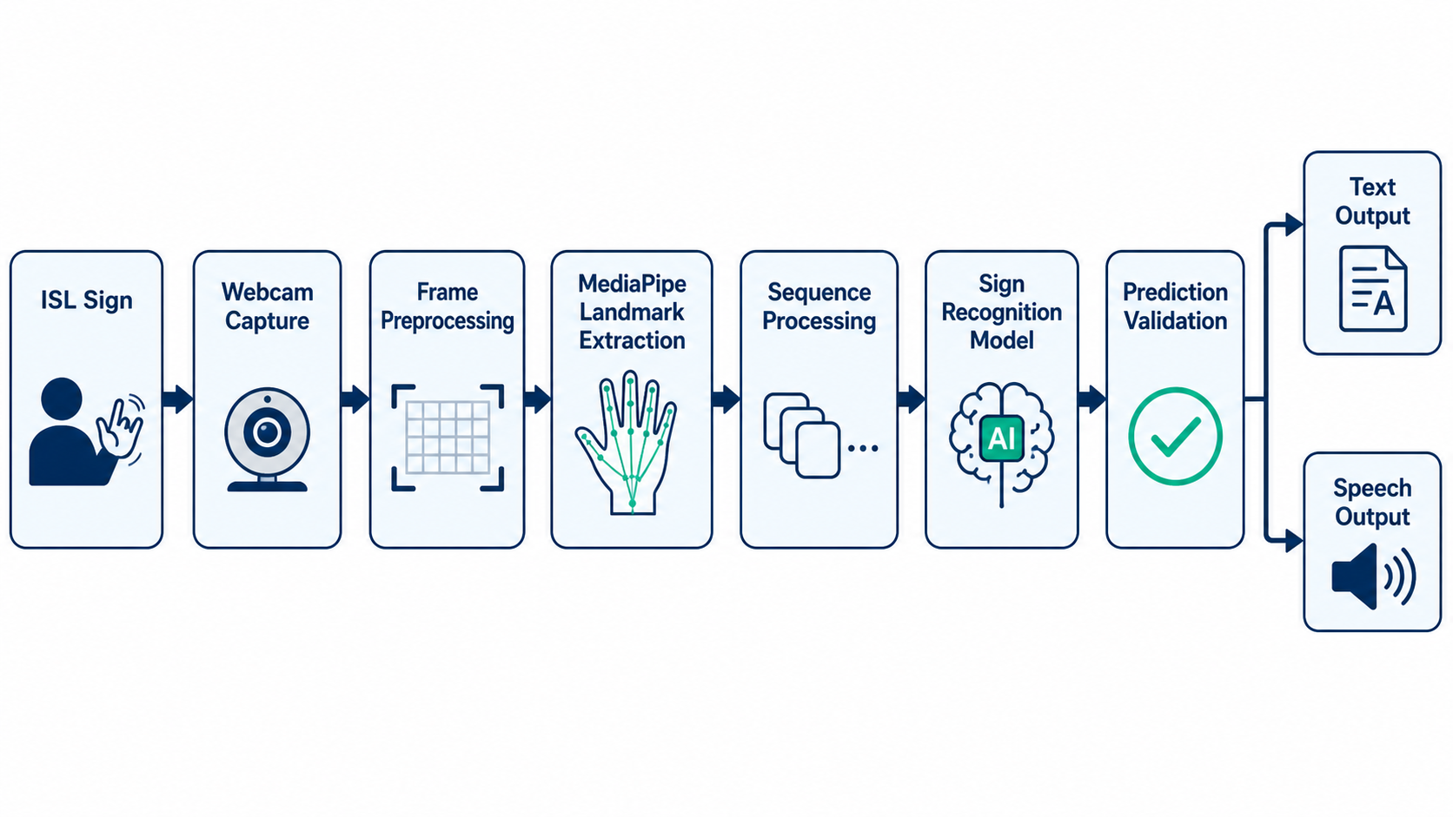
Block Diagram

Slide 11
References
  INCLUDE Dataset: Sridhar et al., “INCLUDE: A Large Scale Dataset for Indian Sign Language Recognition,” ACM Multimedia, 2020.
  iSign Benchmark: Joshi et al., “iSign: A Benchmark for Indian Sign Language Processing,” Findings of ACL, 2024. Source
  ISLTranslate Dataset: Joshi, Agrawal and Modi, “ISLTranslate: Dataset for Translating Indian Sign Language,” 2023. Source
  MediaPipe Hands: Vakunov et al., “MediaPipe Hands: On-Device Real-Time Hand Tracking,” 2020. Source
  ISL Dictionary: Indian Sign Language Research and Training Centre, Government of India, Source
  Kaggle ISL Dataset: Kaggle Official ISL Dataset, Source

Slide 12
Thank You

