Slide 1
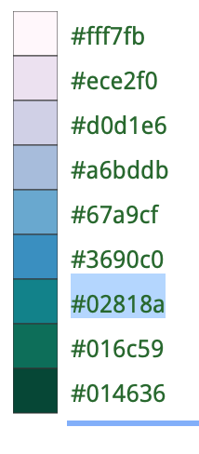
DATA SURVEY
CHEMICAL
BIOLOGICAL
δ¹⁸O, ∆47, TEX86, MgCa
Coral reefs, mangroves
DATA COMPILATION
PRIORS
Temperature
Latitude

