Slide 1
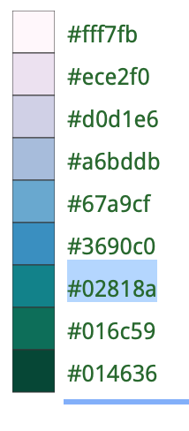
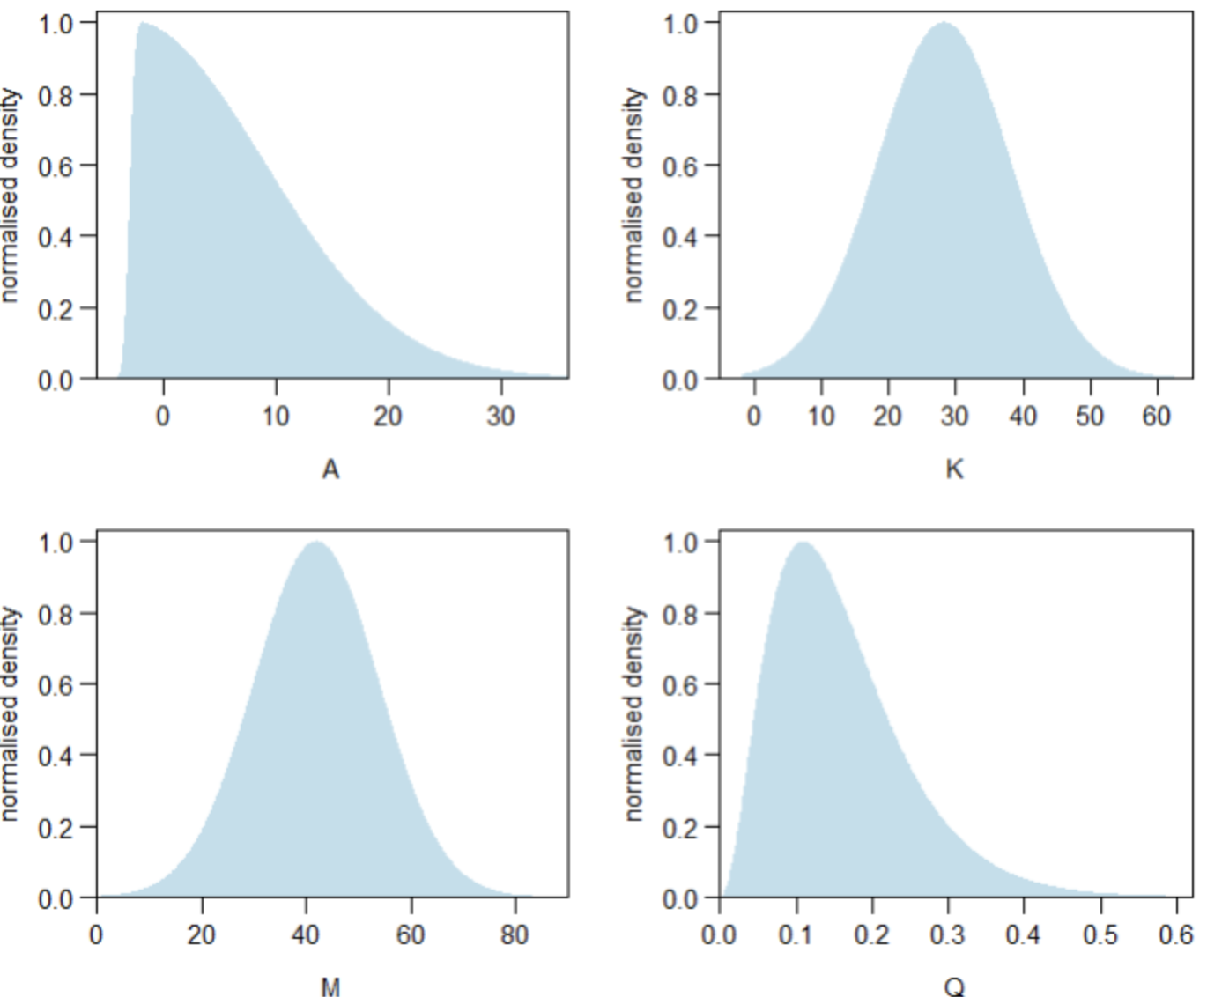
DATA SURVEY
CHEMICAL
BIOLOGICAL
δ¹⁸O, ∆47, TEX86, MgCa
Coral reefs, mangroves
B
DATA COMPILATION
K
Temperature
PRIORS
A
Latitude
M

