Slide 1
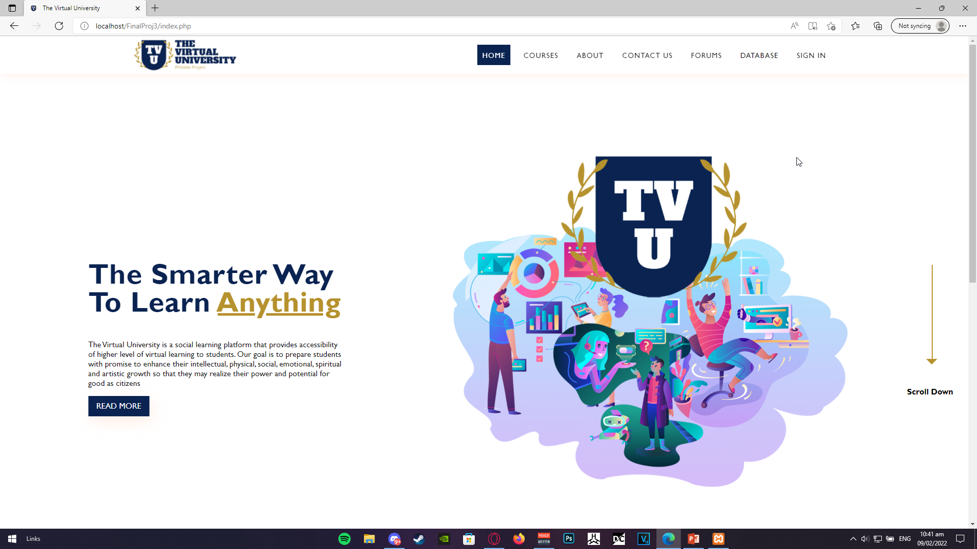
Notes:
Index.php (homepage)
Interactive (napipindot) lang yung home button, courses button, and sa database may drop down button, yung students lang yung interactive, and sign in.

Slide 2
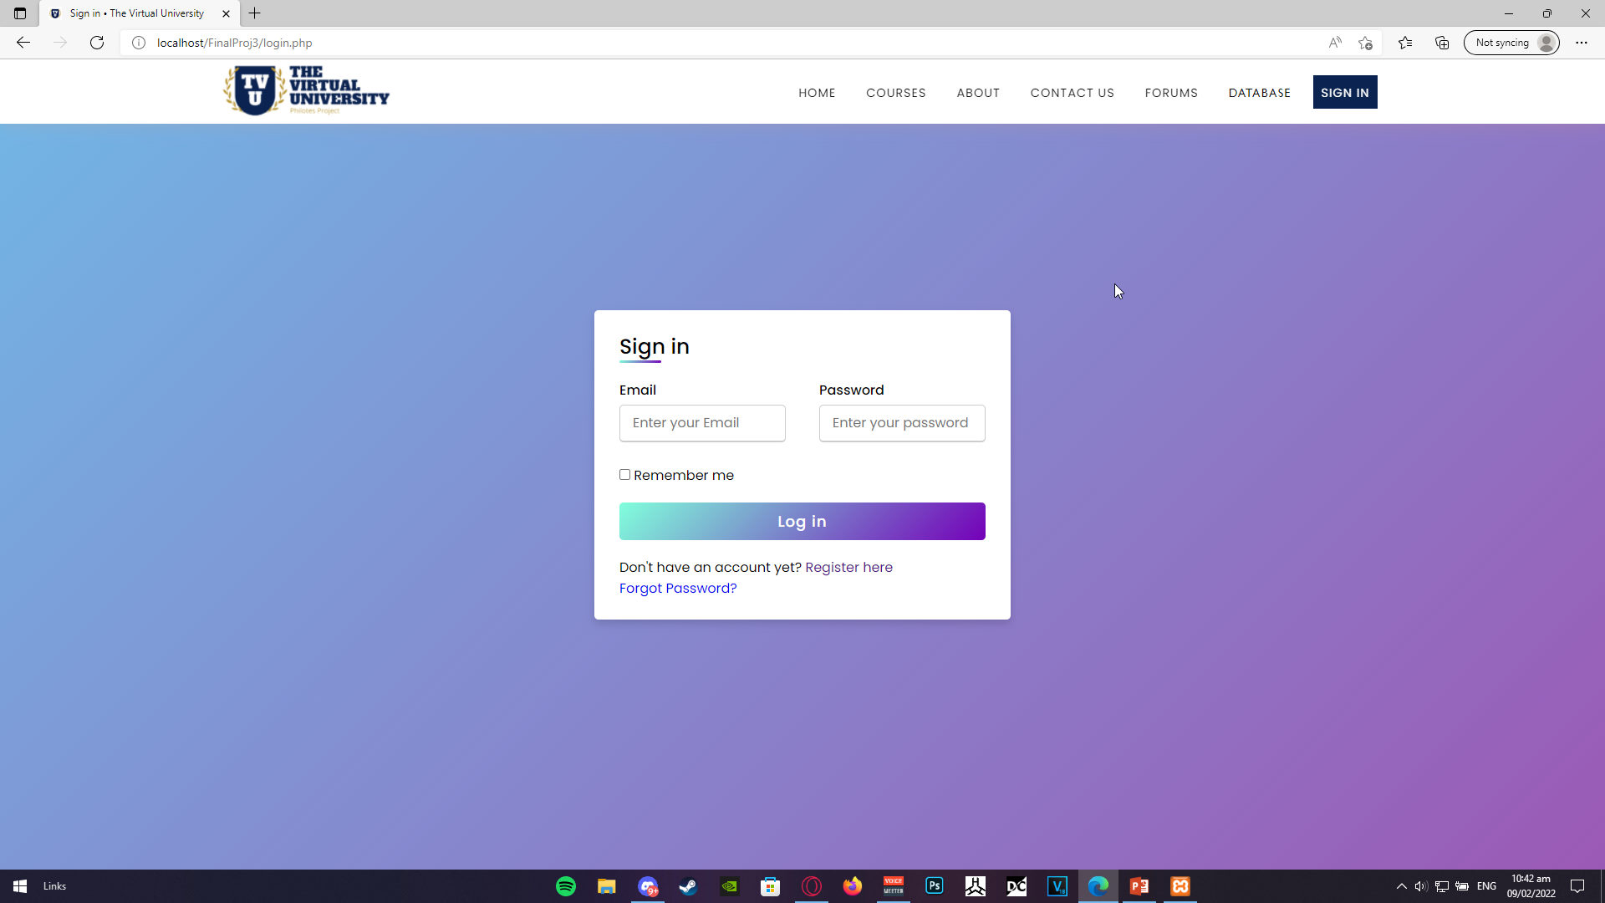
Notes:
Sign In page. Dito kelangan may nakalagay sa fields (email and password) or else hindi makaka sign in. Pag nag login tapos hindi registered yung email or mali yung email/pass, may nalabas na error and pinag llogin ulit yung user.
Interactive lang ulit yung home, database, and sign in button. Tska yung register here, na pag kinllick eh mapupunta nag user sa register page. Yung forgot password design lang eon hehehehe

Slide 3
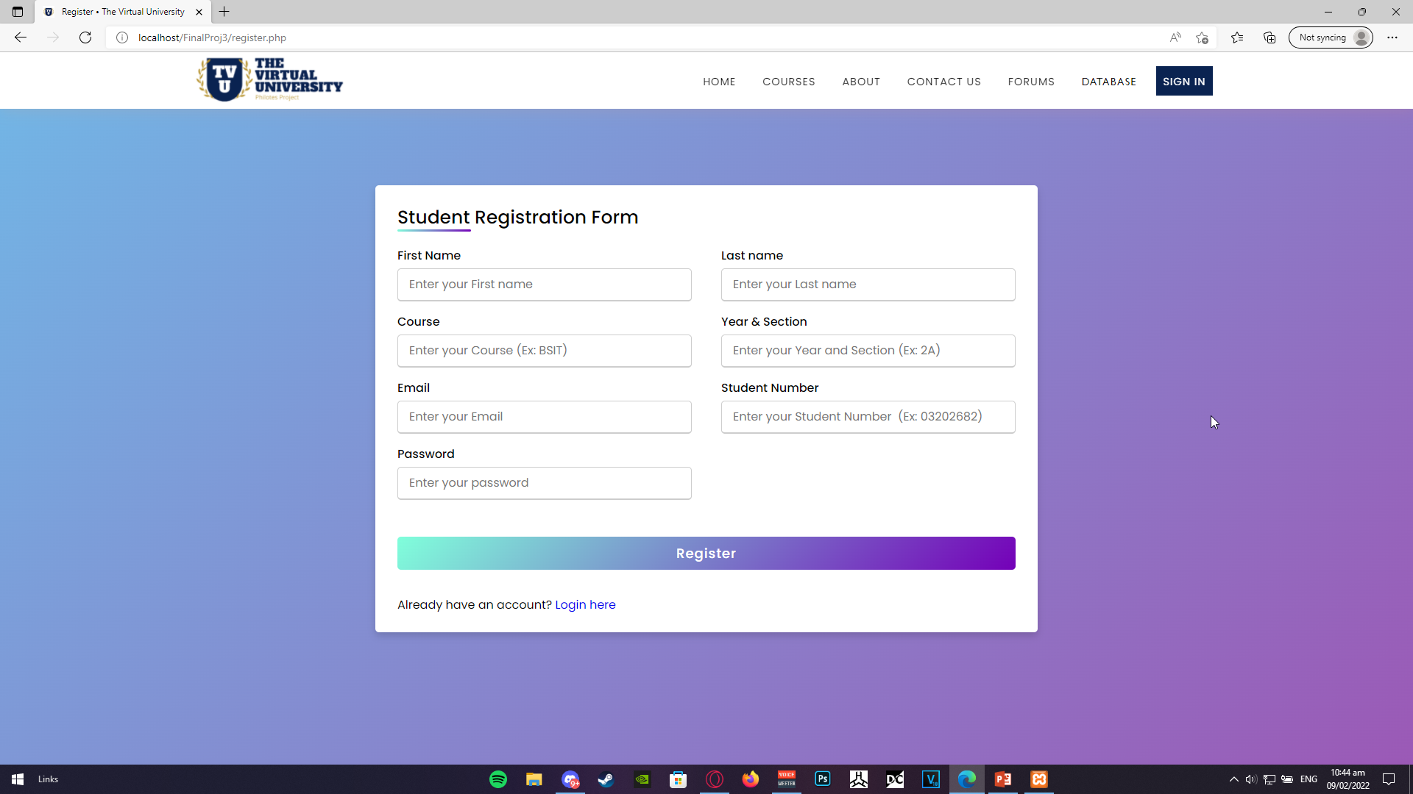
Notes:
Eto yung registration form. Same nung as login page, need may nakasulat lahat sa fields para makapag register. Lahat ng ilalagay ditto is mareregister and maisasave sa database. Pagkaregister, or pag niclick yung login here, ay mapapaunta nag user ddun sa login page

Slide 4
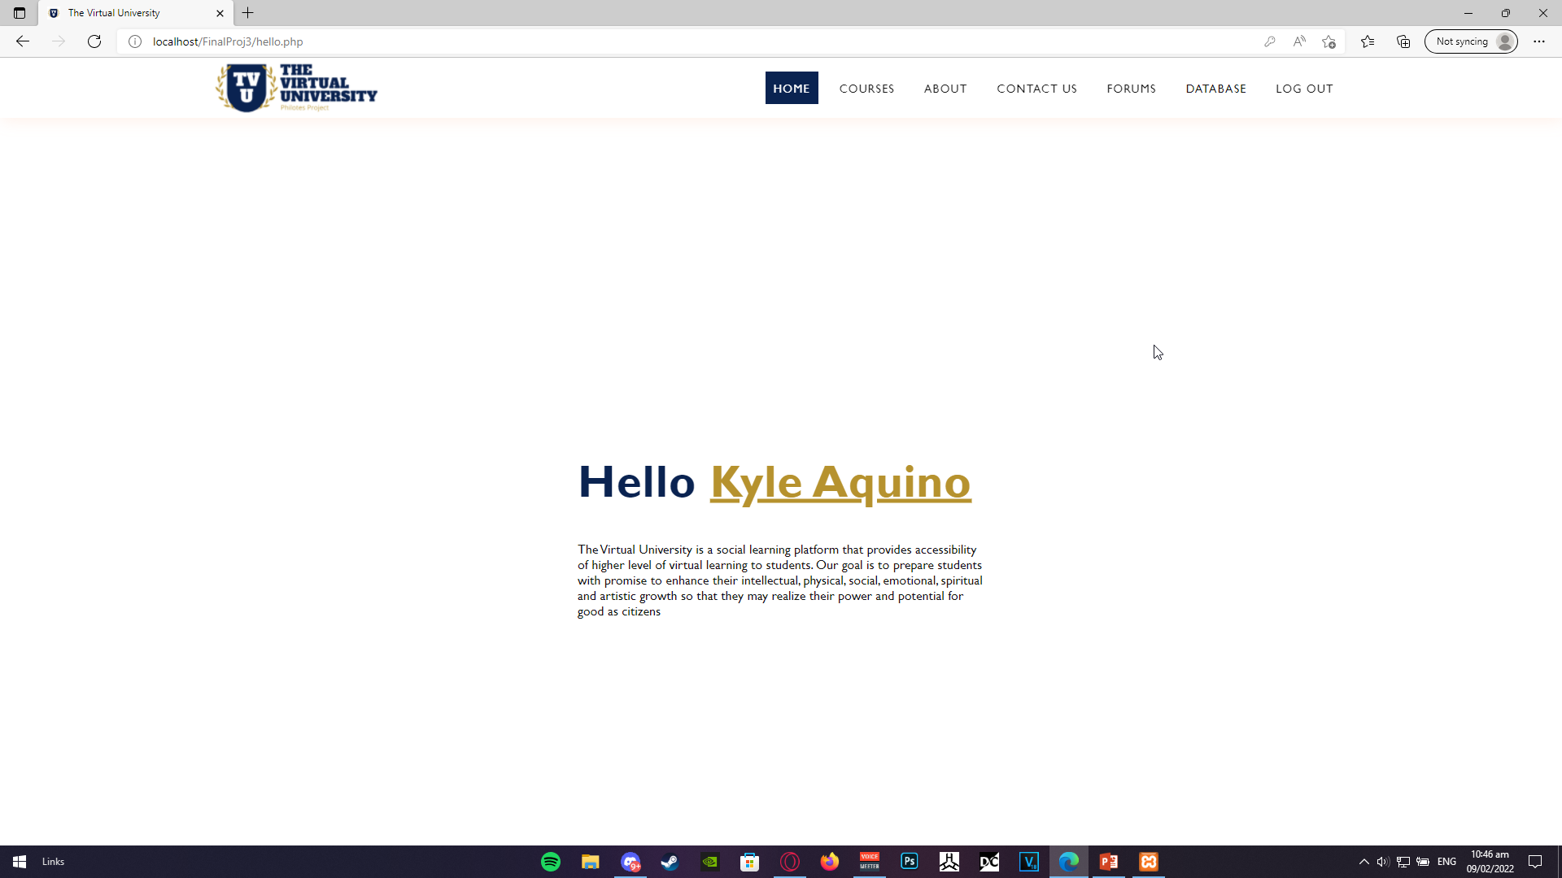
Notes:
Eto yung lalabas after mag sign in yung user. Interactive ulit yung home, courses, and yung database buttons yung log out button, which will take the user back to home page.

Slide 5
Yung student list sa database, hindi ko pa miscreenshot cus inaayos ko pa sql pero gagawin ko sya today, and try ko lagyan nung navigation bar nga ng student sa left side.
Plano ko sana ilagay don yung mga school works, schedule, subjects, grades, cor ganern ganern

Slide 6
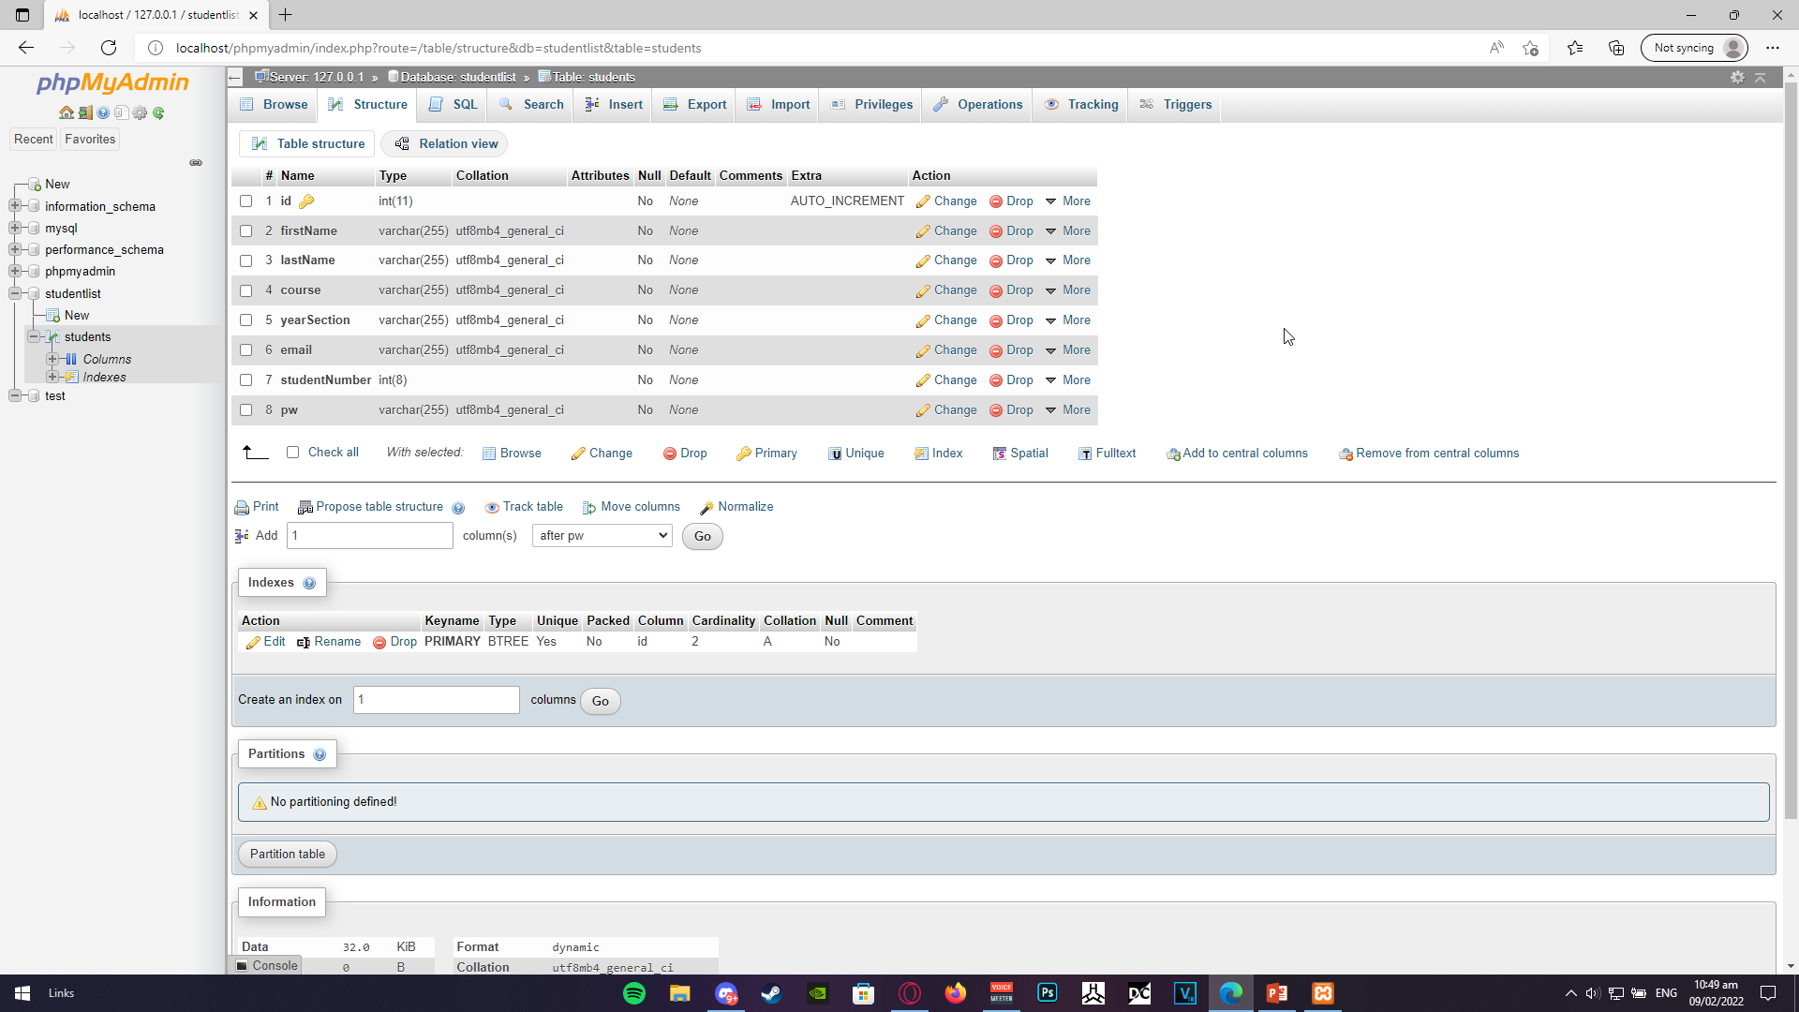
Notes:
So bale eto yujng database natin. Eto yung mga elements so yung id numbering lang sya so like 1,2,3,4,5 ng mga registered students. And then yung firstname,lastname, course, yearSection, email, Studentnumber, and pw.ayan yung mga elements na required sa pag reregister (Except dun sa id cus naka auto increment yon) na nasasave sa database natin.
Dito rin kukuhanin yung isshow sa student list (except sa password)

Slide 7
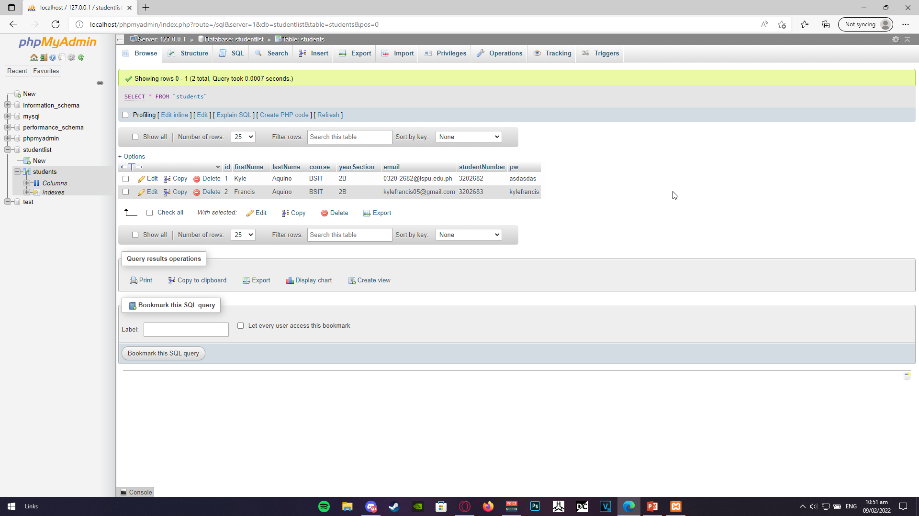
Notes:
Then eto yung mga registered students(accounts) sa database natin

Slide 8
Capabilities
Register
Login
Student List
Caters to student portal’s database

Slide 9
Features
Student navigation bar (sana if magagawana ko pa before maubos time)
- Student’s Grades
- Student’s Subjects
- Student’s information
- Student’s school works
- Student’s subject pages
- Student Forum

