Slide 1
Presentation
Group

Slide 2
Introduction
Description
Research Question:
Which characteristics of Electric Vehicles have a significant impact on their price?

Slide 3
Dimensions
Dataset | Rows | Columns
Full | 180 | 124
Complete | 11 | 11

Slide 4
Data Description

Slide 5
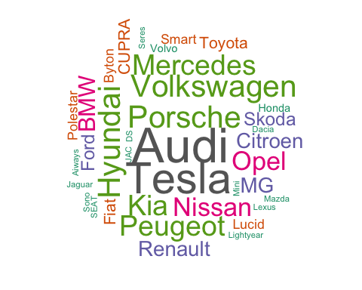
Word Cloud

Slide 6
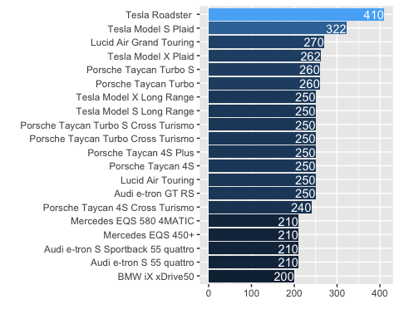
Cars by Top Speed in km/h

Slide 7
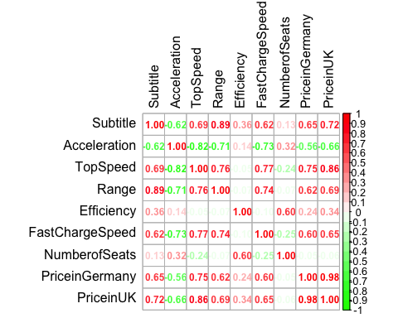
Correlation Matrix

Slide 8
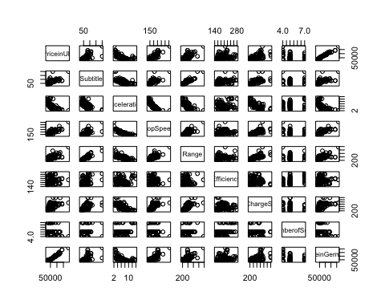
Scatterplot Matrix

Slide 9
Process
Clean data.
Make full model
Reduce multicolinearity
Transform predictors
Transform response
Stepwise-selection with BIC

Slide 10
Full (Untransformed) Model Diagnostics
## ## Shapiro-Wilk normality test ## ## data: . ## W = 0.94368, p-value = 5.779e-05
## ## studentized Breusch-Pagan test ## ## data: . ## BP = 22.387, df = 7, p-value = 0.002178

Slide 11
Reduced Multicolinarity Model Diagnostics
## ## Shapiro-Wilk normality test ## ## data: . ## W = 0.94148, p-value = 4.056e-05
## ## studentized Breusch-Pagan test ## ## data: . ## BP = 21.846, df = 5, p-value = 0.00056

Slide 12
Predictors Transformed Model Diagnostics
## ## Shapiro-Wilk normality test ## ## data: . ## W = 0.92008, p-value = 1.737e-06
## ## studentized Breusch-Pagan test ## ## data: . ## BP = 21.118, df = 7, p-value = 0.003599

Slide 13
Full (Transformed) Model Diagnostics
## ## Shapiro-Wilk normality test ## ## data: . ## W = 0.97905, p-value = 0.05093
## ## studentized Breusch-Pagan test ## ## data: . ## BP = 38.513, df = 7, p-value = 2.421e-06

Slide 14
Final Model
$$\begin{matrix}\frac{1}{\sqrt{\text{PriceinUK}}} & =β_{0} \\ & +β_{1}ln\text{Range} \\ & +β_{2}\text{TopSpeed} \\ & +β_{3}{\text{TopSpeed}}^{2} \\ & +β_{4}\text{Efficiency} \\ & +β_{5}{\text{Efficiency}}^{2} \\ & +ϵ\end{matrix}$$

Slide 15
Results
 | Estimate | Std. Error | t value | Pr(>|t|)
(Intercept) | 0.0191479 | 0.0015399 | 12.434199 | 0.0000000
log(Range) | -0.0005637 | 0.0001617 | -3.487202 | 0.0006865
poly(TopSpeed, 2, raw = T)1 | -0.0000342 | 0.0000047 | -7.333547 | 0.0000000
poly(TopSpeed, 2, raw = T)2 | 0.0000000 | 0.0000000 | 4.588899 | 0.0000112
poly(Efficiency, 2, raw = T)1 | -0.0000527 | 0.0000139 | -3.789260 | 0.0002394
poly(Efficiency, 2, raw = T)2 | 0.0000001 | 0.0000000 | 2.889679 | 0.0045905

Slide 16
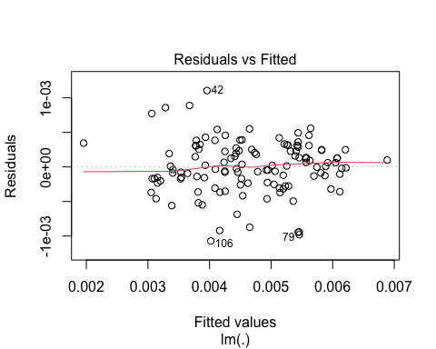
Residuals vs Fitted Values Plot

Slide 17
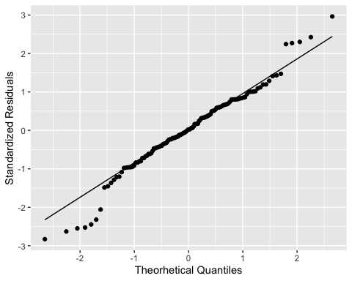
Q-Q Plot

Slide 18
Assumptions Tests
## ## Shapiro-Wilk normality test ## ## data: . ## W = 0.97388, p-value = 0.01654
## ## studentized Breusch-Pagan test ## ## data: . ## BP = 25.56, df = 5, p-value = 0.0001086

Slide 19
Outliers
 | Name | PriceinUK
14 | Tesla Roadster | 189000
35 | Mercedes EQV 300 Long | 70665
43 | Tesla Cybertruck Dual Motor | 48000
44 | Tesla Cybertruck Tri Motor | 68000
Here, outlier was defined as points that were both high leverage and high residual.

Slide 20
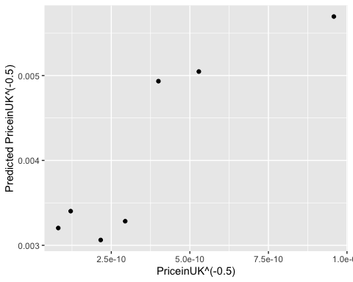
Testing

Slide 21
Prediction Error
prediction | R2 | MAE | RMSE
1 / sqrt(PriceinUK) | 0.7970134 | 4.089800e-03 | 4.213100e-03
PriceinUK | 0.5677872 | 1.511241e+04 | 2.063167e+04

Slide 22
Conclusion

