Slide 1

Master Thesis Report Process Enhancement by Incorporating Negative Instances in Model Repair
Baseline Building
Kefang Ding
Aug 30, 2018
Kefang.ding@rwth-aachen.de

Slide 2
Outlines
Model Introduction
Baseline Types
Baseline Results
Plugin Development

Slide 3
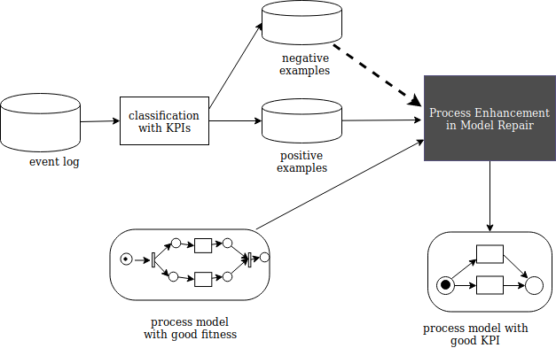
Model Introduction
Input:
event log
process model with good fitness
Output:
process model with KPI

Slide 4
Baseline Types
Enhancement Methods:
Inductive Miner : rediscovery
Model Repair by Fahland : repair
Assign Positive & Negative Labels Methods:
Random & Specific Variant
Labels Overlap on Variant
Positive Distribution
Input Data
Positive Set : Traces(Pos) & Complements : Traces(Pos) – Traces(Neg)
Relation with Model: if fit or not fit
Model Complexity

Slide 5
Baseline Experiments with Inductive Miner
Case 1: pos distribution changes
Trace Num and Variant Num
Model Complexity
Case 2: model with noise
Case 3: data overlap
ID | Data |  | Repair with noise | Result
 | Pos:neg | Overlap
1.1 | 1.0: 0 | 0: 1.0
1.2 | 0.7: 0.3 | 0: 1.0
1.3 | 0.5: 0.5 | 1.0: 0
1.4 | 0.3: 0.7 | 0: 1.0
1.5 | 0: 1.0 | 0: 1.0

Slide 6
Baseline Experiments with Model Repair
Case 1.1:
Case 2:
Case 3:
ID | Data |  | Existing Model |  | Result
 | Pos: neg | Fit : not fit | Enforce pos | Avoid Neg
1.1 | 1.0: 0 | 1.0 : 0 | Yes | No
1.2 | 0.7: 0.3 | 1.0: 0 | Yes | No
1.3 | 0.5: 0.5 | 1.0: 0 | Yes | No
1.4 | 0.3: 0.7 | 1.0: 0 | Yes | No
1.5 | 0: 1.0 | 1.0: 0 | Yes | No

Slide 7
Plugin Development
Assign Label
Extract Positive Instance
Create Base Model
Create Confusion Matrix

Slide 8
Questions & Answers

