Slide 1
Master Thesis Report
Process Enhancement by Incorporating Negative Instances in Model Repair
Baseline Building & Dfg Implementation
Kefang Ding

Slide 2
Outlines
Problem Introduction
Baseline Design
Baseline Performance
Dfg Method Introduction
Dfg Evaluation
Appendix
  Baseline Results
  Plugin Development

Slide 3

Problem Introduction
Description
  Given event log, process model and KPIs, how to incorporate negative KPIs outcomes to repair the process model for better performance?
Input
  Event log
  Existing process model
  KPIs
Output
  Repaired process model

Slide 4
Baseline Design
KPIs Outcomes on Log
  If outcomes generated randomly or specific
  If different outcomes overlap on one variant or not?
  If outcome distribution matters or not
Current Repair Methods
  Inductive Miner :: rediscovery
  Model Repair :: repair
Input Range of Log
  Only positive set or complement of pos and neg
  Simple log or complex log w.r.t. model?

Slide 5
Simple Baseline Experiments – xor
Firstly, list all the cases that I have done experiments on;
Give the cases that have problems with inductive miner and repair methods??
Compare some situations..
At end, to analyze some reasons ==> leads to dfg methods, to incorporate negative information
Simple cases of dfg, and compare it
Complicated cases experiments at Monday for inductive miner, repair and dfg methods.
Sunday I need to finish all the templates so far that I have done.. Monday I only need to add more codes..
but now, I can program the global dependency.

Slide 6
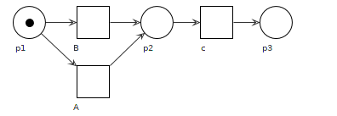
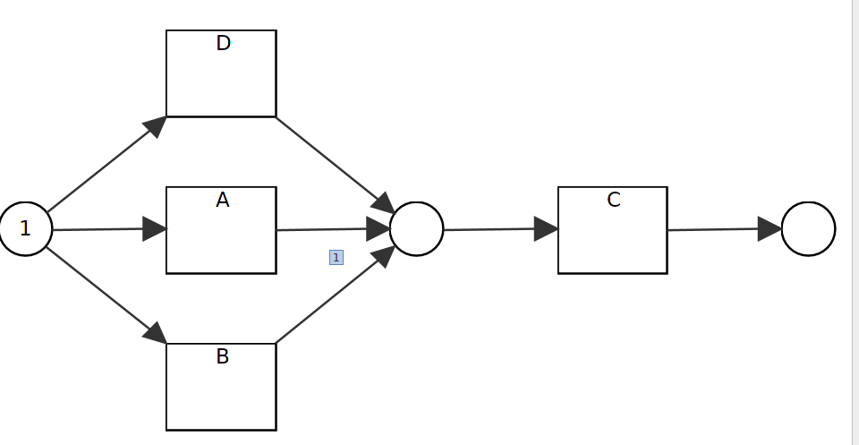
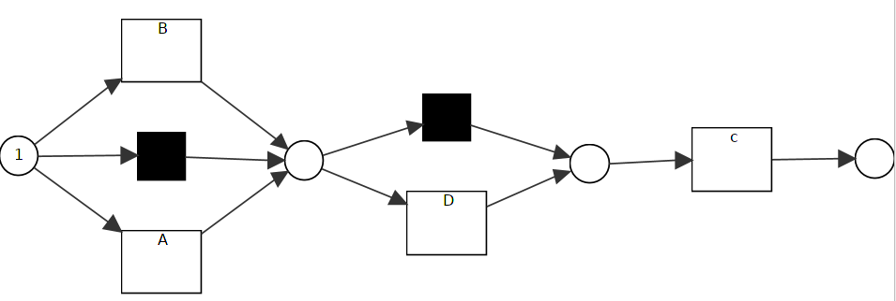
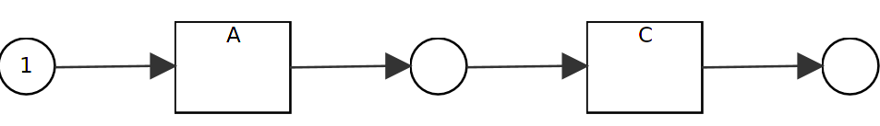
Simple Baseline Experiments – XOR
Case 1.1 add events in Xor relation
  Data::
    Pos: 50<A,C> 50<B,C>,50<D,C>
  IM: create new fit model :: R1.1_1
  RM: add silent transitions, less precision :: R1.1_2
Case 1.2 delete events from xor
  Data::
    Pos: 50<A,C>
    Neg: 50<B,C>
  IM: create new fit model:: R1.2_1
  RM:create fit model :: R1.2_2
Fig M1
Fig R1.1_1
Fig R1.1_2
Fig R1.2_1/ 1.2_2

Slide 7
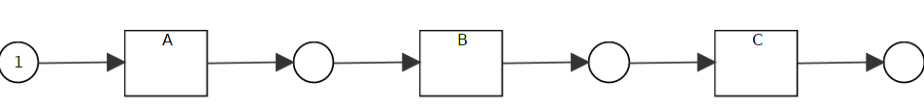
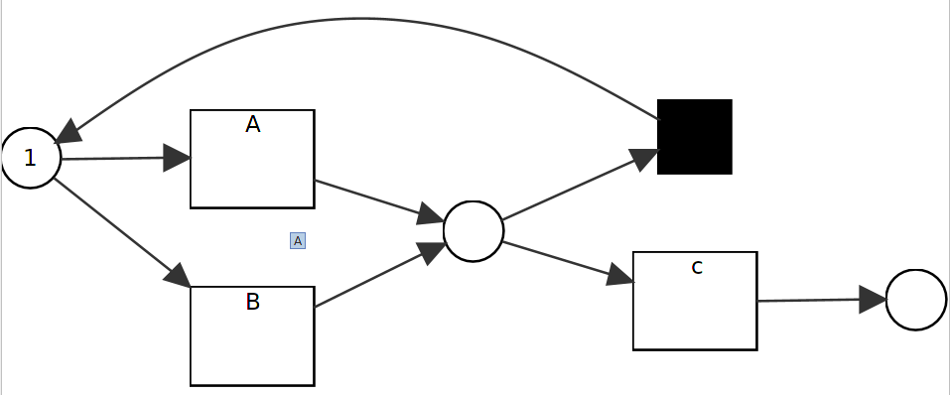
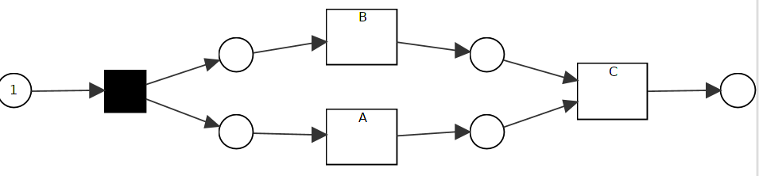
Simple Baseline Experiments – XOR
Case1.3 change xor to sequence
  Data:
    Pos: 50<A,B,C>
    Neg: 50<A,C>,50<B,C>
  IM: fit:: R1.3_1
  RM: add loop to achieve sequence::R1.3_2
Case 1.4 change xor to parallel
  Data:
    Pos: 50<A,B,C>, 50<B,A,C>
    Neg: 50<A,C>, 50<B,C>
  IM: fit:: R1.4_1
  RM: add loop to adapt to parallel, same as ::R1.3_2
Fig M1
Fig R1.3_1
Fig R1.3_2/1.4_2
Fig R1.4_1

Slide 8
Simple Baseline Experiments – XOR
Case1.5 add events on xor branch
  Data: Model: M1
    Pos: 50<A,D,C> 50<B,C>
    Neg: 50<A,C>
Case1.6 add while deleting events
  Data: Model: M1
    Pos: 50<A,C>, 50<D,C>
    Neg: 50<B,C>
IM creates fit models, while RM adds silent transitions or loops to models, and models have less precision.

Slide 9
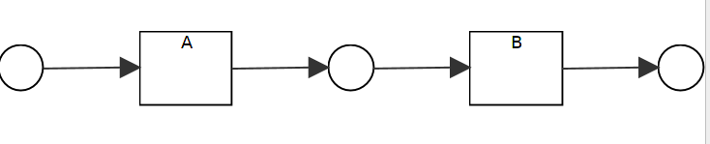
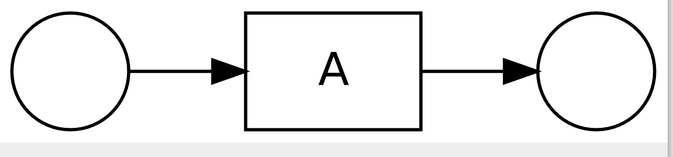
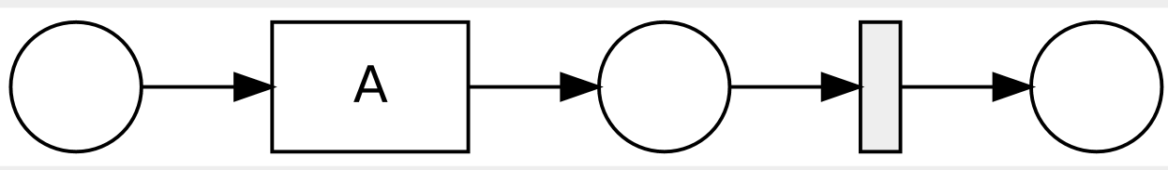
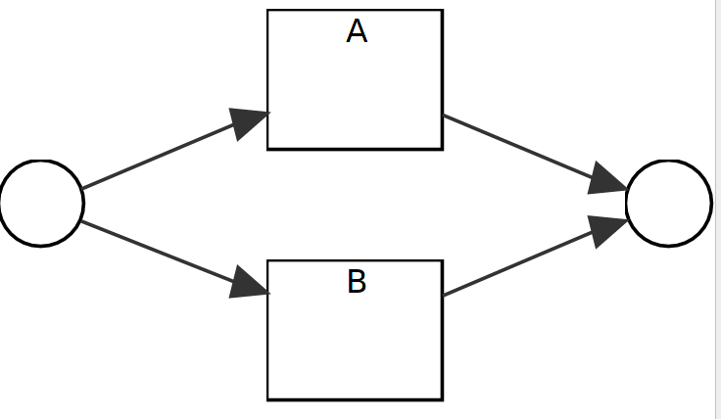
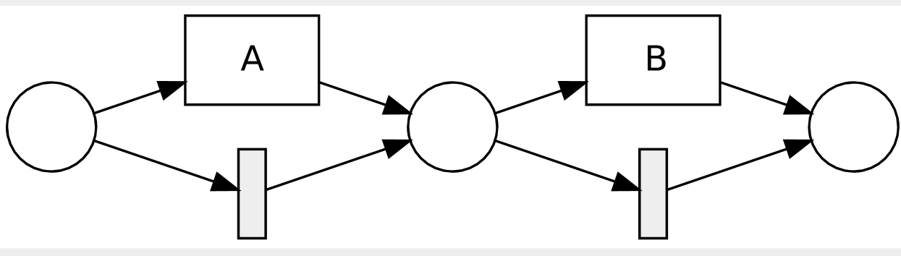
Simple Baseline Experiments – sequence
Case2.1 delete events from sequence
  data:
    Pos:50<A>
    Neg:50<A,B>
  IM: fit :: R2.1_1
  RM: Substitute deleted events with silent transitions :: R2.1_2
Case2.2 sequence to XOR
  data:
    Pos: 50<A>, 50<B>
    Neg: 50<A,B>
  IM: fit model :: R2.2_1
  RM: add silent transition, less precision:: R2.2_2
Fig M2
Fig R2.1_1
Fig R2.1_2
Fig R2.2_1
Fig R2.2_2

Slide 10
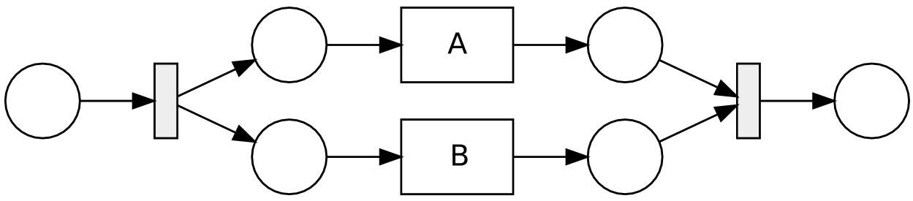
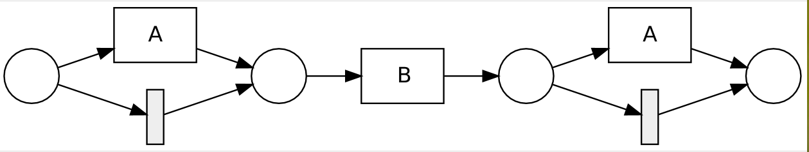
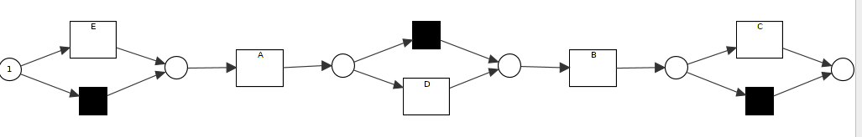
Simple Baseline Experiments – sequence
Case2.3 sequence to parallel
  Data:
    Pos: 55<A,B>, 55<B,A>
  IM: fit:: R2.3_1
  RM: add silent and duplicate transitions:: R2.3_2
Case2.4 add single event to sequence at different positions
  data:
    Pos: 50<A,B,C>, 50<A,D,B>,50<E,A,B>
    Neg: 50<A,B>
  IM: with silent transition, less precision ::R2.4_1
  RM:same as IM, less precision :: R2.4_1
Fig M2
Fig R2.3_1
Fig R2.3_2
Fig R2.4_1/R2.4_2

Slide 11
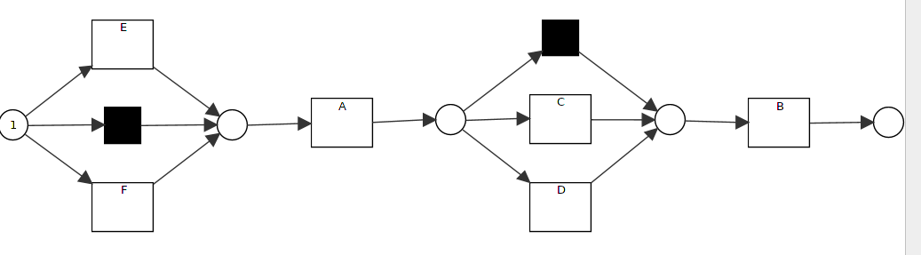
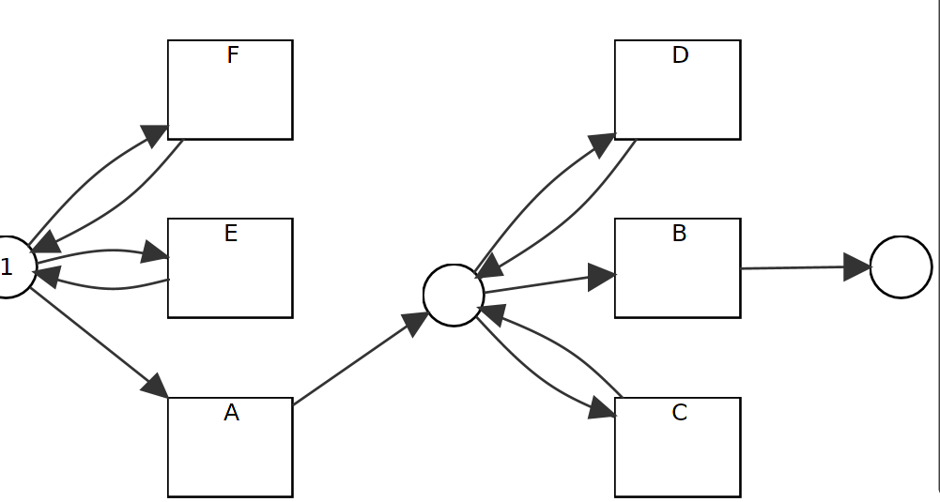
Simple Baseline Experiments – sequence
Case2.5 add multiple events at same positions
  data:
    Pos: 50<A,C,B>, 50<A,D,B>, 50<E,A,B>, 50<F,A,B>
    Neg: 50<A,B>
  IM: with silent transition, less precision:: R2.5_1
  RM:add events by self-loops, less precision::R2.5_2
In most cases, IM creates fit models, while RM has less precision; but in some cases, they have the same model with less precision.
Fig M2
Fig R2.5_1
Fig R2.5_2

Slide 12
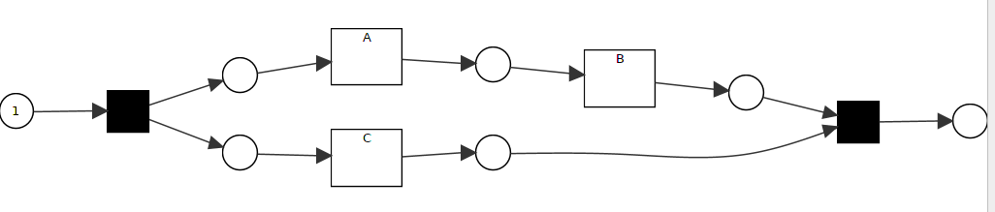
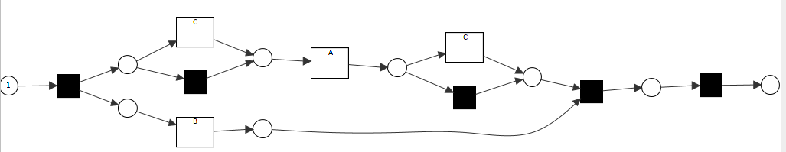
Simple Baseline Experiments – parallel
Case3.1 add events to parallel relation
  data:
    Pos: 50<A,B,C>, 50<A,C,B>, 50<C,A,B>,
    Neg: 50<A,B>, 50<B,A>
  IM: model fits::R3.1_1
  RM: tend to repair it on the branch of parallel
  realtion:: R3.1_2
RM tends to create complicated model to fit model by adding silent, loop and duplicates transitions, while IM has less complicated models with good fitness.
Question:
  what if we want to keep A,B parallel relationship, and add C into it?? If we can’t have complete data, the new discovered model doesn’t consider the original model
Fig M3
Fig R3.1_1
Fig R3.1_2

Slide 13
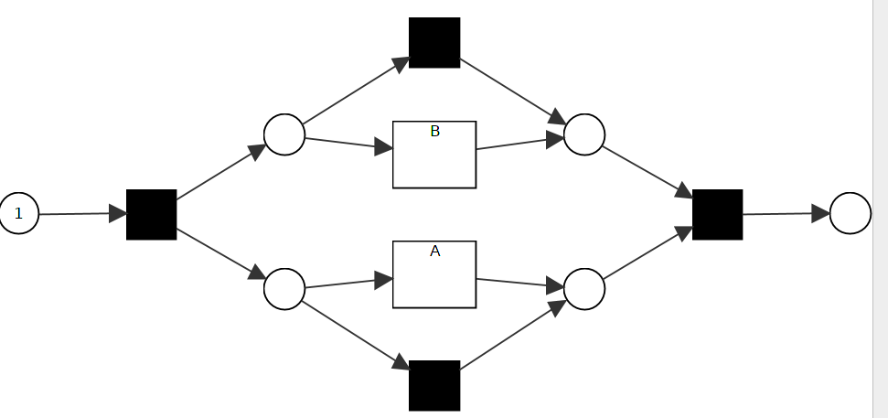
Simple Baseline Experiments – parallel
Case3.2 change parallel to sequence with overlapped labels
  Data
    Pos: 50<A,B>, 5<B,A>
    Neg: 5<A,B>, 50<B,A>
  IM: keep the same model
  RM: keep the same model
Case3.3 change parallel to sequence with noise
  Data
    Pos: 50<A,B>, 5<B,A>, 1<A>,2<B>
    Neg: 5<A,B>, 50<B,A>
  IM: keep model by using filtering
  RM:consider the noise in data :: R3.3_2
Fig M3
Fig R3.3_2

Slide 14
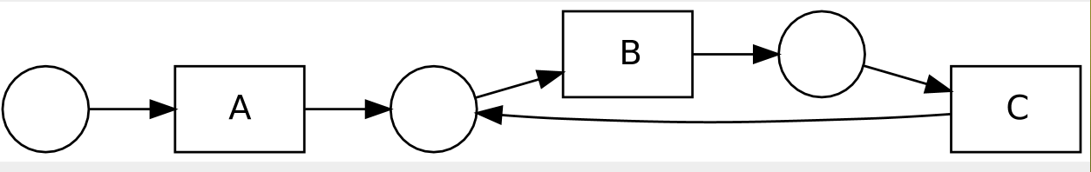
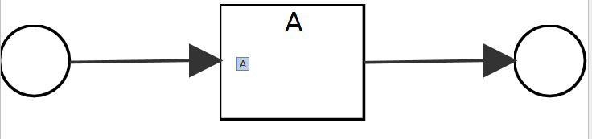
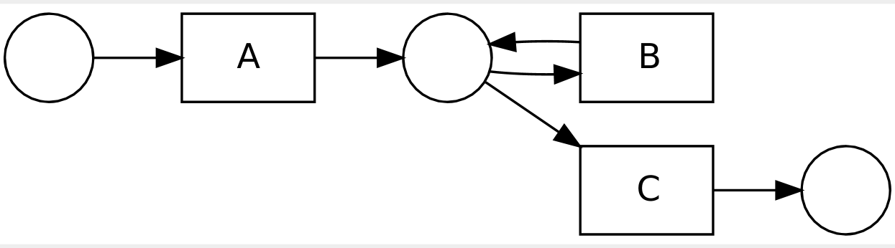
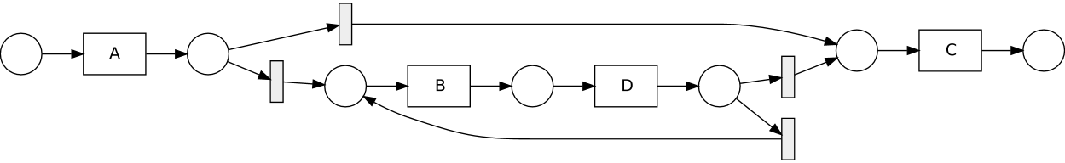
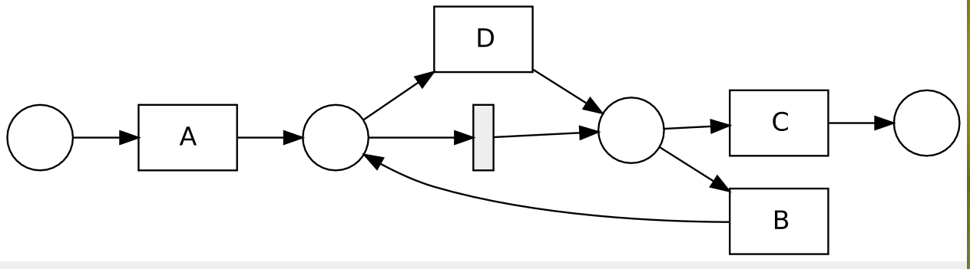
Simple Baseline Experiments – loop
Case4.1 delete loop
  data: M4.1
    Pos: 50<A>
    Neg: 50<A,B,C>, 60<A,B,C,B,C>
  IM: fit model ::R4.1_1
  RM: same model like IM::R4.1_1
Case4.2 add events to loop branch
  data: M4.2
    Pos: 50 <A,C>, 50 <A,B,D C>, 50<A,B,D,B,D,C>
  IM: add loop and silent transition::R4.2_1
  RM: same effect but more complicated:: R4.2_2
Fig M4.1
Fig R4.1_1
Fig M4.2
Fig R4.2_1
Fig R4.2_2

Slide 15


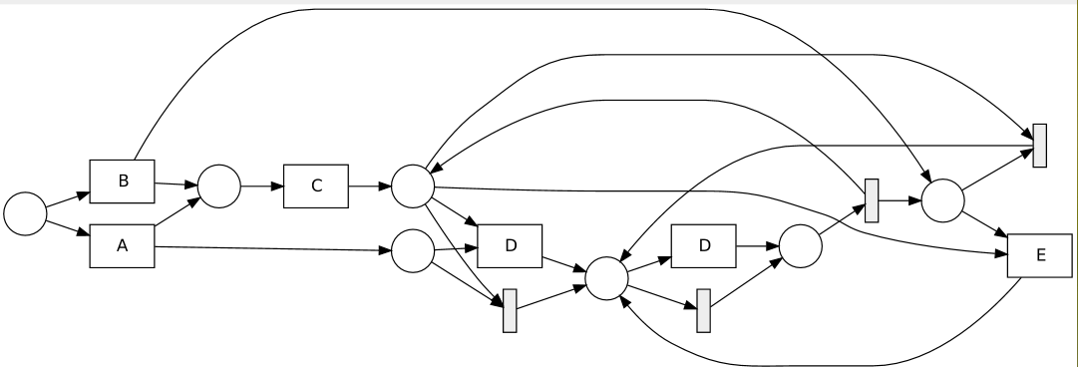
Simple Baseline Experiments – global dependency
Case5.1 add global dependency on model
  Data
    Pos: 50<A,C,D>, 50<B,C,E>
    Neg: 50<A,C,E>, 50<B,C,D>
  IM: can’t see global dependency:: M5.1
  RM:can’t see global dependency:: M5.1
Case5.2 delete global dependency
  Data
    Pos: 50<A,C,D>, 50<B,C,E>, 50<A,C,E>, 50<B,C,D>
  IM: fit model:: M5.1
  RM: complicated model:: R5.2_2
Fig M5.1
Fig M5.2
Fig R5.2_2

Slide 16
Simple Baseline Experiments – Summary
Inductive Miner
  Most cases: TP,TN equals to expected value, FP == 0, FN == 0
  FP>0 & TN not equal
    C2: sequence
      Add events to sequence, single event at one position
      Add events to sequence, multiple event at one position
      Add events to parallel at different positions, before, middle and end while giving original parallel relationA
      dd events to parallel at different positions, before, middle and end while giving sequence
    C5: global dependency
      add global dependency to model
      change global dependency structure
Summary
  IM has good recall, usually good precision.
 | Allowed Behavouir | Not Allowed Behavouir
Positive | TP: == | FN: 0
Negative | FP: 0 | TN: ==

Slide 17
Simple Baseline Experiments – Summary
Repair Model
  Most cases: TP equals to expected number, FP !=0
  Other Cases: FP== 0
    C1: XOR
      Add events to one branch of xor
      Delete events from xor
    C2: sequence
      delete events from sequence
      Add while deleting events from sequence
      Change sequence oder
    C3: parallel
      Delete events from parallel
      Add while add events in parallel
      Change parallel to sequence
    C4: loop
      Delete loop
      Delete events at end of loop
      Delete events in the middle of 2-length loop
Summary
  RM has good recall, usually bas precision
 | Allowed Behavouir | Not Allowed Behavouir
Positive | TP: == | FN: 0
Negative | FP: 0 | TN: ==

Slide 18
Result Analysis Summary
Inductive miner as rediscovery has good recall [fitness] , better precision than repair model technique. But in some cases, it generates a model which is much different with existing ones. [but only users can decide if the new generated model is needed or not.]
Repair model has also good recall [fitness], but mostly less precision by adding loop, subprocesses and silent transitions. In some cases, it can’t see the global changes in the model and change some branches in a local but complex way to create fit model.
For some relation, like global dependency, both inductive miner and repair model techniques fail to discover it.
With overlapped data, they have less precision, can’t see the distribution of overlapped data
With noise in data, repair model is more sensible with noise than inductive miner
Without considering negative information, the generated model from both techniques tends to have less precision.

Slide 19
Problem Introduction
Description
  Given event log, process model and KPIs, how to incorporate negative KPIs outcomes to repair the process model for better performance?
Input
  Event log
  Existing process model
  KPIs
Output
  Repaired process model

Slide 20
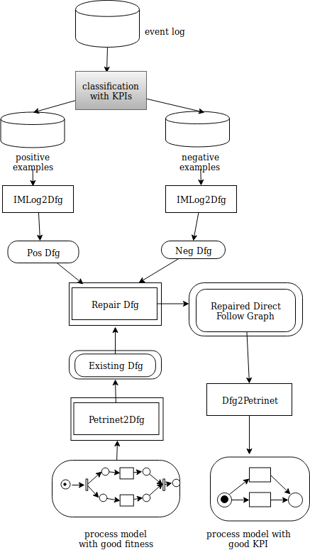
Dfg Implementation
Petrinet2Dfg
  Transform PN to Transtion System
  Create Dfg from TS
Repair Dfg w.r.t. Log
  Generate dfg to pos and neg examples
  Create a matrix to compare all dfgs, existing dfg, pos dfg and neg dfg
  Generate new dfg according to the distribution of existing dfg, pos dfg and neg dfg

Slide 21
Repair Dfg w.r.t. Log – generate new dfg
Case 0, 1
  No need to consider
Case 2,3,4
  Add them into the new dfg
Case 5,6,7
  Consider the distribution of dfgs
    #(pos + existing) > #neg keep df
    #(pos + existing) <= #neg ignore df
ID | Existing Dfg | Pos Dfg | Neg Dfg
0 | 0 | 0 | 0
1 | 0 | 0 | 1
2 | 0 | 1 | 0
3 | 1 | 0 | 0
4 | 1 | 1 | 0
5 | 1 /50 | 0 | 1 /50
6 | 0 | 1 /100 | 1 /50
7 | 1 /50 | 1 /50 | 1 /50

Slide 22
Repair Dfg w.r.t. Log – Assign weights to Dfg
Assign different weights to existing, pos and neg dfg to address different perspectives
  Keep original model
    weight(existing)=1.0, Weight(pos)=0,Weight(neg)=0
  Generate rediscovery model
    weight(existing)=0, Weight(pos)=1.0, Weight(neg)=0
  Address the negative impact
    weight(existing)=1.0, Weight(pos)=0,Weight(neg)=2.0

Slide 23
Simple Baseline Experiments – sequence
Case2.5 add multiple events at same positions
  data:
    Pos: 50<A,C,B>, 50<A,D,B>, 50<E,A,B>, 50<F,A,B>
    Neg: 50<A,B>
  IM: with silent transition, less precision:: R2.5_1
  RM:add events by self-loops, less precision::R2.5_2
  Dfg:
Case2.4 add single event at different positions
  data:
    Pos:
    Neg:
  IM:
  RM:
  Dfg:
In most cases, IM creates fit models, while RM has less precision; but in some cases, they have the same model with less precision.
Fig M2
Fig R2.5_1
Fig R2.5_2

Slide 24
Simple Baseline Experiments – sequence
Case2.5 add multiple events at same positions
  data:
    Pos: 50<A,C,B>, 50<A,D,B>, 50<E,A,B>, 50<F,A,B>
    Neg: 50<A,B>
  IM: with silent transition, less precision:: R2.5_1
  RM:add events by self-loops, less precision::R2.5_2
  Dfg:
Case2.4 add single event at different positions
  data:
    Pos:
    Neg:
  IM:
  RM:
  Dfg:
In most cases, IM creates fit models, while RM has less precision; but in some cases, they have the same model with less precision.
Fig M2
Fig R2.5_1
Fig R2.5_2

Slide 25
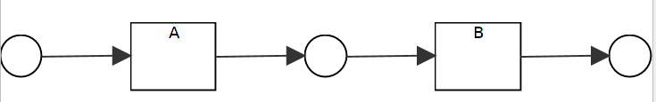
Simple Baseline Experiments – parallel
Case3.2 change parallel to sequence with overlapped labels
  Data
    Pos: 50<A,B>, 5<B,A>
    Neg: 5<A,B>, 50<B,A>
  IM, RM: keep model
  Dfg: see the different distribution:: R3.2_3
Case3.3 change parallel to sequence with noise
  Data
    Pos: 50<A,B>, 5<B,A>, 1<A>,2<B>
    Neg: 5<A,B>, 50<B,A>
  IM: keep model by using filtering
  RM:consider the noise in data :: R3.3_2
  Dfg: see the different distribution:: R3.2_3
Fig M3
Fig R3.3_2
Fig R3.2_3

Slide 26
Simple Baseline Experiments – parallel
Confusion matrix
  Case 3.2 change parallel to sequence with overlap
  Case 3.3 change parallel to sequence with noise
Case 3.2 IM/RM confusion matrix
 | Allowed | Not Allowed
Pos | 55 | 0
Neg | 55 | 0
Case 3.2 Dfg confusion matrix
 | Allowed | Not Allowed
Pos | 50 | 5
Neg | 5 | 50
Case 3.3 IM confusion matrix
 | Allowed | Not Allowed
Pos | 55 | 3
Neg | 55 | 0
Case 3.3 Dfg confusion matrix
 | Allowed | Not Allowed
Pos | 50 | 8
Neg | 5 | 50
Case 3.3 RM confusion matrix
 | Allowed | Not Allowed
Pos | 58 | 0
Neg | 55 | 0

Slide 27
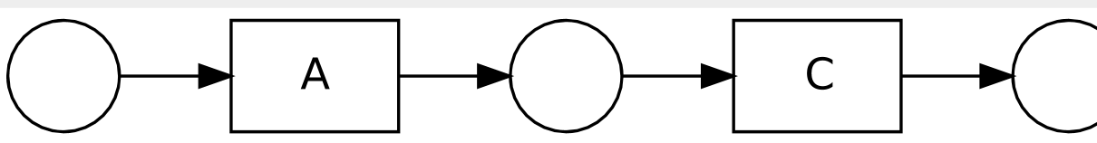
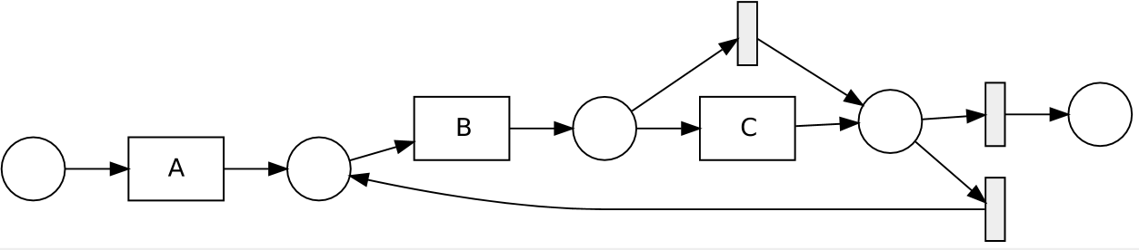
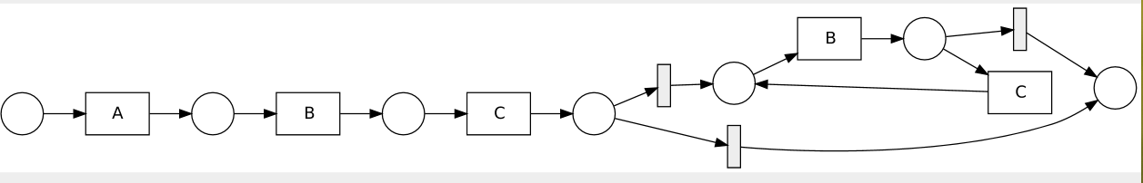
Simple Baseline Experiments – loop
Case4.1 delete loop
  data: M4.1
    Pos: 50<A,C>
    Neg: 50<A,B,C>, 60<A,B,C,B,C>
  IM: fit model ::R4.1_1
  RM: same model like IM::R4.1_2
Case4.2 add loop to sequence
  data: M4.2
    Pos: 50<A,B,C>, 50<A,B,C,B>, 50<A,B,C,B,C,B>
  IM: add loop and silent transition::R4.2_1
  RM: same effect but more complicated:: R4.2_2
Fig M4.1
Fig R4.1_1
Fig M4.2
Fig R4.2_1
Fig R4.2_2

Slide 28
Simple Baseline Experiments – global dependency
Case5.1 add global dependency on model
  Data
    Pos: 50<A,C,D>, 50<B,C,E>
    Neg: 50<A,C,E>, 50<B,C,D>
  IM, RM: can’t see global dependency:: M5.1
  Dfg: can’t see global dependency:: M5.1
Case5.2 delete global dependency
  Data
    Pos: 50<A,C,D>, 50<B,C,E>, 50<A,C,E>, 50<B,C,D>
  IM,: fit model:: M5.1
  RM: complicated model:: R5.2_2
Fig M5.1
Fig M5.2
Fig R5.2_2

Slide 29
Dfg Method Summary
Compared to IM, rediscovery, it has better recall, precision on overlapped labels, and noisy data.
Compared to RM, it creates simpler models, and better recall, precision.
But in some situations, it works not better than others, like global dependency.

Slide 30
Appendix
Plugins
  Assign Labels to Event Log
  Evaluation by Creating Confusion Matrix
  Repair Model by Dfgs

