Slide 1
Master Thesis Report
Process Enhancement by Incorporating Negative Instances in Model Repair
Group Report
Kefang Ding
19 Feb 2019

Slide 2
Outlines
Problem Introduction
Algorithm & Implementation
  Add long-term dependency
  Create dfg model
Demo Presentation
Evaluation

Slide 3

Problem Introduction
Description
  Given event log, process model and KPIs, how to incorporate negative KPIs outcomes to repair the process model for better performance?
Input
  Event log
  Existing process model
  KPIs
Output
  Repaired process model

Slide 4
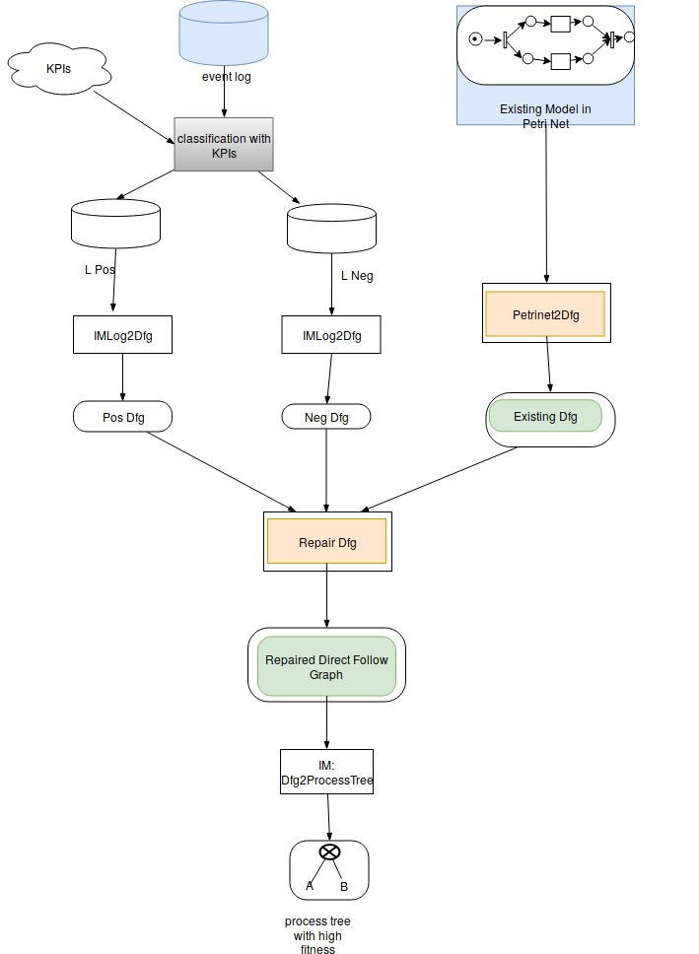
Algorithm – generate dfg model
Items
  Weight from existing dfg
    Transition system
  Weight from positive event log
    Inductiver Miner
  Weight from negative enent log
    Inductiver Miner
  Control Parameters
    Ext 0-1
    Pos 0-1.0
    Negative 0-1.0

Slide 5
Algorithm – generate dfg model
Directly-follows relation
  Existing model, positive and negative event log
  Keep this directly-follows relation if
  Choose, threshold=0.5

Slide 6
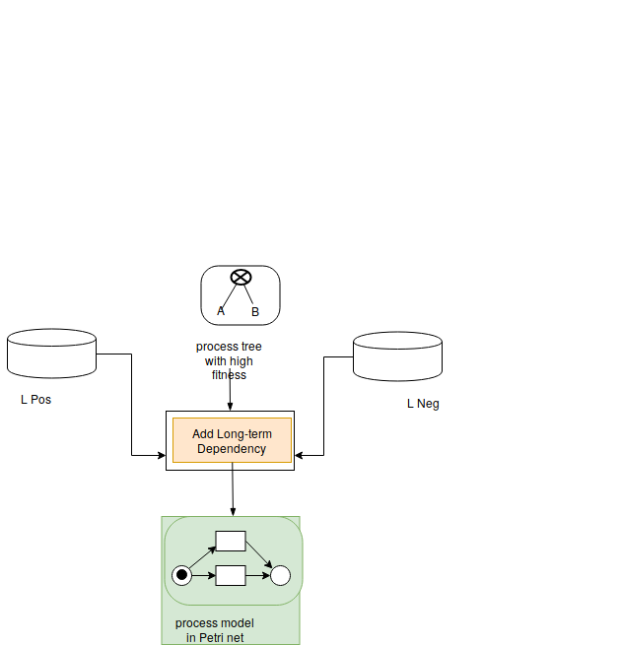
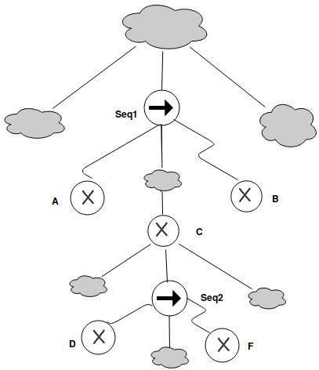
Algorithm – add long-term dependency
Long-term dependency
  Choices Dependency
    exclusive blocks => xor block
    not loop
  Partial Order
    Least Common Ancestor is Seq
      A <C < B, D<F
    In same level
      A,B,C pair
      D,F pair

Slide 7
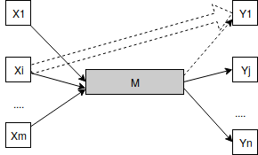
Algorithm – add long-term dependency
Long-term dependency
  Choices Dependency
    exclusive blocks => xor block
    not loop
  Relation xor branches
    Significant correlation

Slide 8
Algorithm – add long-term dependency
Correlation Defintion
  New generated model, positive and negative event log
  Significant Correlation

Slide 9
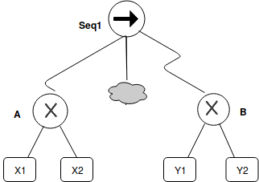
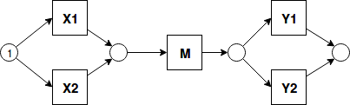
Algorithm – add long-term dependency
Long-term dependency Situations
  1. LT= {X1-Y1,X1-Y2,X2-Y1,X2-Y2}
  2. LT= {X1-Y1,X1-Y2,X2-Y2}
  3. LT= {X1-Y1,X2-Y2}
  4. LT= {X1-Y1,X2-Y1}
  5. LT= {X1-Y1,X1-Y2}
  6. LT= {X1-Y1}
  7. empty set
  Situation 1 is full dependency, it keeps the original model

Slide 10
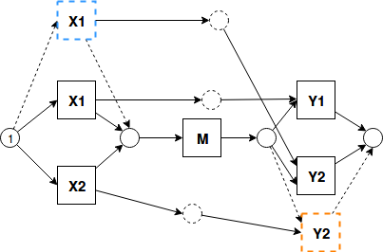
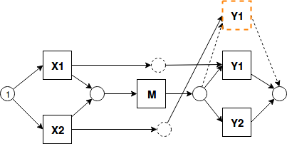
Algorithm – add long-term dependency
  Expressed On Petri net
    Duplicate Transition
      Keep track of added xor branches for source and target xor branches S and T
    Given LT= {X1-Y1,X1-Y2,X2-Y2}
    Given LT= {X1-Y1,X2-Y1}

Slide 11
Algorithm – add long-term dependency
  Expressed On Petri net
    Duplicate Transition
      Keep track of added xor branches for source and target xor branches S and T
      For every item lt in LT, If source and target are already exist in S and T, then duplicate source and target in xor block
    Given LT= {X1-Y1,X1-Y2,X2-Y2}
    Given LT= {X1-Y1,X2-Y1}

Slide 12
Algorithm – add long-term dependency
  Expressed On Petri net
    Duplicate Transition
      Keep track of added xor branches for source and target xor branches S and T
      For every item lt in LT, If source and target are already exist in S and T, then duplicate source and target in xor block
      connect lt source and target by adding one place and arcs
    Given LT= {X1-Y1,X1-Y2,X2-Y2}
    Given LT= {X1-Y1,X2-Y1}

Slide 13
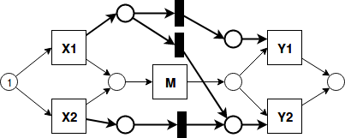
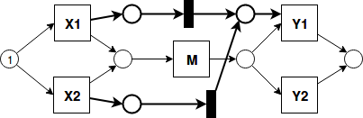
Algorithm – add long-term dependency
  Expressed On Petri net
    Add silent transition
      Get the source set LT-S and target set LT-T of LT
      Create one control place as post-place post for every element in LT-S
      Create one control place as pre-place before every element in LT-T
    Given LT= {X1-Y1,X1-Y2,X2-Y2}
    Given LT= {X1-Y1,X2-Y1}

Slide 14
Algorithm – add long-term dependency
  Expressed On Petri net
    Add silent transition
      Get the source set LT-S and target set LT-T of LT
      Create one control place as post-place post for every element in LT-S,
      Create one control place as pre-place before every element in LT-T
    Given LT= {X1-Y1,X1-Y2,X2-Y2}
    Given LT= {X1-Y1,X2-Y1}

Slide 15
Algorithm – add long-term dependency
  Expressed On Petri net
    Add silent transition
      Get the source set LT-S and target set LT-T of LT
      Create one control place as post-place post for every element in LT-S,
      Create one control place as pre-place before every element in LT-T
      For every item in LT, create one silent transition to connect the corresponding post-place for lt source and pre-place for lt target
    Given LT= {X1-Y1,X1-Y2,X2-Y2}
    Given LT= {X1-Y1,X2-Y1}

Slide 16
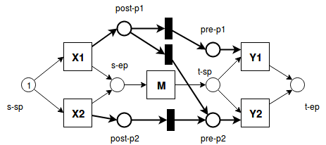
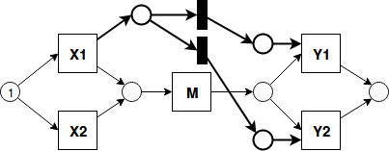
Algorithm – add long-term dependency
Soundness
  Situation 2 and 3 are sufficient to create sound model
  Proof:
    For every xor block pair, M(s-sp)=1, other places p, M(p)=0

Slide 17
Algorithm – add long-term dependency
Soundness
  Situation 2 and 3 are sufficient to create sound model
  Proof:
    For every xor block pair, M(s-sp)=1, other places p, M(p)=0
    Xi is chosen, M(s-ep)=1, M(post-pi)=1, other places p, M(p)=0

Slide 18
Algorithm – add long-term dependency
Soundness
  Situation 2 and 3 are sufficient to create sound model
  Proof:
    For every xor block pair, M(s-sp)=1, other places p, M(p)=0
    Xi is chosen, M(s-ep)=1, M(post-pi)=1, other places p, M(p)=0
    After M, M(t-sp)=1, for any silent transiton st, |InEdge(ts)|=|OutEdge(ts)|=1, token number stays the same until pre places, Sum(M(pre-pi))=Sum(M(post-pi))=1

Slide 19
Algorithm – add long-term dependency
Soundness
  Situation 2 and 3 are sufficient to create sound model
  Proof:
    For every xor block pair, M(s-sp)=1, other places p, M(p)=0
    Xi is chosen, M(s-ep)=1, M(post-pi)=1, other places p, M(p)=0
    After M, M(t-sp)=1, for any silent transiton st, |InEdge(ts)|=|OutEdge(ts)|=1, token number stays the same until pre places, Sum(M(pre-pi))=Sum(M(post-pi))=1
    For any Yj, *Yj=2, able to fire, consume two tokens, and produce one token to Place t-ep

Slide 20
Algorithm – add long-term dependency
Soundness
  Situation 4-7 can’t create sound model
    Not proper to end: token remains before Y1
    Dead part: Y1,Y2 can not be fired
  Ignore those situations

Slide 21
Demo Representation
Repair Model
  Sequence
  Log={pos:<S1,A,B1,C,T1>,<S2,A,B1,C,T2>,<S2,A,B2,C,T2>
  neg:<S1,A,B2,C,T1>}
  LT(Xor(S1,S2),Xor(B1,B2))= {S1-B1, S2-B1,S2-B2}
  LT(Xor(B1,B2), Xor(T1,T2))={B1-T1,B1-T2,B2-T2}
  LT(Xor(S1,S2),Xor(T1,T2))= {S1-T1(??), S2-T2}

Slide 22
Evaluation
Confusion Matrix
 | Allowed behavior | Not allowed behavior
Positive Traces | AP(High) | NP(Low)
Negative Traces | AN(Low) | NN(High)
Precision = Σ AP / Σ AP+ NP
Accuracy = Σ AP + NN / Σ AP + AN + NP + NN
Recall = Σ AP / Σ AP + AN

Slide 23
Appendix – References
Assign Labels
Edit Process Tree

