Slide 1
Master Thesis Report
Process Enhancement by Incorporating Negative Instances in Model Repair
Dfg Long-Term Dependency Discovery
Kefang Ding

Slide 2
Outlines
Problem Introduction
Preliminary
Method Design
Method Implementation
Method Evaluation
Appendix
  Plugin Development

Slide 3
Problem Introduction
Dfg method can not deal with global dependency.
  Can’t discover it
  Can’t remove it
  Can’t find structure change
Given Petrinet discovered by the dfg methods, event log, KPIs, we need to discover the global dependency, remove it or change its structure w.r.t. the event log.

Slide 4
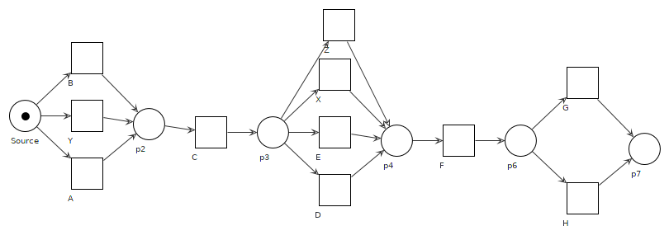
Analysis - {A,B,Y} to {D,E,X,Z}
X
D
E
X D
E
X D
E
Case 1
Z
Z
Case 2
Case 3
Z
Case 1: A set means A has long-term dependency with X and D.
B has long-term dependency with D and E.
Y has long-term dependency with D and Z.
The intersection of A and B means that they have both global dependency with D
A:
B:
Y:

Slide 5
Method Design
Add long-term constraints
  Add places after xor join structure
    If any of {A,B,Y} has long-term dependency, we create post places for each branch,
      == > P[A],P[B],P[Y]
  Add places before xor split structure
    If any of {X,D,E,Z} has long-term dependency with xor join before them, create a pre place for each of them
  Add silent transition to connect places
    If there is connection of any combination from {A,B,Y} *{X,D,E,Z}, we create a silent transition
    Connect the silent transition and places
  [postplace] → tau → [preplace]
D
E
X
A:
Z
B:
Case in graph:
A has long-term dependency with D,E;
Y has long-term dependency with E,X;
B actually has no long-term dependency with next xor, but because other nodes in the same structure has, so we also create post places for it
E shows in every cases, but because other nodes in the same structure has long-term dependency, so we create pre place for it
Y:

Slide 6
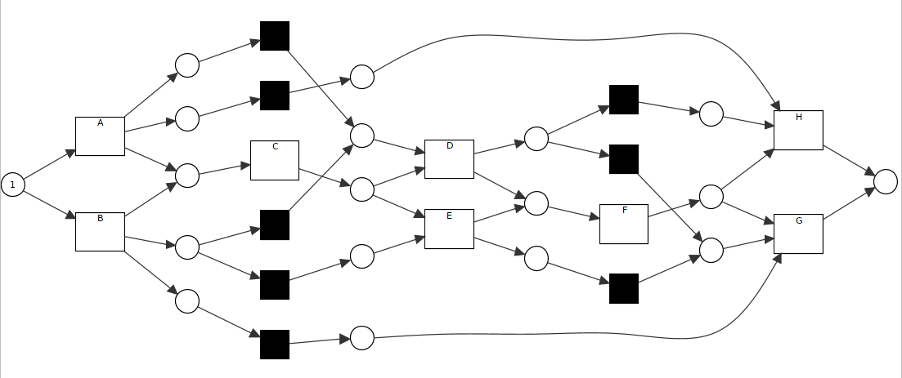
Method Design
Keep Model Sound
  Xor_1:{B,Y,A}, Xor_2: {Z,X,E,D}, Xor_3:{G,H}
  In the previous way to add the silent transition & places in Xor_1 and Xor_2 , the model is sound
  But not work for cross cases :: <A,C,D,F,H>,<B,C,D,F,G>,<B,C,D,E,G>
    Create cross long-term dependency pair {x01,x02},{x02,x03}, {x01,x03}
    <A,C,D,F ...?? > it can’t complete, because there are another choices appeared.

Slide 7
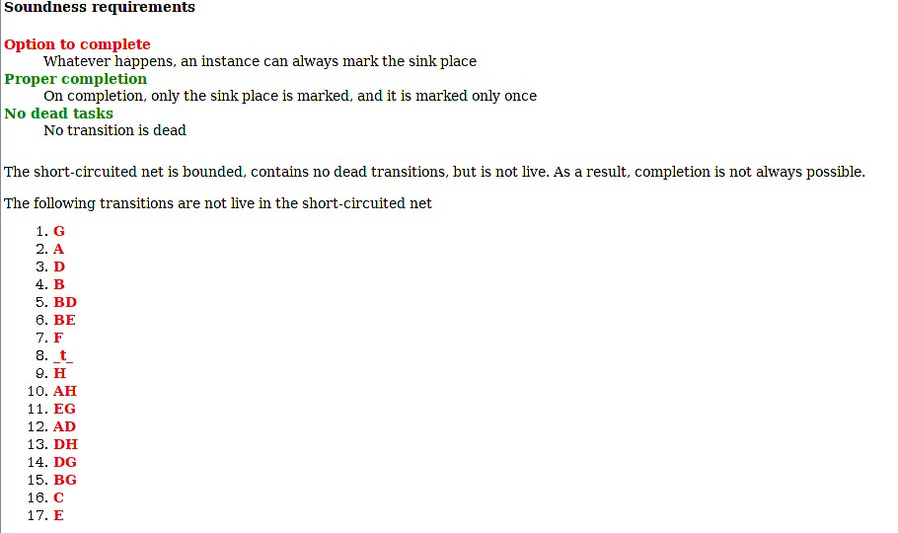
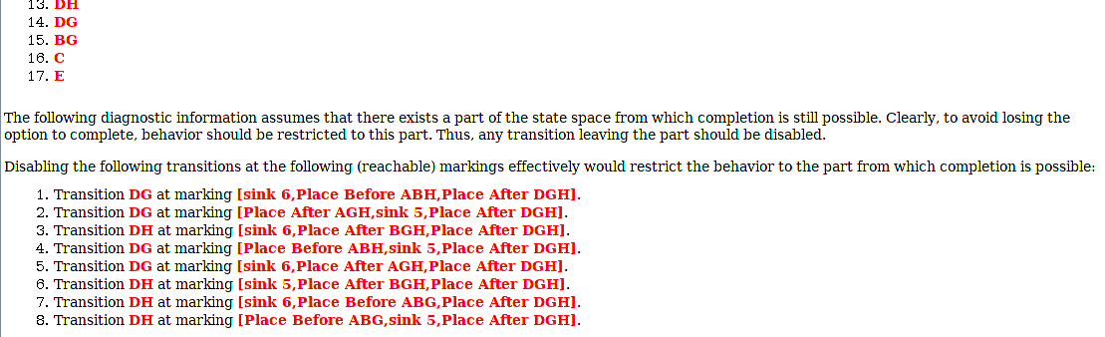
Method Design

Slide 8
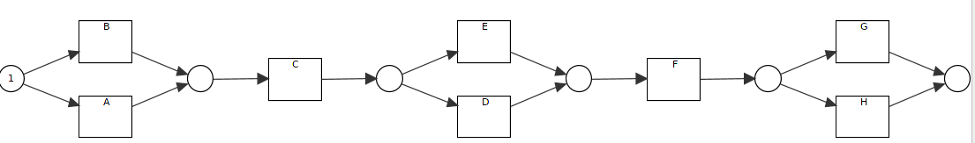
Method Design
Use Binary Relation
  Because the complexity of rules transitions, so we only create the connection of most nearest relation.
    Sequence
      {A,B}&{E,D} :: {E,D}&{G,H}
  Consequence:
    not able to discover the cross-term dependency;
    model less precise

Slide 9
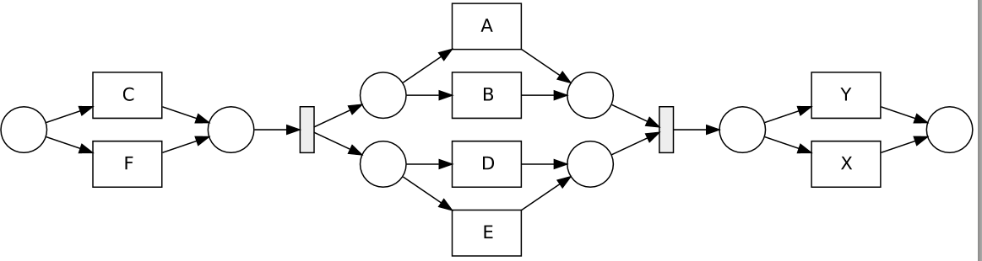
Method Design
Use Binary Relation – case variants:: Parallel
  {C,F}&{A,B}// {C,F}&{D,E}// {A,B}&{X,Y}// {D,E}&{X,Y}
  {A,B}&{D,E}, they have long-term dependency
    In traces with <A,D>, <B,D>,<B,E>

Slide 10
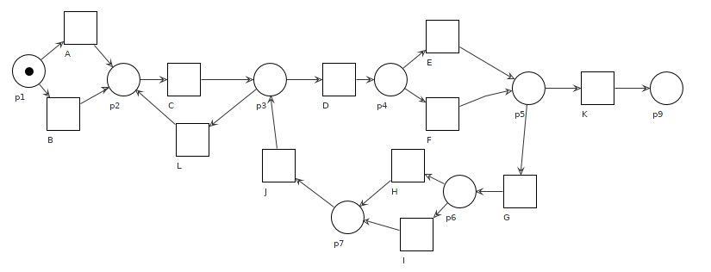
Method Design
Use Binary Relation – Case Variants:: loop
  Every loop is an xor structure, to choose go back or forward
    loop{C,{L,D}} create long-term candidate: {A,B}&{C,L}
      Choose A, without loop:<A,C,D>
      Choose B, with loop: <B,C,L,C,D>
    Xor in the loop
      Candidate from branch
        {E,F}&{G} With E, no loop, with F, go loop <E,G>,<F,K>
        {E,F}&{H,I} :: <E,H>,<F,H>,<F,I>

Slide 11
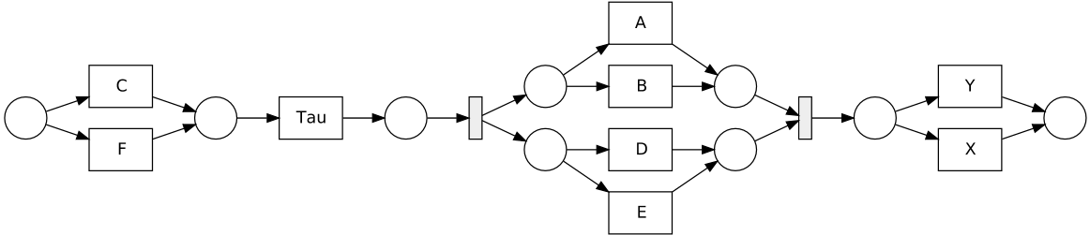
Method Design
Treat Parallel & Loop Specially
  Add control transitions for the xor in parallel & loop
  Add silent transitions before the main structure
    <C,A,D>, <F,B,D>,<F,B,E>,<F,A,D>

Slide 12
Method Design
Begin From Process Tree
  Since the long-term dependency depends also on the block that includes xor, so we use process tree to get block easier
  Long-term dependency needs the order of xor structures, visiting process tree by Depth-First-Search gives us the order of xor

Slide 13


Method Implementation
Methods Design
  Get all possible combinations of xor structure in Petri net, one combination includes:
    one is xor join to create different precondition
    one is xor split to decide which events to choose
    Eg: {A,D}, {A,E}, {B,D},{B,E}
  Check event log, if they have specific paths through xor structure
    <ACD, BCE>
      #{A,D}=true,#{A,E}=false,
      #{B,D}=false,#{B,E}=true
  Add places into Petri net to constrain the choices
    A→o→D , B→o→E

Slide 14
Method Implementation
Obstacles
  Diversity of xor structure
    Xor pure :: all the children are leaf nodes
    Xor impure :: at least one child is not leaf node
    Xor position :: sequence, parallel, loop
  Complexity of impure xor
    Branch is sequence, parallel, or loop
    Substructure of branch has pure xor structure, or not
    Substructure of branch has impure xor structure
  Difficulty to find the order of xor structure
    sequence
    parallel
    loop

Slide 15
Method Implementation
Current Progress
  Complete the xor discovery parts and extract the relation of them
Decision
  Give it up, it’s difficult to find out all the long-term dependency, even to get the combination of xor structure
  Move to Logic Inductive Programmining

