Slide 1
Master Thesis
Process Enhancement by Incorporating Negative Instances in Model Repair
Author: | Kefang
Email: | kefang.ding@rwth-aachen.de
Supervisor: | Dr. Sebastiaan J. van Zelst
Examiners: | Prof. Wil M.P. van der Aalst Prof. Thomas Rose
Institute: | Lehrstuhl für Process and Data Science

Slide 2


Outline
Research Scope
Literature Review
Problem Definition
Algorithm
  Framework
  Design
Implementation
Evaluation
Conclusion
Appendix
  References
  Support Plugin Development

Slide 3




Scope
Process Mining
Process Enhancement
  Reference model
Model repair
  Fitness
  Similarity
Performance
  Negative instances
Process Mining
Process Enhancement
Positive instances
Model Repair
Negative instances

Slide 4

Literature Review
Rediscovery
  Inductive Miner
Model Repair by Fahland
  Deviations
  Subprocesses
Model Repair by Dees
  Data with performance labels
  Classify deviations
  Fahland’s repair only on positive deviations

Slide 5
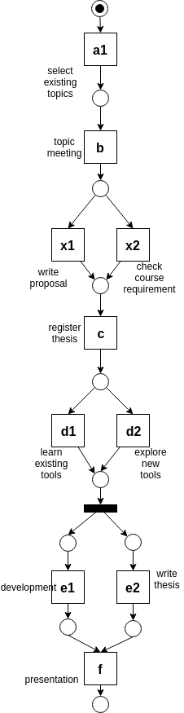
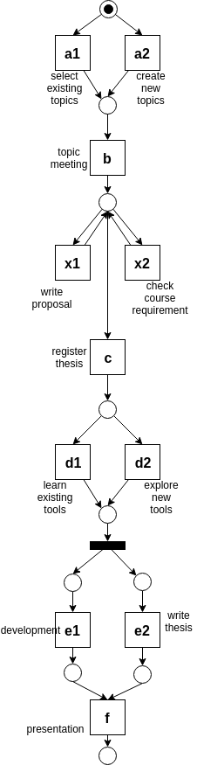
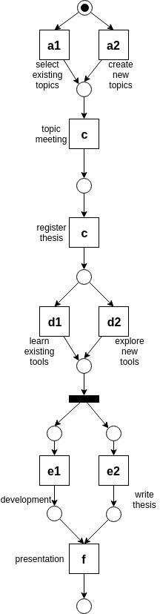
Research Problem – shortcominngs
IM not consider reference model
  Inductive Miner- Infrequent
  Noise threshold: 20%
Fahland’s: add subprocesses as loops
  Default setting
  Deviation found at same place
  Subprocesses as loops
Dee’s: same as Fahland’s method
Similarity, Precision decrease

Slide 6
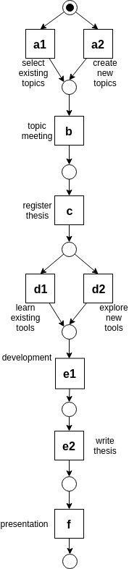
Research Problem – shortcomings
IM keeps the model same
Fahland’s keep model same
Dee’s keep model same
Unable to adapt model with fit traces

Slide 7
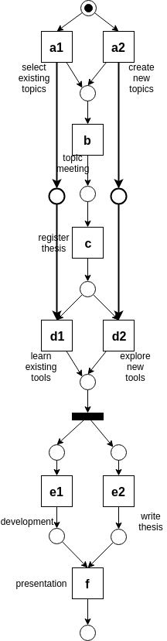
Research Problem – shortcomings
Long-term dependency
  Choices decides choices
  Additional places to limit behavior
Unable to detect long-term dependency

Slide 8

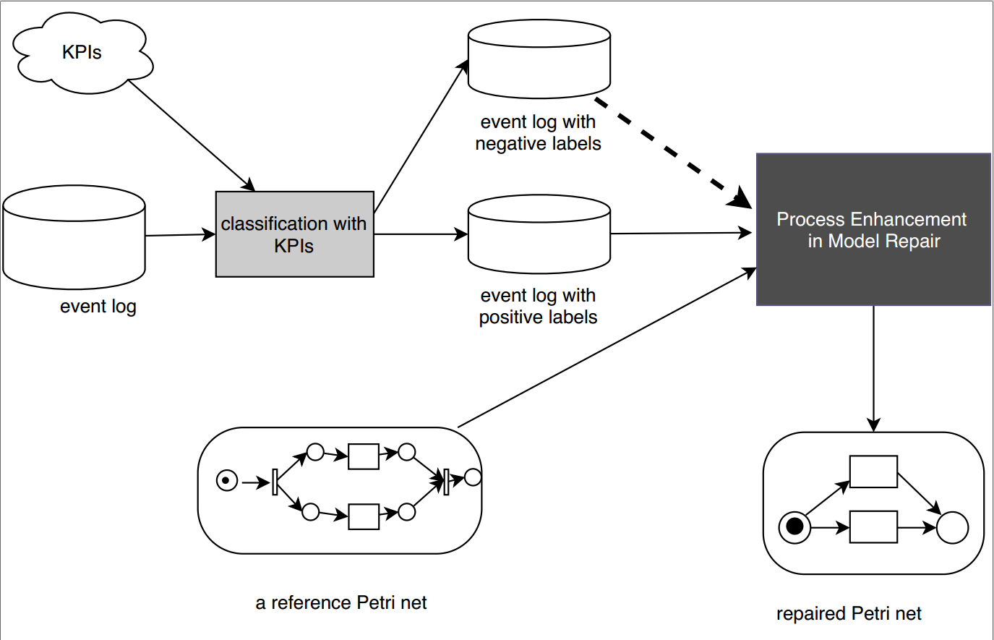
Research Problem
Given an event log with labels, a reference Petri net, how to incorporate negative instances to generate the repaired Petri net which supports better performance?

Slide 9
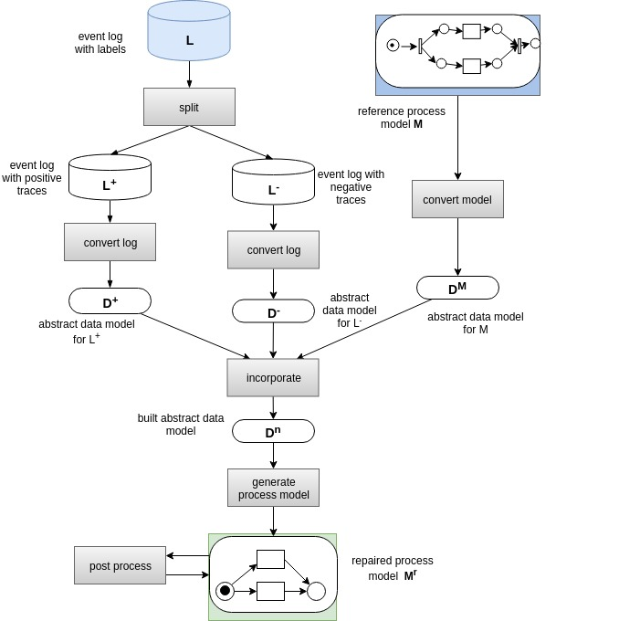
Algorithm – framework
Modules
  Data model
  Convert event log
  Convert model
  Incorporate
  Generate process model
  Post process

Slide 10
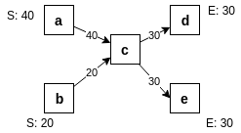
Data Model
Directly-follows graph
  Directly-follows relation

Slide 11
Data Model
Cardinality of directly-follows graph
  For any directly-follows relation
  For start activity a
  For end activity b

Slide 12
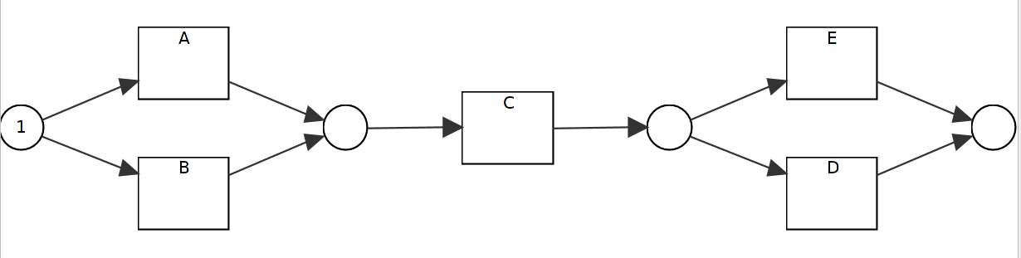

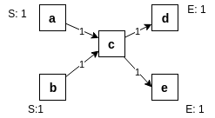
Convert to directly-follows graph
Petri net
  Transition System
  Transitions before and after states
Event log
  Directly-follows relation
  plugin

Slide 13
Data Model
Unification of cardinality
  Models from existing model, positive and negative event log
  For any directly-follows relation
  For any start activity
  For any end activity

Slide 14
Incorporate Data Models
Given directly-follows graphs
Incorporate method
  For any directly-follows relation
  For any start activity,
  For any end activity,
Weighted value
  Three control weights

Slide 15
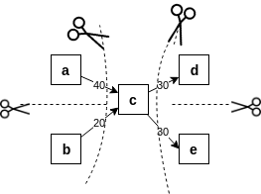
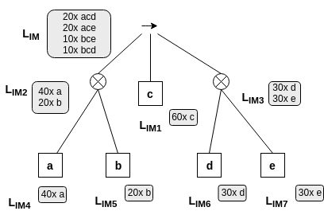
Generate Petri net
Choose directly-follows relation
  t=0
Assign normal cardinality back
IM discovery algorithm
  Directly-follows graph
  Process tree
  Petri net

Slide 16
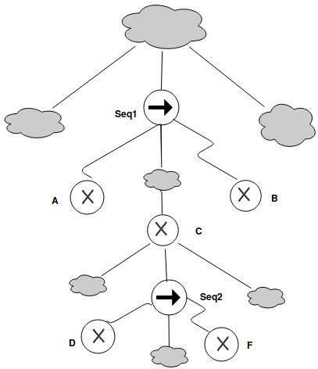
Post Process Petri net
Long-term dependency
  Choices dependency
  Exclusive choices
    Xor block/branches
  In order
    Least common ancestor is Seq
      A < C < B, D<F
    In same level
      A,B,C pair
      D,F pair
  Strong correlation

Slide 17
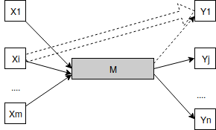
Post Process Petri net
Long-term dependency
  Strong correlation
    Frequency
    Correlation over t

Slide 18
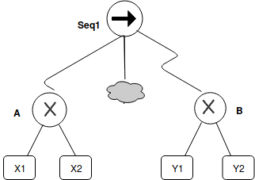
Algorithm – add long-term dependency
Long-term dependency Situations
  1. LT= {X1-Y1,X1-Y2,X2-Y1,X2-Y2}
  2. LT= {X1-Y1,X1-Y2,X2-Y2}
  3. LT= {X1-Y1,X2-Y2}
  4. LT= {X1-Y1,X2-Y1}
  5. LT= {X1-Y1,X1-Y2}
  6. LT= {X1-Y1}
  7. empty set
  Situation 1 is full dependency ==> no consideration
  Situation 7 is empty. ==> no consideration

Slide 19
Algorithm – add long-term dependency
  How to express on Petri net
    Add silent transition
      given
      e.g.
      Add control place as post-place post after S
      Add control place as pre-place before T

Slide 20
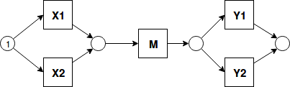
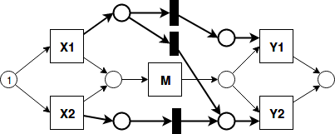
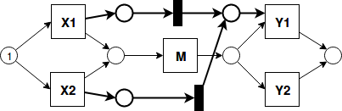
Algorithm – add long-term dependency
  Expressed On Petri net
    Add silent transition
      For every item in LT, create one silent transition to connect the corresponding post-place for lt source and pre-place for lt target
    Given LT= {X1-Y1,X1-Y2,X2-Y2}
    Given LT= {X1-Y1,X2-Y1}

Slide 21
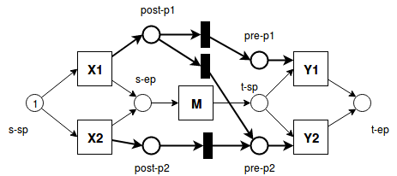
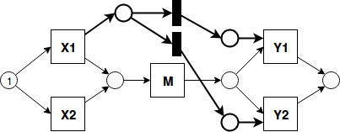
Algorithm – add long-term dependency
Soundness
  Situation 2 and 3 are sufficient to create sound model
  Proof:
    For every xor block pair, M(s-sp)=1, other places p, M(p)=0

Slide 22
Algorithm – add long-term dependency
Soundness
  Situation 2 and 3 are sufficient to create sound model
  Proof:
    For every xor block pair, M(s-sp)=1, other places p, M(p)=0
    Xi is chosen, M(s-ep)=1, M(post-pi)=1, other places p, M(p)=0

Slide 23
Post process
Delete redundant silent transitions

Slide 24
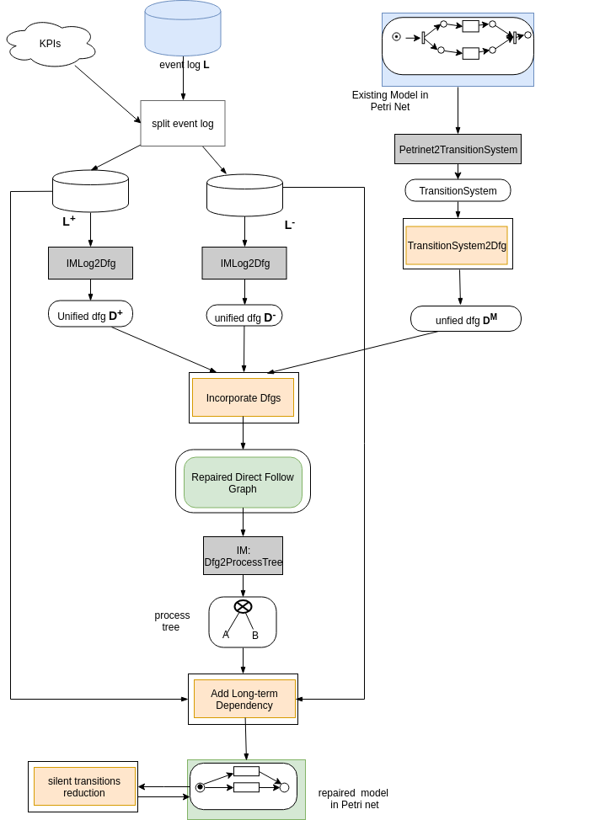
Algorithm – architecture
Data model
Convert models
Incorporate dfgs
Add long-term dependency
Delete redundant silent transitions

Slide 25




Evaluation
Confusion matrix
  Recall
  Precision
  Accuracy
  F1
fitness
generalization
precision
simplicity
 | Allowed behavior | Not allowed behavior
positive | TP | FN
negative | FP | TN

Slide 26
Demo-result

Slide 27
Experiments on Real life data
Data description
Event log
Models

Slide 28
Conclusion

Slide 29
Results

Slide 30
Conclusion

Slide 31



Questions & Answers

Slide 32
Algorithm – add long-term dependency
Soundness
  Situation 2 and 3 are sufficient to create sound model
  Proof:
    For every xor block pair, M(s-sp)=1, other places p, M(p)=0
    Xi is chosen, M(s-ep)=1, M(post-pi)=1, other places p, M(p)=0
    After M, M(t-sp)=1, for any silent transiton st, |InEdge(ts)|=|OutEdge(ts)|=1, token number stays the same until pre places, Sum(M(pre-pi))=Sum(M(post-pi))=1

Slide 33
Algorithm – add long-term dependency
Soundness
  Situation 2 and 3 are sufficient to create sound model
  Proof:
    For every xor block pair, M(s-sp)=1, other places p, M(p)=0
    Xi is chosen, M(s-ep)=1, M(post-pi)=1, other places p, M(p)=0
    After M, M(t-sp)=1, for any silent transiton st, |InEdge(ts)|=|OutEdge(ts)|=1, token number stays the same until pre places, Sum(M(pre-pi))=Sum(M(post-pi))=1
    For any Yj, *Yj=2, able to fire, consume two tokens, and produce one token to Place t-ep

Slide 34
Algorithm – add long-term dependency
Soundness
  Situation 4-7 can’t create sound model
    Not proper to end: token remains before Y1
    Dead part: Y1,Y2 can not be fired
  Ignore those situations

Slide 35
Demo Representation
Repair Model
  Sequence
  Log={pos:<S1,A,B1,C,T1>,<S2,A,B1,C,T2>,<S2,A,B2,C,T2>
  neg:<S1,A,B2,C,T1>}
  LT(Xor(S1,S2),Xor(B1,B2))= {S1-B1, S2-B1,S2-B2}
  LT(Xor(B1,B2), Xor(T1,T2))={B1-T1,B1-T2,B2-T2}
  LT(Xor(S1,S2),Xor(T1,T2))= {S1-T1(??), S2-T2}

Slide 36
Appendix – References
Assign Labels
Edit Process Tree

