Slide 1
Master Thesis Report
Process Enhancement by Incorporating Negative Instances in Model Repair
Dfg Global Dependency Discovery
Kefang Ding

Slide 2
Outlines
Problem Introduction
Preliminary
Method Design
Method Implementation
Method Evaluation
Appendix
  Plugin Development

Slide 3
Problem Introduction
Dfg method can not deal with global dependency.
  Can’t discover it
  Can’t remove it
  Can’t find structure change
Given Petrinet discovered by the dfg methods, event log, KPIs, we need to discover the global dependency, remove it or change its structure to the event log.

Slide 4
Preliminary
Global Dependency Definition:
  Relative to local dependency, the decision to execute events depends not only on the events direct before it, but events far away before it.
  It’s a concept to describe the constraints
Non Free Choices Structure Definition:
  The choice of events to be executed is constrained by the sequence before events.
  it’s the structure in Petri net
Difference
  Global dependency is due to non-free-choice structure.
  Some non-free-choices don’t have global dependency, but local dependency[can be decided by direct previous events].
Characters of Global Dependency
  Xor structures exists and are not directly connected
  Event log has sequences with specific choices from xor structure

Slide 5


Methods Design
Methods Design
  Get all possible combinations of xor structure in Petri net, one combination includes:
    one is xor join to create different precondition
    one is xor split to decide which events to choose
    Eg: {A,D}, {A,E}, {B,D},{B,E}
  Check event log, if they have specific paths through xor structure
    <ACD, BCE>
      #{A,D}=true,#{A,E}=false,
      #{B,D}=false,#{B,E}=true
  Add places into Petri net to constrain the choices
    A→o→D , B→o→E

Slide 6
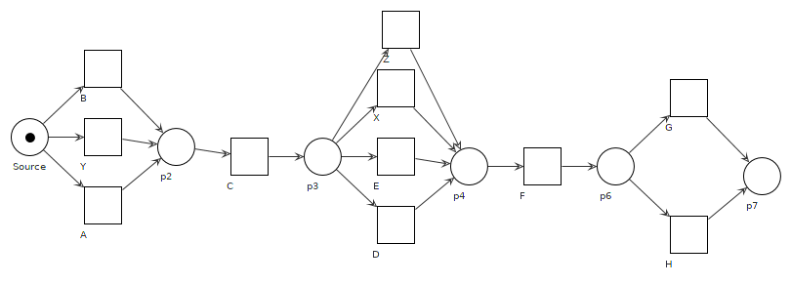
Method Design - {A,B,Y} to {D,E,X,Z}
X
D
E
X D
E
X D
E
Z
Z
Z
A:
B:
Y:

Slide 7
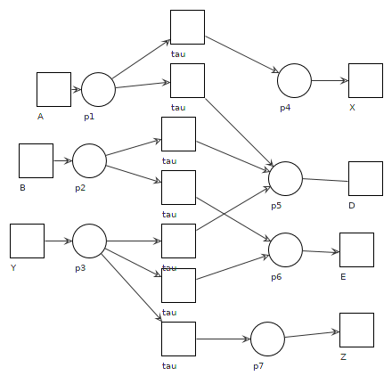
Method Implementation
Places after xor join structure
  If any of {A,B,Y} has global dependency, we create post places for each branch, P[A],P[B],P[Y]
Places before xor split structure
  If any of {X,D,E,Z} has global dependency with xor join before them, create a pre place for each of them
Silent transition to connect places
  If there is connection of any combination from {A,B,Y} *{X,D,E,Z}, we create a silent transition
  Connect the silent transition and places
  [postplace] → tau → [preplace]
X
D
E
Z

