Slide 1
Master Thesis Report
Process Enhancement by Incorporating Negative Instances in Model Repair
Final Report
Kefang Ding

Slide 2
Outlines
Problem Review
Demo Presentation
Algorithm & Implementation
  Add long-term dependency
  Create dfg model
Evaluation
Appendix
  Reference

Slide 3

Problem Introduction
Description
  Given event log, process model and KPIs, how to incorporate negative KPIs outcomes to repair the process model for better performance?
Input
  Event log
  Existing process model
  KPIs
Output
  Repaired process model

Slide 4
Demo Representation
Repair Model
  Sequence
  And
  Nested xor
Evaluate Model
  Confusion matrix

Slide 5
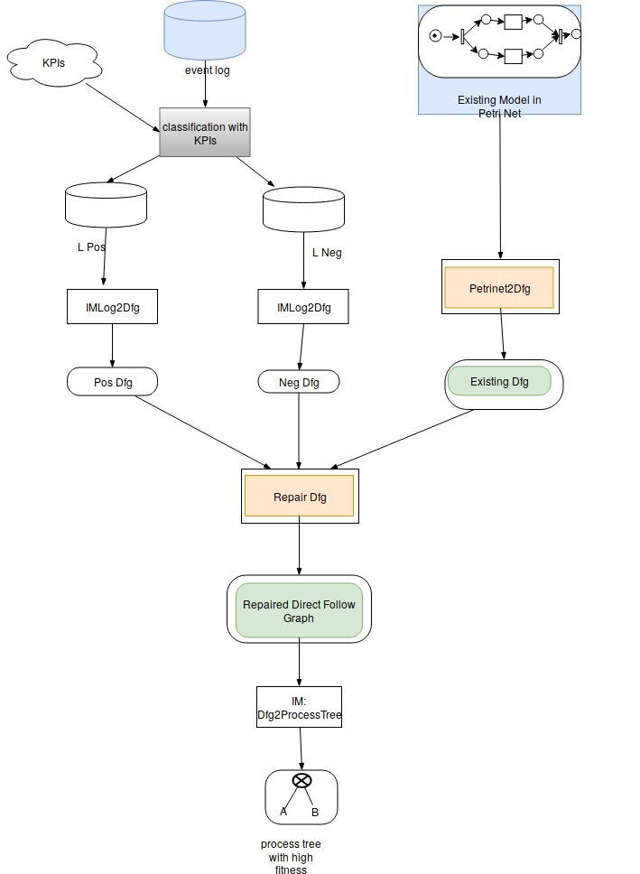
Algorithm – generate dfg model
Directly-follows relation
  Existing model, positive and negative event log
  Keep this directly-follows relation if
  Choose, threshold=0.5

Slide 6
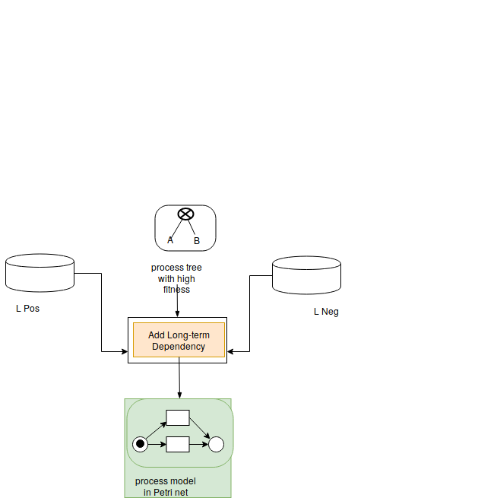
Algorithm – add long-term dependency
Long-term dependency
  Choices Dependency
    exclusive blocks => xor block, not loop
  Relation xor branches
    Significant correlation
  Connected but not complete

Slide 7
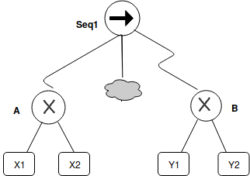
Algorithm – add long-term dependency
Long-term dependency
  Choices Dependency
    exclusive blocks => xor block, not loop
  Relation xor branches
    Significant correlation
  Connected but not complete

Slide 8
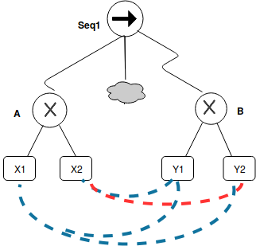
Algorithm – add long-term dependency
Long-term dependency
  Choices Dependency
    exclusive blocks => xor block, not loop
  Relation xor branches
    Significant correlation
  Connected but not complete

Slide 9
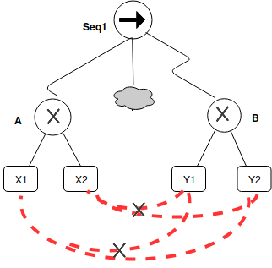
Algorithm – add long-term dependency
Long-term dependency
  Choices Dependency
    exclusive blocks => xor block, not loop
  Relation xor branches
    Significant correlation
  Connected but not complete

Slide 10
Algorithm – add long-term dependency
Long-term dependency
  Choices Dependency
    exclusive blocks => xor block, not loop
  Relation xor branches
    Significant correlation
  Connected but not complete

Slide 11
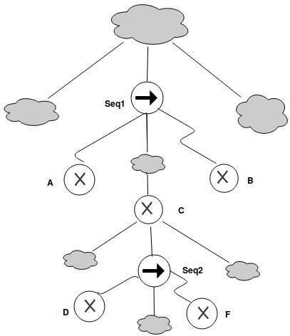
Algorithm – add long-term dependency
Long-term dependency
  Partial Order
    Least Common Ancestor is Seq
      A <C < B, D<F
    In same level
      A,B,C pair
      D,F pair
  Expressed On Petri net
    Add silent transition
    Add places

Slide 12
Algorithm – add long-term dependency
Rephrased Correlation
  New generated model, positive and negative event log
  Significant Correlation

Slide 13
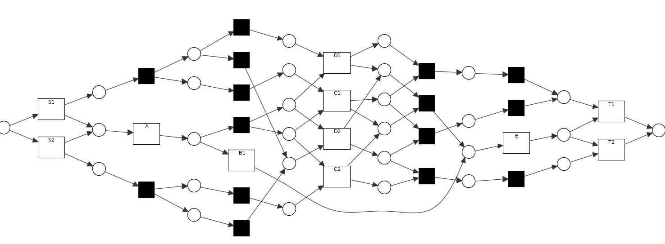
Algorithm – Problem
Unsound model

Slide 14
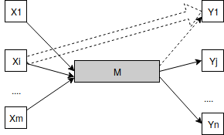
Algorithm – add long-term dependency
Key Problem to Solve
  Given a process tree, a pair of xor block A,B, the obligatory part between A,B are M, what’s the relation of threshold and lt-threshold, such that?
Situations
  Xor branch kept due to existing
  model, but not frequency in positive and negative
  ==> add lt dependency on it
  Only in negative
  ==> choose the rest parts to connect
  Only in positive
  ==> keep lt
  In positive and negative
  ==> how to decide ??

Slide 15
Appendix – references

Slide 16
Appendix – References
Assign Labels
Edit Process Tree

