Slide 1
Master Thesis
Process Enhancement by Incorporating Negative Instances in Model Repair
Baseline Building & Dfg Implementation
Kefang Ding

Slide 2
Outlines
Problem Introduction
Baseline Design
Baseline Performance
Dfg Method Introduction
Dfg Evaluation
Appendix
Baseline Results
Plugin Development

Slide 3
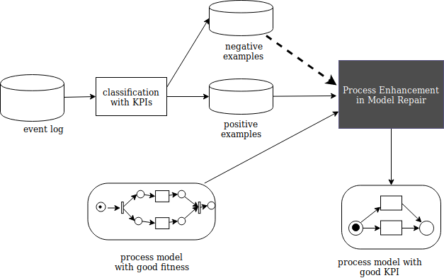
Problem Introduction
Description
Given event log, process model and KPIs, how to incorporate negative KPIs outcomes to repair the process model for better performance?
Input
Event log
Existing process model
KPIs
Output
Repaired process model

