Slide 1
Master Thesis Report
Process Enhancement by Incorporating Negative Instances in Model Repair
Final Report
Kefang Ding

Slide 2
Outlines
Problem Review
Demo Presentation
Algorithm & Implementation
  Add long-term dependency
  Create dfg model
Evaluation
Appendix
  Reference

Slide 3

Problem Introduction
Description
  Given event log, process model and KPIs, how to incorporate negative KPIs outcomes to repair the process model for better performance?
Input
  Event log
  Existing process model
  KPIs
Output
  Repaired process model

Slide 4
Demo Representation
Repair Model
  Sequence
  And
  Nested xor
Evaluate Model
  Confusion matrix

Slide 5
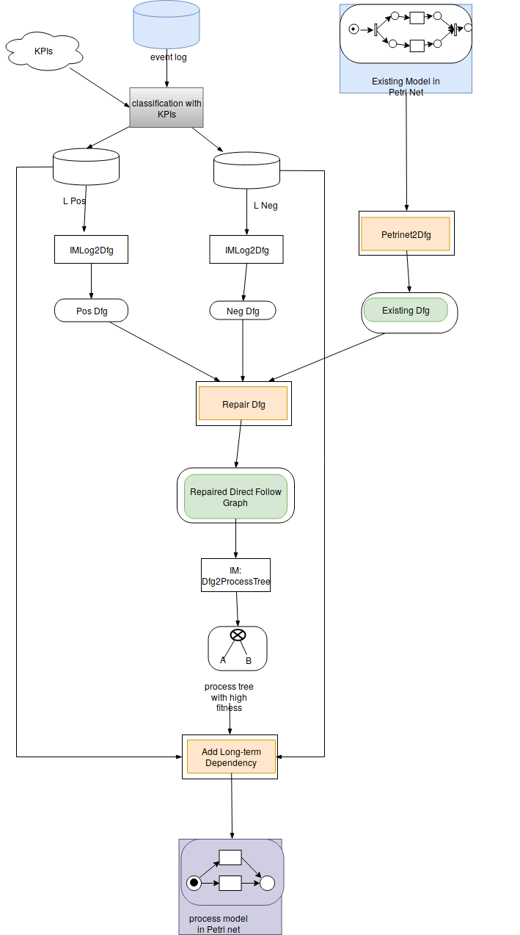
Algorithm – generate dfg model
Directly-follows relation
  Existing model, positive and negative event log
  Keep this directly-follows relation if
  Choose, threshold=0.5

Slide 6
Algorithm – add long-term dependency
Long-term dependency
  On Petri net
  Choices Dependency
    exclusive blocks => xor block, not loop

Slide 7
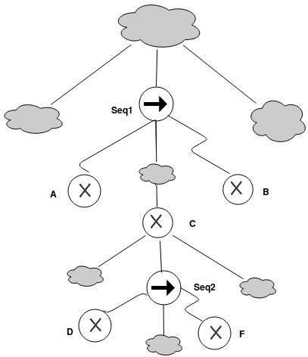
Algorithm – add long-term dependency
Long-term dependency
  Partial Order
    Least Common Ancestor is Seq
      A <C < B, D<F
    In same level
      A,B,C in same level
      D,F in same level
  Relation xor branches
    Significant correlation
  Connected not complete

Slide 8
Algorithm – add long-term dependency
Long-term dependency
  On Petri net
  Choices Dependency
    exclusive blocks => xor block, not loop
  Partial Order
    Least Common Ancestor is Seq
    In same level
  Relation xor branches
    Significant correlation
  Connected not complete

Slide 9
Algorithm – add long-term dependency
Long-term dependency
  On Petri net
  Choices Dependency
    exclusive blocks => xor block, not loop
  Partial Order
    Least Common Ancestor is Seq
    In same level
  Relation xor branches
    Significant correlation
  Connected not complete

Slide 10
Algorithm – add long-term dependency
Correlation
  Supported Connection
  Significant Correlation if
  Disadvantages:
    Generate unsound model
      Some xor branches kept from the existing model but with no frequency in event log, no long-term dependency shows to make model unsound

Slide 11
Algorithm – add long-term dependency
Rephrased Correlation
  Existing model, positive and negative event log
  Normalized Correlation

Slide 12
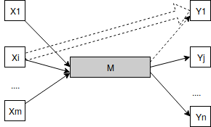
Algorithm – add long-term dependency
Key Problem to Solve
  Given a process tree, a pair of xor block A,B, the obligatory part between A,B are M, what’s the relation of threshold and lt-threshold, such that?
Situations
  Lt-dependency only kept from existing
  model, not showing in positive and negative
  ==> add lt dependency on it
  Only lt in negative
  ==> choose the rest parts to connect
  Only in positive
  ==> keep lt
  In positive and negative
  ==> how to decide ??

Slide 13
Appendix – References
Assign Labels
Edit Process Tree

Slide 14
Appendix – references

