Slide 1

Master Thesis Report Process Enhancement by Incorporating Negative Instances in Model Repair
Baseline Building & Dfg Method Trial
Kefang Ding
Aug 30, 2018
Kefang.ding@rwth-aachen.de

Slide 2
Outlines
Model Introduction
Baseline Design
Baseline Results
Dfg Method
Dfg Evaluation with Baseline
Appendix
Baseline Result
Plugin Development

Slide 3
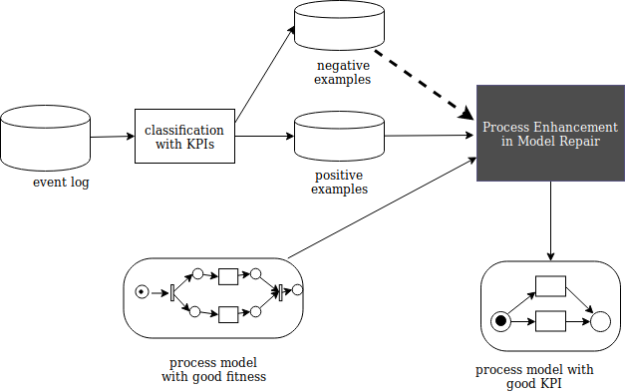
Model Introduction
Input:
event log
process model with good fitness
Output:
process model with KPI

Slide 4
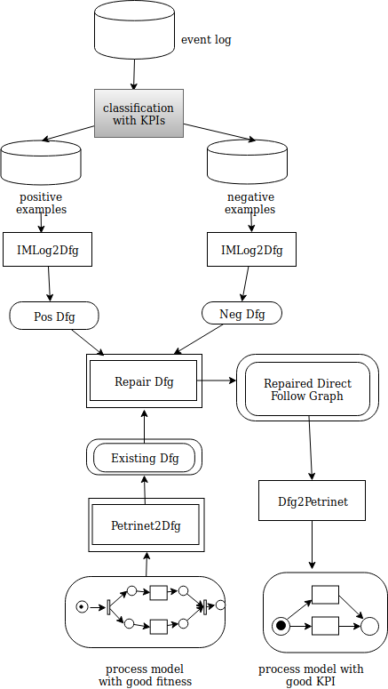
Dfg Method Introduction
Input
Event log
Existing process model
Output
Repaired process model with good KPI
Method
Petrinet2Dfg:
– transform PN to transition system
– get Dfg relation from transition system
Repair Dfg
– create a matrix to store the direct follow relation of
existing Dfg, Pos Dfg, and Neg Dfg
– consider the distribution from existing, pos, and neg dfg
of each direct follow relation

Slide 5
Repair Dfg
Case 0&1::
no need to consider
Case 2,3,4::
add them into the repaired dfg
Case 5,6,7::
consider the distribution of pos, neg and existing dfg
#(pos + existing) > #neg :: keep df
#(pos + existing) < #neg :: remove df
Assign different weights to existing, pos and neg dfg to address different perspectives
Eg 1. keep original model
Weight(existing)=1.0, Weight(Pos)=0.0,Weight(Neg)=0.0
Eg 2. generate rediscovery model
Weight(existing)=0.0, Weight(Pos)=1.0,Weight(Neg)=0.0
Eg 3. address negative impact
Weight(existing)=0.5, Weight(Pos)=0.5,Weight(Neg)=1.0
ID | Existing Dfg | Pos Dfg | Neg Dfg
0 | 0 | 0 | 0
1 | 0 | 0 | 1
2 | 0 | 1 | 0
3 | 1 | 0 | 0
4 | 1 | 1 | 0
5 | 1 /50 | 0 | 1 /50
6 | 0 | 1 /100 | 1 /50
7 | 1 /50 | 1 /50 | 1 /50

Slide 6
DemoShow --Dfg Repair Plugin

Slide 7
Dfg Method Evaluation
Point out some situations which have

Slide 8
Baseline Design
Model Generation Methods:
Inductive Miner : rediscovery
Model Repair by Fahland : repair
Positive & Negative Labeling Methods on Data:
Random & Specific Variant
Labels Overlap & non overlap on Variant
Positive Distribution
Model Input Set
Positive Set : Traces(Pos) & Complements : Traces(Pos) – Traces(Neg)
Model Complexity

Slide 9
Baseline
What I want to report??
--baseline but only simple baselines
– Dfg method, so I can draw sth about it

Slide 10
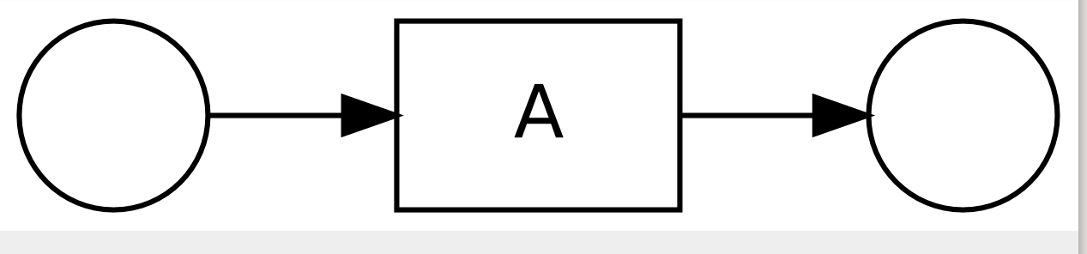
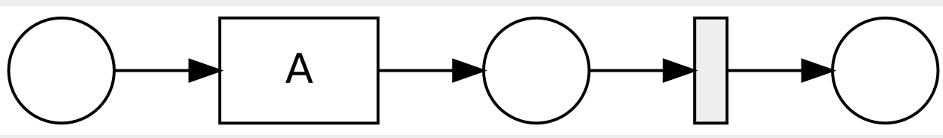
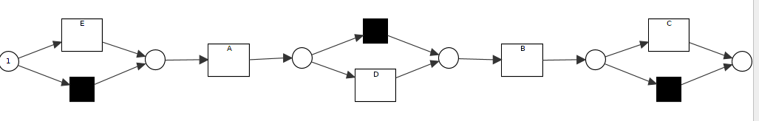
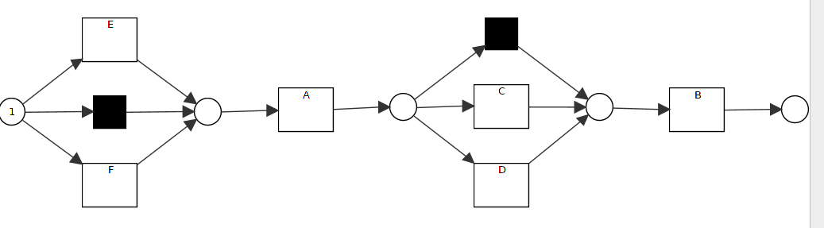
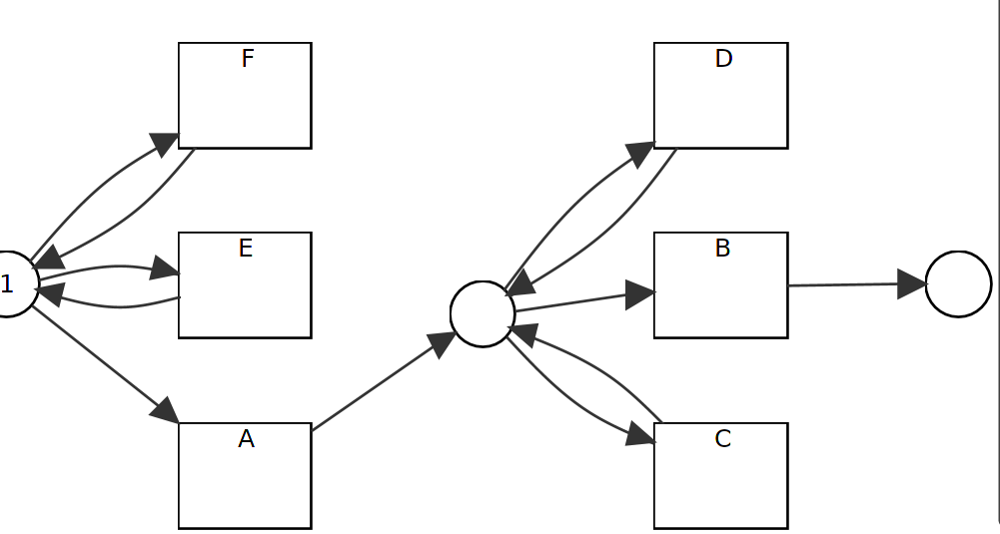
Simple Baseline Experiments – sequence
Case 1.1: delete events from sequence
Data: Pos: 50 <A>, Neg: 50 <A,B>
IM: R1.1 create new model fits
RM: R1.2 substitute deleted events with silent transition
Case 1.2: add events to sequence
Data 1: pos: 50 <A,B,C> , 50 <A,D,B>,
50<E,A,B> neg: 50 <A,B>
data 2: pos: 50 <A,C,B> , 50 <A,D,B>,
50<E,A,B>, 50 <F,A,B> neg: 50 <A,B>
IM: create new model not good fitness
data 1:: R1.10 data 2: R1.16
RM:
single events at any position:
**add events by adding silent transition :: R1.10
multiple events,
**add events by self-loop :: R1.17
Fig M1
Fig R1.1
Fig R1.2
Fig R1.10
Fig R1.16
Fig R1.17

Slide 11
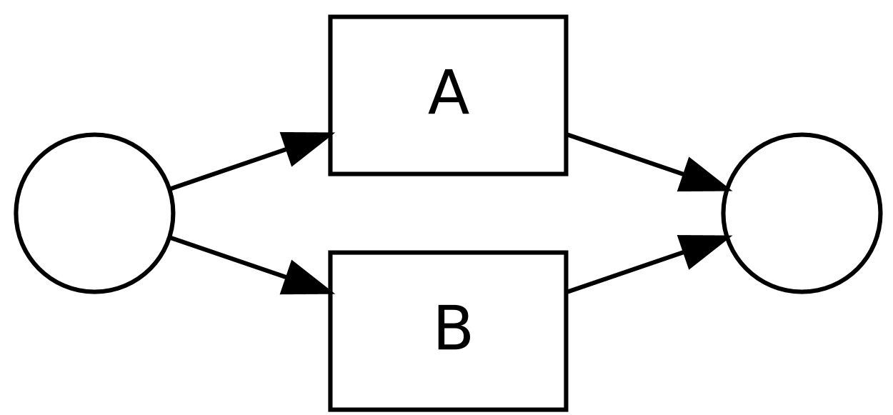
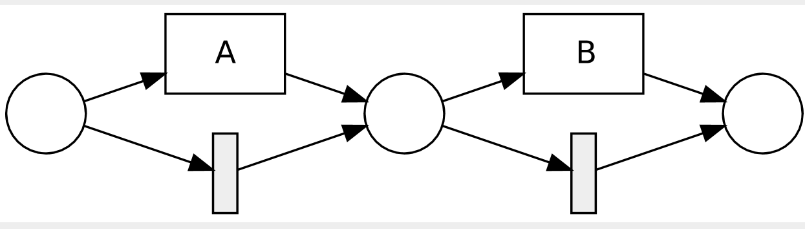
Simple Baseline Experiments – sequence
Case 1.3: add while deleting events
Data: pos: 50 <A,C> neg: 50 <A,B>
IM: create new fit model
RM: add silent transitions to skip event :: R1.13
Case 1.4: sequence to exclusive choice
Data: Pos: 50<A>, 50<B>, Neg: 50<A,B>
IM: create new fit model :: R1.3
RM: add silent transitions to skip event, but less preciser :: R1.4
Fig M1
Fig R1.13
Fig R1.3
Fig R1.4

Slide 12
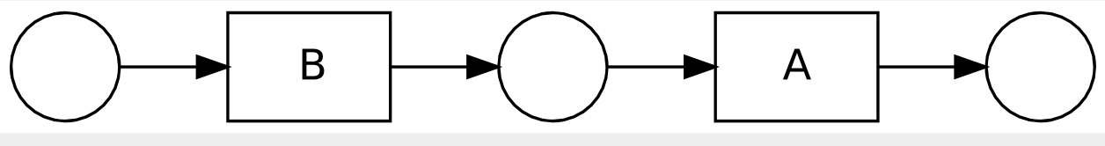
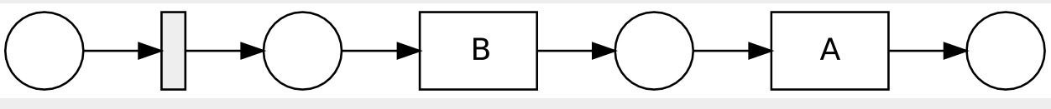
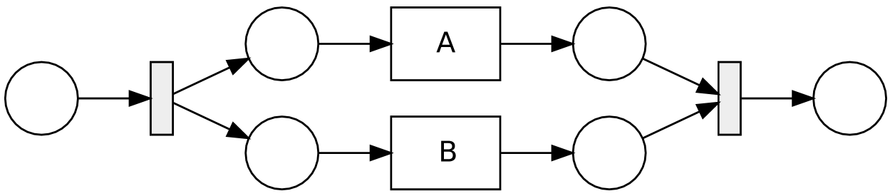
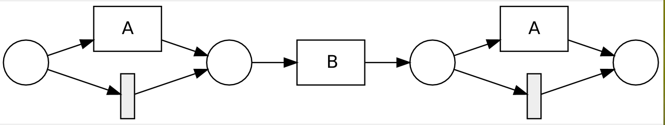
Simple Baseline Experiments – sequence
Case 1.5: change sequence order
Data: Pos: 55<B,A>, Neg: 55<A,B>
IM: create new model fits :: R1.5
RM: add A to end remove A at begin with silent transition :: R 1.6
Case 1.6: sequence to parallel
Data: Pos: 55 <A,B>, 55<B,A>
Data2: pos:50<A,B>,5<B,A> neg:5<A,B>, 50<B,A>
IM: create new model fits :: R1.7
RM: add skip and new transtion :: R1.8
Fig M1
Fig R1.5
Fig R1.6
Fig R1.7
Fig R1.8

Slide 13
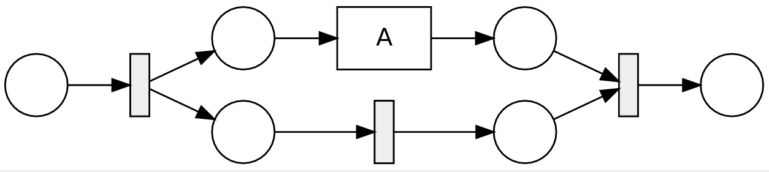
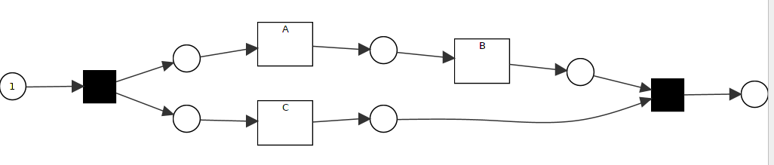
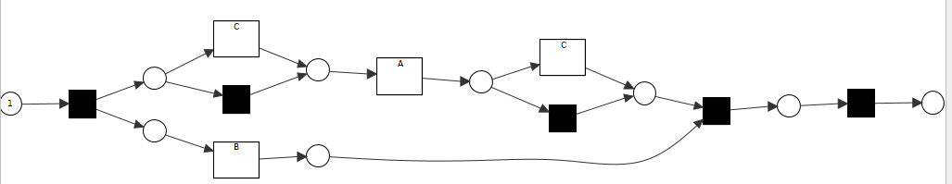
Simple Baseline Experiments – parallel
Case 2.1: delete events from parallel
Data: Pos: 50 <A>, Neg: 50 <B>
IM: create new model fits :: R2.1
RM: substitute deleted events with silent transition :: R2.2
Case 2.2.1: add events to parallel relation
Data 1: Pos: 50 <A, B,C>, 50<A, C, B>, 50 <C, A,B>
neg: 50<A,B>, 50 <B,A>
IM: new model not consider parallel relationship:: R2.13
RM: tend to add events in sequence with silent and
duplicate transitions::
Fig M2
Fig R1.1
Fig R2.2
Fig R2.13
Fig R2.14

Slide 14
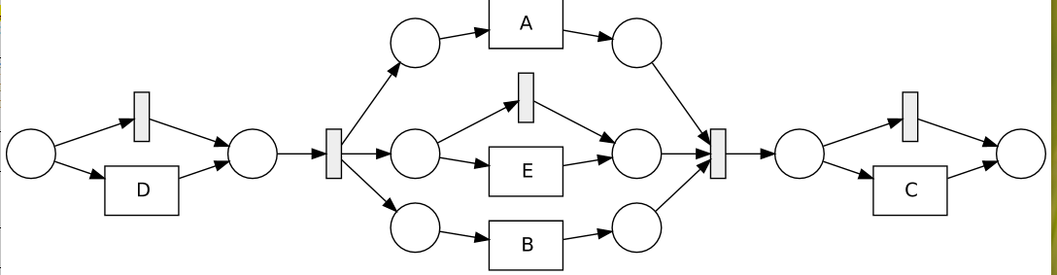
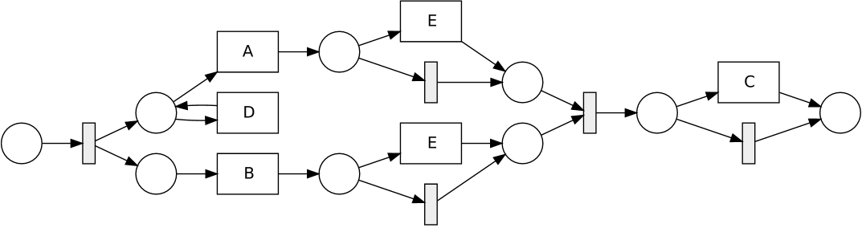
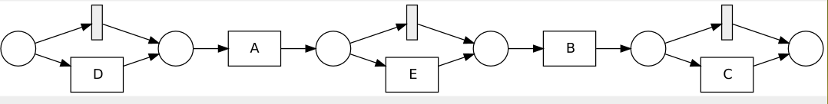
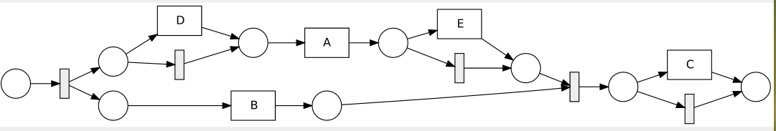
Simple Baseline Experiments – parallel
Case 2.2.2: add events to parallel at different positions
Data : Pos: 50 <A, B, C>, 50 <D,A,B> 50 <A,E,B>,
50<B,A,C>, 50<D,B,A> 50<B,E,A> neg: 50<A,B>, 50 <A,C>
IM: quite fit model:: R2.15
RM: tend to add events in sequence branch with silent and
duplicate transitions or self loop:: R2.16
Case 2.2.3: add events at different
Positions without keeping parallel relation
Data : Pos: 50 <A, B, C>, 50 <D,A,B> 50<A,E,B>
neg: 50<A,B>, 50 <A,C>
IM: can’t see parallel relationship of A,B :: R2.17
RM: keep parallel relationship, and tend to add events
in sequence branch with silent and
duplicate transitions or self loop:: R2.18
Fig M2
Fig R2.15
Fig R2.16
Fig R2.17
Fig R2.2
Fig R2.18

Slide 15
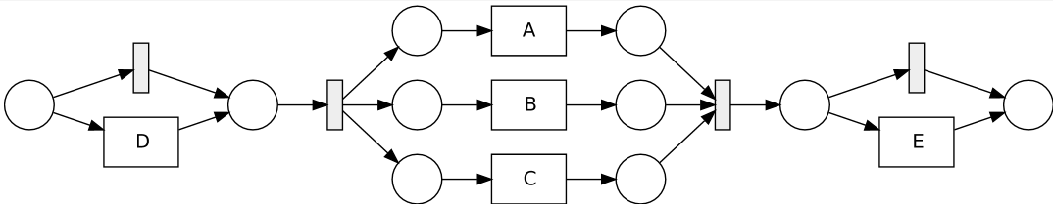
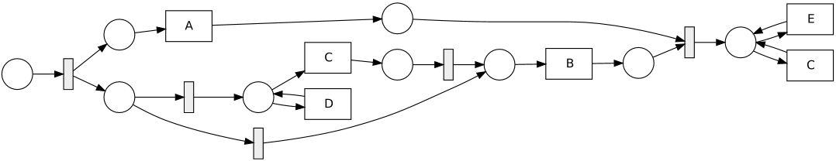
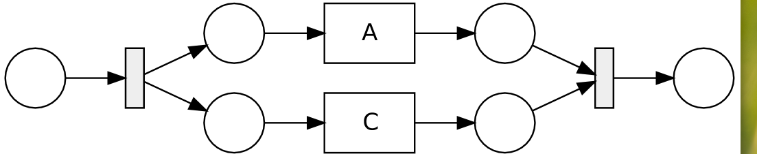
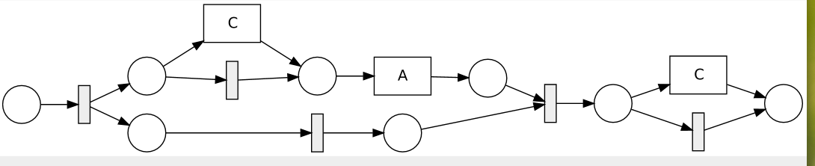
Simple Baseline Experiments – parallel
Case 2.2.4: add event in parallel while adding
other events in sequence
Data :Pos: 50 <A, B, C>, 50<B,A,C>,50 <D,A,C, B>
50 <C,A,B, E> neg: 50<A,B>, 50 <B,A>
IM: quite fit model:: R2.21
RM: tend to add events in sequence branch with silent and
duplicate transitions or self loop, less precision:: R2.22
Case 2.2.5: add events while deleting events
Data : Pos: 50<A,C>, 50<C,A>
neg: 50<A,B,C>, 50<A,B>
IM: quite fit model :: R2.19
RM: keep parallel structure by adding silent transiton
Using duplicate transition to represent parallel:: R2.20
Fig M2
Fig R2.21
Fig R2.22
Fig R2.19
Fig R2.20

Slide 16
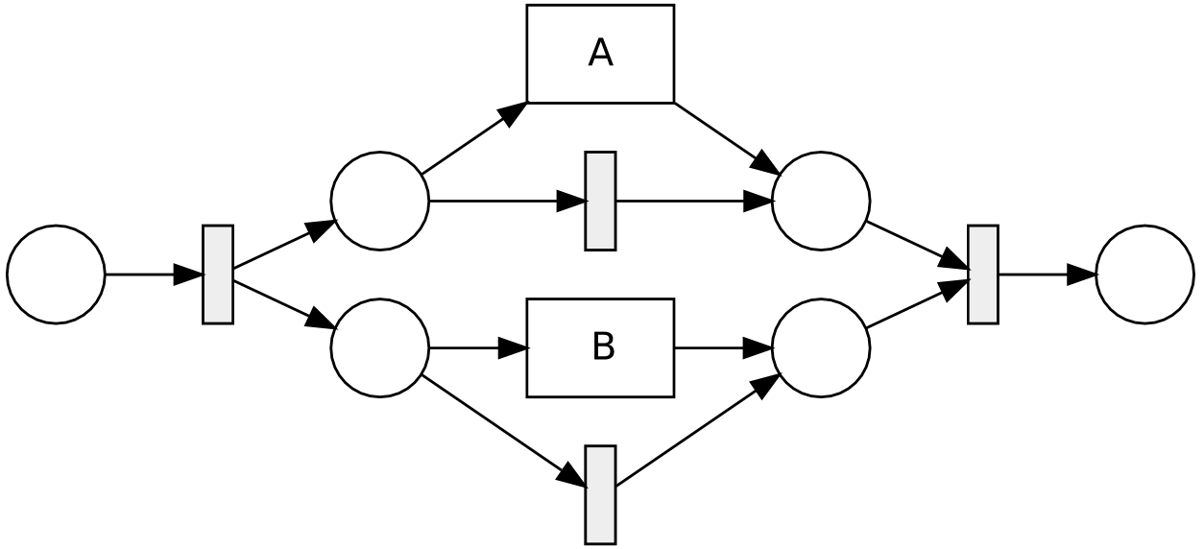
Simple Baseline Experiments – parallel
Case 2.3: change parallel to exclusive choice
Data: Pos: 50 <A>, 50<B>, Neg: 50 <A,B> , 50 <B,A>
IM: create new model fits ::
RM: substitute skipped events with silent transition ,
less precision :: R2.4
Case 2.4: change parallel to sequence
Data: Pos: 50<B,A >, Neg: 50<A, B>
IM: create new fit model :: R1.5
RM: skip A at begin and add A at end :: R1.6
Fig M2
Fig R2.4
Fig R1.5
Fig R1.6

Slide 17
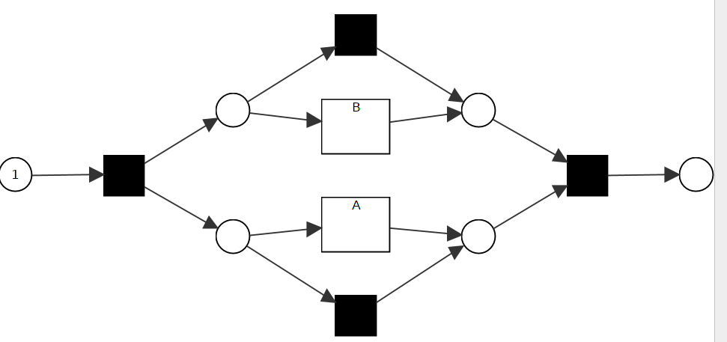
Simple Baseline Experiments – parallel
Case 2.5.1: change parallel to sequence with overlap
Data 1:
Pos: 50<A,B>, 5<B,A> neg: 5<A,B>, 50<B,A>
Data 2:
Pos: 5 <A,B>, 50<B,A> neg:50<A,B>, 5<B,A>
IM: create the same model like original ones
RM: no change in model no matter of the overlap distribution
Case 2.5.2: change parallel to sequence with noise
Data 1:
Pos: 50<A,B>, 5<B,A>, 1<A>,2<B> neg: 5<A,B>, 50<B,A>
IM: create model like original by using filtering,
but can’t remove <B,A> by filtering:: M2
RM: consider the noise in data ::R2.4
Fig M2
Fig R2.4

Slide 18
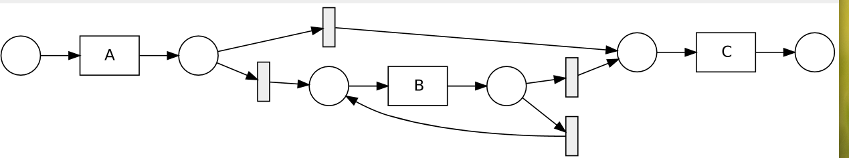
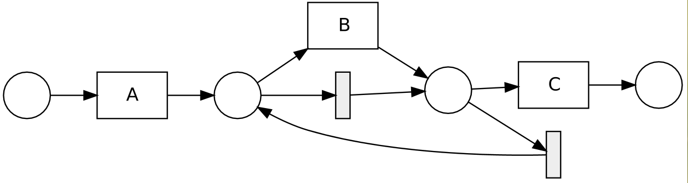
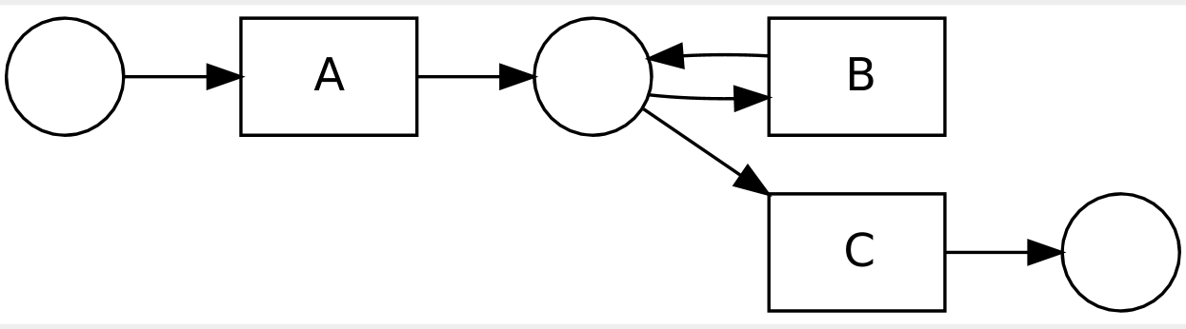
Simple Baseline Experiments – loop
Case 3.1: add self loop to sequence
Data: existing model :: M3.1
Pos: 50<A,C> 50 <A,B,C>,
50<A,B,B,C>, 5050<A,B,B,B,C>
IM: create new model fits, not so simple :: R3.1
RM: add silent transition for skip;
add silent transition for self loop :: R3.2
Case 3.2: delete loop but add duplicate events
Data: existing model :: M3.2
Pos: 50<A,C> 50 <A,B,C>, 50<A,B,B,C>,
Neg: 50<A,B,B,B,C>
IM: can’t see duplicate events :: R3.1
RM: can’t see duplicate events ::R3.2
Fig M3.1
Fig R3.1
Fig R3.2
Fig M3.2

Slide 19
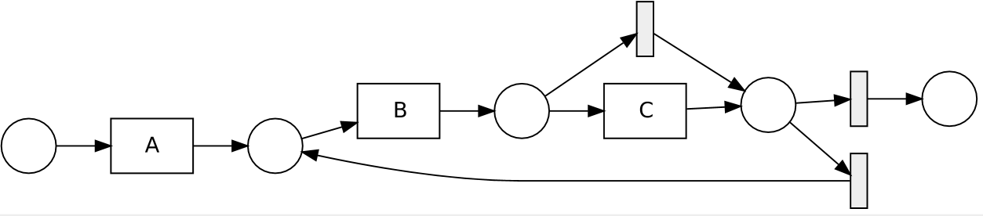
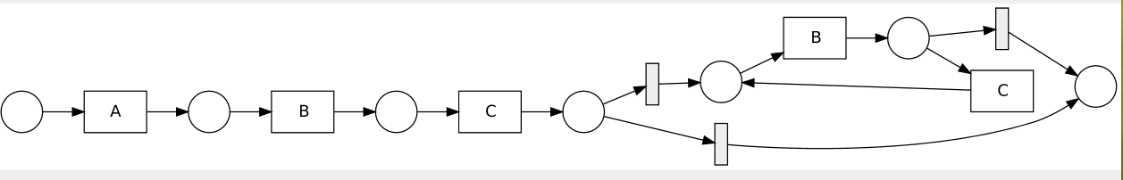
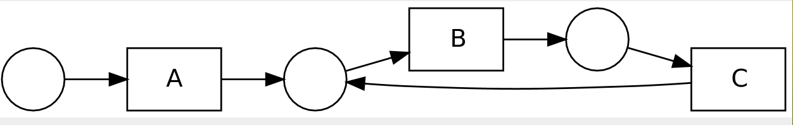
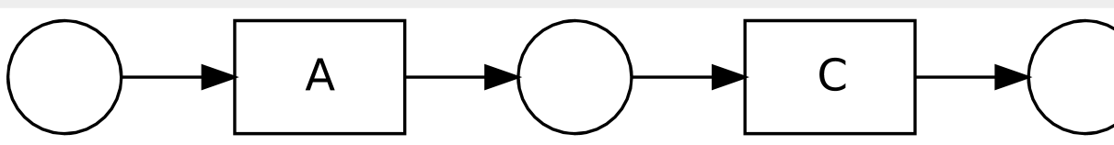
Simple Baseline Experiments – loop
Case 3.3: change sequence to 2-length loop
Data: existing model :: M3.1
Pos: 50 <A, B,C>, 50<A,B,C,B>,
50 <A,B,C,B,C,B>
IM: create new model fits :: R3.3
RM: add new transition at end and silent
transition for loop :: R3.4
Case 3.4.1: delete loop
Data: existing model :: M3.3
Pos: 50<A,C>
Neg: 50<A,B,C> , 50<A,B,C,B,C>
IM: create new model fits :: R3.9
RM: no change on model :: R3.9
quite surprising about the repaired model
Fig M3.1
Fig R3.3
Fig R3.4
Fig M3.3
Fig R3.9

Slide 20
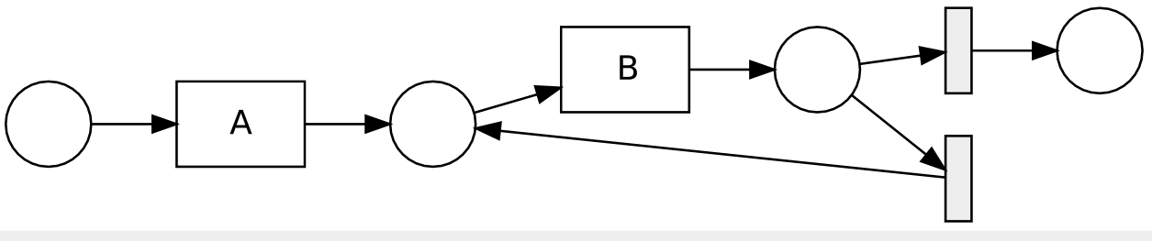
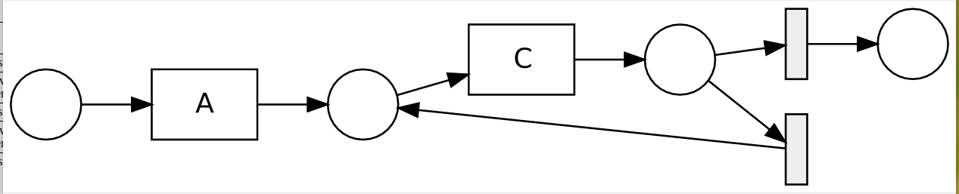
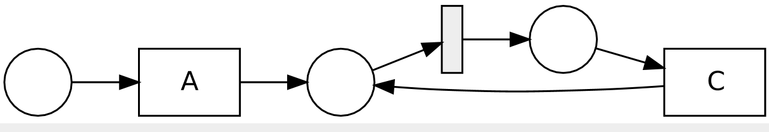
Simple Baseline Experiments – loop
Case 3.4.2: delete events at the end in 2-len loop
Data: existing model :: M3.3
pos: 50<A,B>, 50 <A,B,B>, 50 <A,B,B,B>
neg: 50<A,B,C>, 50<A,B,C,B,C>
IM: create new model fits :: R3.14
RM: no change on model :: R3.14
Case 3.4.3: delete events in the middle in 2-len loop
Data: existing model :: M3.3
pos: 50<A,C>, 50 <A,C,C>, 50 <A,C,C,C>
neg: 50<A,B,C>, 50<A,B,C,B,C>
IM: create new model fits :: R3.16
RM: use silent transition to skip :: R3.17
Fig M3.3
Fig R3.14
Fig R3.16
Fig R3.17

Slide 21
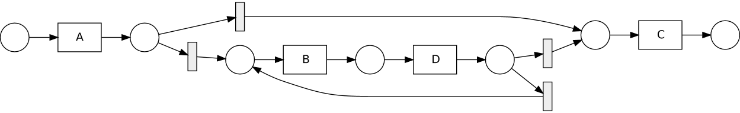
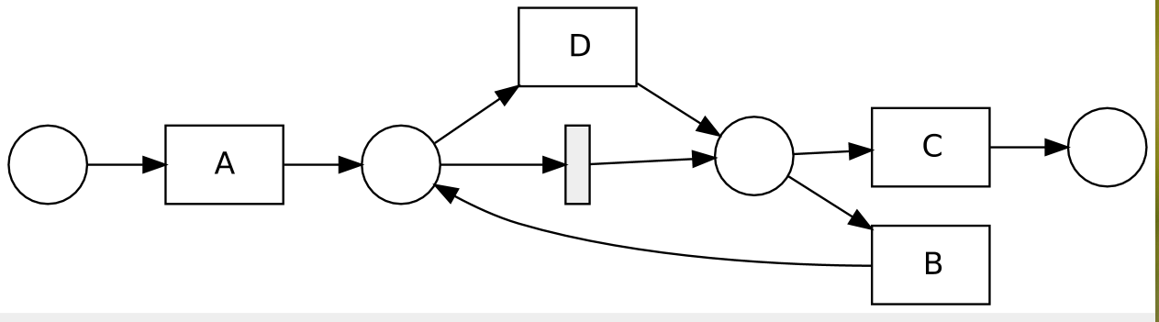
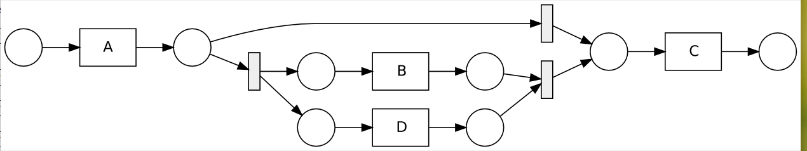
Simple Baseline Experiments – loop
Case 3.5.1: add events in the loop branch
Data: existing model M3.2
Pos: 50 <A,C>, 50 <A,B,D C>, 50<A,B,D,B,D,C>
IM: create model fit :: R3.11
RM: add parallel relation, less precision :: R3.12
Case 3.5.2: add events in parallel relation in the loop
Data: existing model M3.2
Pos: 50 <A,C>, 50 <A,B,D C>, 50<A,B,D,B,D,C>,
50 <A,D,B,C>, 50<A,D,B,D,B,C>
IM: create model without consideration of frequncy :: R3.13
RM: add parallel relation :: R3.12
Fig M3.2
Fig R3.11
Fig R3.12
Fig R3.13

Slide 22
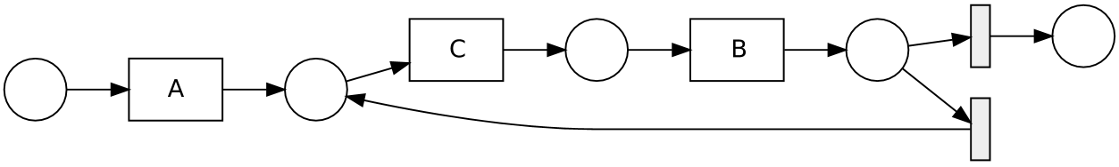
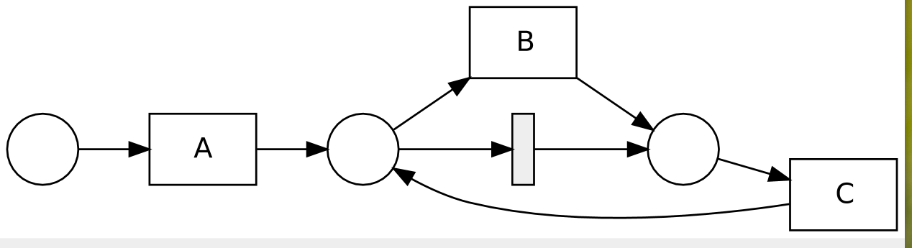
Simple Baseline Experiments – loop
Case 3.6: modify order in a loop
Data: existing model :: M3.3
pos: 50 <A,C,B>, 50 <A,C,B,C,B>
neg: 50 <A,B,C> 50<A,B,C,B,C>
IM: create new model fits :: R3.19
RM: no change on model :: R3.20
Fig M3.3
Fig R3.19
Fig R3.20

Slide 23
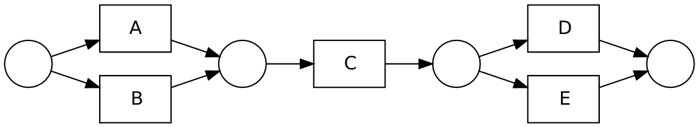
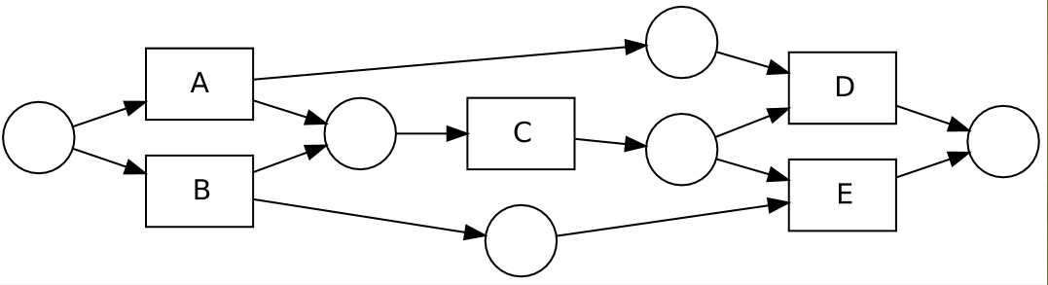
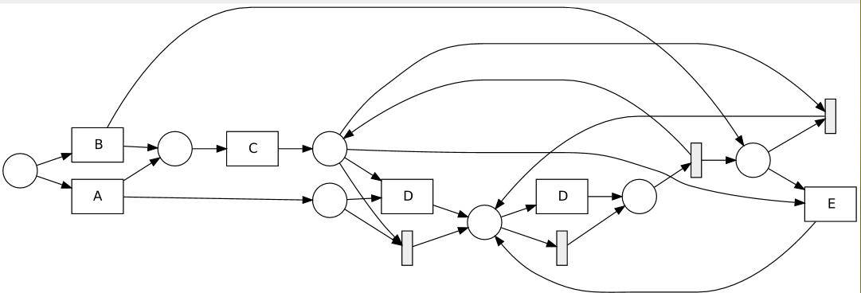
Simple Baseline Experiments – global dependency
Case 4.1: add global dependency to model
Data: existing model M4.1
Pos: 50<A,C,D> 50 <B,C,E>,
Neg: 50<A,C,E> 50<B,C,D>
IM: couldn’t see the global dependency :: M4.1
RM: couldn’t see the global dependency :: M4.1
Case 4.2: change structure of global dependency
Data: existing model M4.2
Pos: 50<A,C,E> 50 <B,C,D>,
Neg: 50<A,C,D> 50<B,C,E>
IM: couldn’t see the global dependency ::M4.1
RM: couldn’t see the global dependency :: M4.1
Case 4.3: delete global dependency
Data: existing model M4.2
Pos: 50<A,C,E> 50 <B,C,D>, 50<A,C,D> 50<B,C,E>
IM: couldn’t see the global dependency ::M4.1
RM: couldn’t see the global dependency :: R4.1
Fig M4.1
Fig M4.2
Fig R4.1

Slide 24
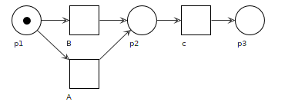
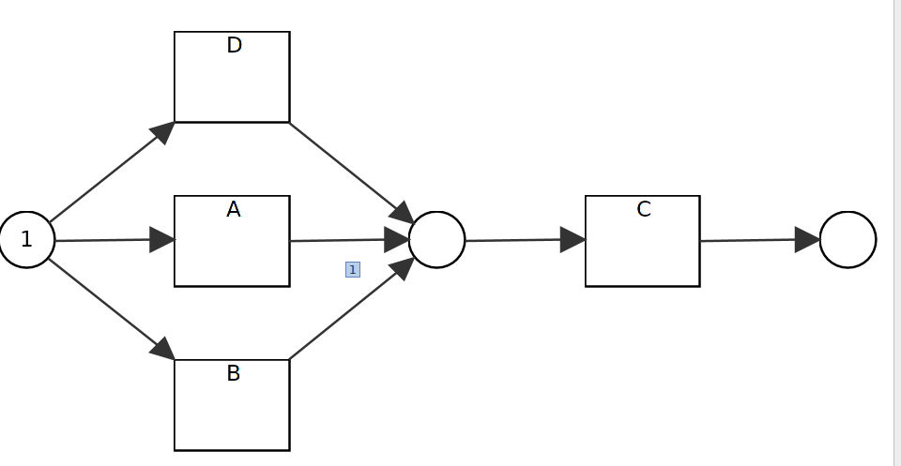
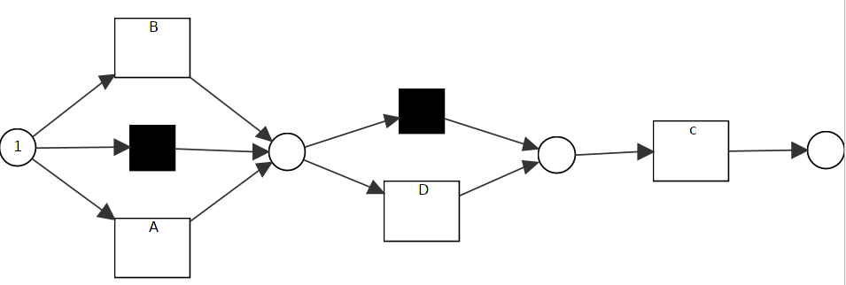
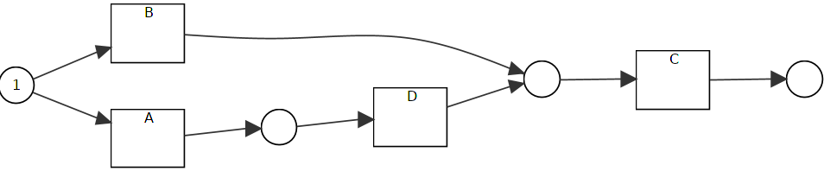
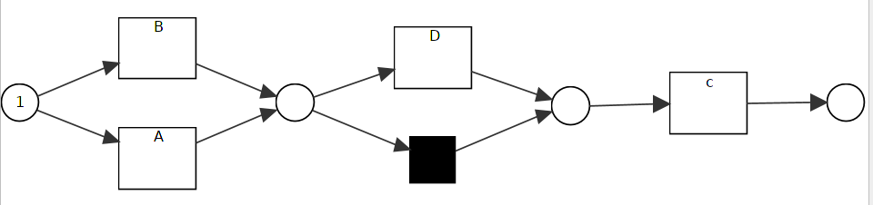
Simple Baseline Experiments – exclusive or
Case 5.1: add events in exclusive or relation
Data: 50<A,C> 50<B,C>, 50<D,C>
IM: create new fit model :: R5.3
RM: add new transition with silent transitions, less precision :: R5.4
Case 5.2: add events on one branch
Data: pos: 50<A,D,C> 50<B,C> neg: 50<A,C>
IM: create new fit model ::R5.7
RM: add silent transitions to skip event, but less precision :: R5.8
Fig M5
Fig R5.3
Fig R5.4
Fig R5.7
Fig R5.8

Slide 25
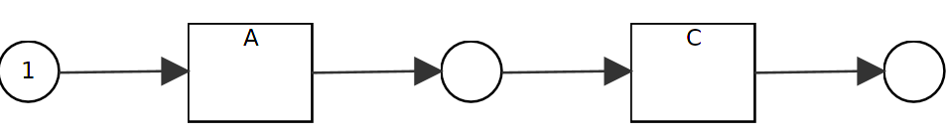


Simple Baseline Experiments – xor
Case 5.3: delete events from xor relation
Data: pos: 50<A,C> neg: 50<B,C>
IM: create new fit model :: R5.9
RM: add silent transitions to skip event :: R5.9
Case 5.4: add while deleting events
Data: pos: 50<A,C>, 50<D,C>, neg: 50<B,C>
IM: create new fit model :: R5.11
RM: add silent transitions to skip event, but less precision :: R5.12
Fig M5
Fig R5.9
Fig R5.11
Fig R5.12

Slide 26



Simple Baseline Experiments – xor
Case 5.5: change xor to sequence
Data: pos: 50<A,B,C> neg: 50<A,C>, 50<B,C>
IM: create new fit model :: R5.13
RM: add loop to carry out sequence :: R5.14
Case 5.6: change xor to parallel
Data: pos: 50<A,B,C> 50<B,A,C> neg: 50<A,C>, 50<B,C>
IM: create new fit model :: R5.15
RM: add loop to change parallel :: R5.14
Fig M5
Fig R5.13
Fig R5.14
Fig R5.15

Slide 27
Result Analysis – Inductive Miner
Performance side for non-overlap data:
True Positive: ==expected number
True Negative: == expected number
!=expected number in cases
C1.2.1: Add events to sequence, single event at one position ,
C1.2.2: Add events to sequence, multiple event at one position
C2.2.2: Add events to parallel at different positions, before, middle and end
while giving original parallel relation
C2.2.3:Add events to parallel at different positions, before, middle and end
while giving sequence
C4.1: add global dependency to model
C4.2: change global dependency structure
False Positive: >0 in the above listed cases
False Negative: ==0
==> good recall and fitness, and usually good precision
Performance with overlapped data
positive: good recall, fitness, but less precision
Positive complement: good recall, fitness, but less precision

Slide 28
Result Analysis – Repair Model
Performance side for non-overlap data:
True Positive: ==expected number
True Negative: ==0, !=0 expected with special cases,
C1.1: Delete events from sequence
C1.3: Add while deleting events to sequence
C1.5: Change sequence order
C2.1: Delete events from parallel
C2.2.5: Add events while deleting events in parallel relation
C2.4: Change parallel to sequence
C3.4.1: delete loop
C3.4.2: delete events at end in 2-length loop
C3.4.3: delete events in the middle in 2-length loop
C5.2: Add events to one branch of xor
C5.3: Delete events from xor
False Positive: !=0 usually, ==0 only in above listed cases
False Negative: ==0
==> good recall and fitness, but bad precision
Performance with overlapped data
positive: good recall, fitness, but less precision
Positive complement: good recall, fitness, but less precision

Slide 29
Result Analysis Summary
Inductive miner as rediscovery has good recall [fitness] , better precision than repair model technique. But in some cases, it generates a model which is much different with existing ones. [but only users can decide if the new generated model is needed or not.]
Repair model has also good recall [fitness], but mostly less precision by adding loop, subprocesses and silent transitions. In some cases, it can’t see the global changes in the model and change some branches in a local but complex way to create fit model.
For some relation, like global dependency, both inductive miner and repair model techniques fail to discover it.
With overlapped data, they have less precision, can’t see the distribution of overlapped data
With noise in data, repair model is more sensible with noise than inductive miner
Without considering negative information, the generated model from both techniques tends to have less precision.

Slide 30

Baseline Experiments with Complex Model
Case 1:
Data: 1500 traces, 0.7:0.3 pos: neg, no overlap
Inductive Miner:
783 275
338 104
Recall: 0.74
Precision: 0.70
Accuracy:0.59
F1-score: 0.72
Repair Model
Case 2:

Slide 31
Plugin Development
Assign Label
Assign Controlled Label based on Variant
Assign Label on Specific Variant
** Extract Data with Positive Label / Positive Complement
Create Base Model
Traces With Positive Label
Traces From Complement Of Positive and Negative Set
Generate Confusion Matrix

Slide 32

Assign Controlled Labels to Log

Slide 33

Assign Labels to Specific Variant in Log

Slide 34


Slide 35
Questions & Answers

