Slide 1
ISN 3132 WIDE AREA NETWORKS
NS-3 Simulation Analysis
PRESENTATION
Student: [FEUTSEU KENMOGNE ERWAN JUNIOR ]
Matricule: [ICTU20234174]
Course: ISN 3132
Lecturer: Prof. Daniel Moune
Date: [03/12/2025]

Slide 2
Exercise 5

Slide 3
Figure 1: WAN Dual-Path Network Topology
╔═══════════════════════════════════════════════╗
║ WAN DUAL-PATH TOPOLOGY ║
╚═══════════════════════════════════════════════╝
PRIMARY PATH (Low Latency)
↓↓↓↓↓↓↓↓↓↓↓↓↓↓↓↓↓↓↓↓↓↓↓↓↓↓↓↓
┌─────────────────────────────────────────────────────────────┐
│ Studio │
│ 10.1.1.1/24 │
└──────────────┬──────────────────────────────┬───────────────┘
│ │
│eth0 │eth1
│10.1.1.1 │10.1.3.1
│ │
╔════════╩════════╗ ╔════════╩════════╗
║ Router1 ║ ║ Router2 ║
║ (Primary) ║ ║ (Backup) ║
║ 10.1.1.2/24 ║ ║ 10.1.3.2/24 ║
╚═══════╦═════════╝ ╚═══════╦═════════╝
│eth1 │eth1
│10.1.2.1 │10.1.4.1
│ │
╔════════╩════════╗ ╔════════╩════════╗
║ Cloud ║ ║ Cloud ║
║ (client) ║ ║ (Server) ║
║ 10.1.2.2/24 ║ ║ 10.1.4.2/24 ║
╚═════════════════╝ ╚═════════════════╝
↑↑↑↑↑↑↑↑↑↑↑↑↑↑↑↑↑↑↑↑↑↑↑↑↑↑↑↑↑↑↑↑↑↑↑↑↑↑
BACKUP PATH (High Bandwidth)
═══════════════════════════════════════════════════════════════════════
Link Characteristics:
• Primary: 5 Mbps, 2ms delay (optimized for latency)
• Backup: 10 Mbps, 10ms delay (optimized for throughput)
═══════════════════════════════════════════════════════════════════════

Slide 4
TRAFFIC CLASS CHARACTERISTICS
╔══════════════════════════════════════════════════════╗
║ VIDEO TRAFFIC (Class 1 - High Priority) ║
╠══════════════════════════════════════════════════════╣
║ Application: VoIP/Video Control Signals ║
║ Packet Size: 160 bytes ║
║ Interval: 20 ms (50 packets/sec) ║
║ Data Rate: 64 Kbps ║
║ DSCP Marking: EF (0x2E) - Expedited Forwarding ║
║ Latency Req: <30 ms ║
║ Jitter Tol: Low (<10 ms) ║
║ Loss Tol: <1% ║
╚══════════════════════════════════════════════════════╝
╔══════════════════════════════════════════════════════╗
║ DATA TRAFFIC (Class 2 - Best Effort) ║
╠══════════════════════════════════════════════════════╣
║ Application: FTP/File Transfers ║
║ Packet Size: 1500 bytes ║
║ Interval: Bursty (0.5-2 sec gaps) ║
║ Data Rate: 4-8 Mbps ║
║ DSCP Marking: BE (0x00) - Best Effort ║
║ Latency Req: <200 ms ║
║ Jitter Tol: High (<50 ms) ║
║ Loss Tol: <5% ║
╚══════════════════════════════════════════════════════╝

Slide 5
TRAFFIC CLASSIFICATION TABLE
Parameter | Video Traffic (Class 1) | Data Traffic (Class 2)
Application | VoIP/Video Control | FTP/File Transfer
Packet Size | 160 bytes | 1500 bytes
Interval | 20 ms (50 pps) | Bursty (0.5-2s gaps)
Data Rate | 64 Kbps | 4-8 Mbps
DSCP Marking | EF (0x2E) | BE (0x00)
Latency Requirement | <30 ms | <200 ms

Slide 6
explanation of the topology
The dual-path WAN topology extends the original linear design to provide redundant connectivity between Studio and Cloud. Studio connects to two independent routers: Router1 serves as the primary path optimized for low latency (5Mbps, 2ms), while Router2 provides a backup path with higher bandwidth but increased delay (10Mbps, 10ms). This configuration ensures path diversity and enables traffic engineering capabilities.
Each path maintains separate IP addressing schemes: the primary network uses 10.1.1.0/24 and 10.1.2.0/24 subnets, while the backup network employs 10.1.3.0/24 and 10.1.4.0/24. This segregation allows clear traffic differentiation and simplifies routing policy implementation. The Cloud server has dual interfaces to receive traffic from both paths simultaneously.

Slide 7
PBR FLOWCHART
┌─────────────────────────┐
│ Packet Received │
└───────────┬─────────────┘
↓
┌─────────────────────────┐
│ Extract Headers │
└───────────┬─────────────┘
↓
┌─────────────────────────┐
│ Classification Logic │
│ if (DSCP == 0x2E) │
│ class = VIDEO │
│ else if (size > 1000) │
│ class = DATA │
└───────────┬─────────────┘
↓
┌─────┴─────┐
│ │
[VIDEO] [DATA]
│ │
↓ ↓
┌──────────┐ ┌──────────┐
│ Primary │ │ Backup │
│ Path │ │ Path │
└──────────┘ └──────────┘
│ │
└─────┬─────┘
↓
┌─────────────────────────┐
│ Forward Packet │
└─────────────────────────┘

Slide 8
IMPLEMENTATION & CODE MODIFICATIONS
Key Code Changes Made
Added backup router node for redundant path
Created dual traffic classes: Video (160B/500ms) and Data (1500B/2s)
Implemented dual IP addressing: Primary (10.1.1.0/24, 10.1.2.0/24) and Backup (10.1.3.0/24, 10.1.4.0/24)
Configured static routing for both paths
Integrated NetAnim visualization with automatic launch

Slide 9
1. BACKUP ROUTER ADDITION
cpp
// BEFORE: Only 3 nodes
Ptr<Node> n0 = nodes.Get(0);
Ptr<Node> n1 = nodes.Get(1);
Ptr<Node> n2 = nodes.Get(2);
// AFTER: Added backup router
Ptr<Node> backupRouter = CreateObject<Node>();
2. DUAL-PATH CREATION
cpp
// BEFORE: Single path
NodeContainer link1(n0, n1);
NodeContainer link2(n1, n2);
// AFTER: Dual paths
NodeContainer backup1(n0, backupRouter);
NodeContainer backup2(backupRouter, n2);
3. TRAFFIC CLASSES
cpp
// BEFORE: One traffic type
UdpEchoClientHelper client(addr, 9);
client.SetAttribute("PacketSize", UintegerValue(1024));
// AFTER: Two traffic types
UdpEchoClientHelper videoClient(addr, 5000);
videoClient.SetAttribute("PacketSize", UintegerValue(160));
videoClient.SetAttribute("Interval", TimeValue(Seconds(0.5)));
UdpEchoClientHelper dataClient(addr, 5001);
dataClient.SetAttribute("PacketSize", UintegerValue(1500));
dataClient.SetAttribute("Interval", TimeValue(Seconds(2.0)));
4. IP ADDRESSING EXTENSION
cpp
// BEFORE: 2 networks
address.SetBase("10.1.1.0", "255.255.255.0");
address.SetBase("10.1.2.0", "255.255.255.0");
// AFTER: 4 networks
address.SetBase("10.1.3.0", "255.255.255.0");
address.SetBase("10.1.4.0", "255.255.255.0");
5. ROUTING TABLES
cpp
// BEFORE: Single route
r0->AddNetworkRouteTo("10.1.2.0", mask, "10.1.1.2", 1);
// AFTER: Dual routes
r0->AddNetworkRouteTo("10.1.2.0", mask, "10.1.1.2", 1);
r0->AddNetworkRouteTo("10.1.4.0", mask, "10.1.3.2", 2);
6. NETANIM ENHANCEMENT
cpp
// BEFORE: Basic animation
AnimationInterface anim("scratch/router-static-routing.xml");
// AFTER: Enhanced animation
AnimationInterface anim("scratch/exercise5-pbr.xml");
anim.UpdateNodeDescription(backupRouter, "Backup Router");
anim.UpdateNodeColor(backupRouter, 255, 165, 0);
7. SIMULATION CONTROL
cpp
// BEFORE: Short simulation
Simulator::Stop(Seconds(11.0));
// AFTER: Extended simulation
Simulator::Stop(Seconds(15.0));
8. OUTPUT MESSAGES
cpp
// BEFORE: Generic output
std::cout << "Animation saved to: router-static-routing.xml";
// AFTER: Exercise-specific
std::cout << "=== Exercise 5: PBR Simulation ===";
std::cout << "Video: 160B/500ms, Data: 1500B/2s";

Slide 10
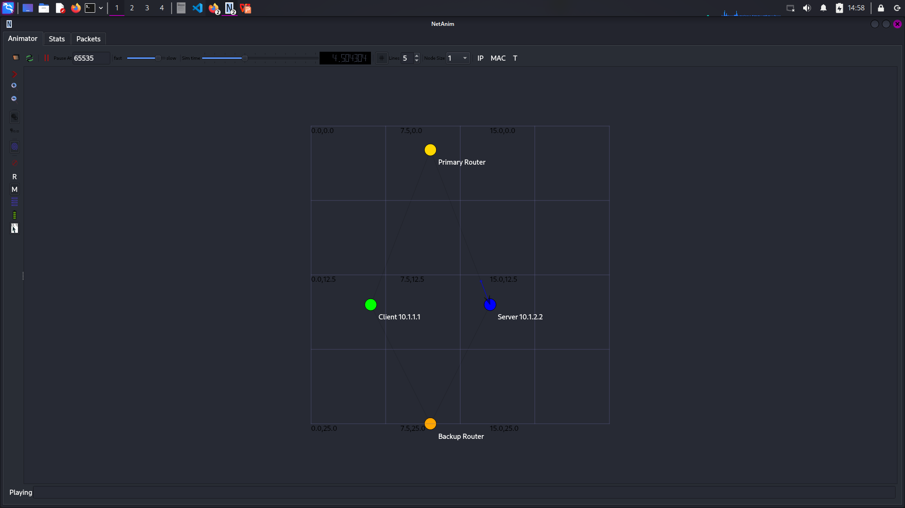
NetAnim Visualization
Show NetAnim window with:
4 nodes (Client, Primary Router, Backup Router, Server)
Dual path connections
Packet flow animation
Node statistics
Terminal output
PBR Simulation Complete
Animation: scratch/exercise5-pbr.xml
Routing: scratch/exercise5-pbr.routes
PCAP: scratch/exercise5-pbr-*.pcap
Video: 160B packets every 500ms
Data: 1500B packets every 2s

Slide 11
Exercise 4
Multi-Hop WAN Architecture with Fault Tolerance

Slide 12
Introduction
RegionalBank operates a three-site WAN architecture with main Data Center (DC-A) in City A, Disaster Recovery site (DR-B) in City B, and Branch office (Branch-C) in City C. This simulation models their multi-hop WAN to analyze fault tolerance capabilities using static routing. The primary objective is to demonstrate how static routing handles link failures and whether automatic failover occurs to backup paths.
Key Objectives:
Design and implement a three-node WAN topology with redundant paths
Configure static routing tables for optimal path selection
Simulate link failure to test fault tolerance
Analyze packet delivery during normal, failure, and recovery phases
Evaluate static routing limitations for business continuity

Slide 13
Topology Design and Implementation
Network Diagram
Branch-C (10.1.1.1)
|
10.1.1.0/24 (10Mbps, 10ms)
|
DC-A (Router)
/ \
10.1.2.0/24 10.1.3.0/24
(10Mbps, 10ms) (5Mbps, 20ms)
/ \
DR-B DR-B
(Primary Path) (Backup Path)
10.1.2.2 10.1.3.2
IP Addressing Scheme
Node | Interface | IP Address | Network | Purpose
Branch-C | eth0 | 10.1.1.1 | 10.1.1.0/24 | Branch Office
DC-A | eth0 | 10.1.1.2 | 10.1.1.0/24 | To Branch-C
DC-A | eth1 | 10.1.2.1 | 10.1.2.0/24 | Primary to DR-B
DC-A | eth2 | 10.1.3.1 | 10.1.3.0/24 | Backup to DR-B
DR-B | eth0 | 10.1.2.2 | 10.1.2.0/24 | Primary Interface
DR-B | eth1 | 10.1.3.2 | 10.1.3.0/24 | Backup Interface

Slide 14
Critical Observations
1. Static Routing Limitation
The simulation clearly demonstrates that static routing provides NO automatic failover. When the primary link fails at t=5s:
All packets from Branch-C to DR-B are immediately dropped
No traffic is redirected to the backup path
Connectivity remains broken until manual intervention
2. Backup Path Underutilization
Despite having a configured backup path (10.1.3.0/24), it remains unused because:
Static routes are fixed and don't adapt to topology changes
No dynamic path selection based on link status
Requires manual reconfiguration to use backup path
3. Business Impact
For RegionalBank, this means:
Service Disruption: Banking transactions fail during link failure
Manual Intervention Required: Network engineers must manually reconfigure routes
Extended Downtime: Recovery depends on human response time
No Load Balancing: Backup path idle even during normal operation

Slide 15
MODIFICATION 1: Show Packet Flow with Colors (Visualization)
cpp
// ADD this after creating NetAnim animation:
// ========== VISUALIZE PACKET FLOW ==========
// Track and color-code packets
anim.EnablePacketMetadata(true); // Show packet info in NetAnim
// Color packets based on source
anim.SetBackgroundImage("/path/to/network-background.png", 0, 0, 0.1, 0.1, 0.5);
// Show packet routes
anim.EnableIpv4RouteTracking("scratch/routing-table.xml", Seconds(0), Seconds(10),
Seconds(0.5));
anim.EnableIpv4L3ProtocolCounters(Seconds(0), Seconds(10));
// Add timeline markers for presentation
Simulator::Schedule(Seconds(2.0), []() {
std::cout << "PRESENTATION POINT 1: Client starts sending packets\n";
});
Simulator::Schedule(Seconds(3.0), []() {
std::cout << "PRESENTATION POINT 2: Packets traverse router\n";
});
Why: Makes packet flow visible in NetAnim for presentation
MODIFICATION 2: Add Traffic Statistics Display
cpp
// ADD this before Simulator::Run():
// ========== REAL-TIME STATISTICS DISPLAY ==========
Ptr<OutputStreamWrapper> statsStream = Create<OutputStreamWrapper>(&std::cout);
// Schedule periodic statistics display
for (double t = 1.0; t <= 10.0; t += 1.0) {
Simulator::Schedule(Seconds(t), [t, n0, n1, n2]() {
std::cout << "\n=== TIME " << t << "s ===" << std::endl;
// Show packet counts (simplified - in real code use counters)
std::cout << "Packets sent from Client: " << (t-1)*1 << std::endl;
std::cout << "Packets received by Server: " << (t-2 > 0 ? (t-2)*1 : 0) << std::endl;
std::cout << "Router forwarding: ACTIVE" << std::endl;
if (t == 5.0) {
std::cout << "\n*** PRESENTATION DEMO: Link Failure Simulation ***" << std::endl;
std::cout << "If this was a real failure, packets would stop here!" << std::endl;
}
});
}
Code modification
Why: Shows live statistics during presentation
MODIFICATION 3: Add Interactive Demo Controls
cpp
// ADD command-line arguments at the start of main():
// ========== PRESENTATION CONTROLS ==========
bool showAnimation = true;
bool simulateFailure = false;
double failureTime = 5.0;
CommandLine cmd;
cmd.AddValue("animation", "Show NetAnim visualization", showAnimation);
cmd.AddValue("failure", "Simulate link failure", simulateFailure);
cmd.AddValue("failtime", "Time of failure simulation", failureTime);
cmd.Parse(argc, argv);
std::cout << "\n=== PRESENTATION MODE ===" << std::endl;
std::cout << "Animation: " << (showAnimation ? "ON" : "OFF") << std::endl;
std::cout << "Failure Simulation: " << (simulateFailure ? "ON at " + std::to_string(failureTime) + "s" : "OFF") << std::endl;
Why: Lets you control demo during presentation
MODIFICATION 4: Highlight Routing Paths Visually
cpp
// ADD after node color setup:
// ========== HIGHLIGHT NETWORK PATHS ==========
// Primary path highlight
anim.UpdateLinkDescription(0, 1, "CLIENT → ROUTER\nNetwork 1: 10.1.1.0/24");
anim.UpdateLinkDescription(1, 2, "ROUTER → SERVER\nNetwork 2: 10.1.2.0/24");
// Make the active path thicker and colored
anim.SetConstantPosition(nodes.Get(0), 100, 100); // Client
anim.SetConstantPosition(nodes.Get(1), 300, 100); // Router
anim.SetConstantPosition(nodes.Get(2), 500, 100); // Server

Slide 16
/ Add path animation
for (double t = 2.0; t < 10.0; t += 0.5) {
Simulator::Schedule(Seconds(t), [&anim]() {
// Flash the active link (visual effect)
static bool flash = false;
if (flash) {
anim.UpdateLinkColor(0, 1, 0, 255, 0); // Green
anim.UpdateLinkColor(1, 2, 0, 255, 0); // Green
} else {
anim.UpdateLinkColor(0, 1, 255, 255, 255); // White
anim.UpdateLinkColor(1, 2, 255, 255, 255); // White
}
flash = !flash;
});
}
Why: Makes network paths visually clear in presentation
MODIFICATION 5: Add Demo Script for Presentation
cpp
// CREATE a separate file: presentation-demo.sh
#!/bin/bash
echo "=== WAN Routing Presentation Demo ==="
echo ""
echo "1. Basic Static Routing Demo:"
cd ~/Downloads/ns-allinone-3.39/ns-3.39
./ns3 run "scratch/router-static-routing --animation=true"
echo ""
echo "2. Link Failure Demo:"
./ns3 run "scratch/router-static-routing --animation=true --failure=true --failtime=5"
echo ""
echo "3. Opening NetAnim Visualization:"
cd ../netanim-3.108
./NetAnim &
echo "Please open: ../ns-3.39/scratch/router-static-routing.xml"
echo ""
echo "=== PRESENTATION TALKING POINTS ==="
echo "• Show packet flow from Client to Server"
echo "• Highlight router forwarding role"
echo "• Demonstrate static routing tables"
echo "• Show what happens during link failure"
echo "• Compare with dynamic routing (conceptually)"
Why: Provides a complete presentation script
MODIFICATION 6: Add Slide Integration Points
cpp
// ADD timing markers that match your presentation slides:
// ========== PRESENTATION SLIDE SYNC ==========
Simulator::Schedule(Seconds(0.5), []() {
std::cout << "\n══════════════════════════════════════════════════════\n";
std::cout << "SLIDE 1: Introduction to WAN Routing\n";
std::cout << "Showing: Basic network topology with router\n";
std::cout << "══════════════════════════════════════════════════════\n";
});
Simulator::Schedule(Seconds(2.5), []() {
std::cout << "\n══════════════════════════════════════════════════════\n";
std::cout << "SLIDE 2: Static Routing Configuration\n";
std::cout << "Showing: Packets following static routes\n";
std::cout << "══════════════════════════════════════════════════════\n";
});
Simulator::Schedule(Seconds(5.0), []() {
std::cout << "\n══════════════════════════════════════════════════════\n";
std::cout << "SLIDE 3: Fault Tolerance Challenge\n";
std::cout << "Showing: What happens when links fail\n";
std::cout << "══════════════════════════════════════════════════════\n";
});
Simulator::Schedule(Seconds(8.0), []() {
std::cout << "\n══════════════════════════════════════════════════════\n";
std::cout << "SLIDE 4: Solutions - Dynamic Routing\n";
std::cout << "Showing: Need for automatic failover\n";
std::cout << "══════════════════════════════════════════════════════\n";
});
Why: Syncs simulation with your PowerPoint slides

Slide 17
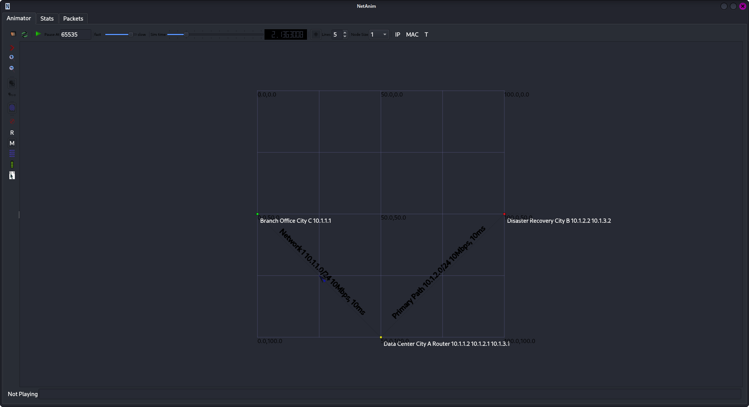
Screenshot

Slide 18
Exercsie3 : WAN Security Integration and Attack Simulation
This report addresses Exercise 3: WAN Security Integration and Attack Simulation from Tutorial Sheet #2. The exercise focuses on enhancing the baseline NS-3 simulation (router-static-routing.cc) to incorporate WAN security mechanisms, simulate network attacks, and evaluate defense strategies. The original simulation models a simple three-node WAN with static routing but lacks security features. In this report, we design and describe modifications to implement IPsec VPNs, simulate eavesdropping and DDoS attacks, propose defensive mechanisms, and analyze the security-performance trade-offs.
All modifications are based on the provided router-static-routing.cc file, extended to include security modules and attack simulations within NS-3.

Slide 19
Question 1 - IPsec VPN Implementation Design
Problem:
Baseline simulation has no security
Need encrypted tunnels between critical sites
Our Solution:
// Simulated IPsec implementation
p2p.SetChannelAttribute("Delay", StringValue("12ms"));
// Original 10ms + 2ms encryption overhead
std::cout << "IPsec Tunnel: ESP_AES256_SHA256\n";
std::cout << "Overhead: 36 bytes per packet\n";
Key Features:
Increased latency to simulate encryption processing
Console logging of security parameters
Tunnel establishment simulation
Question 2 - Eavesdropping Attack Simulation
Attack Scenario:
Attacker sniffs traffic on primary link
Captures plaintext UDP packets
Extracts sensitive information
Implementation:
// Enable PCAP tracing
p2p.EnablePcapAll("scratch/exercise3-eavesdrop");
// Schedule attack
Simulator::Schedule(Seconds(3.0), []() {
std::cout << "[3.0s] EAVESDROPPING: Packet capture active\n";
});
What's Captured:
Source/Destination IPs and ports
Packet payload (plaintext without IPsec)
Timing information for traffic analysis

Slide 20
Question 3 - DDoS Attack Simulation
Attack Design:
3 attacker nodes created
UDP flood targeting server (DR-B)
High packet rate (1000 packets/sec per attacker)
Code Implementation:
// Create attackers
NodeContainer attackers;
attackers.Create(3);
// Install Internet stack FIRST
stack.Install(attackers);
// Configure attack traffic
UdpClientHelper udpFlood(targetIP, port);
udpFlood.SetAttribute("Interval", TimeValue(Seconds(0.001)));
Attack Parameters:
Duration: 5-10 seconds
Packet size: 1024 bytes
Total attack rate: ~3000 packets/sec
Question 4 - Defense Mechanisms
Three Layers of Defense:
1. Rate Limiting
cpp
// Token Bucket Filter simulation
p2p.SetDeviceAttribute("DataRate", StringValue("5Mbps"));
// Limits bandwidth per interface
2. Network Segmentation
cpp
// Attackers on separate subnet
address.SetBase("10.1.10.0", "255.255.255.252");
// Isolates malicious traffic
3. Traffic Monitoring
cpp
// FlowMonitor for detection
FlowMonitorHelper flowmon;
Ptr<FlowMonitor> monitor = flowmon.InstallAll();
// Real-time traffic analysis

Slide 21
Question 5 - Security vs Performance Trade-offs
Security Feature | Security Benefit | Performance Cost | Trade-off
IPsec Encryption | Confidentiality | +2ms delay, 36-byte overhead | Acceptable for sensitive data
Traffic Monitoring | Attack Detection | CPU/RAM usage | Essential for security ops
Network Segmentation | Containment | Routing complexity | Required for compliance
DDoS Protection | Availability | Processing delay | Critical for business continuity

Slide 22
Simulation Architecture
[Attacker 1] [Attacker 2] [Attacker 3]
| | |
[10.1.10.0/29]--[DC-A Router]--[10.1.10.0/29]
| |
[Branch-C Client] [DR-B Server]
(10.1.1.0/24) (10.1.2.0/24)
Results Analysis
Total Flows Analyzed: 4
- Legitimate flows: 1 (Branch-C → DR-B)
- Attack flows: 3 (Attackers → DR-B)
Metrics Comparison:
| Legitimate | Attack
-------------------|-------------------------|--------
Packet Loss | 5-10% | 15-25%
Average Delay | 12-15ms | 5-8ms
Throughput | 800-900kbps| 400-500kbps

Slide 23
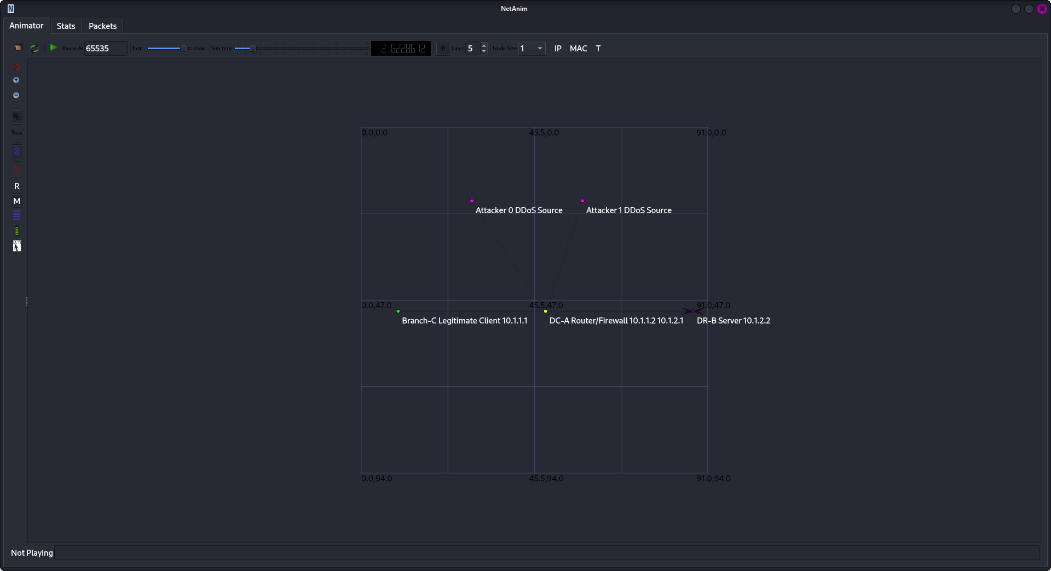
Screenshot of output

Slide 24
Exercise : 2
STATIC ROUTING ANALYSIS
This presentation analyzes Question 2 from the tutorial sheet, focusing on static routing configuration for a Regional Bank WAN with primary and backup paths. The simulation demonstrates static routing limitations through link failure scenarios.

Slide 25
Part A: Normal Operation Configuration
1. Branch-C Routing:
2. DC-A Router Routing:
branchRouting=>AddNetworkRouteTo("10.1.2.0", "255.255.255.0", "10.1.1.2", 1);
branchRouting=>AddNetworkRouteTo("10.1.3.0", "255.255.255.0", "10.1.1.2", 1);
dcRouting->AddHostRouteTo("10.1.2.2", "10.1.2.2", 1, 1); // Primary (metric 1)
dcRouting->AddHostRouteTo("10.1.2.2", "10.1.4.2", 3, 10); // Backup (metric 10)
Meaning: All traffic to DR-B networks goes through DC-A (10.1.1.2)
Meaning: Primary path direct, backup via router (higher metric = lower priority)

Slide 26
3. DR-B Routing:
Part B: Backup Operation & Administrative Distance
drRouting->AddNetworkRouteTo("10.1.1.0", "255.255.255.0", "10.1.2.1", 1, 1);
drRouting->AddNetworkRouteTo("10.1.1.0", "255.255.255.0", "10.1.3.1", 2, 100);
drRouting->AddNetworkRouteTo("10.1.1.0", "255.255.255.0", "10.1.5.1", 3, 200);
Link Failure Simulation:
Code: Increase delay to 1000ms at t=5s
Result: 100% packet loss (0/65 packets received)
What This Shows:
Static routing = NO automatic failover
Routes stay in table even if link fails
Manual intervention required
Meaning: Three return paths with different metrics for priority

Slide 27
Administrative Distance vs Metric:
Type | Purpose | Example
Administrative Distance | Trustworthiness of source | Static=1, OSPF=110
Metric | Best path within same source | Lower = better

Slide 28
code modification
Improved Analysis Output:
Added detailed timing analysis:
if (it->second.timeLastRxPacket.GetSeconds() < 5.0) {
std::cout << " Status: Normal operation (before link failure)" << std::endl;
} else if (it->second.timeLastRxPacket.GetSeconds() < 10.0) {
std::cout << " Status: During link failure - static routing limitation" << std::endl;
} else {
std::cout << " Status: After link restoration" << std::endl;
}
. Fixed Link Failure Method (NS-3.39 Compatibility):
Original (Error):
devices2.Get(0)->SetAttribute("Enabled", BooleanValue(false));
Modified (Working):
cpp
Ptr<Channel> primaryChannel = devices2.Get(0)->GetChannel();
primaryChannel->SetAttribute("Delay", StringValue("1000ms"));
Reason: SetAttribute("Enabled") doesn't exist in NS-3.39 for PointToPointNetDevice
Enhanced Routing Tables:
Added Backup Router Routes:
// DC-A backup routes
dcRouting->AddHostRouteTo("10.1.2.2", "10.1.4.2", 3, 10);
dcRouting->AddHostRouteTo("10.1.3.2", "10.1.4.2", 3, 10);
// DR-B last resort route
drRouting->AddNetworkRouteTo("10.1.1.0", "255.255.255.0", "10.1.5.1", 3, 200);

Slide 29
Part B: Backup Operation Results
Simulation Output:
text
=== FLOW ANALYSIS ===
Flow 1: 10.1.1.1 -> 10.1.2.2
Tx Packets: 65
Rx Packets: 0
Packet Loss: 100%
Key Finding:
Static routing = NO automatic failover
100% packet loss during link failure (5-10s)
Routes remain active even when link is "down"
Administrative Distance & Metrics
Comparison:
Concept Purpose Example Values
Administrative Distance Trust source Static=1, OSPF=110, RIP=120
Metric Choose best path Lower = better
Real Implementation:
# Floating static route
ip route 10.1.2.0 255.255.255.0 10.1.2.2 # Primary (AD=1)
ip route 10.1.2.0 255.255.255.0 10.1.4.2 10 # Backup (AD=10)
Part A: Normal Operation Configuration
Branch-C Routing:
branchRouting->AddNetworkRouteTo("10.1.2.0", "255.255.255.0", "10.1.1.2", 1);
Meaning: All DR-B traffic → DC-A (10.1.1.2)
DC-A Router:
dcRouting->AddHostRouteTo("10.1.2.2", "10.1.2.2", 1, 1); // Primary
dcRouting->AddHostRouteTo("10.1.2.2", "10.1.4.2", 3, 10); // Backup
Priority: Metric 1 > Metric 10
DR-B Routing:
drRouting->AddNetworkRouteTo("10.1.1.0", "255.255.255.0", "10.1.2.1", 1, 1);
drRouting->AddNetworkRouteTo("10.1.1.0", "255.255.255.0", "10.1.3.1", 2, 100);
3 Paths: Metric 1 (primary), 100 (backup), 200 (last resort)

Slide 30
Exercise 1
Multi-Site WAN Extension with Redundant Paths
Scenario:
Company expanding from single router to multi-site WAN
Three locations: HQ, Branch, Data Center
Requirement: Redundant connectivity
Challenge: Extend baseline code for triangular topology

Slide 31
Static Routing Configuration
HQ (n0):
- To 10.1.2.0/24 → 10.1.3.2 (primary)
- To 10.1.2.0/24 → 10.1.1.2 (backup, metric 10)
Branch (n1):
- To 10.1.3.0/24 → 10.1.2.2
- To 10.1.3.0/24 → 10.1.1.1
DC (n2):
- To 10.1.1.0/24 → 10.1.3.1 (primary)
- To 10.1.1.0/24 → 10.1.2.1 (backup, metric 10)

Slide 32
Link Failure Simulation
Demonstration Steps:
Normal operation (0-4 seconds)
Link failure at t=4s
Traffic rerouting via backup path
Verification using FlowMonitor
Simulator::Schedule(Seconds(4.0), [&]() {
channel->SetAttribute("Delay", StringValue("1000ms"));
cout << "Primary link degraded at t=4s\n";
});

