Slide 1
KFUPM CAMPUS SHADE NAVIGATION SYSTEM
CoolPath
Finding the coolest, most shaded path — not just the shortest
Prepared for: Osamah | April 2026 | KFUPM
Notes:
Welcome Osamah. CoolPath is a campus navigation tool built to find the most shaded walking route between KFUPM buildings — not just the shortest. This briefing covers the problem, what we built, Vision 2030 alignment, and how ARE data can take this further.

Slide 2
45°C+
5,088m
THE
PROBLEM
Peak summer temperature
on KFUPM campus
Exposed walkway distance
across campus network
🌡
Heat Stress
Extreme summer heat makes
campus walks a health hazard.
No existing tool routes for shade.
Students exposed to dangerous heat during peak hours (10am–3pm) with no routing guidance.
♿
No Accessibility Routing
No path finder considers ramps, shade, rest stops, or wheelchair-accessible corridors.
📊
No Planning Data
Facilities teams lack a heat-exposure priority map to guide shade infrastructure investment.
Notes:
The problem: peak temperatures exceed 45°C. Students walk between buildings daily. Existing tools route by shortest distance only — ignoring shade. This is a health issue, an accessibility gap, and a planning intelligence gap all in one.

Slide 3
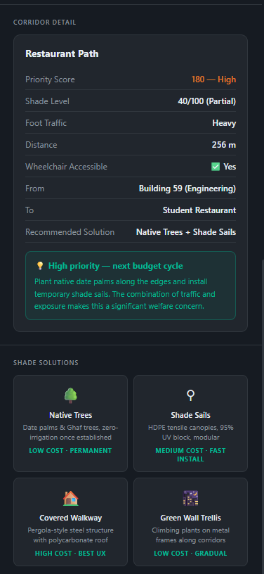
WHAT IS COOLPATH?
A Browser-Based Shade Navigation App
Shortest Route
Dijkstra's algorithm for fastest path
Coolest Route
Shade-weighted algorithm, comfort first
Accessible Route
Excludes inaccessible paths, step-free
Shade Plan Page
Infrastructure priority dashboard
Notes:
CoolPath runs entirely in the browser. Three routing modes plus a dedicated shade planning page for facilities teams. No installation needed.

Slide 4
THE ALGORITHM
How the Coolest Route is Calculated
Coolest Weight = distance × ( 1 + 2.5 × (100 − shadeScore) / 100 )
Fully Shaded
Partially Shaded
Fully Exposed
shadeScore = 100
shadeScore = 60
shadeScore = 0
× 1.0 effective cost
× 2.0 effective cost
× 3.5 effective cost
Coolest Route
Shortest Route
Prefers shaded corridors even if slightly longer in metres. Minimises heat exposure. Best for 10am–3pm peak hours.
Ignores shade entirely. Minimises physical distance only. May route through fully exposed corridors at dangerous times.
Notes:
A fully exposed path costs 3.5x its physical distance in the algorithm. A fully shaded path costs 1x. The algorithm naturally finds routes that are slightly longer in metres but far more comfortable.

Slide 5
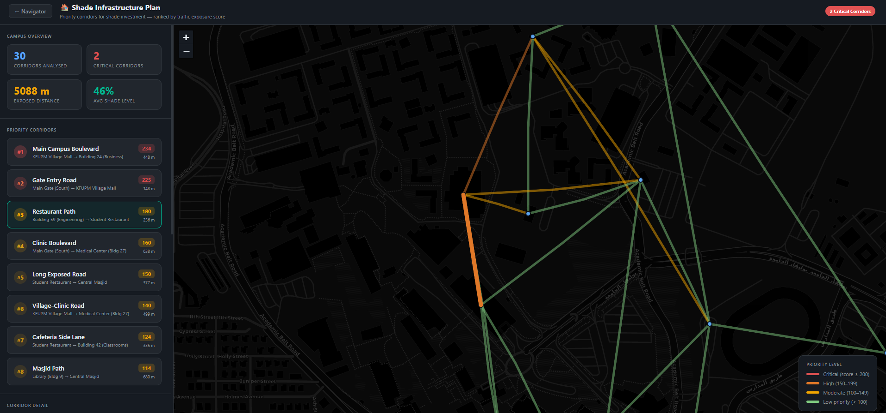
LIVE DEMO
Navigator in Action: Building 76 to Student Restaurant
Route Card Stats
715m total · 56% shade
9 min walk time · comfort score
3 Map Tile Modes
Street · Satellite · Campus
Switch live during routing
Overlay Layers
Heatmap · Crowd density
Toggle shade corridors
Notes:
Live demo: Building 76 to Student Restaurant. 715m, 56% shade, 9 minutes. Route card shows all key stats. Three map tile modes and overlay layers for heatmap and crowd density.

Slide 6
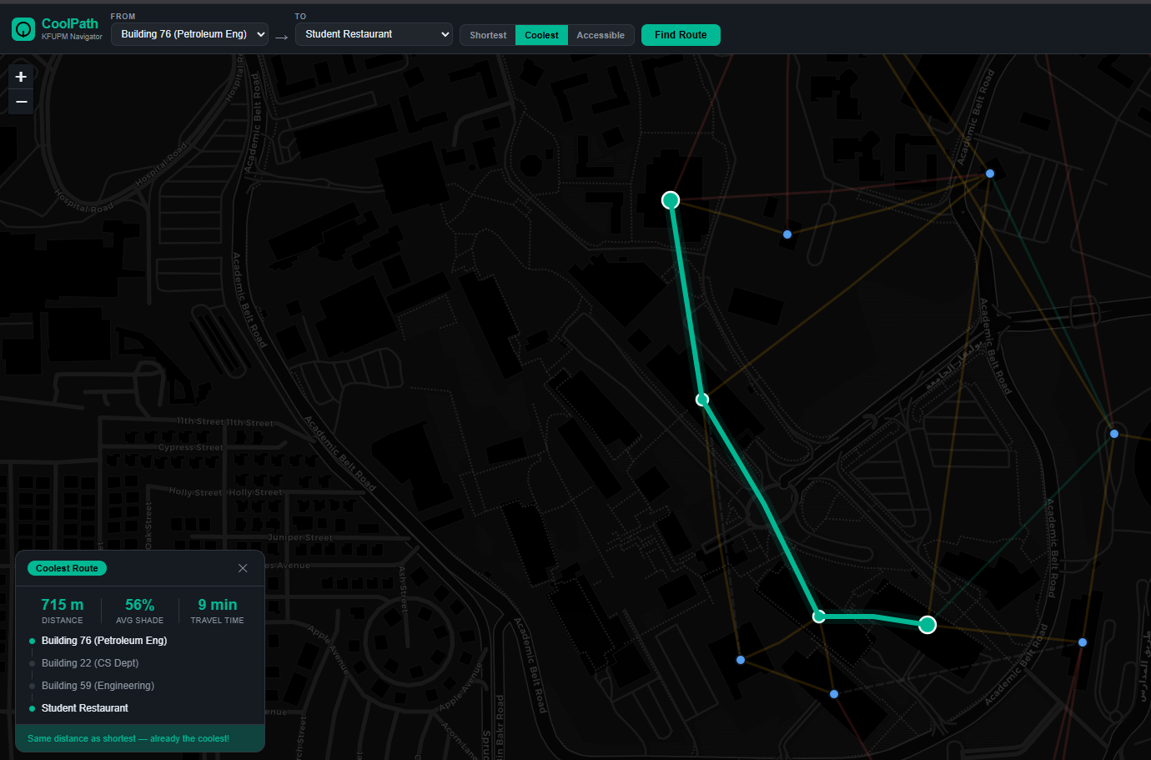
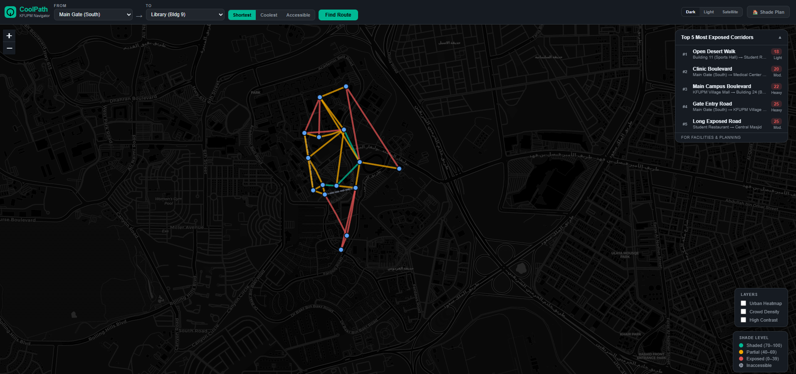
SHADE PLAN
Infrastructure Priority Planning for Facilities Teams
Priority Score = Traffic Density x ( 100 - Shade Score )
>= 200 — Critical Priority
150–199 — High Priority
< 100 — Low Priority
Notes:
The Shade Plan page ranks corridors by priority score. Highest traffic x highest exposure = most urgent. Each corridor gets a specific recommendation: covered walkway, shade sails, trees, or trellis.

Slide 7
INSTITUTIONAL BACKING
Vision 2030 Alignment
Disability
Inclusion
Liveability &
Wellbeing
Sustainable
Urban Design
CRPD obligation — Saudi Arabia ratified 2008
Quality of Life Program targets outdoor comfort
Native tree corridors reduce urban heat island
National Transformation Program KPI: inclusive infrastructure
Shade = direct heat-health intervention
Data-driven shade infrastructure investment
KFUPM Policy obligates accessible routing
Supports walkability goals in hot climate
Replicable model for other Saudi campuses
Accessible mode already built into CoolPath
Reduces reliance on air-conditioned transport
Aligns with NEOM & Vision 2030 city design
Notes:
Three Vision 2030 pillars: disability inclusion (legally mandated via CRPD), liveability (shade = public health), and sustainable urban design (native trees, replicable model).

Slide 8
ACCESSIBILITY
Disability-Inclusive Routing
How Accessible Mode Works
Who Benefits Most
1. Graph rebuild — inaccessible edges removed from routing graph
2. Shade weighting still applied — comfort remains a priority
3. Steps, steep slopes, unpaved surfaces excluded automatically
4. Rest-point nodes flagged for future waypoint integration
5. High-contrast mode + screen-reader labels already implemented
Wheelchair users
Avoids steps, rough surfaces, inaccessible gates
Elderly
Shorter exposure time + rest points on route
Chronic conditions
Heart/respiratory — heat exposure is life risk
Low-vision users
High-contrast mode + full screen-reader support
Deaf users
Visual-only alerts, no audio dependency
Notes:
Accessible mode completely rebuilds the routing graph excluding inaccessible paths. Heat stress disproportionately impacts wheelchair users and people with chronic conditions. High-contrast mode and screen-reader support are already built in.

Slide 9
CURRENT DATA
Campus Network at a Glance
15
30
46%
5,088m
Buildings
GPS-verified
Corridors
Mapped
Average
Shade Score
Exposed
Walkway
Key Insight
12 of 30 corridors score below 40 — 40% of the network rated Exposed or worse.
Notes:
Current dataset: 15 GPS-verified buildings, 30 corridors. Average shade is 46%. 12 corridors — 40% of the network — are rated exposed or critically exposed. This is what students walk through every day.

Slide 10
COLLABORATION OPPORTUNITY
ARE Department: Four Data Upgrades
Solar Shadow Simulation
UTCI Thermal Comfort
Ladybug + Grasshopper tools generate hour-by-hour shade maps.
Replaces manual estimates with high accuracy.
Universal Thermal Climate Index — gold standard outdoor comfort metric.
Enables academic publication and policy citation.
Impact: From ~70% to ~95% shade accuracy
Impact: Publishable methodology
Surface Material Survey
Live Microclimate Sensors
Pavement type (concrete vs asphalt vs tile) affects radiant heat.
Different emissivity values refine routing weights.
Real-time temperature + humidity feeds from campus weather stations.
Enables dynamic routing that updates through the day.
Impact: More precise coolest-route calculation
Impact: Real-time comfort routing
Notes:
Current shade scores are manually estimated — about 70% accurate. ARE involvement gives us four upgrades: accurate solar simulation, UTCI metrics for publication, surface material data, and eventually live sensor feeds.

Slide 11
NEXT STEPS
Three-Phase Development Roadmap
01
02
03
This Semester
Next Semester
Research & Publication
ARE solar shadow data integration
UTCI-based route weighting
Live microclimate sensor feeds
Expand to 25+ buildings campus-wide
Rest point nodes on accessible routes
Multi-university campus model
Time-of-day shade variation
Elevator + ramp link integration
ML-based shade score prediction
Waypoint GPS accuracy improvements
Mobile-responsive layout optimisation
Academic paper submission
Notes:
Three phases: immediate term with real data integration, medium term with UTCI and accessibility upgrades, long term as a publishable research system for hot arid climate routing.

Slide 12
THREE THINGS TO REMEMBER
CoolPath: Ready. Waiting for Real Data.
1
Shortest path is not safest path at 45°C. CoolPath solves a real welfare problem no existing tool addresses.
2
Vision 2030's disability inclusion and sustainability mandates give this institutional backing — not just academic interest.
3
With ARE department data, this becomes scientifically rigorous and publishable. The tool is ready — it needs your data.
github.com/CoolPath-KFUPM | April 2026 | KFUPM Campus Shade Navigation
Notes:
Three takeaways for Osamah: real problem, institutional mandate, and the tool is built and waiting for real data.

